Slide 1

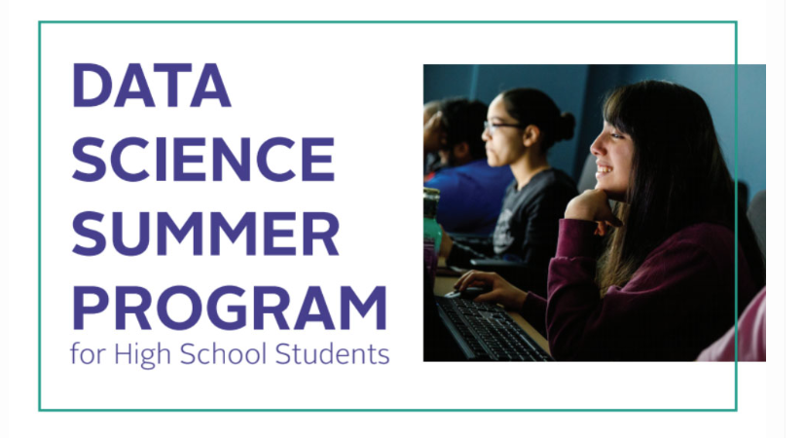
June 25-29, 2018

Slide 2

Acknowledgements
ACM SIGKDD Impact Program:
75 submissions from 20 countries
7 proposals from 5 countries were awarded funding
Data Mining and Predictive Analytics (DaMPA) Center
innovate the computing discipline through harnessing the power of the data revolution
nurture the next generation of computer and data scientists
College of Computing and Digital Media (CDM)

Slide 3

Program Goals
Introduce you to the fast growing field of Data Science
Explore how data science is used to solve real-world problems
Learn about some of the key concepts and techniques in data analytics, data visualization, and machine learning

Slide 4
What to Expect This Week
Lectures by DePaul faculty and graduate students covering key machine learning and analytics techniques
Application areas such as image analysis, music playlist generation, movie recommendation, etc.
Hands on activities with different tools to explore real data sets
Guest speakers from companies such as Microsoft, Facebook, BMW

Slide 5
What Not to Expect
We will use tools to explore or manipulate data, but no extensive coding or programming
Goal of the academy is not to teach coding
We will not focus on or learn everything about a specific tool
But, will make limited use of several popular tools used in data science
You will not become a data science expert
But, will build a foundation for further exploration and study

Slide 6



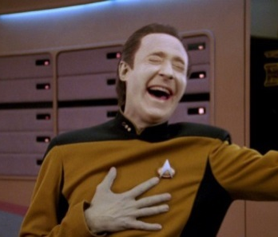
What We Expect from You
Pay attention and participate in the class and group activities
Be respectful of the staff and the other students
Be curious and ask questions
Have some fun!

Slide 7
Schedule (9:30 AM – 3:30 PM)
Today:
Introductions, meet & greet with DePaul students, invited talk by Jeff Hamilton of BMW, introduction to data science and its applications, surveys, visit to the computer lab
Monday-Thursday:
Topics: data summarization/visualization (Tues), classification and image analysis (Wed), clustering and recommender systems
Usually a guest speaker before or during lunch (noon-1:30 PM)
Group project work late afternoon
Friday:
Review, surveys, group presentations, final reception/party

Slide 8
Each day…
Class starts at 9:30 am - Arrive on time!
We will meet in the computer lab (room 512)
Someone from the Data Science team will be in the lab starting at 9:00am
Lunch will be provided around noon
Bring a water bottle – there are water refilling stations on each floor.
Send email to dsacademy@depaul.edu if you need to contact us

Slide 9
Meet the Program Staff

Slide 10
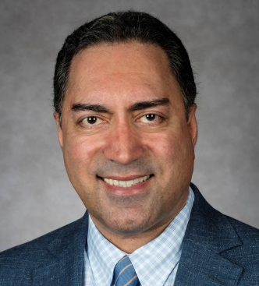
Bamshad Mobasher
Professor, School of Computing
Director, Center for Web Intelligence
Areas of Expertise:
Artificial Intelligence
Machine Learning
Recommender Systems
Web data mining

Slide 11
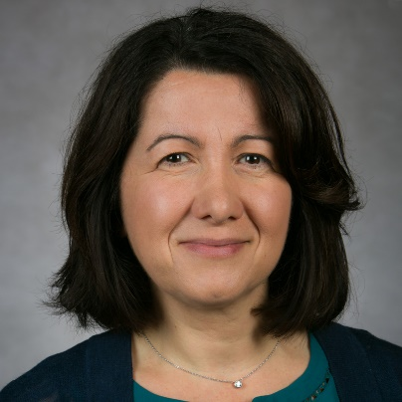
Raffaella Settimi
Associate Professor, School of Computing
Areas of Expertise:
Statistical Modeling
Machine Learning
Bayesian Networks

Slide 12
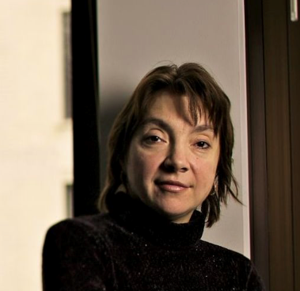
Daniela Raicu
Professor, School of Computing
Director, Center for Data Mining and Predictive Analytics
Co-Director, Medical Informatics (MedIX) Laboratory
Areas of Expertise:
Artificial Intelligence
Machine Learning
Computer Vision
Biomedical Informatics

Slide 13
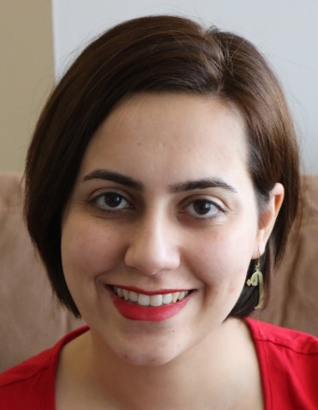
Nasim Sonboli
PhD Student in Computer Science
Research Assistant, Center for Web Intelligence
Areas of Expertise:
Machine Learning
Recommender Systems

Slide 14
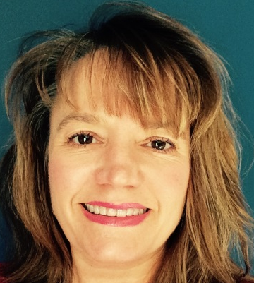
Monica Stettler
Graduate Student, Master’s in Data Science
MBA (Finance) with a career in corporate banking
2 truths + 1 lie:
I speak and/or have studied 6 languages
I was born in Nigeria
I am not American
**Tell me on Slack which is my lie! See you Friday!

Slide 15
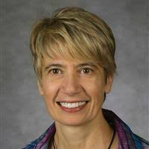
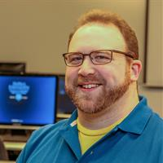
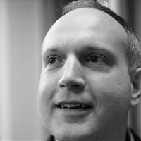
Other Associated DePaul Faculty
Lucia Dettori
Eli Brown
Jonathan Gemmell
Associate Dean
Liaison with CPS
Assistant Professor
Data Visualization
Assistant Professor
AI, Recommender Systems

Slide 16
Ice Breaker & Introductions

Slide 17
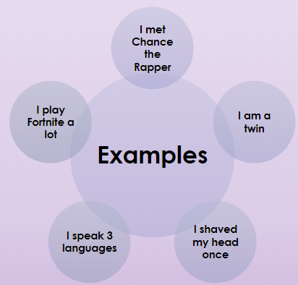
2 truths + 1 lie
Stand up
Say your name
Tell us your school
Tell us 3 FUN FACTS about yourself
2 are true and 1 is a lie
Be creative!
Group will guess and vote for the one they think is the lie
You pick someone from the winning group to go next

Slide 18
Reminders
Don’t lose your computer account information
Remember to bring back and submit your Stipend Check Request From

Slide 19

Questions?

Slide 20
Program Overview

Slide 21
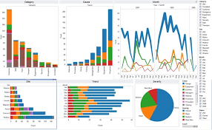
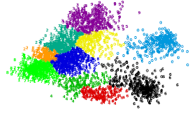
Tuesday (Raffaella & Eli)
Topics: Data Exploration and Visualization
Focus on techniques to learn about characteristics of the data and to visualize trends and patterns
Tools: SPSS and Tableau
Group Activity: Analyze Chicago Divvy bikes usage during the past year

Slide 22
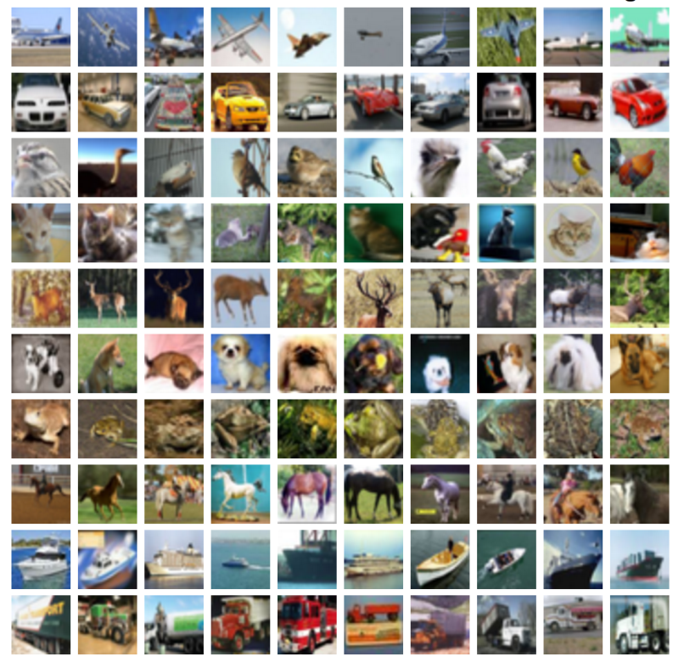
Wednesday (Daniela & Ian)
Topics: Classification and Image Recognition
Focus on discovering patterns in image and video data with applications to human activity recognition
Tools: SPSS and Matlab
Group activity will involve extracting pixel data for face recognition used in various computer vision applications (e.g. surveillance, biometrics, fatigue detection, emotion detection).

Slide 23
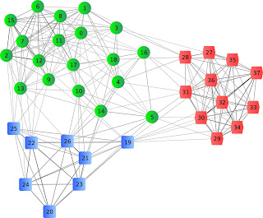
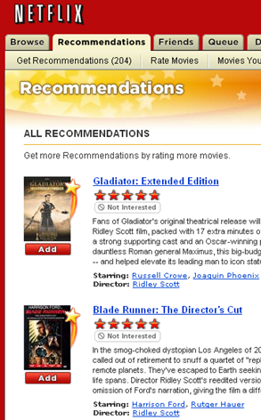
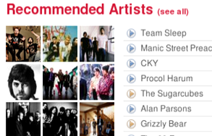
Thursday (Bamshad & Nasim)
Topics: Distance-based Methods and Clustering
Applications: recommender systems & music playlist generation
We’ll use Jupyter Notebooks based on Python as our main tool
Group activity will involve using various functions in a joke recommender system

