Slide 1
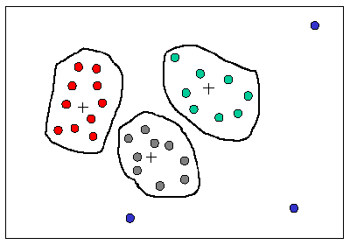
What is Clustering?
Clustering is a process of partitioning a set of data points (or objects) into a set of meaningful sub-classes, called clusters
Don’t have any information about predefined classes and the data objects are not labeled → Unsupervised
Goal of clustering is to discover the natural grouping or structure in a data set
Cluster:
a collection of data objects that are “similar” to one another and thus can be treated collectively as one group
but as a collection, they are different from other groups
high intra-class similarity, but low inter-class similarity

Slide 2
Applications of Cluster Analysis
Data Reduction
Summarization: Preprocessing for classification
Compression: Image processing: vector quantization
Prediction based on groups
Cluster & find characteristics/patterns for each group
Customer segmentation / User behavior analysis
Automatically categorizing groups of objects
Document categorization
Information visualization
Outlier detection: Outliers are often viewed as those “far away” from any cluster

Slide 3
Clustering in Gene Expression Analysis

Slide 4
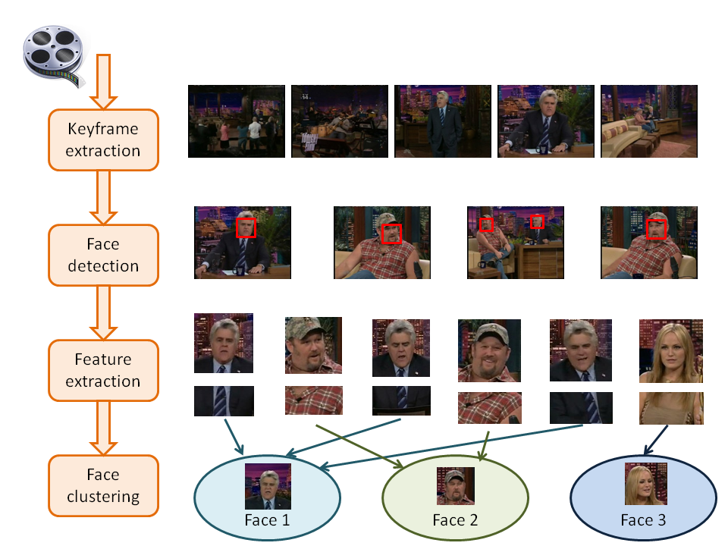
Clustering in Image Recognition

Slide 5
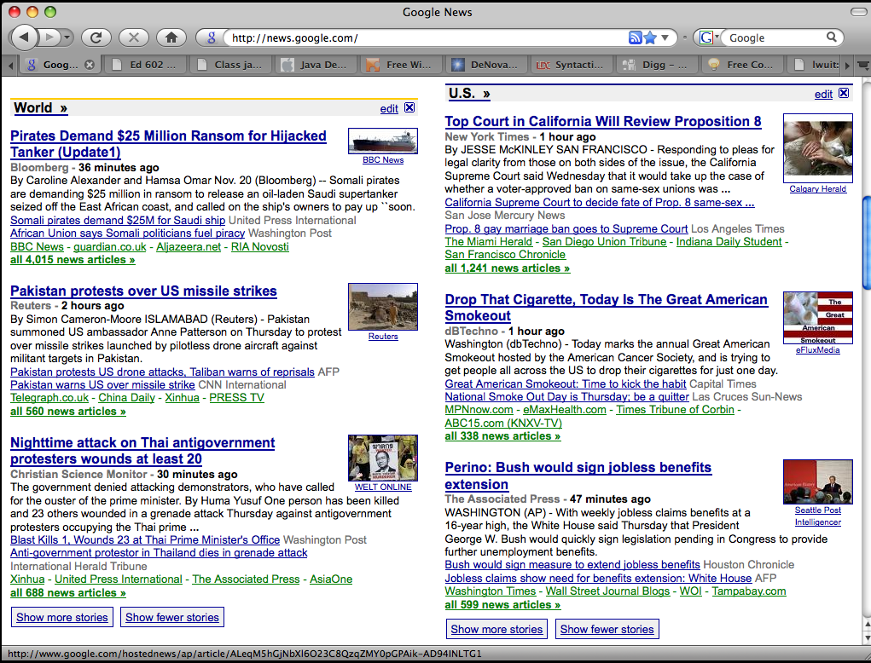
Google News: automatic clustering gives an effective news presentation metaphor

Slide 6
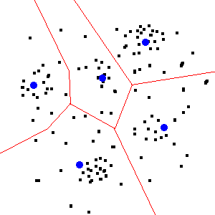
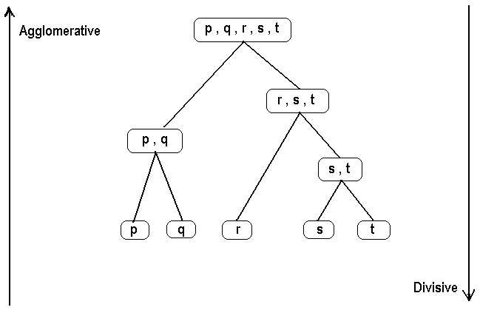
Clustering Methodologies
Two general methodologies
Partitioning Based
divide a set of N items into K clusters (top-down)
Hierarchical
pairs of items or clusters are successively linked to produce larger clusters

Slide 7
K-Means Clustering Method
Most well-known and popular clustering algorithm:
Start with some initial cluster centers selected randomly
Iterate:
Assign/cluster each example to closest center
Recalculate centroids as the mean of the points in a cluster
Stop when there is no change in clusters in successive clusters

Slide 8
Recall the T-Shirt Size Problem
But, now suppose that we don’t have the t-shirt sizes. We need to cluster to see if separate groups emerge.
Height (in cms) | Weight (in kgs) | TShirt Size
158 | 58 | M
158 | 59 | M
158 | 63 | M
160 | 59 | M
160 | 60 | M
163 | 60 | M
163 | 61 | M
164 | 58 | M
159 | 65 | L
160 | 64 | L
162 | 64 | L
165 | 61 | L
165 | 62 | L
165 | 65 | L
168 | 62 | L
168 | 63 | L
168 | 66 | L
170 | 63 | L
170 | 64 | L
170 | 68 | L

Slide 9
K-Means Example
Let’s assume we want two clusters (K = 2). We select two points at random as the initial centroids of the two clusters
Height (in cms) | Weight (in kgs)
158 | 58
158 | 59
158 | 63
160 | 59
160 | 60
163 | 60
163 | 61
164 | 58
159 | 65
160 | 64
162 | 64
165 | 61
165 | 62
165 | 65
168 | 62
168 | 63
168 | 66
170 | 63
170 | 64
170 | 68
Initial cluster centers

Slide 10
K-Means Example
Using a distance function we can find out which data points are most similar to which centroid. This allows us to form two clusters based on these initial centroids
Cluster 1

Slide 11
K-Means Example
Now we can compute the new centroids by finding the mean of the data points in each cluster
Data Points in Cluster 1 |  | Data Points in Cluster 2
Height | Weight | Height | Weight
158 | 58 | 162 | 64
158 | 59 | 165 | 61
158 | 63 | 165 | 62
159 | 65 | 165 | 65
160 | 59 | 168 | 62
160 | 60 | 168 | 63
160 | 64 | 168 | 66
163 | 60 | 170 | 63
163 | 61 | 170 | 64
164 | 58 | 170 | 68
160.3 | 60.7 | 167.1 | 63.8
Cluster 1
centroid for
cluster 1
centroid for
cluster 2

Slide 12
K-Means Example
centroid for
cluster 1
160.3 | 60.7
centroid for
cluster 2
167.1 | 63.8

Slide 13
K-Means Example
We can now recompute distances of the data points to each of the new centroids to determine the new clusters
Note that the data point:
(163, 64)
has now moved to cluster 1
from cluster 2
We repeat this process until there are no further changes to clusters

Slide 14


K-Means Example
How do we compute the distances?
Euclidean:
Example: distance between the data point
(163, 64)
and the centroid of cluster 1
(160.3, 60.7):
$$\sqrt{{\left(163−160.3\right)}^{2}+{\left(64−60.7\right)}^{2}}$$
$$=\sqrt{7.29+10.89}=4.26$$

Slide 15
Another K-means Example

Slide 16
K-means: Initialize centers randomly

Slide 17
K-means: assign points to nearest center

Slide 18
K-means: readjust centers

Slide 19
K-means: assign points to nearest center

Slide 20
K-means: readjust centers

Slide 21
K-means: assign points to nearest center

Slide 22
K-means: readjust centers

Slide 23
K-means: assign points to nearest center
No changes: Done

Slide 24
K-Means Illustration with 4 Clusters

Slide 25
An example of clustering for customer segmentation
Consider the following book ratings (scale: 1-5) by customers of an online bookstore:
ID | TRUE BELIEVER | THE DA VINCI CODE | THE WORLD IS FLAT | MY LIFE SO FAR | THE TAKING | THE KITE RUNNER | RUNNY BABBIT | HARRY POTTER
U1 | 1 | 5 |  | 3 |  |  | 3 | 5
U2 | 5 | 4 |  |  | 3 | 2 | 1
U3 | 3 |  | 1 | 2 | 2 |  |  | 5
U4 |  | 3 |  |  | 4 | 1 |  | 3
U5 | 2 | 4 | 3 |  |  | 2 | 2
U6 | 5 |  |  | 3 | 1 |  | 3 | 1
U7 | 1 | 4 | 5 | 5 | 2 |  |  | 4
U8 | 2 | 1 |  |  | 4 | 5 | 1
U9 |  |  | 3 | 2 | 2 |  |  | 5
U10 | 3 | 5 | 1 |  |  |  | 4 | 4
U11 |  |  | 2 | 1 |  | 2 |  | 3
U12 | 4 | 4 |  | 2 |  | 1 | 1 | 4
U13 |  |  | 2 |  | 4 |  | 4 | 5
U14 |  | 5 | 3 | 3 | 2 |  | 1 | 1
U15 |  | 2 |  |  | 3 | 3 |  | 2
U16 |  | 3 | 2 | 1 | 1 |  | 4 | 4
U17 | 1 | 5 | 1 | 2 |  | 4 |  | 4
U18 | 5 |  | 4 |  | 3 | 3 | 4 | 5
U19 |  | 4 |  | 2 |  | 5 | 1 | 5
U20 | 2 | 5 | 1 | 1 | 5 | 3 |  | 4

Slide 26
Clustering in Customer Segmentation
Cluster centroids after k-means clustering with k=4
In this case, each centroid represented the average rating (in that cluster of users) for each book
The first column shows the centroid of the whole data set, i.e., the overall item average ratings across all users
 | Full Data | Cluster 0 | Cluster 1 | Cluster 2 | Cluster 3
 | Size=20 | Size=4 | Size=7 | Size=4 | Size=5
TRUE BELIEVER | 2.83 | 4.21 | 1.81 | 2.83 | 3.17
THE DA VINCI CODE | 3.86 | 4.21 | 3.84 | 2.96 | 4.31
THE WORLD IS FLAT | 2.33 | 2.50 | 2.71 | 2.17 | 1.80
MY LIFE SO FAR | 2.25 | 2.56 | 2.64 | 1.63 | 1.95
THE TAKING | 2.77 | 2.19 | 2.73 | 2.69 | 3.35
THE KITE RUNNER | 2.82 | 2.16 | 3.49 | 2.20 | 2.89
RUNNY BABBIT | 2.42 | 1.50 | 2.04 | 2.81 | 3.37
HARRY POTTER | 3.76 | 2.44 | 4.36 | 3.00 | 4.60
Quiz: how these customer segments differ from each other?

Slide 27
Clustering in Customer Segmentation
We can compare a new customer to the cluster centroids to determine the best matching segment for that customer.
This could be used to market or recommend new items to the customer
 | Full Data | Cluster 0 | Cluster 1 | Cluster 2 | Cluster 3 |  | New User NU1
 | Size=20 | Size=4 | Size=7 | Size=4 | Size=5
TRUE BELIEVER | 2.83 | 4.21 | 1.81 | 2.83 | 3.17 |  | 3.00
THE DA VINCI CODE | 3.86 | 4.21 | 3.84 | 2.96 | 4.31
THE WORLD IS FLAT | 2.33 | 2.50 | 2.71 | 2.17 | 1.80 |  | 3.00
MY LIFE SO FAR | 2.25 | 2.56 | 2.64 | 1.63 | 1.95
THE TAKING | 2.77 | 2.19 | 2.73 | 2.69 | 3.35 |  | 4.00
THE KITE RUNNER | 2.82 | 2.16 | 3.49 | 2.20 | 2.89 |  | 3.00
RUNNY BABBIT | 2.42 | 1.50 | 2.04 | 2.81 | 3.37
HARRY POTTER | 3.76 | 2.44 | 4.36 | 3.00 | 4.60 |  | 4.00
Correlation w/ NU1 | 0.63 | -0.41 | 0.50 | 0.65 | 0.74

