Slide 1
Personalization & Recommender Systems
Bamshad Mobasher
Center for Web Intelligence
DePaul University, Chicago, Illinois, USA

Slide 2
Personalization
The Problem
Dynamically serve customized content (books, movies, pages, products, etc.) to users based on their predicted preferences
Why we need it?
Information spaces are becoming much more complex for user to navigate (huge online repositories, social networks, mobile applications, blogs, ….)
For businesses: need to grow customer loyalty / increase sales
Amazon → 35%+ sales from recommendations
Netflix → 80%+ of movie selections based on personalization
Facebook → 90% of user feeds are personalized

Slide 3
Common Approaches
Collaborative Filtering
Give recommendations to a user based on preferences of “similar” users
Preferences on items may be explicit or implicit
Usually in the form of a rating
Content-Based Filtering
Give recommendations to a user based on items with “similar” content in the user’s profile
Hybrid Approaches

Slide 4

Content-Based Recommenders :: more examples
Music recommendations
Play list generation
Example: Pandora

Slide 5

Collaborative Recommender Systems

Slide 6
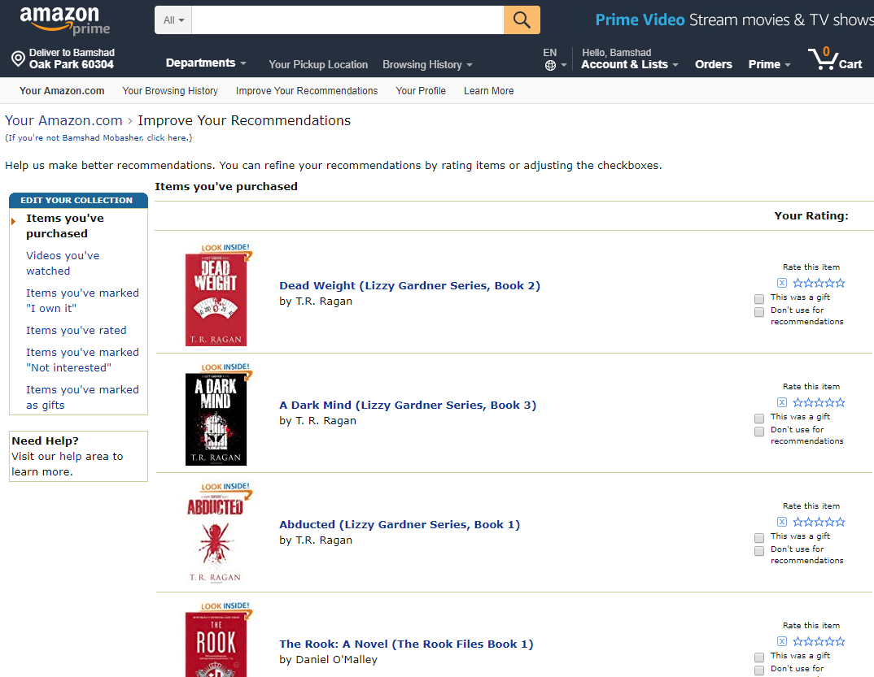

Slide 7
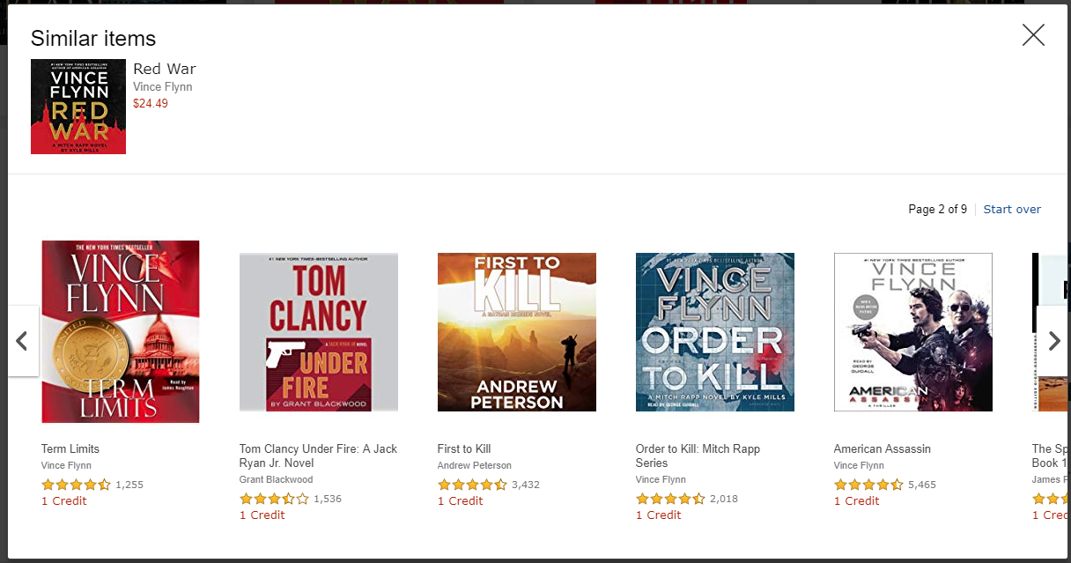
Collaborative Recommender Systems

Slide 8

Collaborative Recommender Systems

Slide 9
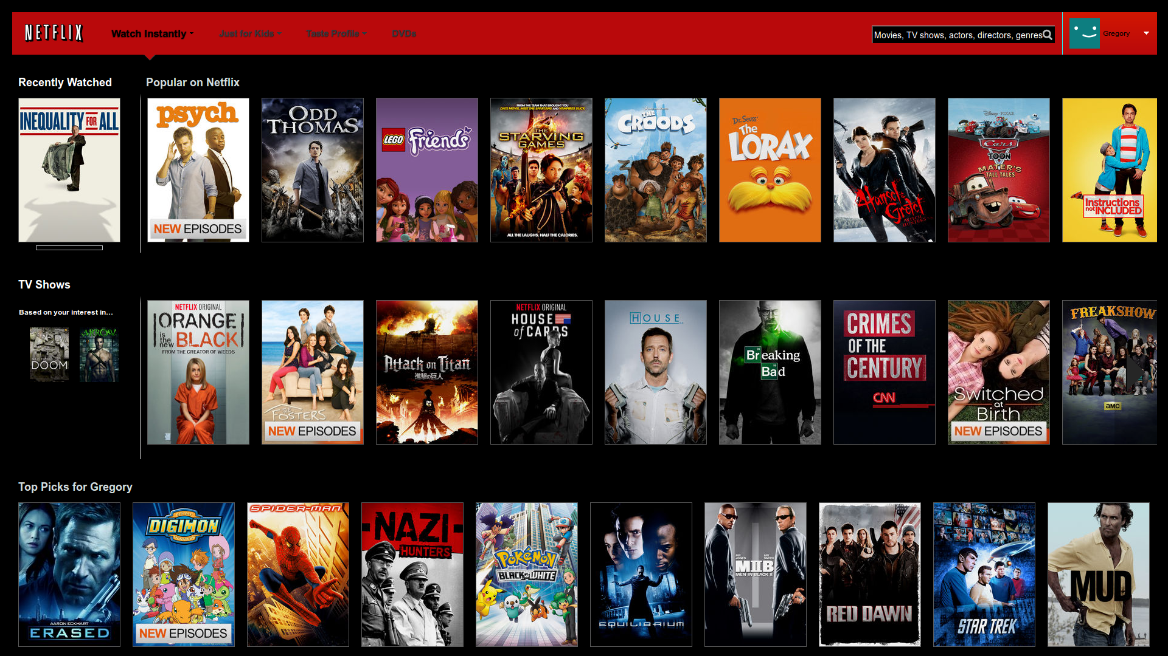
Collaborative Recommender Systems

Slide 10
KNN In Collaborative Filtering
Ratings scale: 1 = “hate it”; 10 = “love it”
We have previous ratings of movies by Sally, Bob, Chris, Lynn
Karen is a new user who has rated 3 movies, but has not yet seen “Independence Day”; should we recommend it to her?
Approach: use KNN to find similar users, then combine their ratings to get prediction for Karen.
Will Karen like “Independence Day?”

Slide 11

Correlation as Similarity
In cases where there could be high mean variance across data objects (e.g., movie ratings), Pearson Correlation coefficient is the best option
Pearson Correlation
Often used in recommender systems based on Collaborative Filtering

Slide 12
KNN In Collaborative Filtering
Predicted Rating for Karen?
K = 1 → Bob as neighbor → predicted rating = 8
K = 2 → Bob and Sally → predicted rating = (9 + 8)/2 = 8.5
K = 3 → Bob, Sally, Lynn → predicted rating = (9+8+2))/3 = 6.3

Slide 13
Item-based Collaborative Filtering
Find similarities among the items based on ratings across users
Often measured based on a variation of Cosine measure
Prediction of item I for user a is based on the past ratings of user a on items similar to i.
Suppose:
Predicted rating for Karen on Indep. Day will be 7, because she rated Star Wars 7
That is if we only use the most similar item
Otherwise, we can use the k-most similar items and again use a weighted average
sim(Star Wars, Indep. Day) > sim(Jur. Park, Indep. Day) > sim(Termin., Indep. Day)

Slide 14
Item-Based Collaborative Filtering
Prediction

 | Item1 | Item 2 | Item 3 | Item 4 | Item 5 | Item 6
Alice | 5 | 2 | 3 | 3 |  | ?
User 1 | 2 |  | 4 |  | 4 | 1
User 2 | 2 | 1 | 3 |  | 1 | 2
User 3 | 4 | 2 | 3 | 2 |  | 1
User 4 | 3 | 3 | 2 |  | 3 | 1
User 5 |  | 3 |  | 2 | 2 | 2
User 6 | 5 | 3 |  | 1 | 3 | 2
User 7 |  | 5 |  | 1 | 5 | 1
Item similarity | 0.76 | 0.79 | 0.60 | 0.71 | 0.75
Best match

Slide 15






Content-Based Recommenders
Predictions for unseen (target) items are computed based on their similarity (in terms of content) to items in the user profile.
E.g., suppose user profile contains
recommend highly: and recommend “mildly”:

