Slide 1
Distance-Based Methods

Slide 2
Distance or Similarity Measures
Many machine learning and analytics tasks involve the comparison of objects and determining their similarities (or dissimilarities)
Clustering
Nearest-neighbor classification
Search and Retrieval
Correlation analysis
Many of todays real-world applications rely on the computation similarities or distances among objects
Personalization
Recommender systems
Document categorization
Search Engines
Target marketing

Slide 3
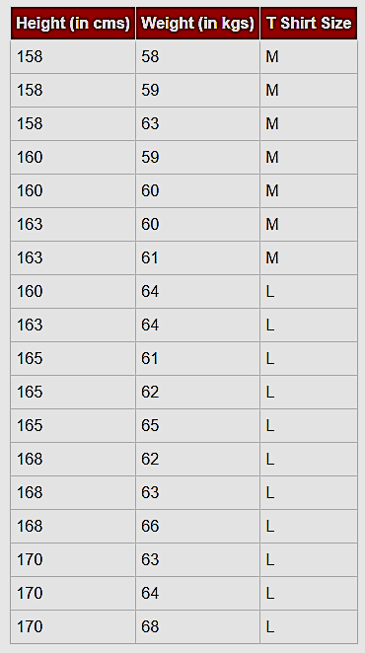
Example
Suppose we have height, weight and T-shirt size of some customers
Want to predict the T-shirt size of a new customer given only height and weight information we have
New customer named “Monica” has height 161cm and weight 61kg.

Slide 4
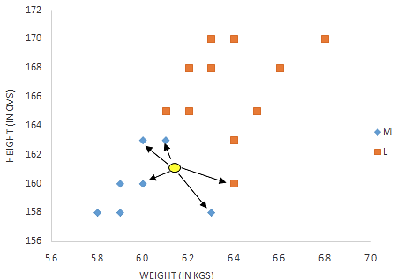
Example
Monica: height = 161cm weight = 61kg
What size T-Shirt should we recommend to Monica?
Monica

Slide 5
Similarity and Dissimilarity
Similarity
Numerical measure of how alike two data objects are
Value is higher when objects are more alike
Often falls in the range [0,1]
Dissimilarity (distance)
Numerical measure of how different two data objects are
Lower when objects are more alike
Minimum dissimilarity is often 0
Upper limit varies
Larger distance → less similar
Smaller distance → more similar

Slide 6
Distance or Similarity Measures
Measuring Distance or Similarity
In order to group similar items, we need a way to measure the distance between objects
This requires the representation of objects as “feature vectors”
An Customer Database
Term Frequencies for Documents
Feature vector corresponding to Employee 2: <M, 51, 64000.0>
Feature vector corresponding to Document 4: <0, 1, 0, 3, 0, 0>

Slide 7

Normalizing Numeric Data
When there are features with vastly different scales, we need to normalize (or rescale) the data so that all features have the same scale
Min-Max Normalization

Slide 8



Common Distance Measures
Consider two vectors
Rows in the data matrix
Common Distance Measures:
Manhattan distance:
Euclidean distance:

Slide 9
Example: Distances
Data Matrix
Manhattan:
Distance(x1, x2) = 2 + 3 = 5
Euclidean:
Distance(x1, x2) = SQRT(4 + 9) = 3.61

Slide 10
Back to T-Shirt Size Prediction
Monica: height = 161cm weight = 61kg
Monica

Slide 11
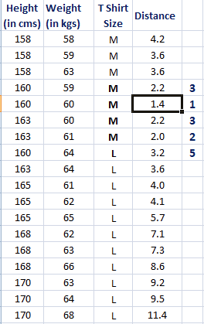
Finding Nearest Neighbors
Finding Euclidean distance to Monica (height = 161 weight = 61)
5 Nearest Neighbors to Monica
(using Euclidean Distance)

Slide 12
Nearest Neighbor Classifiers
Basic idea:
If it walks like a duck, quacks like a duck, then it’s probably a duck
Compute Distance
Test Record
Training Records
Choose k of the “nearest” records

Slide 13
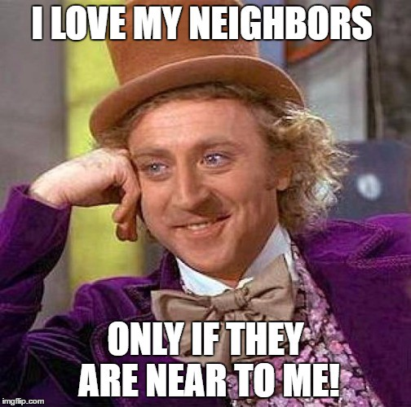
K-Nearest-Neighbor Strategy
Given object x, find the k most similar objects to x
The k nearest neighbors
Variety of distance or similarity measures can be used to identify and rank neighbors
Note that this requires comparison between x and all objects in the database
Classification:
Find the class for each of the k neighbor
Determine the majority class among the neighbors
Could use weighted voting which means the closest neighbors count more
Assign the majority class to x

Slide 14
KNN in Information Retrieval
Sec. 1.1
Documents are represented as vectors of terms
(Each doc is a data object with the terms as features)
Index terms, Features
 | antony | brutus | caesar | calpurnia | cleopatra | mercy | worser
Antony & Cleopatra | 5 | 3 | 2 | 0 | 3 | 1 | 1
Julius Caesar | 2 | 1 | 7 | 4 | 0 | 0 | 0
The Tempest | 0 | 0 | 0 | 0 | 0 | 2 | 1
Hamlet | 0 | 2 | 1 | 0 | 0 | 1 | 2
Othello | 0 | 0 | 1 | 0 | 0 | 1 | 3
Occurrence count of the index term in the document
Documents

Slide 15
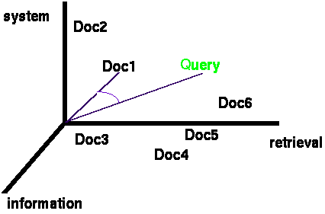
Documents & Query in N-dimensional Space
Documents are represented as vectors in the term space
Typically values in each dimension correspond to the frequency of the corresponding term in the document
A search query is also represented as vectors in the same vector-space
Documents are ranked based on similarity to the quert

Slide 16
KNN For Recommendation
Collaborative Filtering Example
Ratings scale: 1 = “hate it”; 10 = “love it”
We have previous ratings of movies by Sally, Bob, Chris, and Lynn
Karen is a new user who has rated 3 movies, but has not yet seen “Independence Day”; should we recommend it to her?
Approach: use kNN to find similar users, then combine their ratings to get prediction for Karen.
Will Karen like “Independence Day?”

Slide 17

Correlation as Similarity
In cases where there could be high mean variance across data objects (e.g., movie ratings), Pearson Correlation coefficient is the best option
Pearson Correlation
Often used in recommender systems based on Collaborative Filtering

Slide 18
Collaborative Filtering
(Using k Nearest Neighbor)
Predicted Rating for Karen?
K = 1 → Bob as neighbor → predicted rating = 8
K = 2 → Bob and Sally → predicted rating = (9 + 8)/2 = 8.5
K = 3 → Bob, Sally, Lynn → predicted rating = (9+8+2))/3 = 6.3

