Slide 1
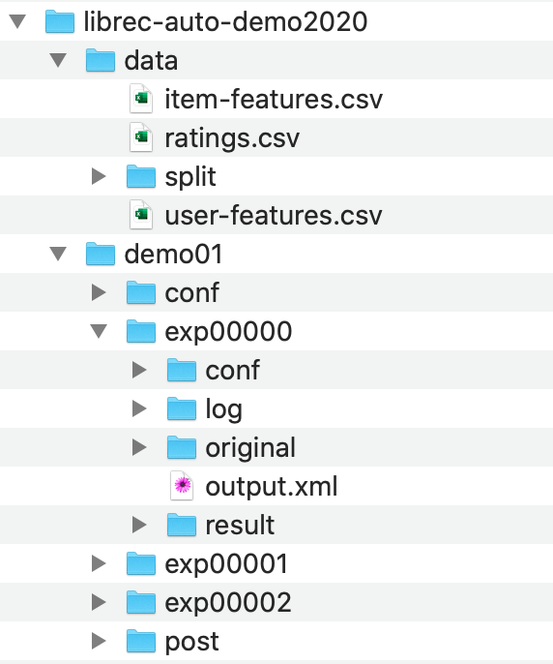
data directory
study directory
experiment directories

