Slide 1

Library Management System
Course Instructor: Juena Ahmed Noshin
Presented By
Nasimul Hasan - 16-32415-2
Anim Bhuiya - 16-31114-1
Pritam Saha Keerthi – 15-29742-2
Salman Al Mamun – 15-29726-2

Slide 2

Scenario
A University Library has a lot of books for their Students who can borrow books for their study. The books have a unique ID, name and others. The Students has a unique, name, address & gender. The Students came from a department which have a unique ID. The students can borrow one or many book at a time from the library . The students have to issue the books in order to borrow them. Students can issue one book at a time The books has an issue date, return date. The students have to return the books before the expiry date. The library has some staff who can be identified by their unique staff ID. They manage the books on the library. One staff has to manage many books at a time.

Slide 3

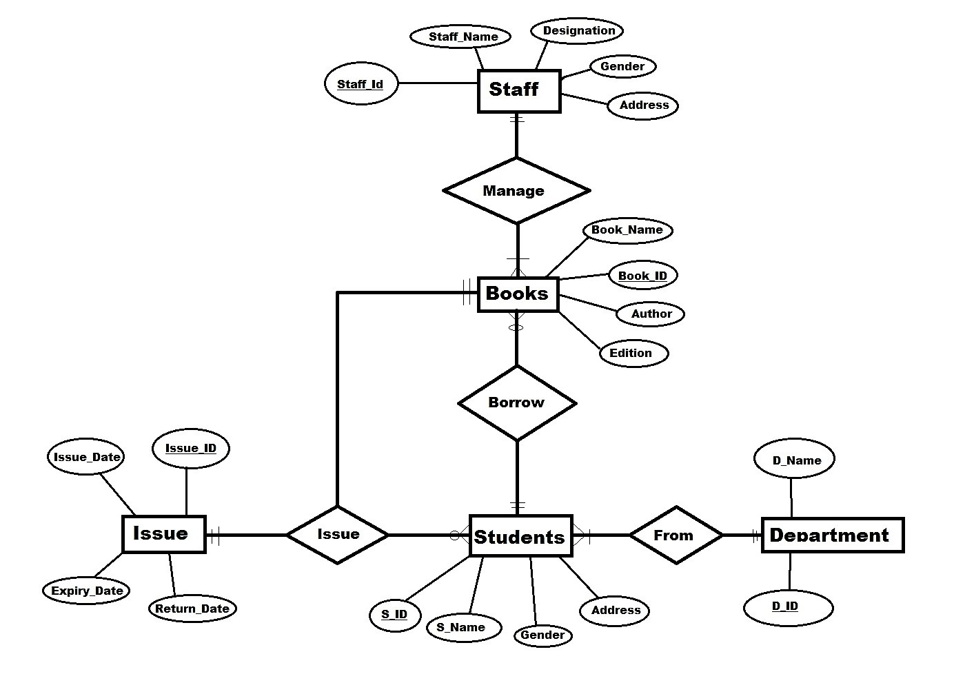
Entity-Relationship Diagram

Slide 4

Normalization
Book_ID, Book_Name, Author, Edition, S_ID, S_name, S_Address, s_gender, D_Name, D_id, Issu_date, Return_date, Expiry_Date, Issue_ID, Staff_name, Staff_id, Designation, stf_address.
1NF Normalization
Doesn’t Follow 1NF normalization as
No Repeated Datas
2NF Normalization
After removing partial dependency , the end tables are:
Tab 1: Book_ID, Book_Name, Edition, Author.
Tab 2: S_ID, S_name, S_Address, s_gender
Tab 3: D_id, D_Name,
Tab 4: Issue_ID ,Issu_date, Return_date, Expiry_Date,
Tab 5 : , Staff_id, Staff_nameDesignation, stf_address.

Slide 5
Normalization
Orignal Table:
Book_ID, Book_Name, Author, Edition, S_ID, S_name, S_Address, s_gender, D_Name, D_id, Issu_date, Return_date, Expiry_Date, Issue_ID, Staff_name, Staff_id, Designation, stf_address.
3NF Normalization
Doesn’t follow 3NF as there is no Transitive Dependency.
The End Tables
Books: Book_ID, Book_Name, Edition, Author.
Student: S_ID, S_name, S_Address, s_gender
Department: D_id, D_Name,
Issue: Issue_ID ,Issu_date, Return_date, Expiry_Date,
Staff : Staff_id, Staff_nameDesignation, stf_address.

Slide 6
Thank You

