Slide 1
What is SOA?
A service-oriented architecture (SOA) is a style of software design where services are provided to the other components by application components, through a communication protocol over a network.

Slide 2
What is Service?
A service is a package of closely related standardized functions which are called repeatedly in similar fashion and should therefore implemented by dedicated facility which is specific to perform them.
A service can be partitioned and have multiple service functions
The smallest subset within service functions are called service primitives

Slide 3
Anatomy of Service
S
Service Interface
Service
Implementation
Access layer between the service consumer and service provider.
It contains
Service Identity
Service input and output data info
Service purpose and function mediate
Contains core functional or business logic of the service
The implementation should be totally transparent to the service consumer with no knowledge necessary about the implementation specifies

Slide 4
What is Web Service?
A web service is any piece of software that makes itself available over the internet and uses a standardized XML messaging system. XML is used to encode all communications to a web service. For example, a client invokes a web service by sending an XML message, then waits for a corresponding XML response.

Slide 5
What is WSDL
A WSDL is an XML document that describes a web service. It actually stands for Web Services Description Language

Slide 6
Definition
An architecture based on reusable, well defined services implemented by IT companies.
Components are loosely coupled
Provide platform, technology and language independent.

Slide 7
Why SOA?
SOA functionality is not depending on any vendor, product or application.

Slide 8
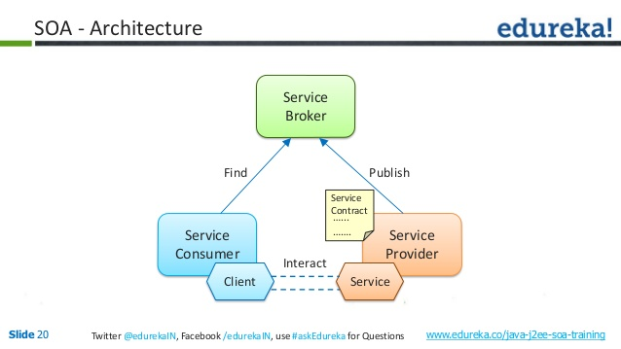

Slide 9
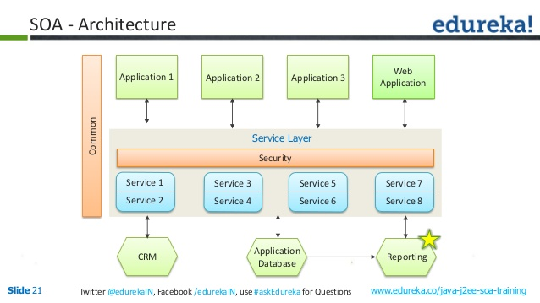

Slide 10
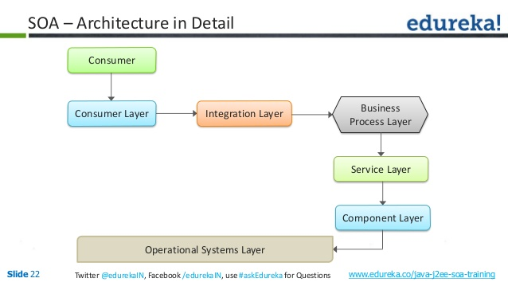

Slide 11
SOA-Framework
Consumer Interface Layer – This layer is used by the customers
Business Process Layer – Provides the business Process flow. Also accommodates new changes in the business easily, hence this layer is provided
Service Layer – Comprises of all the services provided in the enterprise
Component Layer – This layer has the actual service to be provided.
Operational subsystem layer – This layer contains the data model

Slide 12
Principles of SOA
Service loose coupling – Service does not have high dependency
Service abstraction – Hides the implementation details
Service Reusability – Services can be reused again and again without rewriting them
Service Statelessness – Do not maintain the state to reduce the resource consumption
Service Discoverability – Services can be registered and discovered from the service registry

Slide 13
ORACLE SOA
Oracle SOA Suite provides a comprehensive suite of components for developing, securing, and monitoring service-oriented architecture (SOA). Service components (BPEL process, business rule, human task, spring, and mediator) are the building blocks that you use to construct a SOA composite application.

Slide 14
Components of Oracle SOA Suite
Service Infrastructure
Oracle Mediator
Oracle Adapters
Business Events and Events Delivery Network
Oracle Metadata Repository
Oracle Business Rules
Oracle WSM Policy Manager
Oracle BPEL Process Manager
Spring Context
Human Workflow
Oracle Business Activity Monitoring
Oracle User Messaging Service
Oracle B2B
Oracle JDeveloper
Oracle Enterprise Manager
Oracle Service Bus
Oracle Complex Event Processing

Slide 15
The Service Infrastructure provides the internal message routing infrastructure capabilities for connecting components and enabling data flow
Using Oracle Mediator, you create routing services and rules for them
Oracle Adapters use JCA technology to connect external systems to the Oracle SOA Suite
Business events are messages sent as the result of an occurrence or situation, such as a new order or completion of an order
The Oracle Metadata Repository (MDS) stores business events, rulesets for use by Oracle Business Rules, XSLT files for Oracle Service Bus and Oracle Mediator, XSD XML schema files for Oracle BPEL Process Manager, WSDL files, and metadata files for Complex Event Processing.

Slide 16
Oracle Business Rules, initiated by a BPEL process service component, enable dynamic decisions at runtime allowing you to automate policies, constraints, computations, and reasoning while separating rule logic from underlying application code
Oracle WSM Policy Manager provides the infrastructure for enforcing global security and auditing policies in the Service Infrastructure
Oracle BPEL Process Manager provides the standard for assembling a set of discrete services into an end-to-end process flow, radically reducing the cost and complexity of process integration initiatives
Oracle SOA Suite provides support for the spring framework functionality of the WebLogic Service Component Architecture (SCA) of Oracle WebLogic Server

Slide 17
Many end-to-end business processes require human interactions with the process. For example, humans may be needed for approvals, exception management, or performing activities required to advance the business process
Oracle Business Activity Monitoring (Oracle BAM) is a complete solution for building real-time operational dashboards and monitoring and alerting applications over the Web
Oracle User Messaging Service provides a common service responsible for sending out messages from applications to devices
Oracle B2B is an eCommerce gateway that enables the secure and reliable exchange of messages between an enterprise and its trading partners

Slide 18
Oracle JDeveloper is the development component of Oracle SOA Suite
You can configure, monitor, and manage your SOA composite application during run time from Oracle Enterprise Manager Fusion Middleware Control Console
Oracle Service Bus connects, mediates, and manages interactions between heterogeneous services, not just Web services, but also Java and .Net, messaging services and legacy endpoints
Oracle SOA Suite provides Oracle Complex Event Processing (Oracle CEP), a data management infrastructure that supports the notion of streams of structured data records together with stored relations

