Slide 1
HOLIC’S ADS
Problem Statement:-
TARGET CONSUMER BASED ON REAL-TIME WEATHER INFORMATION.
Description:-
By leveraging real-time information about an individual and their context, more relevant and impaction content can be delivered at the precise moment when it offers the most value.
Notes:
Description:-

Slide 2
IMPORTANCE OF ADS
In an effort to maximize profits and the effectiveness of their ads, businesses constantly develop innovative advertising practices, embracing the most advanced digital technologies available.
Weather's role.
Weather is the most primal and universal factor in consumer decision-making. It affects where we go, what we wear, what we eat, what we buy – and crucially, how we feel. This makes weather data the perfect tool for contextual targeting.

Slide 3
Requirements
PHP
Java Script
HTML
CSS
OpenWeatherAPI
JSON objects
Notes:
PHP

Slide 4
Scenario:-
If network goes down and if previous JSON object instance is stored the adds based on the reference will be replicated on UI.
At every 30 minutes interval of time request is sent to openWeatherAPI to get live data.
The data is fed into neural network model to take appropriate decision of weather and display corresponding advertisements.
Notes:
k

Slide 5
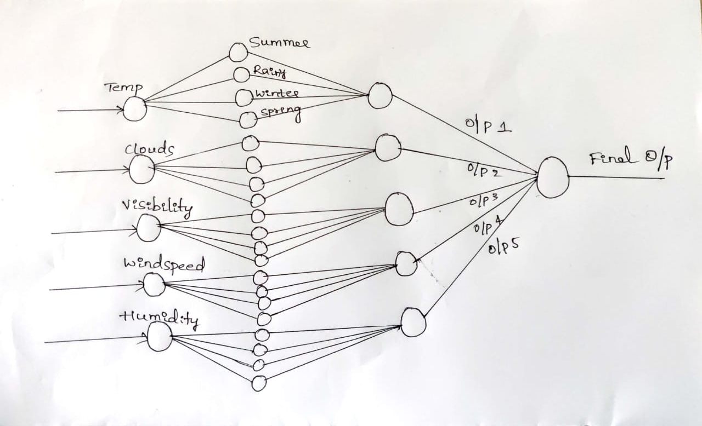
APPROACH:-
Notes:
k

Slide 6
