Slide 1

Deep Learning Based Semantics Model for Software Defect Prediction
Advisor: Prof. Kobayashi
Defensor: LI JIDONG
17M38124
Notes:
Hello, my name is lijidong , come from Kobayashi lab, This is my presentation of master thesis, The title is Deep learning Based Semantics Model for Software Defect Prediction. this master thesis is underdirected by professor Kabayshi.

Slide 2
Abstract
Goal
Construct an effective deep learning software defect prediction model
Proposal
BERT with fine-tuning model BERT+BAMA
Evaluation
Evaluate BERT+BAMA with four exsiting methods
Evaluate two embedding models
Notes:
In this presentation, our goals construct an effective deep learning software defect prediction model. w
our proposed method is BERT with fine-tuning model BERT+BAMA
To evaluate the model, we evaluate the model with four existing methods, besides, we also evaluate two embedding models

Slide 3
Background and Related works
Software Defect Prediction (SDP)
Predict modules that most likely contain bug
Using property of source code, machine learning
Purpose of the research
Help code view and testing
Large software quality assurance
Notes:
The next is background and related work
Software defect prediction is technique that predict modules that most likely contain bug. it use property of source code, ,machine learning.
The purpose of the research is that help code view and testing
large software can use it for quality assurance.

Slide 4
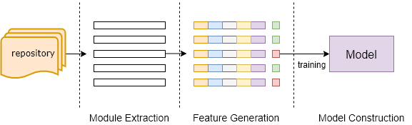
General Procedure of Machine Learning SDP Model
Notes:
So, the general procedure of machine learning SDP model can be shown in this figure.
First, we extract modules from history respository, use metrics to measure modules and generate features. use bug tracking system to label modules' defectiveness.
finally, use machine learning model to training the instances.

Slide 5
Existing Traditional Methods
Machine learning
SVM, KNN, Decision Tree, Ensemble Learning
Metrics
Code of line(LOC)[1]
CK[2]
Mood[3]
[1] Fumio Akiyama. An example of software system debugging. InIFIP Congress (1),volume 71, pages 353–359, 1971.
[2] Shyam R Chidamber and Chris F Kemerer. A metrics suite for object oriented design.IEEE Transactions on software engineering, 20(6):476–493, 1994
[3] Rachel Harrison, Steve J Counsell, and Reuben V Nithi. An evaluation of the moodset of object-oriented software metrics.IEEE Transactions on Software Engineering,24(6):491–496, 1998
Notes:
The existing machine learning model SVM, Decision Tree, Ensemble learning. and the metrics are LOC, CK, Mood.

Slide 6
Problem of Traditional Models
Problems
Need manually define metrics and generate features
Can not learn code dependency information
Pre-defined metrics only obtain statistical information of source code
Notes:
however, traditional models have some problems, the first is that traditional models need to pre-define metrics and generate features. That is time consuming. The second problem is that traditional metircs can not learn code dependency information. that iis predefine metrics can only obtain statistical information of source code
so, what is semantics, In this study, the semantics is the information presented by code snippet

Slide 7
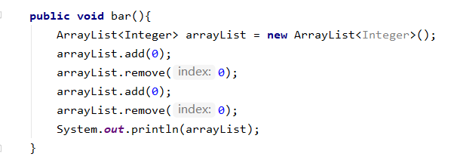
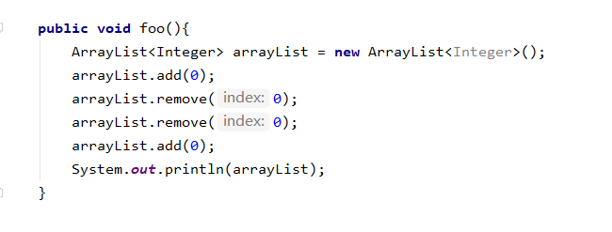


Motivation Example
$$add,remove,add,remove$$
$$add,remove,remove,add$$
Notes:
Take these two pictures as an example, method bar and foo share same count of line. same varible, however, if use traidtional method, we can not identify that foo function has bug. When we tokenize them, the order is different.

Slide 8
Exsiting Deep Learning Models
Exsiting deep learning models
Deep Belief Network(DBN)[4]
Convolutional Neural Network(CNN)[5]
BiLSTM+Attention[6]
Problems
Can not learn identical token's representation under different contexts
[4]Wang, S., Liu, T., & Tan, L. (2016, May). Automatically learning semantic features for defect prediction. In 2016 IEEE/ACM 38th International Conference on Software Engineering (ICSE) (pp. 297-308). IEEE.
[5]Li, J., He, P., Zhu, J., & Lyu, M. R. (2017, July). Software defect prediction via convolutional neural network. In 2017 IEEE International Conference on Software Quality, Reliability and Security (QRS) (pp. 318-328). IEEE.
[6]Fan, G., Diao, X., Yu, H., Yang, K., & Chen, L. (2019). Software defect prediction via attention-based recurrent neural network. Scientific Programming, 2019.
Notes:
To solve this problem, deep learning based model are proposed by many researcheres. Existing representive deep learning method are Deep belief network (DBN), CNN and BiLSTM with attention mechanism. However, the existing models can not learn identical token's representation under different contexts.

Slide 9
Proposed Model (1)
BERT+BAMA
Extract code dependency information
Different token representation under different contexts
Notes:
To solve the problems of both traditional models and exsiting deep learning model, we proposed BERT+BAMA model that can extract code dependency informantion and different token representation under different contexts.

Slide 10
Proposed Model (2)
int, a, b, c, ...
BERT
public, class,...
pretrain
Java corpus
data preprocessing
private, int,...
......
for, int,i, ...
embedding
PROMISE dataset source code
token sequences
0.2, 0.4, 0.5, ...
0.1,0.3,0.6,...
0.2,0.4,0.7,...
......
0.2,0.3,0.6, ...
Notes:
This is overview of our proposed model, first we tokenize dataset of Java courpus and dataset source code into token sequences, for Java source code token sequences, we use them to pretrain a bert model. The pretrained mdoel will be used to embedd PROMISE dataset sequences.

Slide 11
Proposed Model (3)
feature concatenation
Global Max Pooling
New instances
Embedding
BiLSTM
Logistic regression
Attention
Global Avg Pooling
clean
buggy
Notes:
After we get the embeddings, we pass them into BiLSTM to learn tokens context sensitive representation, then use Gobal Max Pooling, Attention mechanism and Global Average Pooling method to generate three kind of features. finally, concatenate them and training them using logistics regression. use the trained model to predict new instances' defectiveness.

Slide 12
Data Preprocessing
For Java corpus and PROMISE[7] dataset source code
Remove all comments
Directly tokenize files into sequences
Remove punctuation and “String” variable
Remove “import”, “package” tokens
Marian Jureczko and Lech Madeyski. Towards identifying software project clusterswith regard to defect prediction. InProceedings of the 6th International Conferenceon Predictive Models in Software Engineering, pages 1–10, 2010.
Notes:
For data preprocessing, we remove all comments. then, tokenize files into sequences, remove punctuation and String variable. for those tokens contains less informantion, such as import and package that also will be removed.

Slide 13
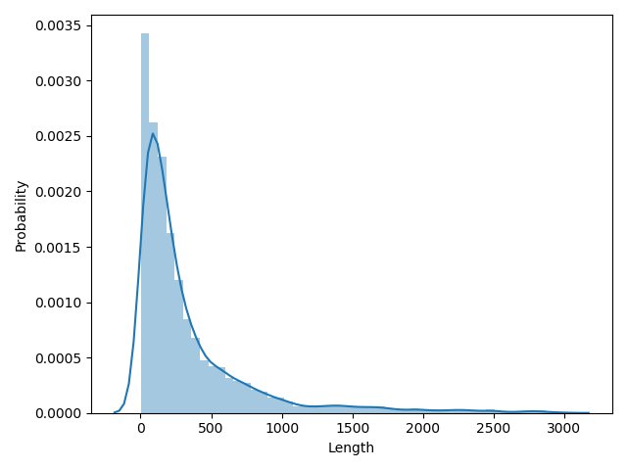
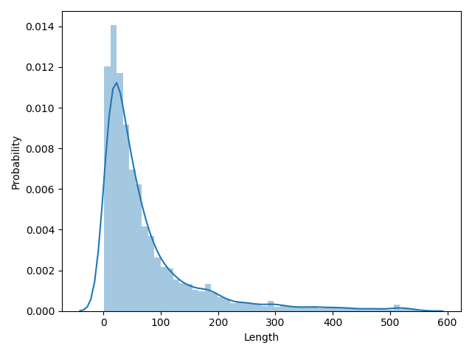
Why Tokenization
Retain entire context information for source code
full-token
AST-node
full-token:Directly tokenize source code
AST-node: Parse source code into AST, then select specific nodes
Notes:
So, why directly tokenize source code, we want to keep entire context information for source code, the two figures show the lengtho distribution of under two processed methods of whole dataset, full-token type is obviously longer than that of AST-node type. which will loss part of context information.

Slide 14
Why BERT Pretraining
Why pretraining
Training tokens efficiently
Try to relieve the problem that tokens disappeared in test set
Why BERT pretraining[8]
No pretrained BERT model for Java available
Capture position information
Strong token representation ability
Future research on programming language
[8]acob Devlin, Ming-Wei Chang, Kenton Lee, and Kristina Toutanova. Bert: Pre-training of deep bidirectional transformers for language understanding.arXivpreprint arXiv:1810.04805, 2018.
Notes:
So, why need BERT pretraining, to answer this question, the first thing is that why we need pretraining, with pretraining, we can training tokens efficiently before experiment, besides, it can also relieve the problem that tokens in training set disappeared in test set.
Then why BERT pretraining, The first reason is that No pretrained BERT model for Java accessible
The second reason is that it can capture position information
The third reason is that it can has strong token representataion ability, token under different context can get different representation.
The final reason is that we want to do further research about BERT's application on programming language

Slide 15
Why BiLSTM
Learn the contextual information
Generate context sensitive representation for tokens
Learn both forward and backward contextual information
Notes:
Why, it can the contextual information, and generate context sensitive represenation for tokens, can learn both forward and backward contextual information

Slide 16















Attention Mechanism
$$c$$
context vector
hidden states
scalar computation
$$u$$
$$α_{1}$$
$$α_{2}$$
$$α_{3}$$
$$α_{4}$$
$$α_{n}$$
weight distribution $α$
$$u$$
sum
$$......$$
context vector
$$h_{1}$$
$$h_{2}$$
$$h_{3}$$
$$h_{4}$$
$$y_{n}$$
Notes:
The figures show how to extract information from hiddens. use vector u make dot production generate the weight distribution and then, each time of hiddens make scalar computation, then sum them to generate context vector.

Slide 17

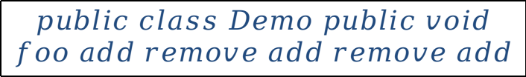
Why Attention
Fixed length vector can not contain all information of the long sequence
The length of sequence depends on Java files
context vector
$$public class Demo public void$$
$$foo add remove add remove add$$
BiLSTM
$$void foo add remove$$
BiLSTM
Notes:
why need Attention, because that Fixed length vector can not contain all information of the long sequence, andThe length of sequence depends on Java files. Besides, since we use full-token processing method, it will be long token sequence for each instance, Only BiLSTM is weaker to learn long distance sensitive representation, use Attention that can focus important tokens

Slide 18
Why Global Max Pooling and Global Average Pooling
Global Max Pooling
Extract dominant features
Reduce complexity of model
Global Average Pooling
Balance Global Max Pooling to prevent overfiting
Notes:
So, Why we need global max pooling and global average pooling.
for global max pooling, it can extract dominant features from a sequence and reduce complexity of model
for global Average pooling, it used to balance global max pooling, for too much dominant feature may ocurr overfitting problem, by using global average pooling to generate no-domaint feature to prevent that problem. and it flect on our experiment only use global max pooling.

Slide 19
Research Questions
RQ1:Can data augmentation improve the performance of deep learning models?
RQ2:Can our model outperform other models, including traditional metrics based models and deep learning based models?
RQ3:Can embedding with our pretrained BERT model outperform Word2vec model?
RQ4:Which data preprocessing method is better for software defect prediction?

Slide 20
Research Questions
RQ1:Can data augmentation improve the performance of deep learning models?
RQ2:Can our model outperform other models, including traditional metrics based models and deep learning based models?
RQ3:Can embedding with our pretrained BERT model outperform Word2vec model?
RQ4:Which data preprocessing method is better for software defect prediction?

Slide 21
Approach Overview
Approach
Implement two baseline features and four baseline models
Conduct Within-Project Software Defect Predict (WPDP) experiment
Conduct Cross-Project Software Defect Prediction (CPDP) experiment
Notes:
to answer the question we...

Slide 22
Two Baseline Features and Four Baseline Models
Two baseline features
Token: Convert tokens sequence into index sequences
Stat: Features from PROMISE dataset
Four baseline methods
BiLSTM+ATT: Word2vec embedding based model with attention
TextCNN: Word2vec embedding based model
Token+LR: Token feature with logistic regression
Stat+LR: Stat feature with logistic regression

Slide 23













WPDP and CPDP
WPDP
training set
test set
$$....$$
$${ver}_{1}$$
$${ver}_{i−1}$$
$${ver}_{i+1}$$
$${ver}_{n}$$
$$...$$
$${ver}_{i}$$
CPDP
training set
test set
$$....$$
$${pro}_{1}$$
$${pro}_{i−1}$$
$$...$$
$${pro}_{i+1}$$
$${pro}_{n}$$
$${pro}_{i}$$
Notes:
In SDP, there are two kind of software defect prediction one is WPDP, another is CPDP, for WPDP, the experiment conudct within a single project, select one version as test set, the others will be training set. In our WPDP experiment, we set latest version as test set in a project. for CPDP, it is inter project experiment, select one project as test set, others will be training set. In our experiment, every project will be test set in turn.

Slide 24
Dataset
PROMISE dataset
Dataset
project | version | #avg | #avg(p) | df
ant | 1.3~1.7 | 338 | 307 | 0.23
camel | 1.2,1.4,1.6 | 815 | 367 | 0.45
jvy | 1.1,1.4 | 176 | 151 | 0.32
jedit | 3.2,4.1~4.3 | 360 | 325 | 0.17
lucene | 2.2,2.4 | 293 | 265 | 0.62
poi | 1.5,2.0,2.5 | 312 | 279 | 0.50
synapse | 1.1,1.2 | 239 | 212 | 0.33
velocity | 1.4.1,1.6.1 | 213 | 182 | 0.59
xalan | 2.4~2.7 | 830 | 739 | 0.58
xerces | 1.2.0,1.3.0,1.4.4 | 410 | 224 | 0.36
#avg: Number of instance of orginal dataset
#avg(p): Number of instance of processed dataset
df: defect rate of each project
Notes:
The table is description of source project, thereby, we conduct experiment on 10 prejects, since the number of instance of most project is no more than 1000. This can limit the ability of deep leanring, also reflect that data augmentation is needed in SDP.

Slide 25
Experiment Design for RQ2
RQ1:Can data augmentation improve the performance of deep learning models?
RQ2:Can our model outperform other models, including traditional metricsbased models and deep learning-based models?
RQ3:Can inputs embedding with our pretrainedBERTmodel outperformWord2vecmodel?
RQ4:Which data preprocessing method is better for software defect prediction?
Compare F1 score of BERT+BAMA with four baseline models in both WPDP and CPDP experiments on ten projects
Notes:
to answer RQ2, we conduced experiment by Compare F1 score of BERT+BAMA with four baseline models in both WPDP and CPDP experiments on ten projects.

Slide 26
Experiment for RQ2
Parameter settings
Parameters | BERT+BAMA | BiLSTM+ATT | TextCNN
embedd size | 64 | 300 | 300
input length | 512 | 512 | 512
vocab size | 100,000 | 100,000 | 100,000
optimizer | Adam | Adam | Adam
learning rate | 0.005 | 0.005 | 0.005
epoches | 5 | 5 | 5
hidden size | 64 | 64 | -
filter size | - | - | 2,3,4
number filter | - | - | 32
loss function | cross entropy | cross entropy | cross entropy
Notes:
Here is parameter setting for deep learning model. Apart from the embedd size that BERT+BAMA model is 64 different from that of BILSTM+ATT and TextCNN model.

Slide 27
Results for RQ2(1)
F1 score of WPDP
Project | BERT+ BAMA | BiLSTM+ATT | TextCNN | Token+LR | Stat+LR
xecers | 0.20 | 0.07 | 0.39 | 0.46 | 0.21
synapse | 0.52 | 0.37 | 0.48 | 0.45 | 0.48
xalan | 0.36 | 0.55 | 0.51 | 0.36 | 0.39
camel | 0.48 | 0.49 | 0.50 | 0.51 | 0.46
ivy | 0.23 | 0.20 | 0.21 | 0.13 | 0.20
velocity | 0.65 | 0.53 | 0.43 | 0.57 | 0.64
ant | 0.48 | 0.35 | 0.42 | 0.23 | 0.54
poi | 0.67 | 0.18 | 0.52 | 0.0 | 0.12
lucene | 0.77 | 0.74 | 0.73 | 0.76 | 0.73
jedit | 0.10 | 0.10 | 0.04 | 0.09 | 0.05
Notes:
The F1 scores of WPDP experiment shown in the table, BERT+BAMA achieve 6 highest scores in ten projects while other model achieve only two or one highest F1 score.

Slide 28
Results for RQ2(2)
F1 score of CPDP
Project | BERT+ BAMA | BiLSTM+ATT | TextCNN | Token+LR | Stat+LR
xecers | 0.39 | 0.37 | 0.38 | 0.29 | 0.28
synapse | 0.54 | 0.51 | 0.49 | 0.38 | 0.40
xalan | 0.58 | 0.33 | 0.45 | 0.42 | 0.32
camel | 0.58 | 0.38 | 0.30 | 0.27 | 0.25
ivy | 0.52 | 0.19 | 0.38 | 0.37 | 0.43
velocity | 0.39 | 0.14 | 0.40 | 0.19 | 0.28
ant | 0.44 | 0.21 | 0.46 | 0.36 | 0.51
poi | 0.33 | 0.60 | 0.31 | 0.34 | 0.56
lucene | 0.47 | 0.12 | 0.34 | 0.42 | 0.26
jedit | 0.12 | 0.25 | 0.38 | 0.35 | 0.37
Notes:
For CPDP, the experiment also be like this that BERT+BAMA achieve 6 highest score, while other models only achieve one and two highest F1 score

Slide 29
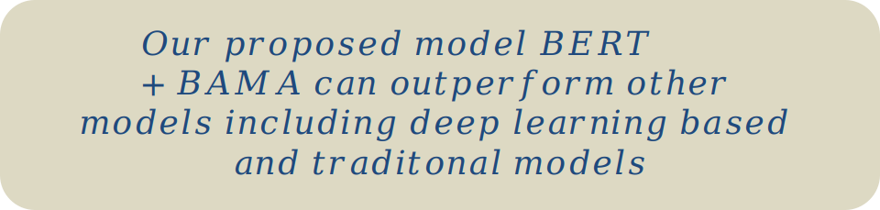
RQ2-Answer
RQ2: Can our model outperform other models, including traditional metrics based models and deep learning-based models?
$$Our proposed model BERT+BAMA can outperform other$$
$$models including deep learning based$$
$$and traditonal models$$

Slide 30
Experiment Design for RQ3
RQ1:Can data augmentation improve the performance of deep learning models?
RQ2:Can our model outperform other models, including traditional metricsbased models and deep learning-based models?
RQ3:Can embedding with our pretrained BERT model outperform Word2vec model?
RQ4:Which data preprocessing method is better for software defect prediction?
We use BiLSTM and TextCNN model to compare the F1 score ​​of WPDP and CPDP experiments on ten projects using these two embedding methods without fine-tuning, respectively

Slide 31
Experiment for RQ3
Experiment setting
Settings | BERT | Word2vec
mode | WPDP & CPDP
model | TextCNN & BiLSTM
fine-tuning | False
metrics | F1 score
Notes:
Here is the experiment setting for RQ3, In this experiment , both two embedding mdoel did not adopt fine-tuning strategy, that mean the embedding weight will not changed during experiments. and we use F1 score evaluate models

Slide 32
Results for RQ3(1)
F1 score of WPDP
Model | TextCNN |  | BiLSTM+ATT
Embedding | BERT | Word2vec | BERT | Word2vec
xecers | 0.41 | 0.03 | 0.28 | 0.29
synapse | 0.60 | 0.32 | 0.0 | 0.41
xalan | 0.43 | 0.59 | 0.32 | 0.65
camel | 0.36 | 0.50 | 0.44 | 0.45
ivy | 0.13 | 0.21 | 0.13 | 0.19
velocity | 0.60 | 0.53 | 0.49 | 0.53
ant | 0.30 | 0.40 | 0.57 | 0.56
poi | 0.37 | 0.18 | 0.0 | 0.20
lucene | 0.62 | 0.54 | 0.76 | 0.76
jedit | 0.07 | 0.10 | 0.10 | 0.11
Notes:
The results of RQ3 WPDP experime shown in the table, For BiLSTM+ATT model, BERT embedding achieve 0 highest F1 score during the training.

Slide 33
Results for RQ3(2)
F1 score of CPDP
Model | TextCNN |  | BiLSTM+ATT
Embedding | BERT | Word2vec | BERT | Word2vec
xecers | 0.20 | 0.37 | 0.39 | 0.40
synapse | 0.36 | 0.51 | 0.50 | 0.46
xalan | 0.02 | 0.40 | 0.51 | 0.30
camel | 0.50 | 0.43 | 0.29 | 0.30
ivy | 0.03 | 0.42 | 0.30 | 0.26
velocity | 0.03 | 0.41 | 0.27 | 0.19
ant | 0.03 | 0.48 | 0.27 | 0.32
poi | 0.23 | 0.49 | 0.26 | 0.33
lucene | 0.01 | 0.36 | 0.22 | 0.05
jedit | 0.07 | 0.34 | 0.34 | 0.19
Notes:
For CPDP experiment, especially TextCNN model, BERT based embedding method only achieve 1 highest F1 score.

Slide 34
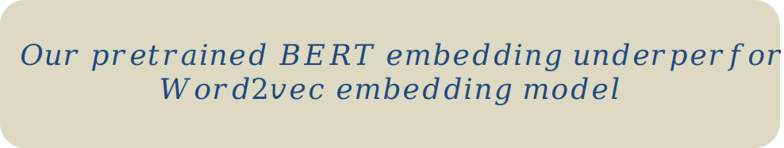
RQ3-Answer
RQ3:Can embedding with our pretrained BERT model outperform Word2vec model?
$$Our pretrained BERT embedding underperfor$$
$$Word2vec embedding model$$

Slide 35
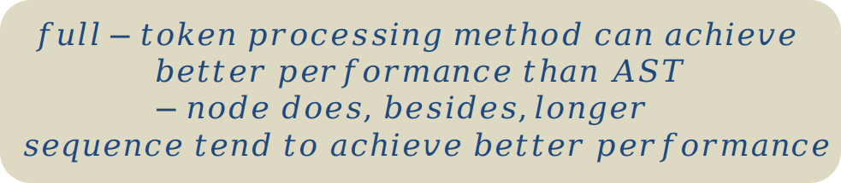
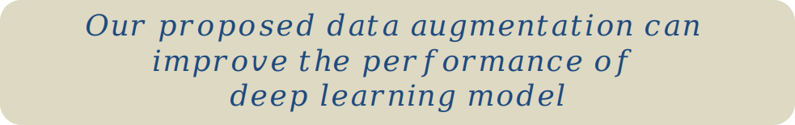
Answers to RQ1 and RQ4
RQ1:Can data augmentation improve the performance of deep learning models?
RQ4:Which data preprocessing method is better for software defect prediction?
$$Our proposed data augmentation can$$
$$improve the performance of$$
$$deep learning model$$
$$full−token processing method can achieve$$
$$better performance than AST−node does, besides,longer$$
$$sequence tend to achieve better performance$$

Slide 36
Conclusion
Goal
Construct an effective deep learning model for SDP
Proposal
BERT+BAMA model for SDP
BERT and Word2vec embedding model comparison
Evaluation
BERT+BAMA outperforms other models
Our trained BERT embedding underperform Word2vec embedding

Slide 37
Extra

Slide 38
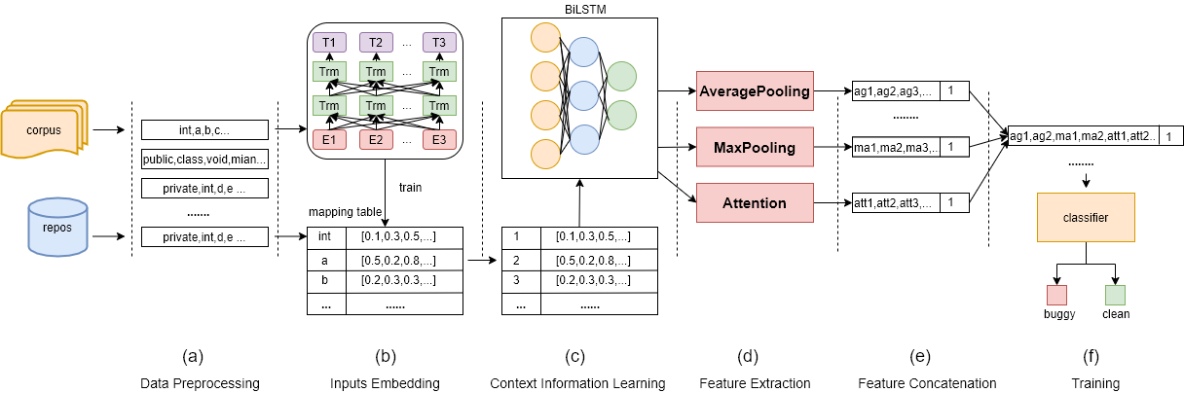
Proposed method overview

Slide 39











BERT Structure
$$T_{1}$$
$$T_{2}$$
$$...$$
$$T_{n}$$
$$outputs$$
$$Trm$$
$$Trm$$
$$...$$
$$Trm$$
$$Transformer blocks$$
$$Trm$$
$$Trm$$
$$...$$
$$Trm$$
$$E_{1}$$
$$E_{2}$$
$$...$$
$$E_{n}$$
$$inputs embedding$$
Task
Masked language model: word prediction
Next sentence prediction: sentence prediction

Slide 40
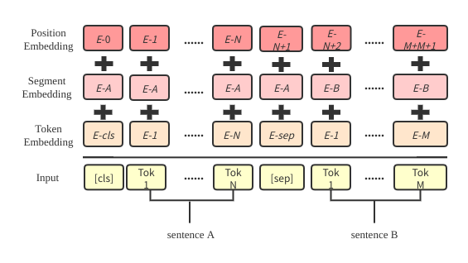
BERT Training
Inputs embedding

Slide 41
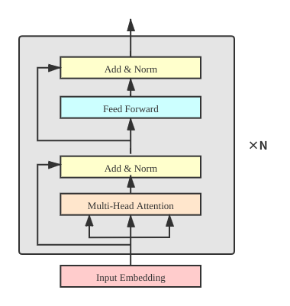
Transformer blocks

Slide 42














Context Information learning
Why BiLSTM
Q:public, static, void, main,remove, add
$$y_{0}$$
$$y_{1}$$
$$y_{2}$$
$$y_{3}$$
$$s_{0}$$
$$h_{0}$$
$$h_{1}$$
$$h_{2}$$
$$h_{3}$$
$$s_{1}$$
$$x_{0}$$
$$x_{1}$$
$$x_{2}$$
$$x_{3}$$
forward LSTM
public, static, void, ____
Can only make use of previous context information

Slide 43




Context Information learning
BiLSTM
$$y_{0}$$
$$y_{1}$$
$$y_{2}$$
$$y_{3}$$
$$s_{1}^{'}$$
$$h_{0}^{'}$$
$$h_{0}^{'}$$
$$h_{0}^{'}$$
$$h_{0}^{'}$$
$$s_{0}^{'}$$
$$s_{0}$$
$$h_{0}$$
$$h_{1}$$
$$h_{2}$$
$$h_{3}$$
$$s_{1}$$
$$x_{0}$$
$$x_{1}$$
$$x_{2}$$
$$x_{3}$$
$$y_{n}=\vec{y_{n}}+\overset{⃖}{y_{n}}$$
public, static, void, ____,remove, add

Slide 44
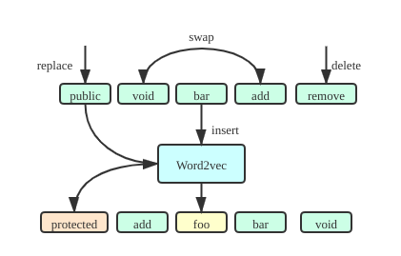
Experiment for RQ1
Data augmentation
Adapted from EDA[9]
Random replace, random delete,random swap, random insert
[9]Wei, J. W., & Zou, K. (2019). Eda: Easy data augmentation techniques for boosting performance on text classification tasks. arXiv preprint arXiv:1901.11196.

Slide 45
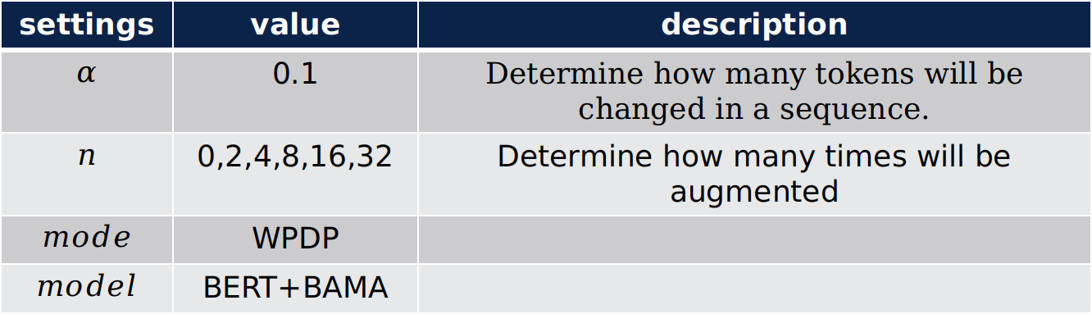
Experiment for RQ1
settings | value | description
$$α$$ | 0.1 | Determine how many tokens will be changed in a sequence.
$$n$$ | 0,2,4,8,16,32 | Determine how many times will be augmented
$$mode$$ | WPDP
$$model$$ | BERT+BAMA

Slide 46
Corpus Training
Word2vec pretrain settings
settings | values
dimension size | 300
window size | 5
mini frequency count | 5
epoches | 15

Slide 47
Corpus Training
Corpus Description
processed on part of project of BigCode
properties | values
Number of lines | 306,522
Total tokens | 84,955,239
Vocabularize size | 2,047,760
Average sequence length | 277

Slide 48
Corpus Training
BERT pretraining settings
settings | values
Total paramters | 264,241,330
hidden size | 64
batch size | 8
epoches | 2

Slide 49
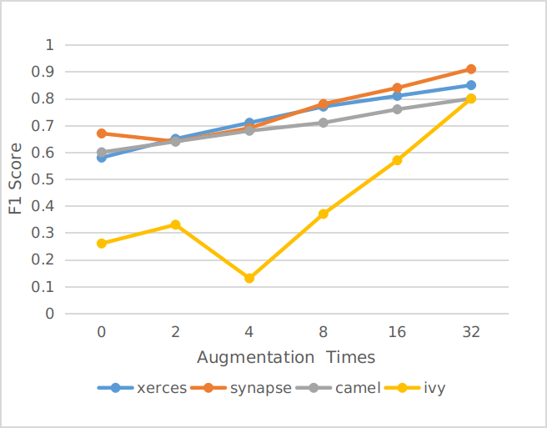
Hidden size optimization
Results

Slide 50
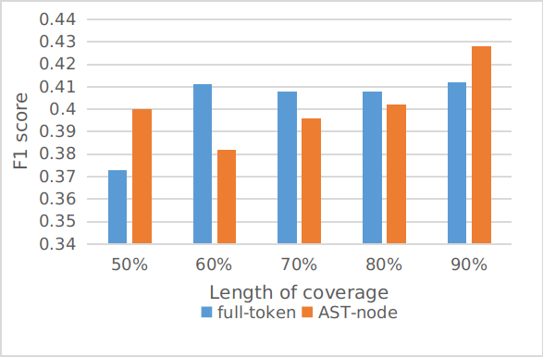
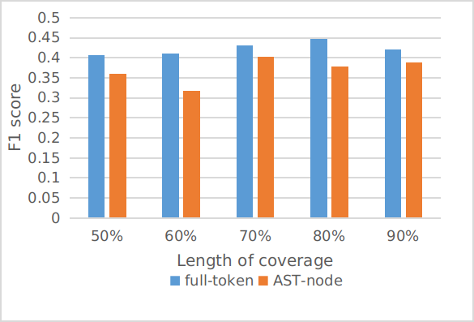
Results for RQ4
Average F1 score
WPDP
CPDP

