Slide 1
Feature Generation for Software Defect Prediction via Pre-trained Model of Code Semantics
Midterm Presentation
M2 LI,Jidong
2019/02/15
Kobayashi Lab

Slide 2
Software Defect Prediction(SDP)
Construct Model to perdict potential bug modules.
Goal
Optimization for resource allocation
Improve the quality of software

Slide 3
Process
The process of SDP
new instances
instances
metrics
buggy
extract
construct
training
model
repository
predict
buggy

Slide 4
Related Work
Metrics [2]
Structure Metircs(CK,LOC)
Developers based(age, experience...)
Change metrics
[1]Paramshetti, P., & Phalke, D. A. (2014). Survey on software defect prediction using machine learning techniques. International Journal of Science and Research (IJSR), 3(12), 1394-1397.
[2]Chen X, Gu Q, Liu WS, Liu SL, Ni C. Survey of static software defect prediction. Ruan Jian Xue Bao/Journal ofSoftware, 2016,27(1):1−25 (in Chinese). http://www.jos.org.cn/1000-9825/4923.htm

Slide 5


Existing Problems
traditional metrics
fail to extract the semantics of code
e.g structure metircs
I eat apple
I apple eat

Slide 6
Research Purpose
Improve the perfomance of semantics extraction
Construct effective SDP model
Identify how well deep learning based model than other traditional models.

Slide 7
Code Naturalness
Naturalness hypothesis[1]
similar to human language
Text feature extraction
count based(Bag of Word[2] & TF-IDF[3])
unable to extract semantics
prediction based(word2vec[4] & Bert[5])
[1]Miltiadis Allamanis, Earl T Barr, Premkumar Devanbu, and Charles Sut_x0002_ton. A survey of machine learning for big code and naturalness. ACM Computing Surveys (CSUR), 51(4):81, 2018
[2]Sriram, B., Fuhry, D., Demir, E., Ferhatosmanoglu, H., & Demirbas, M. (2010, July). Short text classification in twitter to improve information filtering. In Proceedings of the 33rd international ACM SIGIR conference on Research and development in information retrieval (pp. 841-842). ACM.
[3]Ramos, J. (2003, December). Using tf-idf to determine word relevance in document queries. In Proceedings of the first instructional conference on machine learning (Vol. 242, pp. 133-142).
[4]Tomas Mikolov, Kai Chen, Greg Corrado, and Jeffrey Dean. Effi-cient estimation of word representations in vector space. arXiv preprintarXiv:1301.3781, 2013.
[5]Jacob Devlin, Ming-Wei Chang, Kenton Lee, and Kristina Toutanova. Bert:Pre-training of deep bidirectional transformers for language understanding.arXiv preprint arXiv:1810.04805, 2018.

Slide 8
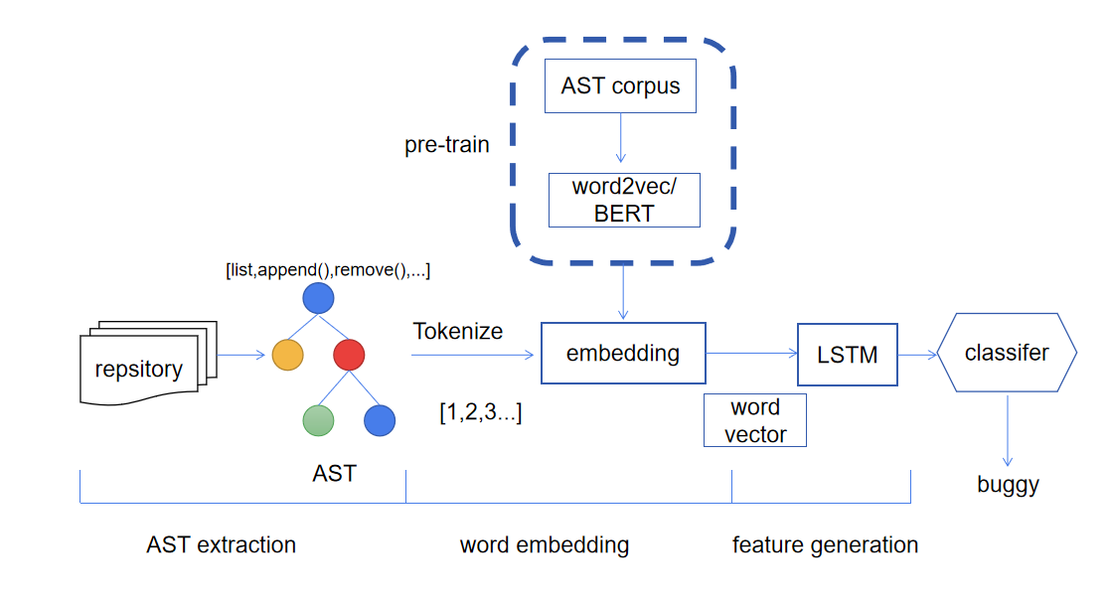
Approach

Slide 9
Pre-trained model (contain vec)
sequence
corpus
tokeniz
word2vec
word vector
Input of LSTM
list [4.353,0.467,0.344,..]
append [0.370,6.341,0.634,..]
remove [2.403,10.328,-6.343,...]
....

Slide 10
Progress
Data collection
AST corpus(Done)
Defect data(Doing)
Experiment(Todo)
Evaluation
Research questions(Done)
comparison group(Done)
Making benchmark(Todo)

Slide 11
Experiment Design I
Effectiveness validation
Our model+LR
Structures metrics & changes metris+LR

Slide 12
Experiment Design II
Validation of pre-train model
Pre-trained
Without pred-trained

Slide 13
Experiment Design III
Validation of sematics
our model+LR
BOW+LR
TF-IDF+LR
Reasoning
How well can semantics affect SDP(skip)
Importance of semantics of code.(skip)

Slide 14
Conclusion
Pre-trained based model
Limitation of exsiting word embedding
Research plan
Data collection and processing(1 month)
Modelling and evaluation(1 month)
Paper writing(until the end)

