Slide 1

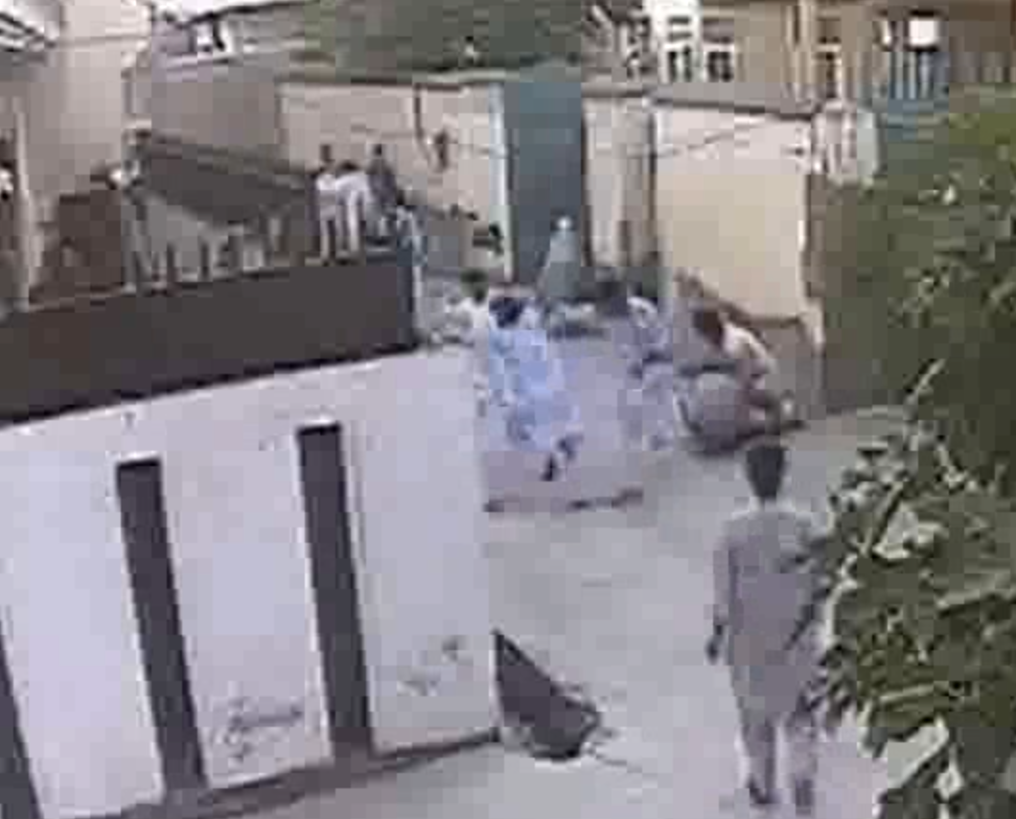
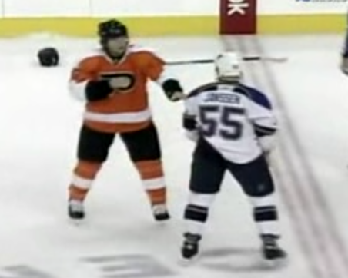
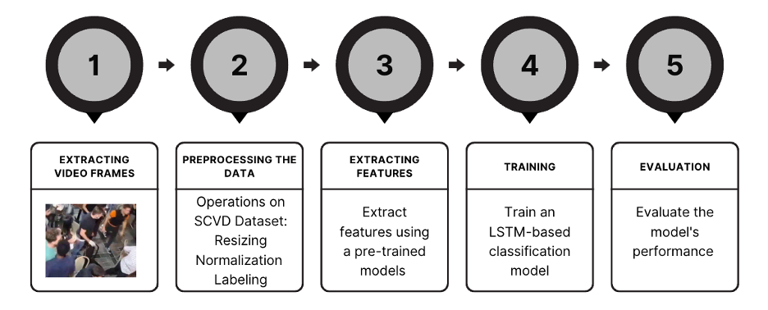
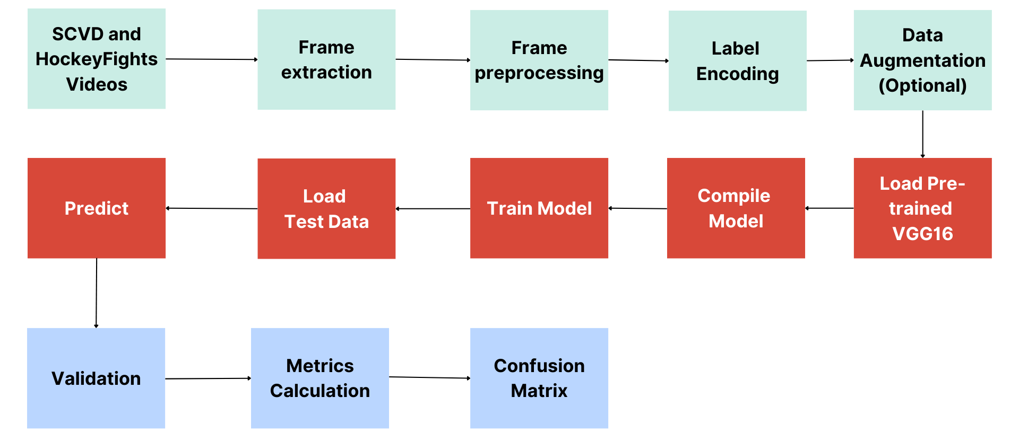
YILDIZ TECHNICAL UNIVERSITY
FACULTY OF ELECTRICAL AND ELECTRONICS
DEPARTMENT OF COMPUTER ENGINEERING
VIOLENCE DETECTION IN VIDEOS
Esma Nur Ekmekci, Muhammad Nasir Sabır, Hafize İrem Türkmen
nasir.sabir@std.yildiz.edu.tr, nur.ekmekci@std.yildiz.edu.tr, irem@yildiz.edu.tr
Özet
Bu çalışmada, konvolüsyonel sinir ağları (CNN) ve uzun kısa süreli bellek (LSTM) mimarileri kullanılarak videolarda şiddet tespiti için yeni bir yaklaşım sunulmaktadır. Bu çalışmanın arkasındaki temel motivasyon, şiddet tespit sistemlerinin doğruluğunu ve verimliliğini artırmaktır. VGG16 ve ResNet gibi önceden eğitilmiş modeller SCVD ve Hockey Fights gibi veri kümeleri üzerinde kullanılmıştır. Temel sonuçlar, tespit doğruluğunda önemli gelişmeler elde edildiğini göstermektedir.
Abstract
In this study, a novel approach for violence detection in videos using convolutional neural networks (CNN) and long short-term memory (LSTM) architectures is presented. The main motivation behind this work is to improve the accuracy and efficiency of violence detection systems. Pre-trained models such as VGG16 and ResNet are utilized on datasets like SCVD and Hockey Fights. Key results demonstrate that significant improvements in detection accuracy are achieved.
I.Introduction
The goal of this project is to develop an efficient and accurate system for detecting violent activities in video streams using convolutional neural networks (CNN) and long short-term memory (LSTM) architectures. The motivation for this work is driven by the need to enhance public safety through the timely warning of violent incidents. Traditional surveillance systems, often relying on human operators, are prone to errors. Machine learning techniques are intended to overcome these limitations, offering a more reliable solution. Various machine learning methods have been explored in previous literature, with the combination of CNN and LSTMs showing significant potential [1] in capturing both spatial and temporal features. This project aims to demonstrate the effectiveness of this integrated approach and provide a comprehensive evaluation on datasets such as SCVD and HockeyFights. By contributing to the existing body of knowledge, an innovative solution that can be used in real-world surveillance systems will be provided, ultimately enhancing public safety and security.
III. Experimental/Application Results
In this section, experimental results are discussed.
A. Scope of Experiments
The initial approach involved using CNN and LSTM models together to detect both image and motion features. However, due to a lack of data, a decision was made to incorporate pre-trained models into the system for analysis and comparison. The studies began with the SCVD dataset, which consists of surveillance video footage. However, due to the poor quality of this dataset, a cleaner dataset, Hockey Fights, was chosen for comparison. The performance of the models on these two datasets was tested under different conditions.
B. Dataset Differences
Figure 3 illustrates an example of the scvd dataset and Figure 4 illustrates an example of the Hockey Fight dataset.
Figure 3. SCVD Figure 4. Hockey Fight
C.Some Findings From the Experiments
Some of the findings discovered during the experiments will be shared here. When working with the SCVD dataset, the number of epochs made a big difference to the success rate, but not so much with the Hockey Fight dataset. ResNet, one of the pre-trained models used in this study, outperformed VGG16 in processing the images. With other conditions being the same, the accuracy values of the ResNet model were better by a small margin. RMSprop was tried as an optimizer and it was found to cause fluctuations in the train and validation accuracy graphs, so it was continued with the Adam optimizer. Graphs and confusion matrix were used for the evaluations.
The organization of this study is as follows. Section 2 gives the details of the system design while the findings from the experimental studies are summarized in section 3. In the end, the conclusion is explained and brief references are given. II. System Design
This system is developed using the VGG16 pre-trained model and LSTM architectures for violence detection [2]. The system consists of several components. First, the video data needs to be preprocessed. To achieve this, the video data is split into frames beforehand. Following this step, feature extraction [3] is performed on these frames using the VGG16 model. The extracted features are then fed as sequences into the LSTM network for temporal analysis. Finally, the detected events are classified, and the results are reported to the user. The entire process ensures that the video data is thoroughly analyzed, providing accurate and efficient detection of violent activities.
The functioning of the system is visualized with roadmap flow in Figure 1. This diagram help you better understand how the system works.
Figure 1. Roadmap
If a more detailed analysis of the flow is desired, Figure 2 can be examined.
Figure 2. Detailed Roadmap
C.Comparison of Experiments
Table 1. Results of Experiments
The results obtained from the experiment were analyzed using 4 different metrics and are presented in Table 1. Accuracy reflects the proportion of correctly identified instances of each classes so it provides an overall aspect of our model’s correctness in classification. The F1 score combines accuracy and recall. It offers a balanced evaluation. Precision indicates the ratio of accurately predicted instances of violence among all instances classified as violent, highlighting the importance of precise identification of violent cases. Recall measures the proportion of accurately predicted violent instances among all actual violent instances so it shows effectiveness in capturing all relevant instances of violence.
Conclusion
In this project, studies were carried out on violence detection from video over 2 different data sets. Apart from the CNN+LSTM model, pre-trained models were also used with LSTM to analyze the improvements in the model.The pre-trained models VGG16 and ResNet took part in the project. Both models improved the system both in terms of speed and accuracy. ResNet was the most suitable choice in the project in terms of speed and consistency. The need for systems that automatically identify violent occurrences increases. So we can foresee that work in this field will develop further. Examples in this regard can be the use of cloud-based architectures or integration with other systems.
References
[1] G. Anitha, M. Siddharth Shanker, M. Durgam Muni, L. Soma Sukrith, K. Venkatraman, and S. M. Usman, “Spatio temporal feature-based weapon and violence detection from video surveillance using deep learning,” in Proceedings of the 7th International Conference on ISMAC (IoT in Social, Mobile, Analytics and Cloud) (I-SMAC 2023), IEEE, Chennai, Tamil Nadu, India, 2023, pp. 597–602, ISBN: 979-8-3503-4148-5. DOI: 10.1109/ISMAC58438.2023.10290433.
[2] Sumon, S. A., Goni, R., Hashem, N. B., Shahria, T., & Rahman, R. M. (2020). Violence detection by pretrained modules with different deep learning approaches. Vietnam Journal of Computer Science, 7(1), 19-40. https://doi.org/10.1142/S2196888820500013.
[3] Punia, R. (2023, May 6). How to Extract Frames from a Video using Python — A Complete Guide. Medium.https://rs-punia.medium.com/how-to-extract-frames-from-a-video-using-python-a-complete-guide-3124618b76cb
Scenario | Accuracy | Precision | Recall | F1 Score
CNN+LSTM Using SCVD When Epoch is 20 | 0.661 | 0.652 | 0.611 | 0.630
VGG16+LSTM Using SCVD When Epoch is 40 | 0.834 | 0.813 | 0.834 | 0.823
VGG16+LSTM Using SCVD When Epoch is 100 | 0.948 | 0.965 | 0.920 | 0.942
VGG16+LSTM Using Hockey Fights When Epoch is 20 | 0.86 | 0.931 | 0.786 | 0.851
VGG16+LSTM Using Hockey Fights When Epoch is 20, Added a Layer to LSTM Model | 0.825 | 0.770 | 0.942 | 0.847
VGG16+LSTM Using Hockey Fights When Epoch is 20, Optimizer = ’rmsprop’ | 0.66 | 0.608 | 0.951 | 0.742
ResNet+LSTM Using Hockey Fights When Epoch is 40 | 0.925 | 0.882 | 0.928 | 0.905

