Slide 1
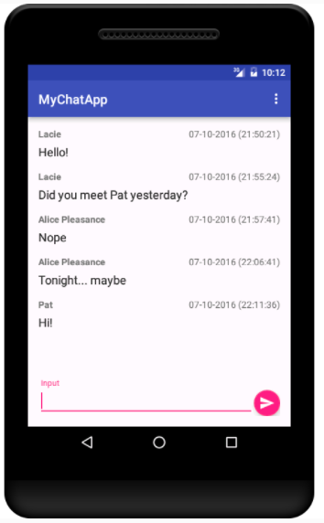
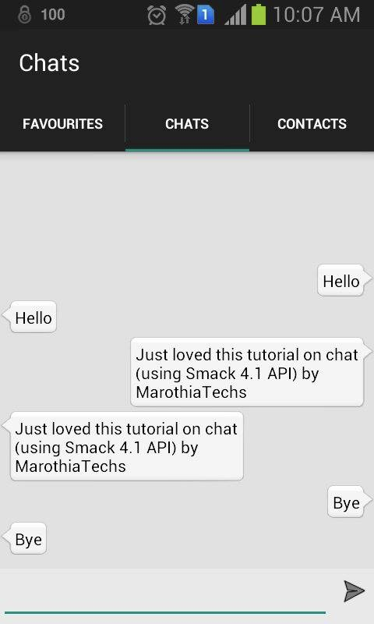
My Chat App

Slide 2
Need
Java (Android)
Swift (iOS)
Firebase (Social log in and backen noSQL database)

Slide 3
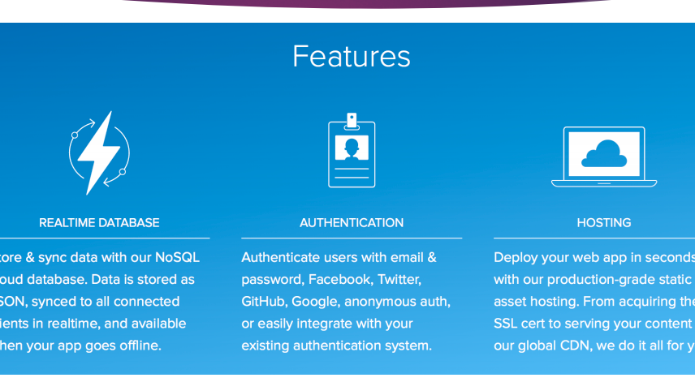
Firebase

Slide 4
Possible Steps
I will have 4 screens:
— Main screen for choosing the entry option (Login or Register) and showing the number of currently logged in users
— Login for the actual user authentication
— Registration screen, in which we create new Users
— Chat screen (Which can show a Chat fragment or a ListOfUsers fragment)

Slide 5
Reference

