Slide 1

LEARNING
RECOMMENDER SYSTEM
Personalized next-course ranking using learner-profile similarity
PRIYA NASKAR | BWU/BCA/24/063
Roll No.: 24103460061 • BCA (Hons.)
Department of Computational Sciences | Brainware University
Subject: Machine Learning • Subject Code: BCA57205
Academic Session 2026–2027
01

Slide 2
INTRODUCTION
Project background and overview
Digital learning environments offer many courses. Choosing a suitable next course can be difficult when learners differ in level, preferences, completed-course history, study hours and performance.
PROJECT OVERVIEW
The system compares a learner profile with historical learner profiles, finds similar learners and ranks course codes using their recorded next-course recommendations.
AI
INPUT
ENGINE
OUTPUT
Existing learner ID or manually entered profile
Cosine-distance nearest neighbours + weighted voting
Ranked next-course codes, match scores and explanations
02

Slide 3
PROBLEM STATEMENT & OBJECTIVES
PROJECT OBJECTIVES
PROBLEM
• Load and validate learner-profile data from CSV.
• Convert learner attributes and course history into a consistent feature representation.
• Find similar learners using cosine-distance nearest-neighbour search.
• Rank next-course candidates using similarity-weighted votes.
• Exclude current and already-completed courses.
• Evaluate against a popularity baseline and present results in Streamlit.
AI
AI
Learners may find it difficult to identify an appropriate next course from their current learning profile. The project uses historical learner data to rank likely next-course codes for a new or existing learner.
AI
03

Slide 4
SCOPE OF THE PROJECT
Coverage, intended users and boundaries
COVERAGE
TARGET USERS
LIMITATIONS
AI
AI
• Existing learner ID lookup
• Manual learner profile
• Course history, learning level, preference, study hours and performance
• Similarity-based ranking
• Dataset audit, EDA and evaluation
Learners who need support identifying a likely next course from a profile similar to historical learners. The dashboard also supports demonstration and analysis by project evaluators.
• Recommends course codes, not videos/quizzes/URLs
• Depends on one supplied dataset
• Modest holdout metrics
• Does not prove improved learning outcomes
Dataset: data/learning_path_dataset.csv
04

Slide 5
LITERATURE REVIEW / EXISTING SYSTEM
EXISTING APPROACH: COLLABORATIVE FILTERING
PROJECT'S POSITION & LIMITATION
AI
AI
Recommender systems use user–item interactions or similarities between users to estimate relevant items. Neighbour-based methods find similar users and aggregate observed preferences.
This project applies neighbour-based collaborative filtering to learner profiles. It uses available learner attributes and the Next_Course_Recommendation label—not course descriptions or learning-resource metadata. Recommendations are dataset-specific.
AI
AI
05

Slide 6
PROPOSED SYSTEM
End-to-end learner-profile recommendation
01 Learner profile
02 Validation
03 Feature vector
AI
ID lookup or manual input
Check profile fields and values
DictVectorizer representation
04 Neighbour search
05 Weighted voting
06 Ranked output
Cosine distance; default k = 20
Aggregate neighbour course labels
Course codes + match score + reason
AI
Candidate filtering removes the learner's current course and completed courses before ranking.
06

Slide 7
PROJECT METHODOLOGY
Technologies, tools and algorithm
DATA & PREPARATION
MACHINE LEARNING
APPLICATION & TOOLS
AI
Python • CSV / pandas
Validate required columns
Normalize strings and numeric fields
Reject missing/duplicate IDs
Filter conflicting target labels
scikit-learn
DictVectorizer
NearestNeighbors (brute force)
Cosine distance
Similarity-weighted voting
Streamlit dashboard
joblib model persistence
Visualisation / EDA charts
VS Code • Python environment
train_model.py + app.py
AI
Training: stratified 80/20 split • random_state = 42 • default neighbourhood = 20
07

Slide 8
PROJECT INTERNAL STRUCTURE
System architecture and data flow
Source CSV
Data validation
Feature builder
Recommender
AI
learning_path_dataset.csv
required fields • cleaning
profile dictionaries
cosine neighbours + votes
MODEL BUNDLE
STREAMLIT UI
AI
joblib saved model + metrics
inputs • EDA • ranked output
Training script creates the reusable model bundle; the dashboard loads it for live inference.
08

Slide 9
MODULE-WISE STRUCTURE & WORKFLOW
app.py
data_loader / validators
AI
Streamlit interface and navigation
Load CSV and validate records
features.py
recommender.py
Build categorical, history and scaled numeric features
Neighbour search, filtering and ranking
eda.py / ui_components.py
train_model.py + joblib
AI
AI
Charts, tables and dashboard components
Train, evaluate and save model bundle
Project separates interface, data preparation, feature engineering, validation, EDA, recommendation logic and training into maintainable modules.
09

Slide 10
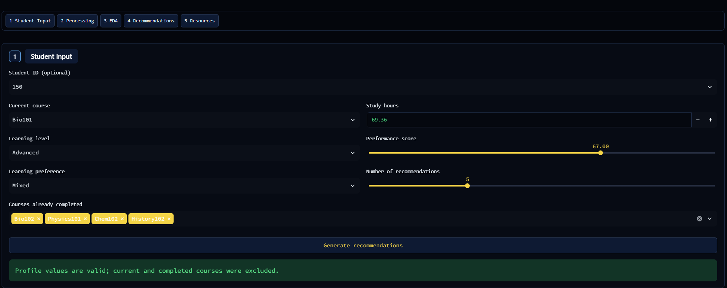
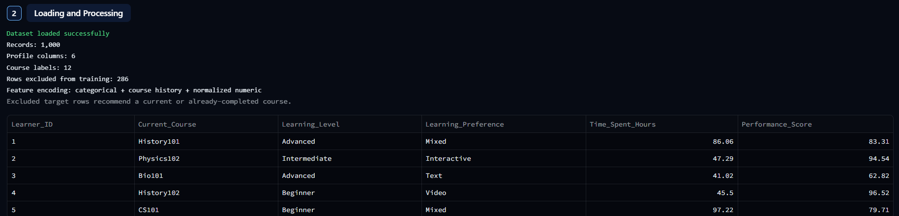
IMPLEMENTATION — DASHBOARD INPUT & PROCESSING
ACTUAL SCREENSHOTS FROM PROJECT DOCUMENTATION
Figure 8.4: Student Input section
Figure 8.5: Loading and Processing section
10

Slide 11
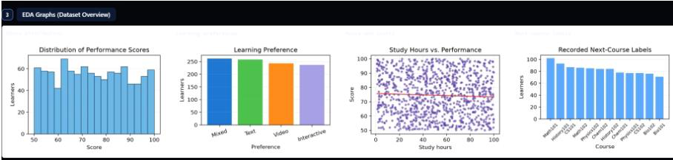
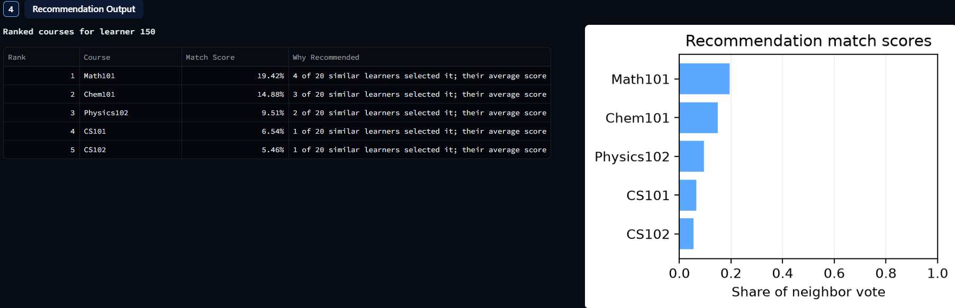
IMPLEMENTATION — EDA & RECOMMENDATION OUTPUT
AI
AI
Figure 8.7 : Recommendation Output section
Figure 8.6 : EDA Graphs section
EDA VIEWS
Score distribution • learning preference • study hours vs performance • next-course labels
AI
OUTPUT
Ranked course codes, match-score shares and explanation based on similar learners
11

Slide 12
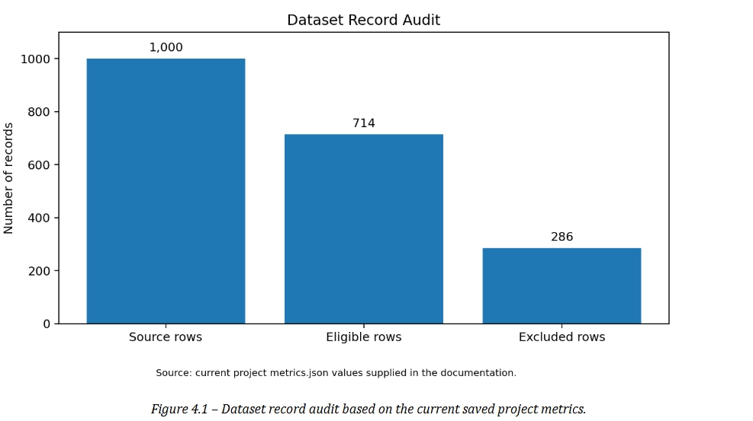
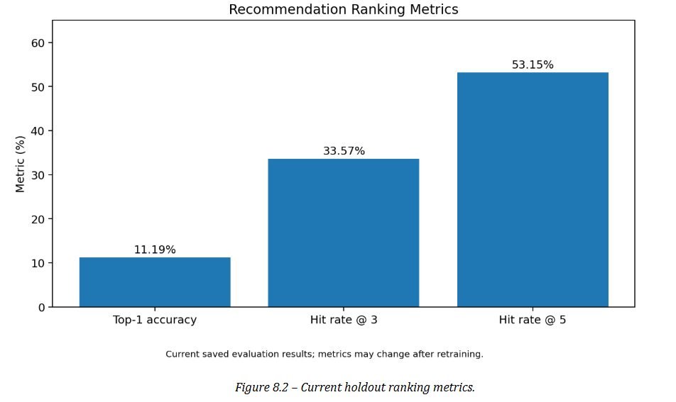
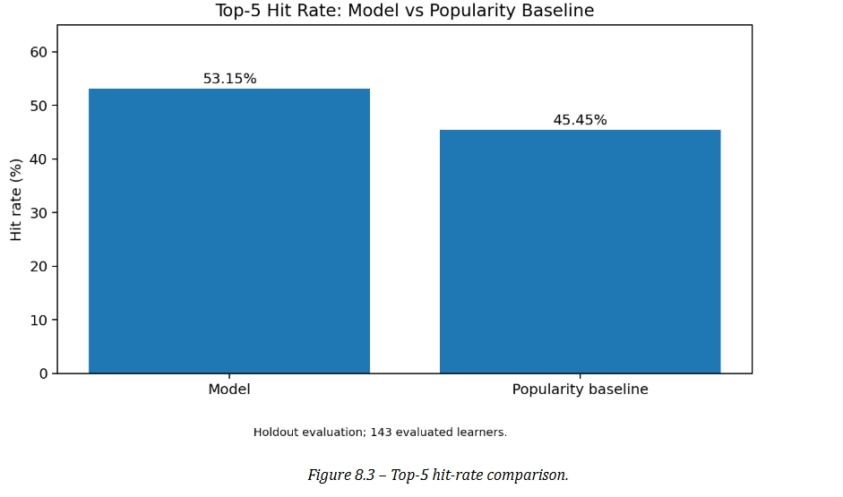
DATASET AUDIT & VISUAL RESULTS
Original charts from the project report
AI
AI
1,000 source rows | 714 eligible | 286 excluded
Top-1: 11.19% | Hit@3: 33.57% | Hit@5: 53.15%
AI
Top-5 hit rate vs popularity baseline: 53.15% vs 45.45%
12

Slide 13
TESTING & RESULTS
Holdout evaluation and documented test plan
TEST CONFIGURATION
RANKING METRICS
BASELINE / MRR
Stratified 80/20 split
Random state: 42
Holdout: 143 learners
Top-1 accuracy: 11.19%
Hit Rate@3: 33.57%
Hit Rate@5: 53.15%
Popularity Hit@5: 45.45%
MRR@5: 0.2472
Gain: +7.70 percentage points
AI
DOCUMENTED FUNCTIONAL TEST CASES
• TC-01 Load dataset and validate required columns
• TC-02 Select an existing learner
• TC-03 Enter a valid manual profile
• TC-04 Reject invalid numeric values
• TC-05 Exclude selected learner from own neighbour list
• TC-06 Filter current/completed courses
• TC-07 Respect requested recommendation count
• TC-08 Report missing model bundle
AI
AI
Test cases are documented scenarios; mark Pass/Fail only after execution in the actual application.
13

Slide 14
CONCLUSION & FUTURE SCOPE
CONCLUSION
FUTURE SCOPE
AI
The project demonstrates an end-to-end ML workflow: CSV validation, feature preparation, cosine-distance neighbour search, similarity-weighted course ranking and an interactive Streamlit dashboard. Current Hit Rate@5 is 53.15% versus 45.45% for the popularity baseline on 143 holdout learners. This is a modest, dataset-specific improvement.
• Add verified course titles, descriptions, prerequisites and URLs
• Use larger and more diverse learner datasets
• Compare alternative recommendation algorithms
• Add cross-validation, confidence and coverage analysis
• Monitor quality after deployment and retrain when data changes
Responsible interpretation: recommendation does not guarantee better learning outcomes.
14

Slide 15
REFERENCES
• Project source dataset: data/learning_path_dataset.csv (local project data file).
• Scikit-learn — DictVectorizer: scikit-learn.org/stable/modules/generated/sklearn.feature_extraction.DictVectorizer.html
• Scikit-learn — Nearest Neighbors: scikit-learn.org/stable/modules/neighbors.html
• Scikit-learn — Model evaluation: scikit-learn.org/stable/modules/model_evaluation.html
• Streamlit documentation: docs.streamlit.io
• Joblib documentation: joblib.readthedocs.io
• Python documentation: docs.python.org/3
• Project-specific implementation and saved evaluation values: supplied project documentation.
AI
15

Slide 16
AI
THANK
YOU!
AI
AI
16

