Slide 1


Selenium AndroidDriver
Using Selenium for Mobile Web Testing
Atanas Georgiev
Powered by
KendoUI
Senior QA Engineer
KendoUI Team
Telerik QA Academy
http://qaacademy.telerik.com

Slide 2
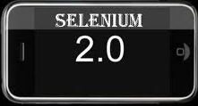

What should I know so far?
What is Selenium
What is Selenium Web driver
XPath

Slide 3

What is Android OS?
Linux-based operating system designed primarily for touchscreen mobile devices such as smartphones and tablet computers
The world's most widely used smartphone platform
Apps are written primarily in a customized version of Java

Slide 4
Why Selenium AndroidDriver?
Allows to run automated tests that ensure your site works correctly when viewed from the Android browser
Models many user interactions such as finger taps, flicks, finger scrolls and long presses
Supports all core WebDriver APIs
Supports mobile specific and HTML5 APIs
Runs the tests against a WebView (rendering component used by the Android browser)

Slide 5
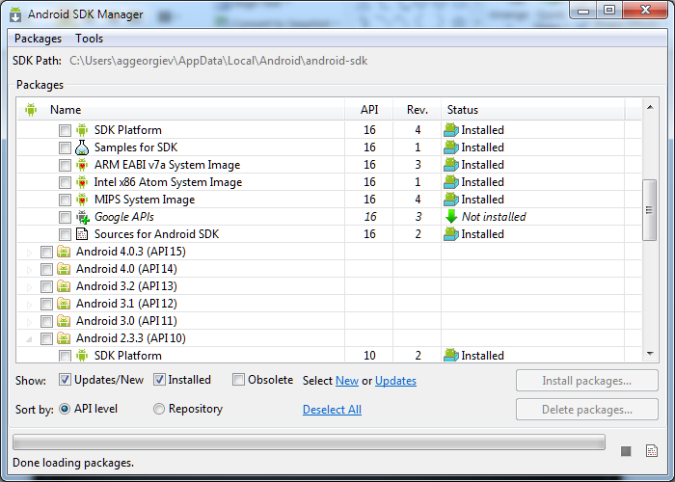
Set up the environment
Install the Android SDK
Create emulated device
Tip: Set Intel (x86) processor
for the device
Tip: For Windows: install HAXM
(Hardware Accelerated Execution
Manager – Android SDK Manager
extra)

Slide 6
Installing AndroidDriver
Terms:
APK - android application package file
Android Debug Bridge (ADB) - a versatile command line tool that let you communicate with an emulator instance or connected Android-powered device

Slide 7
Setup the device
Run "adb devices" (in ~/android_sdk/tools/) - to get the serial ID of the device or emulator you want to use:
Problem: My device is connected, but I see an empty list
Resolution:
- Assert that USB debugging is enabled
- Device is not supported from Android SDK out of the box. USB driver has to be downloaded from manifacturer’s site (for example asus transformer: support.asus.com)
Download the Android server
https://code.google.com/p/selenium/downloads/list

Slide 8
Setup the device (2)
Install the Android server
"adb -s <serialId> -e install -r android-server.apk"
Tip: Make sure you are allowing installation of application not coming from Android Market. Go to Settings -> Applications, and check "Unknown Sources".
Start the AndroidDriver application
"adb -s <serialId> shell am start -a android.intent.action.MAIN –n org.openqa.selenium.android.app/.MainActivity"
Tip: additional “-e debug true” starts the application in debug mode, which has more verbose logs

Slide 9
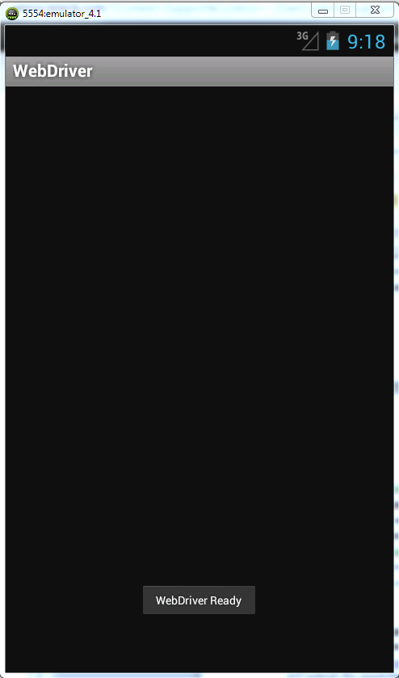
Setup the device (3)
Setup the port forwarding in order to forward traffic from the host machine to the emulator " "adb -s <serialId> forward tcp:8080 tcp:8080 "
Result: This will make the android server
available at http://localhost:8080/wb/hub
from the host machine. You're now ready to
run the tests.

Slide 10

Set Eclipse as test development IDE
Install Eclipse ADT (Android Development Tools): http://developer.android.com/tools/sdk/eclipse-adt.html
Create Java Project
Tip: Make sure you create Java Project
(not Android or Android Test Project)
because you will hit “Could not find
AndroidTest.apk” error, when you run tests.
Tip: Eclipse add-ins are installed from Help ->
Install New Software

Slide 11
Necessary references
android_webdriver_library.jar (and android_webdriver_library-srsc.jar) - should be located at ~Android\android-sdk\extras\google\webdriver
android.jar - should be located at ~Android\android-sdk\platforms
Selenium Client & WebDriver Language Bindings download from: http://selenium.googlecode.com/files/selenium-java-2.31.0.zip
Tip: To avoid conflicts set android_webdriver_library.jar and android.jar to be the last reference
Tip: Add files to build path by right-clicking on Project -> Build Path -> configure Build Path -> Libraries

Slide 12
Ready to roll
CONGRATULATIONS !
You are now ready to create test class and write tests

Slide 13
Touch event usage example
Initialize web element:
WebElement pic1 = driver.findElement(By.className("photo1"));
Initialize action
TouchActions scrollPic = new TouchActions(driver).scroll(pic1, -300, 0);
Execute action
scrollPic.perform();
Tip: Selenium click, doubleClick equal to singleTap, doubleTap for touch devices – both fire the same events

Slide 14
Sample test case
@Test
public void formsSlider() throws Exception{
//Initialize Android driver
AndroidDriver driver = new AndroidDriver();
// Navigate to page
driver.get(baseUrl + "/index.html");
WebElement formsTab = driver.findElement(By.xpath("//a[contains(@href,'/forms/index.html')]"));
formsTab.click();
Thread.sleep(2000);
// Move the slider
WebElement handle = driver.findElement(By.xpath("//a[@title='drag']"));
TouchActions scrollRight = new TouchActions(driver).scroll(handle, 150, 0);
scrollRight.perform();
Thread.sleep(2500);
// Assert result
String changedVal = handle.getAttribute("aria-valuetext");
assertTrue(changedVal.equals("100"));
}

Slide 15
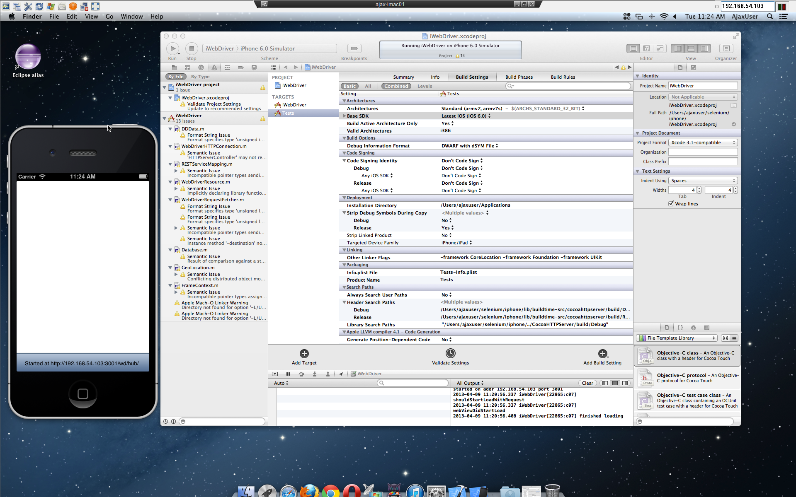
Selenium iPhoneDriver
Why Not?
iOS driver do not have any support of touch actions and gestures simulation

Slide 16
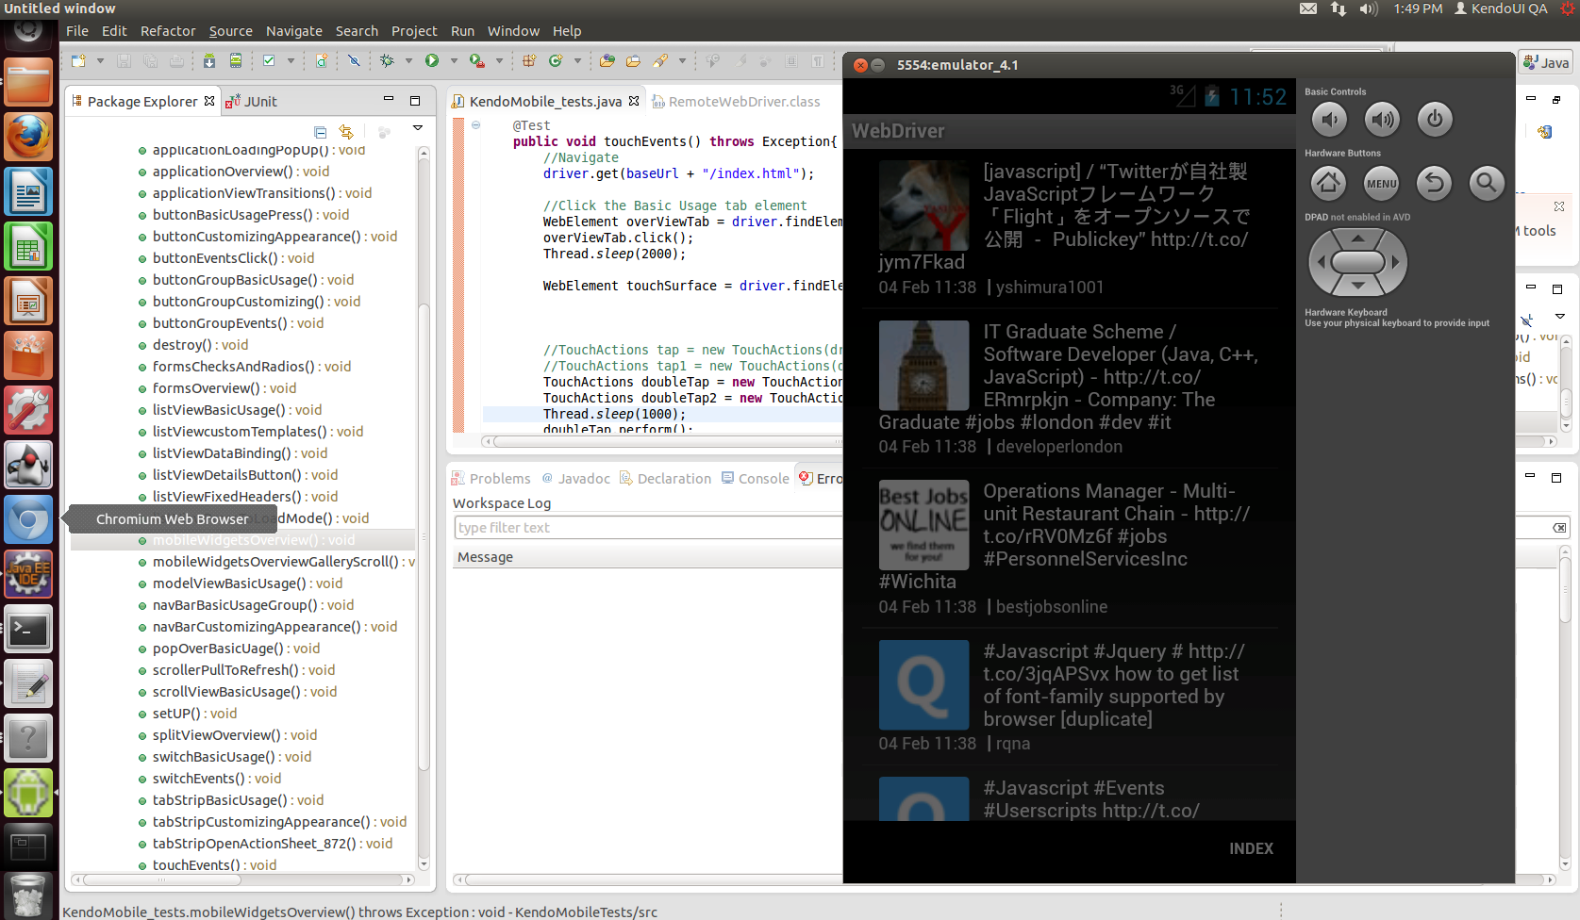
Implementation and Integration
Runs on different operating systems

Slide 17
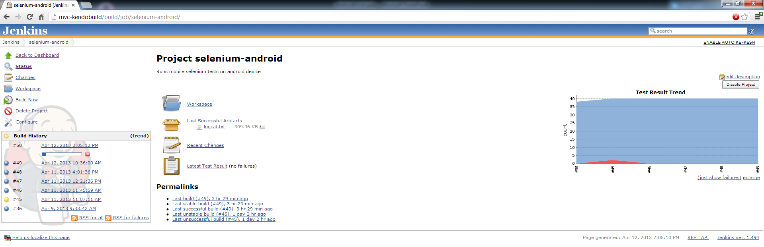
Implementation and Integration
Can be used as part of Continuous Integration
Homework
Setup the environment
Create test case for http://demos.kendoui.com/mobile/m/index.html

Slide 18
Sources
http://developer.android.com
https://code.google.com/p/selenium/wiki/AndroidDriver
http://seleniumplusplus.blogspot.com/2012/12/simulating-touch-gestures-on-ipadiphone.html
http://www.testingexperience.com/
http://wikipedia.org
Cover picture by Dimo Dimov

Slide 19

…just one more thing

Slide 20
Selenium AndroidDriver

