Slide 1


Using Appim with Ruby
for Mobile Web Testing
Atanas Georgiev
Powered by
KendoUI
Senior QA Engineer
KendoUI Team
Telerik QA Academy
http://qaacademy.telerik.com

Slide 2
Real life issues
Not able to scroll, swipe, pinch (ChromeDriver): https://bugs.chromium.org/p/chromedriver/issues/detail?id=635
Not able to start tests in Windows (Appium): https://github.com/appium/appium/issues/5713

Slide 3
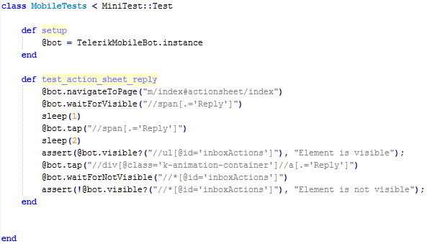
Sample test

Slide 4
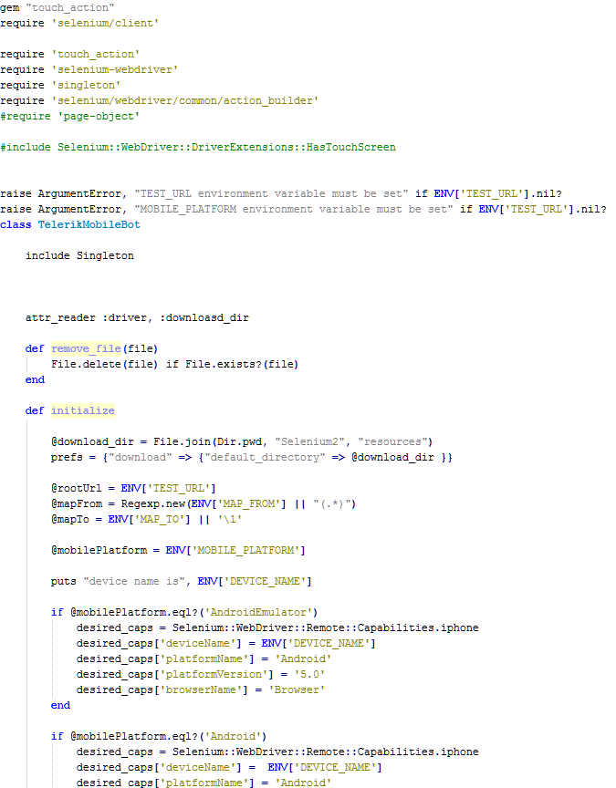
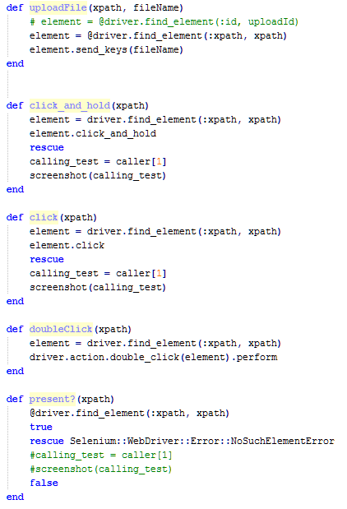
The “bot” file

Slide 5
Before we start
Start appium:
info: Welcome to Appium v1.4.13 (REV c75d8adcb66a75818a542fe1891a34260c21f76a)
info: Appium REST http interface listener started on 0.0.0.0:4723
info: Console LogLevel: debug
adb devices:
List of devices attached
08dc6adc device

Slide 6

Run:
MOBILE_PLATFORM="Android" DEVICE_NAME="08dc6adc" TEST_URL="http://kendobuild/
staging-kendo-ui/" MAP_FROM="web\/(.*)\.html" MAP_TO='\1' ruby ActionSheet.rb
Run options: --seed 58933

Slide 7
Why not on Simulator?
No Chrome installed on Android simulators
Workarounds suggested here:
https://github.com/appium/appium/issues/1702

Slide 8
Tools Used:
Droid@Screen
http://playingwithsid.blogspot.com/2012/03/how-to-display-your-android-screen-on.html
ASM
https://code.google.com/p/android-screen-monitor/

