Slide 1

THE UNIVERSITY OF DODOMA
GROUP ASSIGNMENT
GROUP NUMBER | : | 09
MODULE NAME | : | MICROCONTROLLER
MODULE CODE | : | CT 321
FACILITATOR | : | Dr. CRALLET VICTOR
SEMESTER | : | TWO
ACADEMIC YEAR | : | 2025 / 2026
S/N | NAME | REG NUMBER | PROGRAMME
1 | JOHN MURESA | T23-03-15878 | BSC CE
2 | ISMAIL ABDALLAH | T23-03-15805 | BSC CE
3 | JOSEPHAT MARCO KAPELA | T23-03-15007 | BSC CE
4 | MAGRETH ADRIAN | T23-03-16428 | BSC CE

Slide 2
ATmega32 External Event Object Counter
This project centers on the design, architectural formulation, and structural implementation of a reliable External Event Object Counter built around the high-performance, low-power 8-bit ATmega32 AVR RISC-based microcontroller.

Slide 3
Comprehensive Project Context & Theoretical Problem Statement
Industrial Context: Automated manufacturing assembly lines, sorting facilities, and conveyor networks demand precise edge-point logging for high-speed moving parts.
The Polling Paradigm Flaw: Continuous execution loop polling—using sequential conditional checks like if (PIND & (1 << PD2)) inside a while(1) block—wastes CPU processing cycles and limits scaling.
The Fatal Latency Window: If a high-frequency object cuts a sensor beam while the CPU is executing multi-cycle LCD rendering updates or timing delay loops, the pulse transition goes entirely undetected.
The Engineering Solution: Transition the input signal path to a dedicated hardware-driven External Interrupt line ($INT0$). This completely separates input signal capture from visual output processes.

Slide 4
System Architecture & Subsystem Deconstruction
Central Processing Core: ATmega32 8-bit MCU running a low-power internal clock matrix.
Asynchronous Input Stage: High-speed edge trigger sensor line routed straight to pin 16, corresponding to the hardware External Interrupt 0 pin ($PD2 / INT0$).
Visual Telemetry Interface: High-bandwidth 8-bit parallel connection bus bridging Port C (PC0 through PC7) directly to an alphanumeric 16x2 LCD module.
Hardware Strobe Control Lines: Dedicated General Purpose Input/Output (GPIO) pins assigned to Register Select (RS) for instruction parsing, and Enable (E) for locking data characters.
Local System Status Beacon: An active-high, high-efficiency indicator LED tied to pin PB2 to give immediate hardware confirmation for every counted pulse.

Slide 5
Simple Code Settings (Registers)
Port Direction Definitions:
DDRC = 0xFF; Establishes Port C as an output bus for the LCD character grid.
DDRD &= ~(1 << PD2); Configures pin PD2 as a dedicated input line.
Pull-Up Noise Isolation:
PORTD |= (1 << PD2); Activates the internal pull-up resistor, keeping the input stable at $+5\text{V}$ and preventing floating line errors.
Hardware Edge Configuration:
MCUCR |= (1 << ISC01); MCUCR &= ~(1 << ISC00); Codes the Microcontroller Control Register to monitor for a clean falling edge.
Interrupt Masking & Initialization:
GICR |= (1 << INT0); Unmasks the external interrupt channel.
sei(); Activates global execution by setting the assembly I-bit inside the status register (SREG).

Slide 6
Firmware Flow, Stack Management & Asynchronous Execution
The Background Loop Execution: Main program path executes a continuous task loop focused on string conversion (itoa), status checks, and redrawing data onto the LCD.
The Asynchronous Event Trigger: When an object triggers the sensor, the CPU immediately pauses main loop operations, saves its position by pushing the program counter to the hardware stack, and jumps to the interrupt vector table.
Vector Target: ISR(INT0_vect) execution path.
Vector Operations Phase:
Increments the objectCount tracking variable directly inside the internal RAM.
Toggles pin PB2 High to drive the status indicator LED.
Executes a brief software window to debounce input signals.
Pulls pin PB2 Low, pops the stack, and returns straight to the background loop.

Slide 7
System Schematic Capture Design
Full design capture using the professional KiCad Electronic Design Automation (EDA) software suite.
Pin-accurate connections modeled for the dual-in-line 40-pin (DIP-40) ATmega32 socket footprint.
Clean decoupling capacitor placement across power rails to smooth out voltage ripples.
Standardized terminal block placements for power, external sensor connections, and peripheral links.

Slide 8
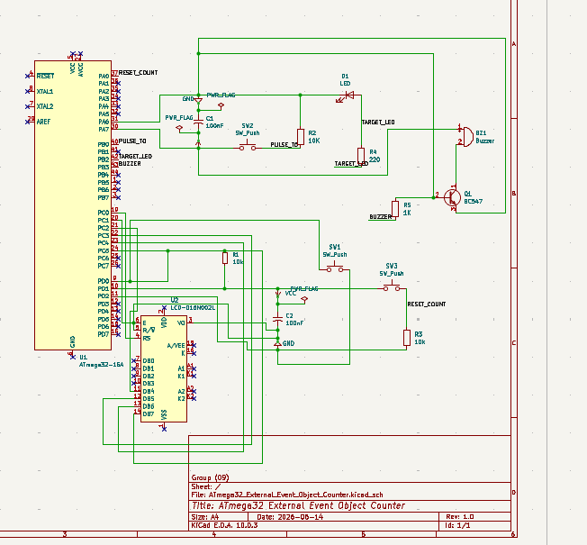
Complete KiCad Schematic Sheet showing all components and wire nets

Slide 9
Functional Simulation Emulation & Validation testing
Testbed Toolchain: Simulated environment verified inside the SimulIDE engine.
Functional Evaluation: The compiled .hex machine file was injected into the virtual ATmega32 core model.
Dynamic Pulse Stress Testing: Input signal sources injected continuous square-wave pulses up to 50 Hz directly into the input line.
Observed Performance: The interrupt system captured 100% of incoming signals, successfully displaying real-time text counts on the LCD panel with zero software lockups.

Slide 10
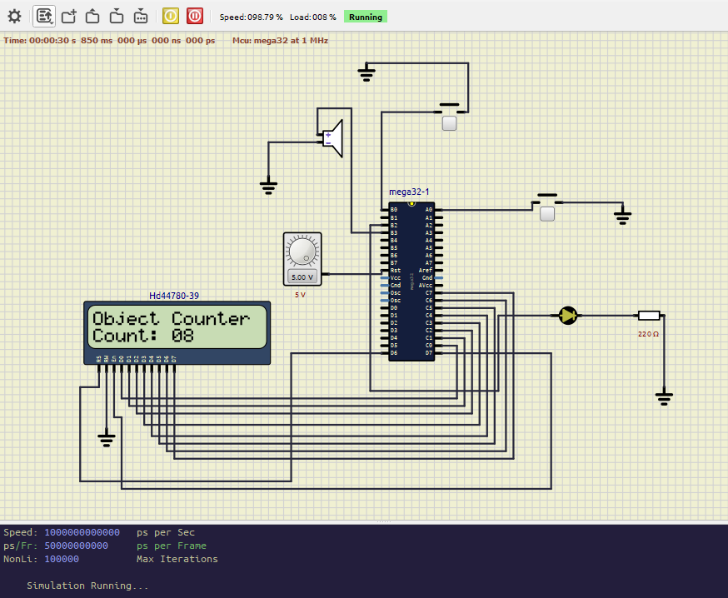
Active SimulIDE workspace running the simulation

Slide 11
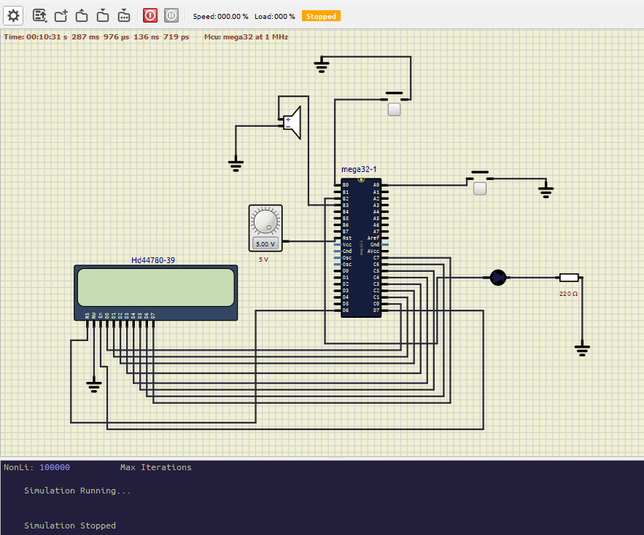
SimulIDE workspace STOPPING the simulation

Slide 12
Advanced Single-Layer PCB Optimization Strategies
Manufacturing Constraint: Restricted to a single-sided copper layout, meaning tracks cannot use vias to pass through to alternate board layers.
Curved Trace Tracking Geometry: Swapped out standard 45-degree trace angles for smooth, rounded Curved Traces along the 8-bit data bus to optimize track spacing.
Central Channel Bridging: System power rails and ground returns are routed directly through the vacant space under the central socket of the ATmega32 chip to save board space.
Jumperless Optimization: Traces are carefully routed directly beneath stationary axial resistor bodies, using the component bodies as insulation bridges to eliminate jumper wires.

Slide 13
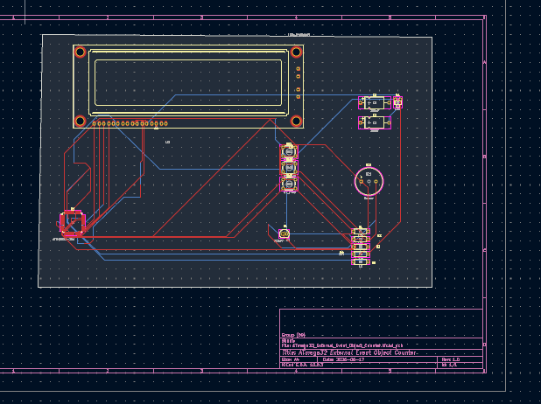
KiCad 2D Copper Trace PCB Layout Grid showing curved paths

Slide 14
3D Mechanical Inspection & Layout Audit
Automated Inspection: Layout checked via KiCad’s internal Design Rules Check (DRC) engine.
Audit Metrics: Confirmed 0 unconnected nets, 0 track clearance errors, and 0 thermal pad issues.
3D Mechanical Alignment: Verified physical spacing clearances for terminal blocks, trimmer resistors, and display headers.
Industrial fabrication files generated via full Gerber data package export.

Slide 15
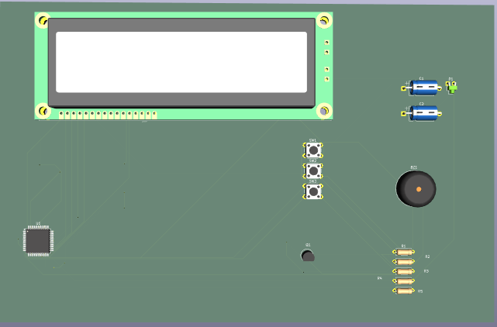
KiCad 3D Viewer Renders showing Top Component

Slide 16
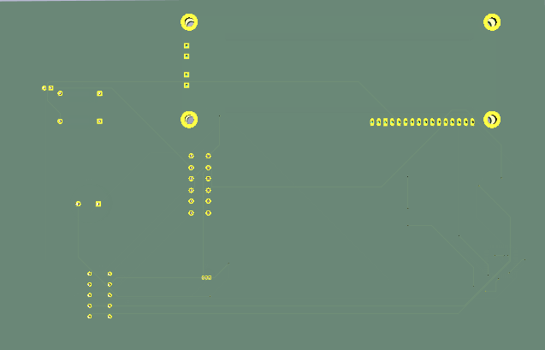
KiCad 3D Viewer Renders showing Bottom Copper Trace views

Slide 17
Engineering Directory Architecture & Version Control
Industry-Standard Architecture: Modular file organization built into a structured project directory.
Directory Layout:
firmware/ Hosts our application C files, system header code, and compiled production .hex files.
kicad/ Contains schematic sheets, board files, and exported Gerber manufacturing packages.
simulide/ Preserves the virtual circuit layout files and simulation datasets.
documentation/ Coordinates system block diagrams and pin allocation charts.
Incremental Commit Tracking: Repository managed on GitHub using intentional, milestone-based updates to show clear project progression.

Slide 18
System Summary & Performance Metrics
Low-Latency Edge Node: Successfully engineered a real-time, low-overhead counting device.
Deterministic Acquisition: Edge-detection hardware eliminates input pulse loss up to a tested frequency of 50 Hz.
Efficient Code Footprint: Register-level configurations optimize flash memory use, leaving plenty of room for future features.
Manufacturing Ready Layout: Compact single-layer board layout achieved with zero jumper wires, cutting down on physical points of failure.

Slide 19
Technical Defense Open Floor
Thank you for your time. The floor is now open for questions and technical discussion.
https://github.com/naslaizer/ATmega32_External_Event_Object_Counter

