Slide 1
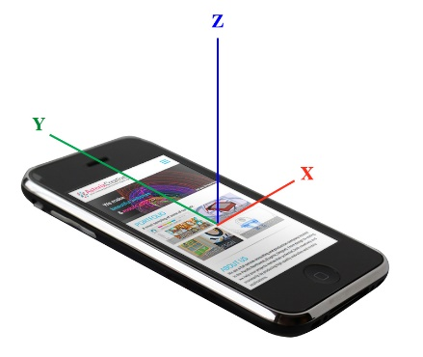
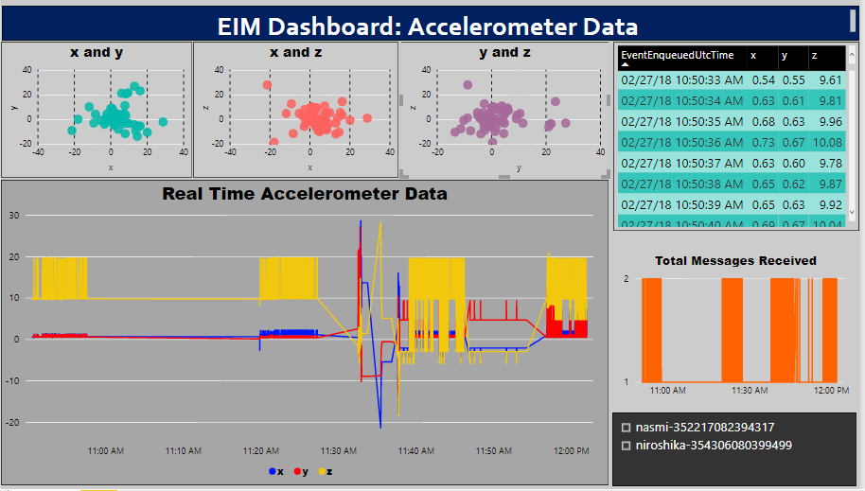
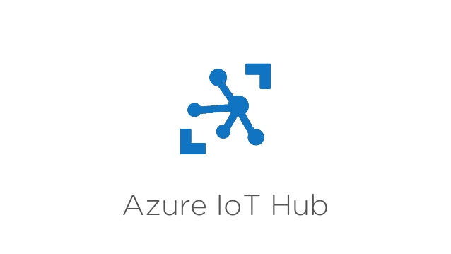
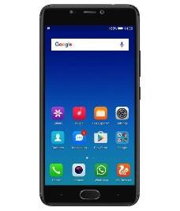

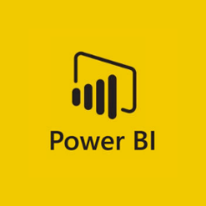
Enterprise Information Management (EIM) Practice
Real Time Accelerometer Dashboard
How it Works
Mobile Device
Ingestion
Analytics
Dashboard
Mobile device: Upon shaking the Android device, the accelerometer sensor data (x,y,z) is sent to the IoT Hub on the cloud.
IoT Hub: This is an ingestion service that collects the raw sensor data. From here, the data is routed to the Stream Analytics.
Stream Analytics: This analytics service allows the sensor data to be transformed. The data is passed through here in to Power BI.
Power BI: This is a data visualization tool, where the real time dashboards have been created.
Try it …
All the necessary code and steps, to recreate the demo (including the Android application) is provided at the link below:
https://github.com/nasmii/Send-Android-sensor-data-to-Microsoft-Azure-Cloud

