Slide 1

INVESTOR PITCH · CONFIDENTIAL
01 / 13
The AI merchandiser every Walmart has and the 500-store chain wants.
Merchandising Copilot for Mid-Size Retailers
Team | Track | Owns
Leticia | IT | Data pipeline, LLM layer, recommendations, frontend (shared)
Justus | IT | Forecasting, RAG, scripts, deployment, frontend (shared)
Marie | Product | Business Plan, ROI story, unit economics
Alexander | Business | Pitch deck, demo script, GenAI log compilation
2758-T4 Advanced Topics in Machine Learning
Nova School of Business and Economics
DATE: dd.mm.yyyy
merchai.io
02
Notes:
Good morning. We're MerchAI. The single line we want you to remember is on this slide — we're building the AI merchandiser every Walmart already has, but the 500-store chain still can't afford. Over the next ten minutes we'll show you a working prototype, the math behind a 92% gross margin business, and what we want from you today.

Slide 2
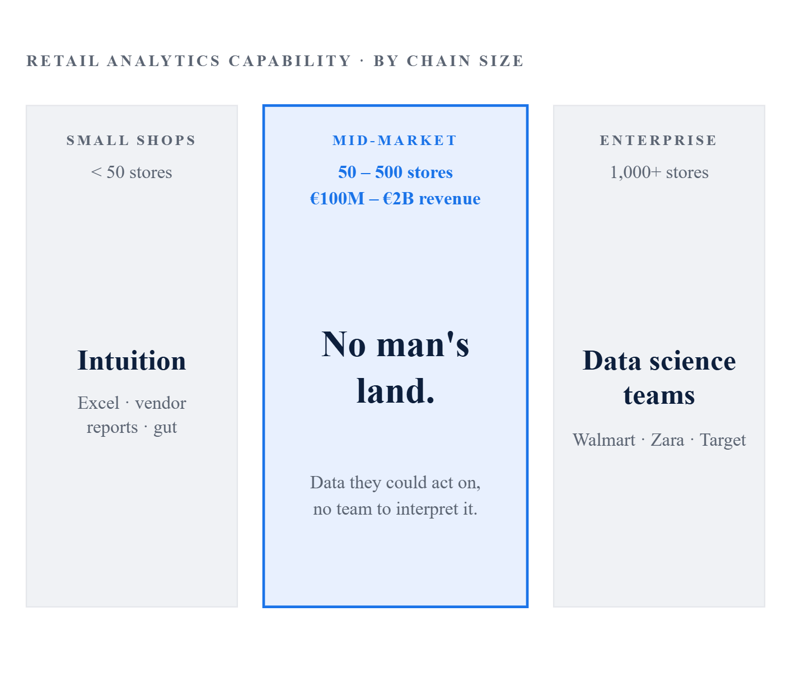

01· PROBLEM
02 / 13
THE PROBLEM
Mid-market retailers bleed margin every day because their data sits unused.
Three failure modes recur in every chain we've spoken to. None are unsolvable - they are translation problems.
THE THREE DAILY FAILURE MODES
THE MID-MARKET GAP
01 / LATE
Late markdowns.
Inventory held too long at full price, then liquidated under time pressure. Margin gone.
02 / SLOW
Replenishment latency.
Demand spikes on winning SKUs detected too late. Stockouts during peak sell-through.
03 / BLIND
Promo blind spots.
Promotional uplift systematically underestimated. Inventory shortfalls on launch.
Many mid sized companies assume advanced analytics is out of reach.
But AI and machine learning now make powerful insights affordable and easy to use.
Source: MerchAI customer interviews; McKinsey Retail AI 2024
02
Notes:
Here's the problem. Mid-market retailers — fifty to five hundred stores, a hundred million to two billion in revenue — are too big to run on intuition and too small to staff a data science team. Every day they leak margin in three places: late markdowns, replenishment latency, and promo blind spots. The data sits in the POS. Nobody acts on it.

Slide 3
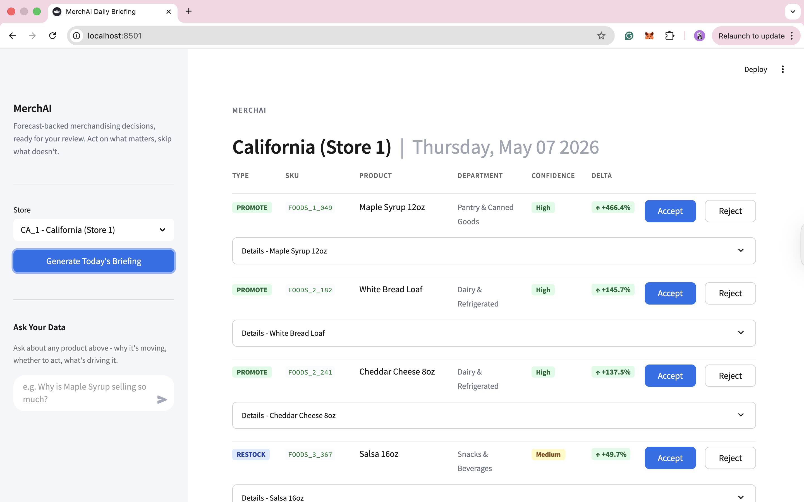
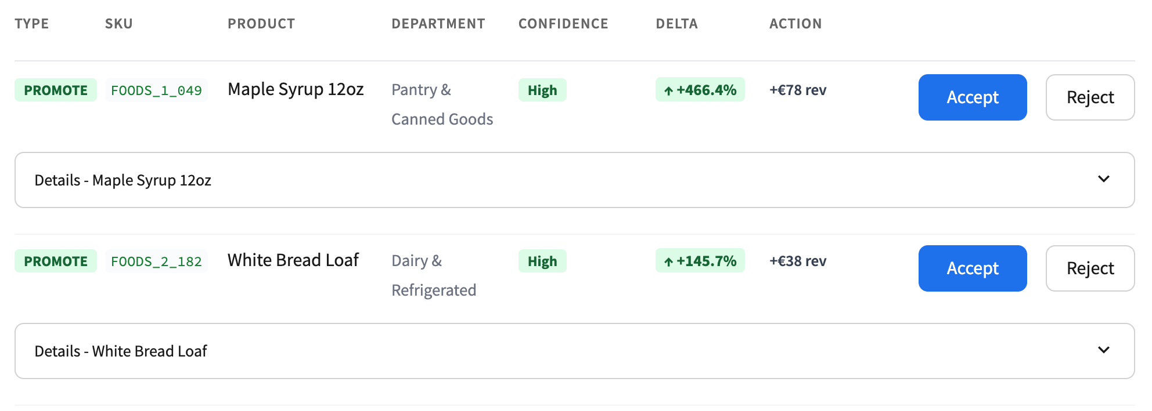
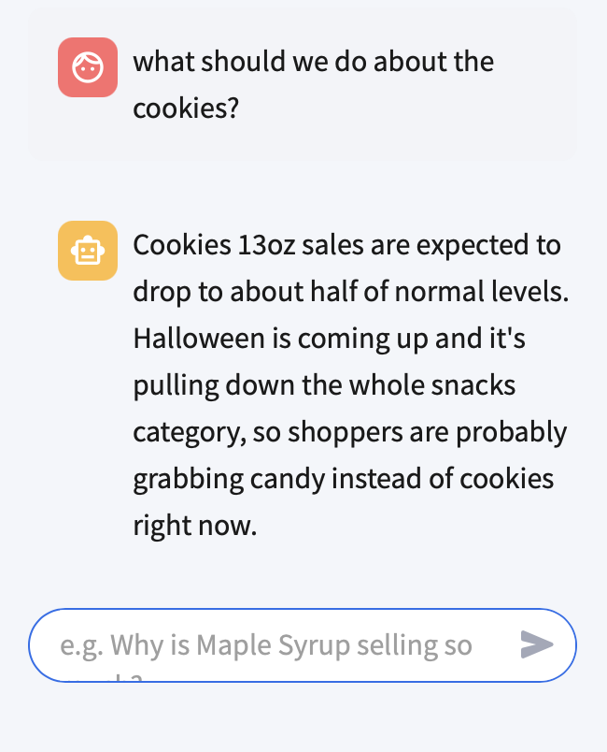
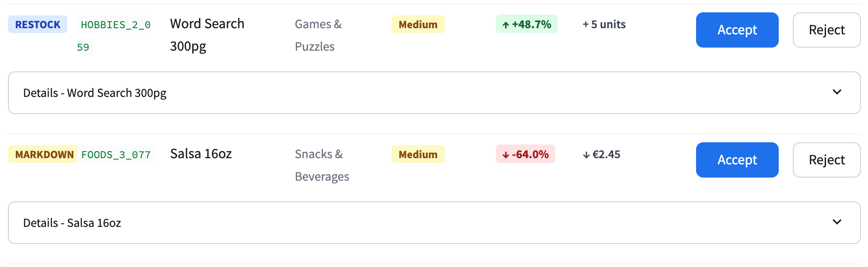
02 · SOLUTION
03 / 13
THE SOLUTION
MerchAI delivers a daily AI briefing:
decisions, not dashboards.
Every morning the manager opens one screen and sees what to do, why, and how confident the system is.
WHAT THE MANAGER SEES
BRIEFING UI: LIVE PROTOTYPE
01
Colour-coded briefing cards · Markdown, Restock, Promote
02
Confidence badges · High / Medium / Low, derived from signal magnitude
03
Guard check results · expandable panel showing what was verified
04
Recommended Action · system pre-calculates the optimal move (Promote, Restock, or Markdown) with projected margin impact
05
One-click Accept / Reject · system pre-calculates the exact action
06
Ask Your Data · plain-English Q&A grounded in the live forecast
THREE DECISION TYPES
PROMOTE
Push this product harder. Offensive action - capitalise on growth potential.
RESTOCK
Order more before you run out. Reactive action - meet an incoming demand spike.
MARKDOWN
Cut the price before it expires. Defensive action - protect margin on slowing demand.
Streamlit dashboard · prototype on M5 Walmart data
03
Notes:
Our solution is a daily AI briefing. Not a dashboard. The store manager opens their laptop and sees colour-coded cards: mark this down, restock that, promote this one. Every card has a confidence badge, a citation, and a one-click accept or reject. We deliver decisions, not charts.

Slide 4
03 · HOW IT WORKS
04 / 13
THE PIPELINE
Five layers from raw POS to a cited, verified recommendation in under 60 seconds.
The LLM translates - it does not generate the numbers. The forecast does.
01 · FORECAST
02 · RETRIEVE
03 · REASON
04 · VERIFY
05 · DELIVER
LightGBM
RAG · ChromaDB
Claude Sonnet 4.6
Hallucination Guard
Streamlit
Per-store demand model. Outputs SKU-level delta_pct vs. 28-day baseline.
282 context docs · SNAP, seasonality, weekday, price elasticity, YoY.
Translates forecast + context into plain-language recommendation with citations.
54-phrase intent check + numeric regex with 2× tolerance.
Briefing cards · confidence badges · accept / reject · audit trail.
Trained on Walmart M5
Tightly scoped retrieval.
Translator, not oracle.
Numbers must match.
Decision-ready output.
(Kaggle), then fine-tuned on the store's own POS history. Pure mathematical prediction
no LLM involved at this stage.
Re-weights the raw forecast against store-specific context (SNAP weeks, weather, promo calendar). The LLM only ever sees what we feed it.
System prompt explicitly forbids inventing figures. Claude rewrites the forecast into manager-readable language.
Every figure in Claude's output is regex-checked against the input. Mismatch > 2% triggers a re-prompt.
Verified card with citations + accept/reject buttons. Every action logged for the audit trail.
NUMBERS FROM
WORDS FROM
CYCLE TIME
LightGBM
Claude Sonnet 4.6
< 60s
Trained per store on real POS data - never the LLM.
Constrained to verbatim citation of forecast values.
From overnight POS load to a manager's screen,
per store.
DESIGN PRINCIPLE
The LLM is a translator, not an oracle. Hallucinations on the numeric layer are blocked at step four - before the manager ever sees the card.
Pipeline runs nightly · CPU-only forecasting · ChromaDB self-hosted
04
Notes:
Under the hood, five layers. A LightGBM forecast produces the numbers. RAG retrieval pulls relevant historical context. Claude reasons over it and writes the recommendation. A two-layer hallucination guard verifies the output. Then the dashboard delivers it. Crucially — the LLM translates, it does not invent the numbers.

Slide 5
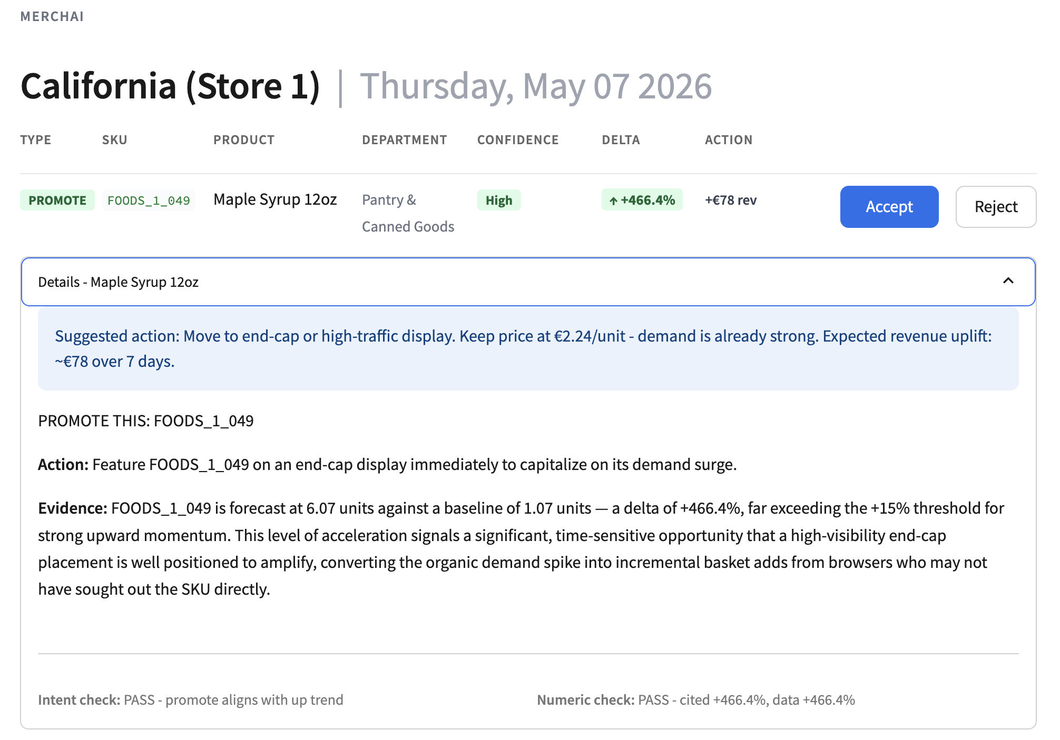
04 · PROTOTYPE
05 / 13
PROTOTYPE IN ACTION
Working prototype live on M5 Walmart data across three stores.
Not a deck demo. A running pipeline you can interrogate today.
PROOF POINTS
LIVE BRIEFING CARD · CA_1
Forecast accuracy (28-day holdout)
Stores running
WRMSSE 0.74
3 · CA_1, CA_2, TX_1
RAG context corpus
Hallucination guard phrases
382 documents
54
Recommendation types
Audit trail
Promote / Restock / Markdown
FULL · TIMESTAMPED
Built end-to-end by the four-person team in the course's project window. The same pipeline can ingest a partner chain's POS extract on day one.
Dataset: M5 Forecasting Competition · Kaggle · 42,840 SKUs × 1,941 days
05
Notes:
This is not a slide deck demo. We have a working prototype running on the M5 Walmart dataset across three stores. WRMSSE 0.74 on a 28-day holdout. 57 RAG context documents. 54-phrase hallucination guard. Three recommendation types, full audit trail. We'd love to walk you through it after the pitch.

Slide 6
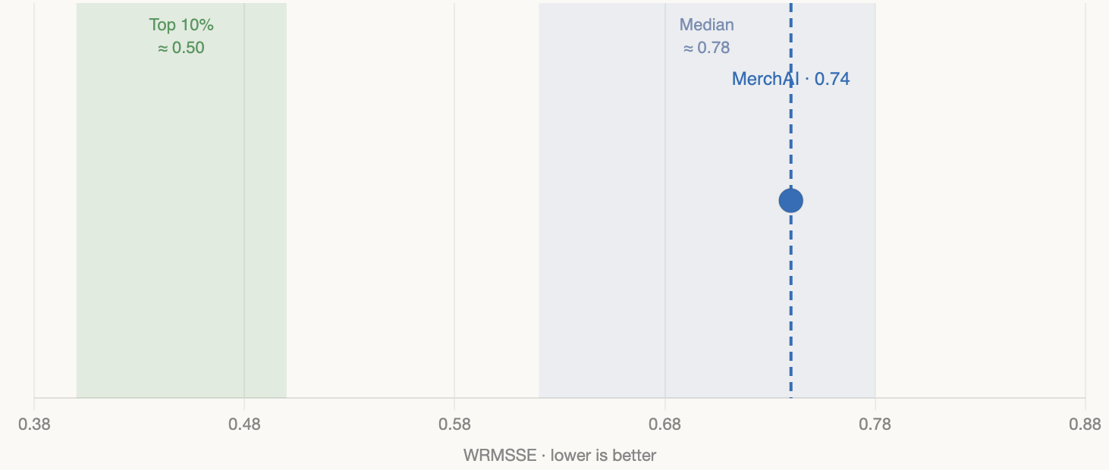
05 · PERFORMANCE
06 / 13
FORECASTING PERFORMANCE
WRMSSE 0.74 on a 28-day holdout. Clear path to top-decile.
M5 Forecasting Competition · Kaggle / Walmart · 5.8 million row feature matrix.
DATASET & MODEL
BENCHMARK · M5 PUBLIC LEADERBOARD
Stores
3 · CA_1, CA_2, TX_1
SKUs · Days
42,840 × 1,941
Feature matrix
5.8M rows × 22 cols
Model
LightGBM · per-store
PER-STORE WRMSSE
STORE
WRMSSE
CA_1
0.7425
Per-store models, consistent results: the pipeline scales to any store on day one
CA_2
0.7259
TX_1
0.7615
Path to top-decile: additional lag windows (7d/14d/56d/84d) · leaf-count tuning · SNAP-aware feature crosses.
Overall
0.74
Source: M5 Forecasting Competition · Kaggle 2020 · public leaderboard
06
Notes:
Appendix four — full financial model. Three scenarios, full operating cost stack, complete LTV-CAC table. The headline: 92% gross margin holds across pilot, growth, and scale phases. Operating costs are dominated by team salaries, not infrastructure.

Slide 7
06 · GUARD
07 / 13
HALLUCINATION GUARD DEEP DIVE
Two layers, both deterministic. No second LLM call. Auditable, fast, free.
LAYER 1 · INTENT CHECK
WORKED EXAMPLE
01
54 retail action phrases · markdown / restock / promote vocabulary, calibrated.
# source forecast
02
Deterministic substring matching · zero inference latency.
delta_pct = +419.6%
03
Why not a second LLM call? · cost, drift, opacity. We need a verdict we can ship to compliance.
# case A · LLM output
"Forecast +419.6% vs baseline. Recommend immediate replenishment."
INTENT ✓
NUMERIC ✓
VERDICT · PASS
LAYER 2 · NUMERIC CHECK
# case B · LLM output
"Forecast +200% vs baseline. Recommend immediate replenishment."
01
Regex extraction of every numeric value in the LLM output.
INTENT ✓
NUMERIC ✗
VERDICT · FAIL
02
2× tolerance band against the source forecast: catches fabricated precision while allowing rounding.
200 is outside the 2× band of 419.6 (low=210, high=839). Card is dropped from the briefing and logged for prompt review.
03
Cited value must round-trip · LLM cannot invent a number not present in the source forecast.
guard_v1.py · 54 phrases · 2× tolerance band
07
Notes:
Appendix two — the system prompt we ship in production. Three deliberate design decisions. Role anchoring locks Claude into a retail merchandiser persona. Strict data rules force verbatim citation of forecast numbers. One-recommendation-per-call output keeps the format machine-parseable.

Slide 8
07 · MARKET
08 / 13
MARKET OPPORTUNITY
A €1.1B European TAM sitting between tools too cheap and suites too expensive.
2,000+ chains × 150 stores avg. × €300/store/month = €1.1B addressable in Europe alone
THE MATH
POSITIONING · PRICE × COMPLEXITY
European chains in target band
2,000+
Average stores per chain
150
Blue Yonder
Price per store / month
€300
Relex
ToolsGroup
European TAM (ARR)
€1.1B
Nextail
COMPLEXITY →
TARGET CUSTOMER PROFILE
Daisy
Intelligence
50–500 stores · €100M – €2B revenue DACH · Benelux · Iberia Apparel, footwear, sporting goods, home, grocery Decision makers: CMO, Head of Buying
MerchAI
SWEET SPOT
Generic BI
dashboards
PRICE →
Sources: McKinsey Retail AI 2024; Statista European retail chains; bottom-up estimate
08
Notes:
The market. There are roughly two thousand European retail chains in our target band. At 150 stores average and 300 euros per store per month, that's a 1.1 billion euro ARR opportunity in Europe alone. We sit between Relex at the top — too expensive, twelve-month implementations — and generic BI dashboards at the bottom that don't tell you what to do.

Slide 9
08 · BUSINESS MODEL & ECONOMICS
09 / 13
BUSINESS MODEL & UNIT ECONOMICS
€300 per store / month. 92% gross margin. First paying chain crosses break-even alone.
UNIT ECONOMICS
REVENUE RAMP & LTV / CAC
PER BRIEFING
FULLY LOADED /STORE/MO
SELLING PRICE /STORE/MO
SCENARIO
STORES
MONTHLY REV
GM
€0.05
€25
€300
Pilot Month 6
50
€15,000
92%
9 calls · 804 input + 220 output tokens / call · Claude sonnet 4.6
LLM €1.42 + hosting/ChromaDB/ops ~€23.50
Mid-market budget - no committee
Early Growth Month 18
500
€150,000
92%
BREAK-EVEN
Scale Month 36
3,000
€900,000
92%
OpEx €21,500/mo ÷ contribution margin €275/store = 78 stores to break-even.
78
stores
LTV PER CHAIN
CAC · FOUNDER-LED
€1.5M
€8k
92% gross margin at €300 sticker
OpEx €21,500/mo ÷ contribution margin €275/store = 78 stores
LTV / CAC · LAUNCH
AT SCALE · PHASE 3
SAAS BENCHMARK
IMPLICATION
The first paying chain crosses break-even on its own
188 : 1
43 : 1
3 : 1
COST STACK
Founder-led GTM at launch; full sales team at scale; SaaS healthy benchmark.
Full breakdown in Appendix A2: Financial Model.V
09
Notes:
On profitability — the first paying chain puts us into the black. Founder-led CAC is 8 thousand euros. Lifetime value is 1.5 million per chain. That's an LTV-to-CAC of 188 to 1 at launch. Even at scale with a real sales team, we stay at 43 to 1. The benchmark is 3.

Slide 10
09· COMPETITION
10 / 13
COMPETITIVE LANDSCAPE
We are not competing with Relex. We are filling the gap they left behind.
Action-oriented, mid-market priced, days to deploy.
VENDOR
TARGET SEGMENT
PRICE POINT
ACTION-ORIENTED?
DEPLOYMENT
Relex
1,000+ store enterprise
ACV > €1M
DASHBOARDS
12–24 months
Blue Yonder (JDA)
500+ store enterprise
ACV > €1M
DASHBOARDS
Heavy integration project
ToolsGroup
Mid-to-large chains
High six figures
DASHBOARDS
Multi-month rollout
Nextail
Fashion retailers only
Mid-market
SINGLE VERTICAL
Apparel-only scope
MerchAI
50–500 store mid-market
€200–500 / store / mo
DECISIONS · CITED
Days, not months
DIFFERENTIATOR · 01
DIFFERENTIATOR · 02
DIFFERENTIATOR · 03
Decisions, not dashboards.
Mid-market priced, no procurement committee.
CSV-to-briefing in days, not 12-month integrations.
Sources: vendor websites; analyst reports; MerchAI competitive scan April 2026
10
Notes:
Competitive landscape. We are not competing with Relex. Relex serves enterprises with thousand-store estates and twelve-month deployments. We serve the mid-market that Relex priced out. Decisions, not dashboards. Days, not months.

Slide 11



10 · DEFENSIBILITY
11 / 13
DEFENSIBILITY & MOAT
Three compounding moats - none of which OpenAI can replicate as a feature.
Defensibility doesn't rest on any single feature. It rests on three structural advantages that accrue with usage.
MOAT 01
MOAT 02
MOAT 03
Decision Data Flywheel
Workflow Embedment
POS Integration Depth
Every accept / reject / modify is logged with the underlying data snapshot. By Year 3, recommendations are calibrated to that chain's seasonal patterns and buyer preferences. No competitor can replicate 3 years of decision history without running the product for 3 years.
The morning briefing becomes the manager's routine - the screen they open before the coffee is poured. Switching means rebuilding a process , not just swapping software. That is operational switching cost, not technical.
Our value requires the retailer's transaction data, SKU catalogue, and price history. OpenAI has no access and no incentive to build 1-to-1 ERP connectors . The data layer is the product, not the LLM.
COMPOUNDS WITH USAGE
RAISES SWITCHING COST
STRUCTURAL · NOT FEATURE-LEVEL
"Wrapper risk" check: each moat is structural, not LLM-feature-level
11
Notes:
On defensibility — three compounding moats. The decision data flywheel: every accept and reject builds a preference dataset unique to that chain. Workflow embedment: the morning briefing becomes the routine. POS integration depth: our value requires the retailer's transaction data, which OpenAI has no access to and no incentive to integrate.

Slide 12
11 · GO TO MARKET
12 / 13
GO-TO-MARKET
Two design partners in six months. Three paying chains by Month 18.
A staged path from free pilot to ERP channel partnership.
PHASE 01 · MONTHS 1 – 6
PHASE 02 · MONTHS 7 – 18
PHASE 03 · MONTHS 19 – 36
Design Partners
Paid Commercialisation
Scale
Free pilot · co-development access
CSV-based POS integration · no ERP yet
Warm intros + LinkedIn outreach to CMOs
Two partners in apparel or sporting goods
Convert design partners to paid contracts
3–5 paying chains acquired via case study
ERP connector v1 (SAP, Microsoft Dynamics)
€200–500 / store / month tiered pricing
ERP vendor channel partnerships
DACH + Benelux geographic expansion
Multi-tenant architecture
First AE hires; founder transitions to pipeline
→ TARGET · 60% manager adoption rate
→ TARGET · 4:1 ROI documented in pilot chain
→ TARGET · 3,000 stores · €900k MRR
M6
M12
M18
M36
2 partners
First paid
3–5 chains
3,000 stores
GTM v1.2 · subject to pilot learning · founder-led through Month 12
12
Notes:
Go-to-market. Two design partners in six months. Three to five paying chains by month 18. ERP channel partnerships in the scale phase. We're already running founder-led outreach to category managers across the DACH and Benelux regions.

Slide 13
12 · TEAM & THE ASK
13 / 13
TEAM & THE ASK
Four builders. One product. Ready to find our first design partner.
THE TEAM
THE ASK
NAME
TRACK
KEY CONTRIBUTION
Leticia
Forecasting
LightGBM pipeline · WRMSSE 0.74 · feature engineering on 5.8M rows
WHAT WE WANT FROM YOU TODAY
Justus
LLM & RAG
Claude integration · ChromaDB context store · prompt architecture
ONE MID-SIZE RETAIL CHAIN. 90 DAYS. THEIR POS DATA.
Marie
Product / UX
Streamlit briefing UI · confidence badges · Ask-Your-Data interface
Alexander
Business / GTM
Market sizing · unit economics · design-partner outreach
In exchange: a working daily briefing system on their own data, full co-development input on the roadmap, and a measurable margin-improvement target inside the pilot window.
Course: 2758-T4 Advanced Topics in Machine Learning · Nova SBE · April 2026. Prototype shipped end-to-end within the project window.
90
€0
4 : 1
DAY PILOT
PILOT FEE
ROI TARGET
Intros welcome - DACH, Benelux, Iberia. Apparel · footwear · sporting goods · home · grocery.
Thank you · Q&A · merchai.io · contact@merchai.io
13
Notes:
Our team and our ask. Four builders — two engineers, one business, one operations. We've shipped the prototype. What we want from you today: one mid-size retail chain willing to run a free 90-day pilot on their own POS data. In exchange, a working briefing system and co-development input. Thank you.

Slide 14
APPENDIX
A · 3 SLIDES
APPENDIX · FOR THE DEEPER QUESTIONS
Hallucination guard · Prompt architecture · Forecasting performance · Full financial model · GenAI transparency.
A1 – A5 · approximately 5 minutes if read end-to-end
—
Notes:
Appendix one — the hallucination guard. Two layers. Intent check: 54 retail action phrases, deterministic matching. We chose deterministic over a second LLM call because it's faster, free, and auditable. Numeric check: regex extraction with 2x tolerance. The example shows it catching a fabricated number while passing a correctly cited one.

Slide 15
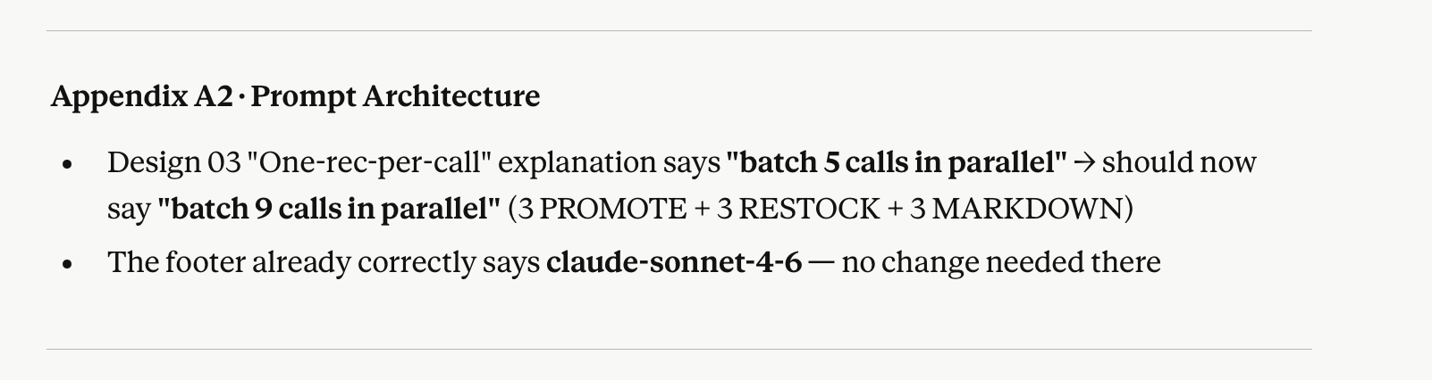
MERCHAI
APPENDIX · A1
A1 / A4
A1 · PROMPT ENGINEERING ARCHITECTURE
Three deliberate decisions: role anchoring, verbatim citation, one-call-one-rec.
SYSTEM PROMPT · PRODUCTION VERBATIM
WHY THESE THREE DECISIONS
# role anchoring You are a retail merchandising analyst producing daily action recommendations
for a single store manager.
# strict data rules - Cite forecast values verbatim ; do not
paraphrase, round, or estimate numbers.
- Use only RAG context provided. Do not
invent SNAP weeks, holidays, or events.
- If signal is ambiguous, say so.
# output format Return exactly one recommendation per
call. Schema:
{
"sku" : "<id>",
"action_type" : "MARKDOWN | RESTOCK | PROMOTE",
"confidence" : "HIGH | MEDIUM | LOW",
"rationale" : "<text with citations>",
"cited_values" : ["+419.6%", "18 units"]
}
DESIGN 01
Role anchoring.
Update Numbers
Locks Claude into the merchandiser persona. Refuses out-of-scope requests at the system layer rather than relying on downstream filtering.
DESIGN 02
Strict data rules.
Verbatim citation makes the numeric guard useful. Without it, the LLM paraphrases ("about 400%") and the regex check has nothing to match against.
DESIGN 03
One-rec-per-call.
Machine-parseable JSON. Failures in one card don't pollute the others. Lets us batch 5 calls in parallel and reject cards individually.
USER PROMPT STRUCTURE
PART 01
PART 02
Forecast Summary
Historical Context
SKU · delta_pct · stock
RAG · 3 docs from 382
prompt_v1.4 · claude-sonnet-4-6 · temp 0.2
A1
Notes:
Appendix three — forecasting performance. LightGBM trained on M5. Three stores, 42 thousand SKUs, 5.8 million rows. WRMSSE 0.74 overall. For context, the M5 leaderboard top 10% sits around 0.50. We have a clear path there with additional lag windows and leaf-count tuning.

Slide 16
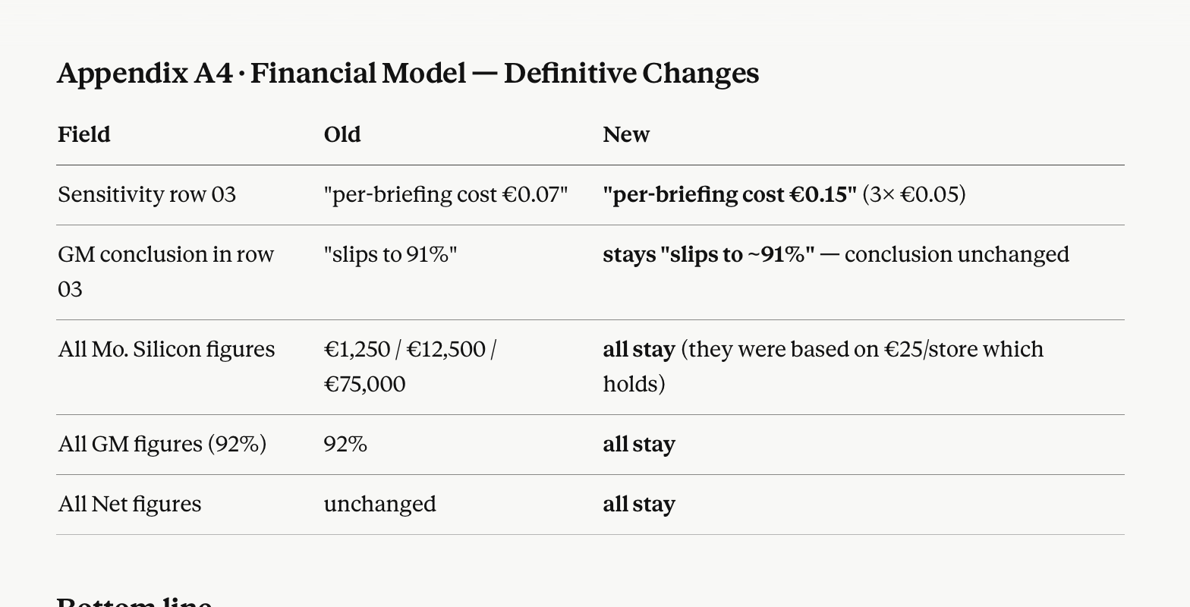
MERCHAI
APPENDIX · A2
A2 / A4
Update Numbers
A2 · FULL FINANCIAL MODEL
92% gross margin holds across pilot, growth, and scale. OpEx is dominated by salaries, not silicon.
Three-scenario P&L
LTV / CAC · all phases
SCENARIO
STORES
MO. REVENUE
MO. SILICON
MO. OPEX
NET
METRIC
PHASE 1
PHASE 3
Pilot M6
50
€15,000
€1,250
€21,500
−€7,750
Avg contract size
75 stores
200 stores
Early Growth M18
500
€150,000
€12,500
€21,500
+€116,000
ACV
€270k
€720k
Annual gross churn
18%
15%
Scale M36
3,000
€900,000
€75,000
€21,500
+€803,500
LTV
€1.5M
€4.8M
CAC
€8k
€110k
Operating cost stack · annual
LTV / CAC
188 : 1
43 : 1
LINE
ANNUAL
NOTES
Team salaries (4)
€222,000
Lisbon market-rate · early-stage
Sensitivity highlights
Cloud infra
€4,800
Beyond per-store silicon
01
Churn 25% (worst case): LTV drops to €1.08M · LTV/CAC still 135:1 in Phase 1.
Sales & marketing
€18,000
Founder-led; no paid acq.
02
Price €200/store: Pilot break-even rises from 78 to 117 stores. Still inside first paying chain.
G&A
€9,600
Legal · accounting · SaaS
03
LLM cost +3×: per-briefing cost €0.07 — gross margin slips from 92% to 91%. Negligible.
Total OpEx
€258,000
~€21,500 / month
DRIVER
Churn matters more than price. Workflow embedment is the lever.
MerchAI financial model v1.2 · April 2026 · all figures in EUR
A2
Notes:
Appendix five — GenAI transparency, as required by the course brief. We used Claude across four workstreams: ideation, writing, coding, and documentation. Every session is logged in Appendix A of the business plan. Ten sessions, all traceable.

Slide 17




MERCHAI
APPENDIX · A3
A3 / A4
A3 · GENAI TRANSPARENCY SUMMARY
How we used AI to build MerchAI. 10 logged sessions across four workstreams.
Per the course brief — full session-by-session log in business plan Appendix A.
WORKSTREAM 01
WORKSTREAM 02
Ideation
Writing
Tool: Claude.ai Use: Idea generation, feature scoping, market sizing pressure tests. Team-authored ideas refined through dialogue; no copy-paste of LLM-generated content.
Tool: Claude.ai Use: Grammar, clarity, and logic review of team-authored drafts. Substantive content authored by the team; LLM used as an editor, not a writer.
3 SESSIONS LOGGED
2 SESSIONS LOGGED
WORKSTREAM 03
WORKSTREAM 04
Coding
Documentation
Tool: Claude Code Use: Pipeline implementation, debugging, deployment scaffolding. All architectural decisions reviewed and signed off by the human authors.
Tool: Claude Code Use: Business plan document generation from team-authored outline and source material. All numbers traceable to the financial model spreadsheet.
4 SESSIONS LOGGED
1 SESSION LOGGED
Full session-by-session log in business plan Appendix A · Nova SBE 2758-T4 · GenAI transparency policy
A3

Slide 18
MERCHAI
APPENDIX · A4
A4 / A4
A4 · REFERENCES
Bibliography.
APA-style references for all external figures cited in this deck.
[1] Anthropic. (2026). Claude API pricing. https://www.anthropic.com/pricing
[8] KeyBanc Capital Markets. (2024). 2024 SaaS survey. https://www.key.com/businesses-institutions/industry-expertise/2024-saas-survey.html
[2] Bessemer Venture Partners. (2024). State of the cloud 2024. https://www.bvp.com/atlas/state-of-the-cloud-2024
[9] Makridakis, S., Spiliotis, E., & Assimakopoulos, V. (2022). The M5 accuracy competition: Results, findings and conclusions. International Journal of Forecasting, 38(4), 1346–1364. https://doi.org/10.1016/j.ijforecast.2021.11.013
[3] Eurostat. (2024). Structural business statistics: Retail trade enterprises by employment size class. https://ec.europa.eu/eurostat/web/structural-business-statistics
[10] McKinsey & Company. (2024). The state of AI in retail and consumer goods. McKinsey Global Institute. https://www.mckinsey.com/industries/retail/our-insights
[4] Gartner. (2024). Magic Quadrant for Retail Assortment Management Applications. https://www.gartner.com/en/documents/retail-assortment-management
[11] OpenView Partners. (2024). SaaS benchmarks report. https://openviewpartners.com/saas-benchmarks
[5] Grand View Research. (2024). Retail analytics market size, share & trends report, 2024–2030. https://www.grandviewresearch.com/industry-analysis/retail-analytics-market
[12] SaaS Capital. (2024). Annual SaaS retention benchmark survey. https://www.saas-capital.com/research
[6] Kaggle. (2020). M5 Forecasting — Accuracy competition. https://www.kaggle.com/competitions/m5-forecasting-accuracy
[13] Statista. (2024). Number of retail enterprises in Europe by employee size class. https://www.statista.com/statistics/retail-enterprises-europe
[7] Ke, G., Meng, Q., Finley, T., Wang, T., Chen, W., Ma, W., Ye, Q., & Liu, T.-Y. (2017). LightGBM: A highly efficient gradient boosting decision tree. Advances in Neural Information Processing Systems, 30. https://papers.nips.cc/paper/6907-lightgbm
[14] Vendor product pages: Relex Solutions, Blue Yonder (JDA), ToolsGroup, Nextail, Daisy Intelligence. (2026). relexsolutions.com · blueyonder.com · toolsgroup.com · nextail.co · daisyintel.com
All sources publicly available · last accessed April 2026 · APA 7th edition
A4

