Slide 1
Hand gesture classification
Using Convolutional Neural Network (CNN)

Slide 2
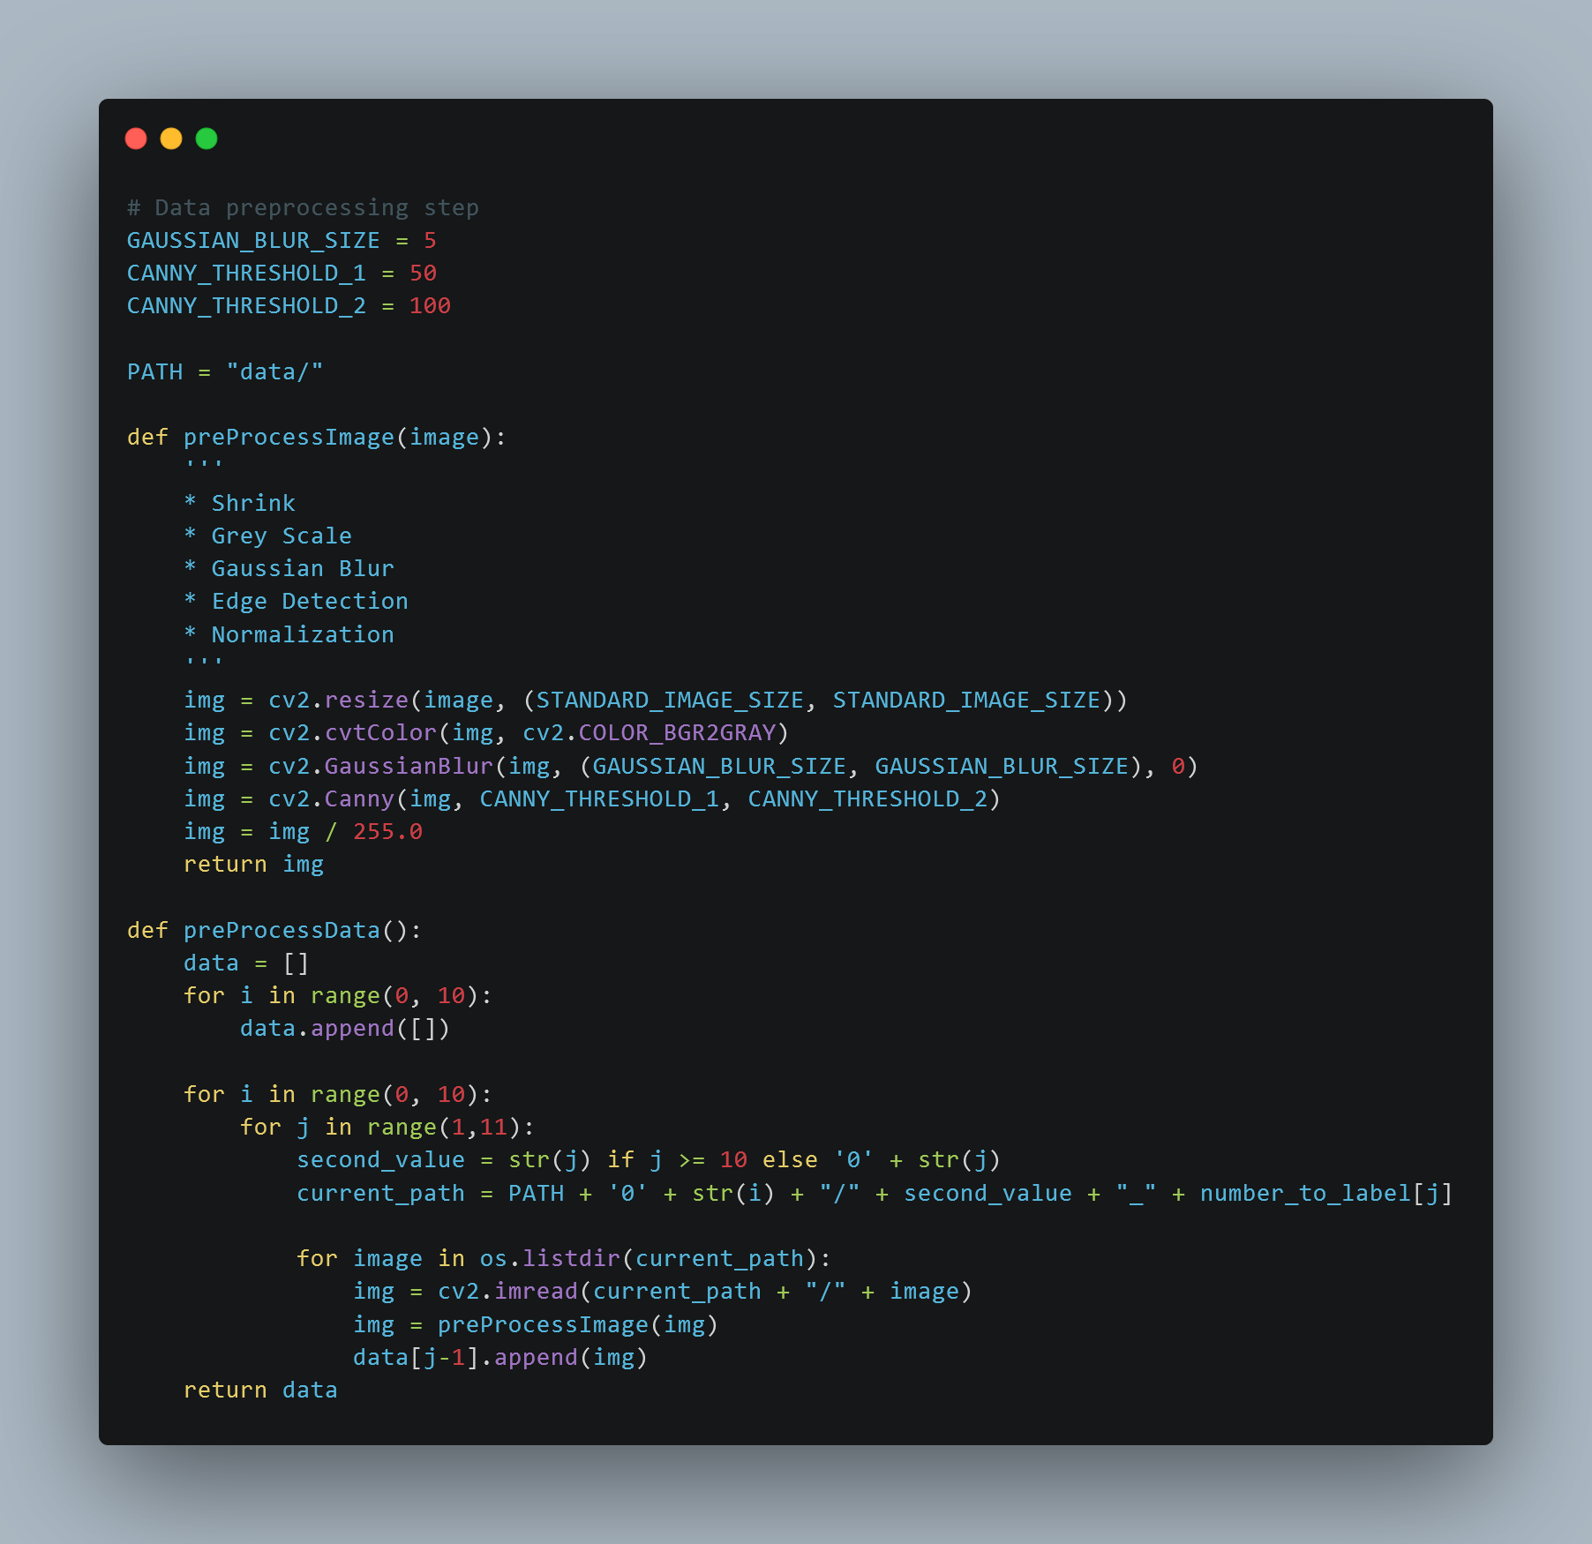

Slide 3
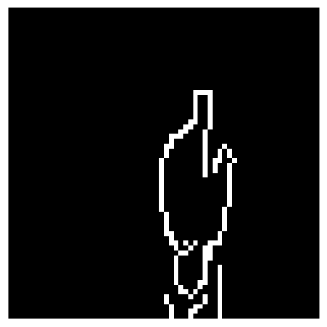
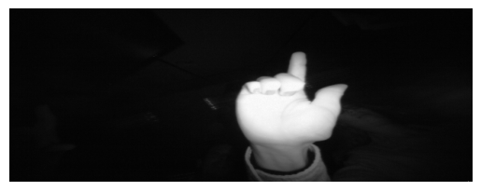
Before and after
https://www.kaggle.com/datasets/gti-upm/leapgestrecog

Slide 4
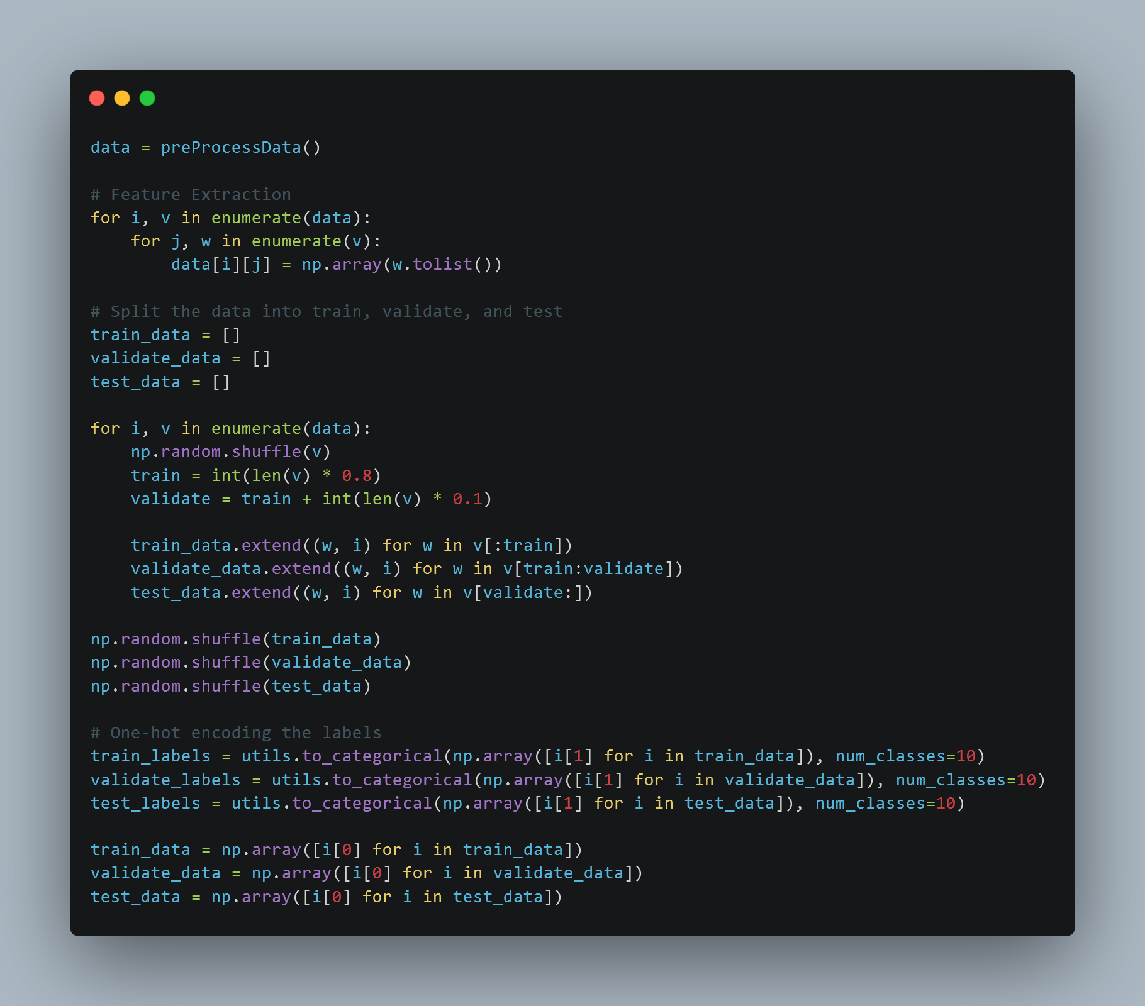

Slide 5
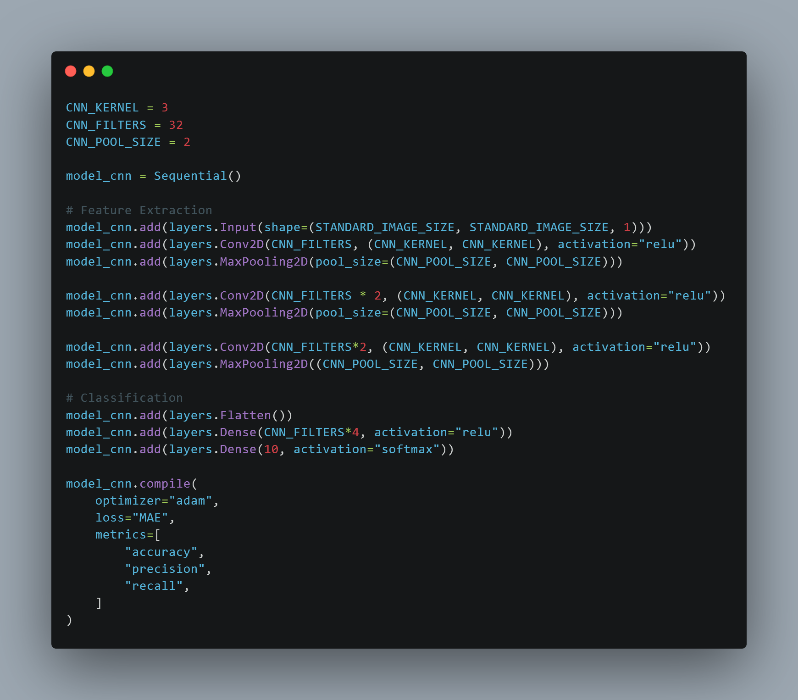
https://carbon.now.sh/

Slide 6
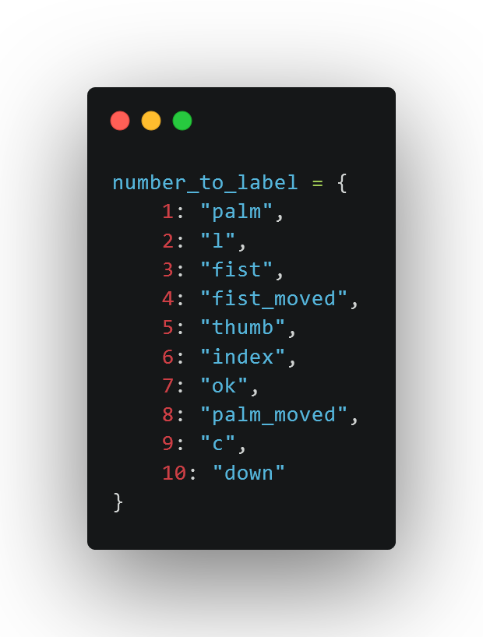
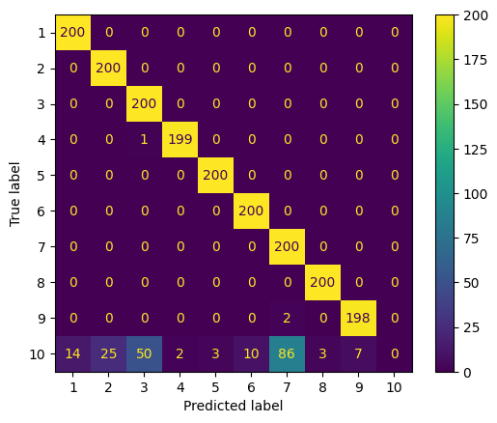
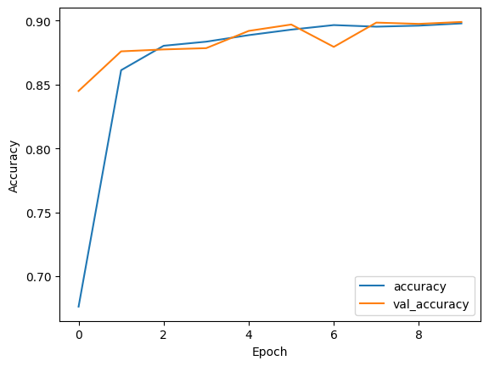
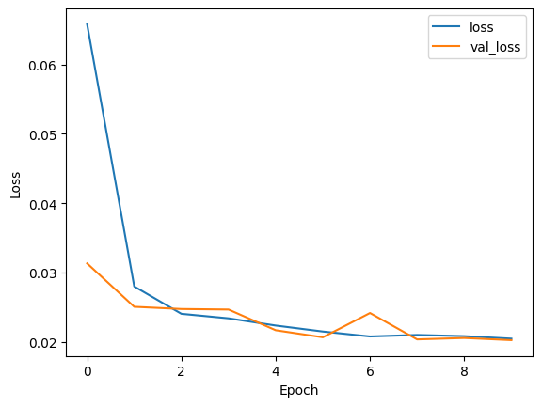
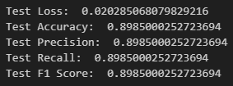
Training time: ~18.4s

Slide 7
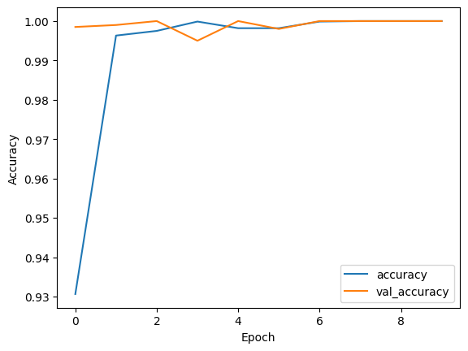
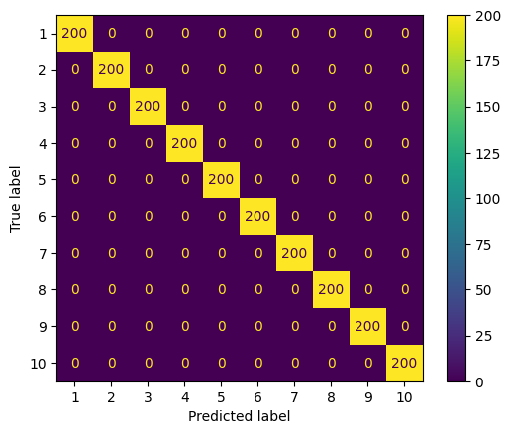
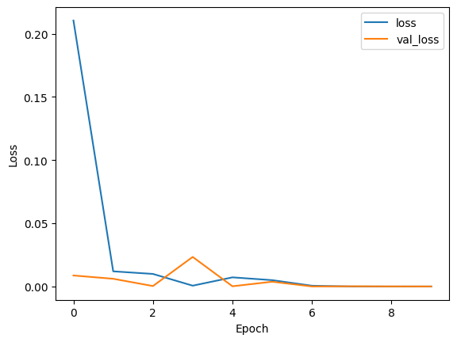
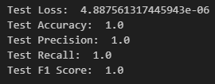
Training time: ~19.6s
Notes:
Re enable extra layers

Slide 8
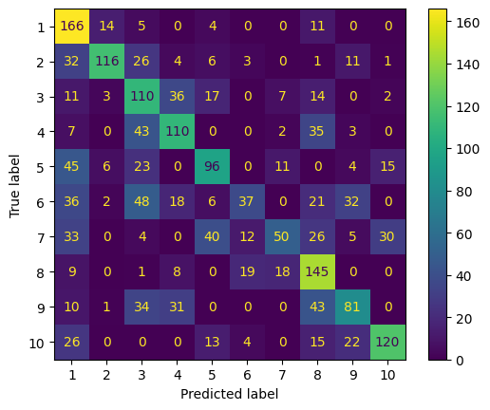
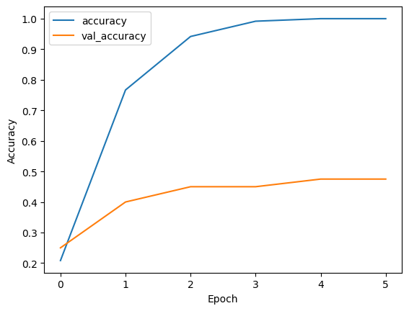
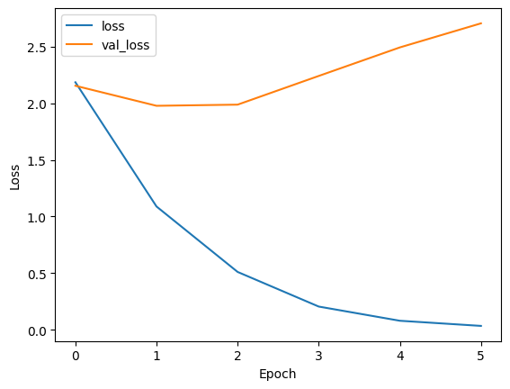
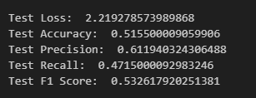
Training time: ~5.1s
Notes:
Training -> 120
Evaluation -> 40
Epoch -> 6
Turn off 2 layers

Slide 9
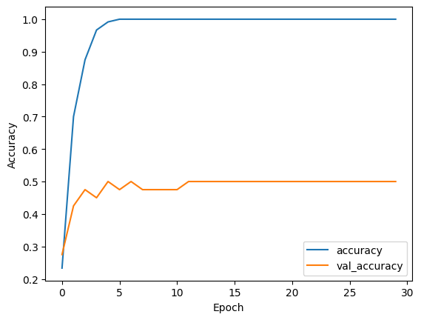
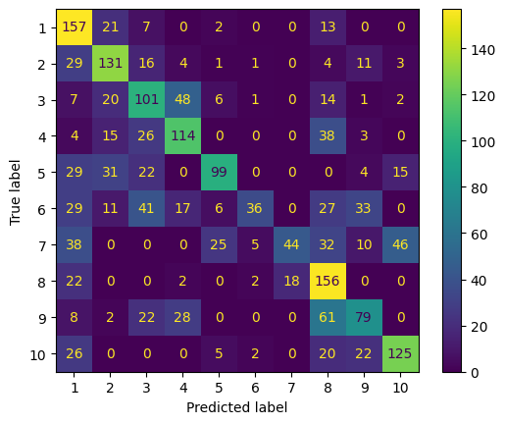
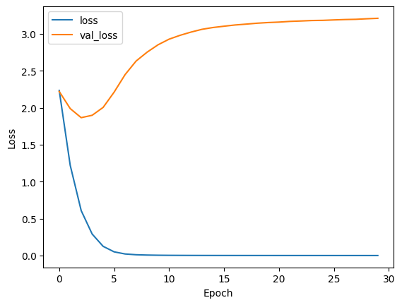
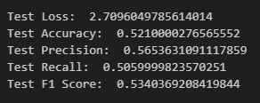
Training time: ~6.2s
Notes:
Epoch -> 30

Slide 10
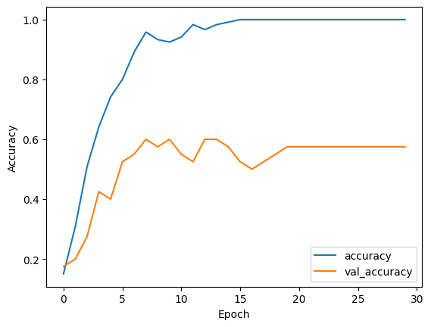
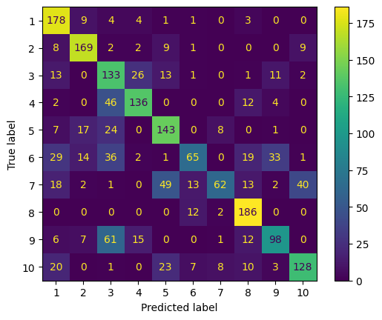
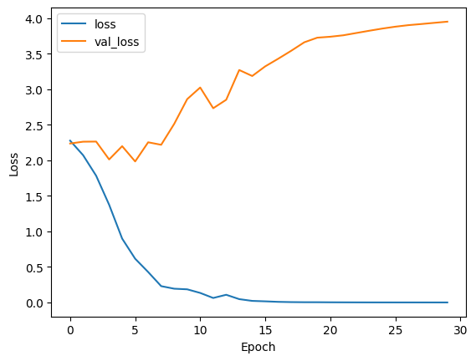
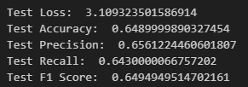
Training time: ~8.5s
Notes:
Re enable extra layers

Slide 11
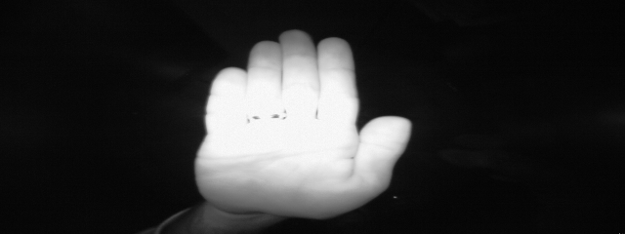
Limitations
Trained on Infrared images
Hand Clarity
Augmentation
https://www.kaggle.com/datasets/gti-upm/leapgestrecog

Slide 12
Sources
Dataset: https://www.kaggle.com/datasets/gti-upm/leapgestrecog
Source code: https://github.com/nasope/dat305-2024
Code beautifier: https://carbon.now.sh/

