Slide 1
3rd Quarter Finance Report
2014-2015 Financial year
Finance report – Q3 2014/15 year

Slide 2
Contents
Introduction
Budget overview
Financial performance
Financial position
Cashflow
Other financial management matters
Finance report – Q3 2014/15 year

Slide 3

Introduction
This presentation seeks to summarize financial management activities undertaken by the Commission during the financial year to 31 December2014, particularly focussing on the third quarter of the financial period. The events and matters reported are in the main for accountability to Parliament on performance for the period against the Annual Performance Plan, Appropriation Act and other obligations advanced by the Committee from time to time. Additional information is provided in this presentation in the interest of openness, transparency and completeness in reporting.
Finance report – Q3 2014/15 year

Slide 4
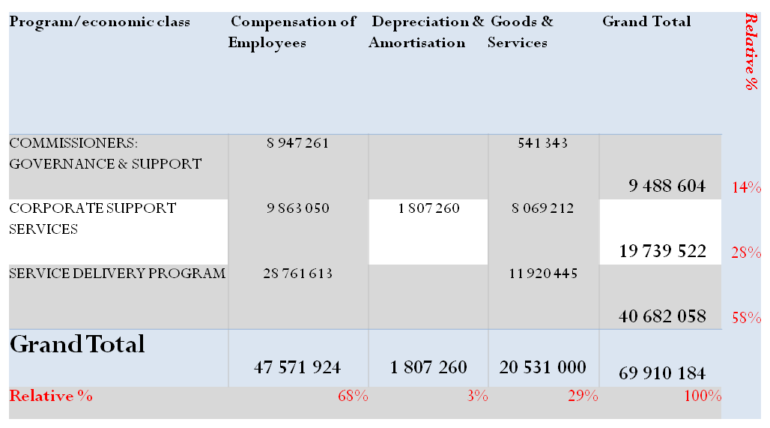

Budget overview per program & economic classification
Funds available for the financial year were as follows;
  Allocation from NT R67, 2 m
  Internal sources (Interest )
  R2, 7 m
Total adjusted budget= R69, 9 million
58% set aside for the main service delivery program
COE key driver of expenditure (68%). CGE is a service organisation
Finance report – Q3 2014/15 year

Slide 5
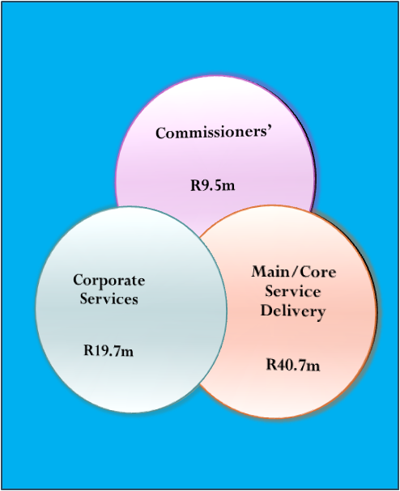

Itemised budget over MTEF period
Cls | 2013/14 | 2014/15 | 2015/16 | 2016/17 | 2017/18
Bank Charges | 51 600 | 54 690 | 57 971 | 61 449 | 64 706
CAPEX |  | - | - | - | -
Compensation of Employees | 44 479 979 | 47 717 258 | 50 581 597 | 53 110 677 | 55 766 211
Computer Servicing, Internet & Website | 639 900 | 671 908 | 703 726 | 745 945 | 785 448
Courier Services | 127 800 | 135 452 | 143 579 | 152 194 | 160 258
Employee Assistance Program | 300 000 | 317 962 | 337 040 | 357 262 | 376 197
Media Outreach | 888 000 | 941 168 | 997 638 | 1 057 497 | 1 110 372
Office Cleaning, Maintenance, Plants & Security | 1 615 821 | 1 712 567 | 1 815 321 | 1 924 240 | 2 024 510
Office Consumables | 35 700 | 37 838 | 40 108 | 42 514 | 44 767
Printing & Stationery | 904 800 | 958 974 | 1 016 513 | 1 077 503 | 1 134 604
Professional Services | 3 144 200 | 3 332 457 | 3 532 404 | 3 744 348 | 3 940 294
Report writing & Printing Materials | 1 310 000 | 1 388 435 | 1 471 741 | 1 560 046 | 1 638 060
Telecommunication Expenses | 2 142 000 | 2 270 251 | 2 406 466 | 2 550 854 | 2 683 427
Travel, Accomodation and Related Expenditure | 4 796 000 | 4 893 522 | 4 712 226 | 4 994 960 | 5 258 693
Venues, Catering & Event Management | 1 994 200 | 2 113 601 | 2 240 417 | 2 374 842 | 2 495 653
Training and development | 650 000 | 688 918 | 730 253 | 774 069 | 812 772
Grand Total | 63 080 000 | 67 235 000 | 70 787 000 | 74 528 400 | 78 295 972
2014/2015 figures
Finance report – Q3 2014/15 year

Slide 6
Overview – financial performance
Total Income for the year to December 2014 : R52, 3 million
Transfer were R50, 4 million, year to December 2014 and R16,8 million for quarters 3 – therefore year to date share of 75% was duly transferred
Interest income of R198, 531 earned in the 3rd quarter (YTD ; R610, 630).whilst R21, 061 was received from other sundry sources(SETA, etc)
Cumulative donor income arose from Gender summit activities during the first quarter – R1,2 m in Q1 and none in recorded in Q3
Total cumulative spending was R55, 8 m (or 80% of the annual budget) was incurred as at 31 December 2014, signalling around 5% overall spending pressure (over R3m).
Finance report – Q3 2014/15 year

Slide 7
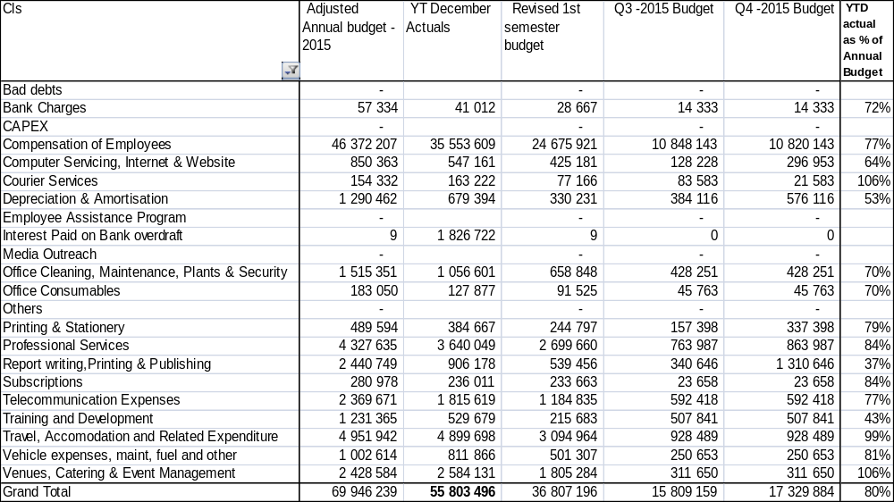
General Budget & Expenditure overview
Finance report – Q3 2014/15 year

Slide 8
Cumulative outlook -Spending pressures and Key Drivers
Salaries within budget but material at R35, 5 m (YTD) against an annual budget of R46,4 m
Travel and Accommodation exceeds budget by 22% during the quarter and already equals the annual allocation by 31 December 2014. Stringent measures necessary in order to stem the spending pressure
Venues and Catering also overspends by 22% and already above the annual allocation by 6%
Telecommunication, and Professional services although within budget but respectively accounted for R1, 8 m & R3, 6 m (YTD)
Interest and penalties paid to SARS at R1, 8 m
Finance report – Q3 2014/15 year

Slide 9
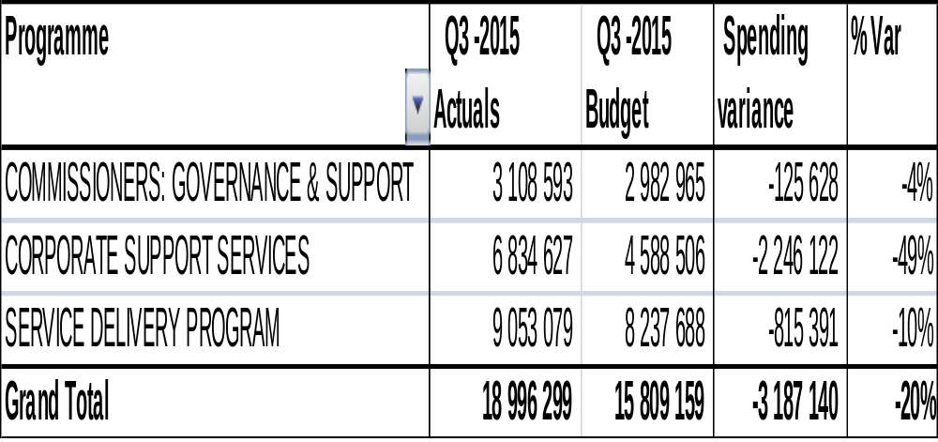
Q3 spending variance per programme
SARS, Travel, Accommodation and Event management are key drivers across programmes
Finance report – Q3 2014/15 year

Slide 10
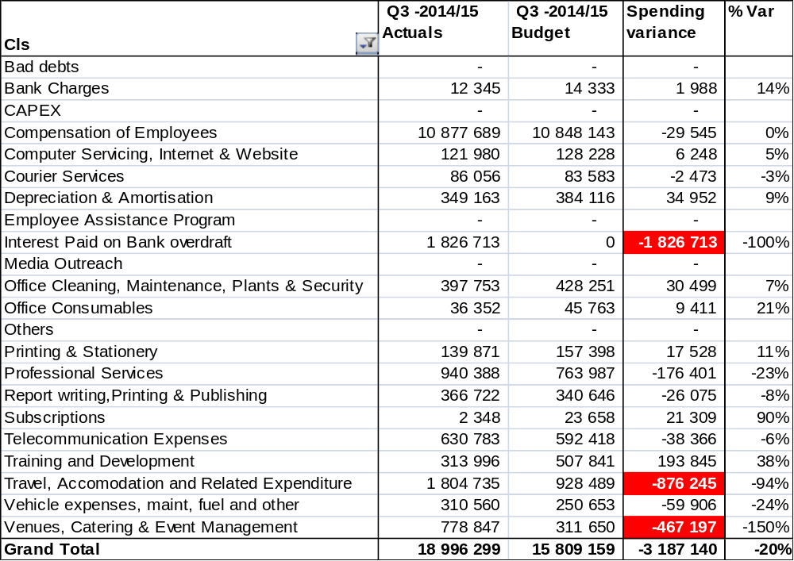
Quarter 3 – Oct to Dec 2014 spending variances
Quarter 3 spending deviations the primary reason for the cumulative year to date over-expenditure (R 3 m)
Overall spending gap was 20% above budget
Interest and penalties – R1,8 m
Travel and venues - exceeded budget by a combined R1, 3 m
Finance report – Q3 2014/15 year

Slide 11
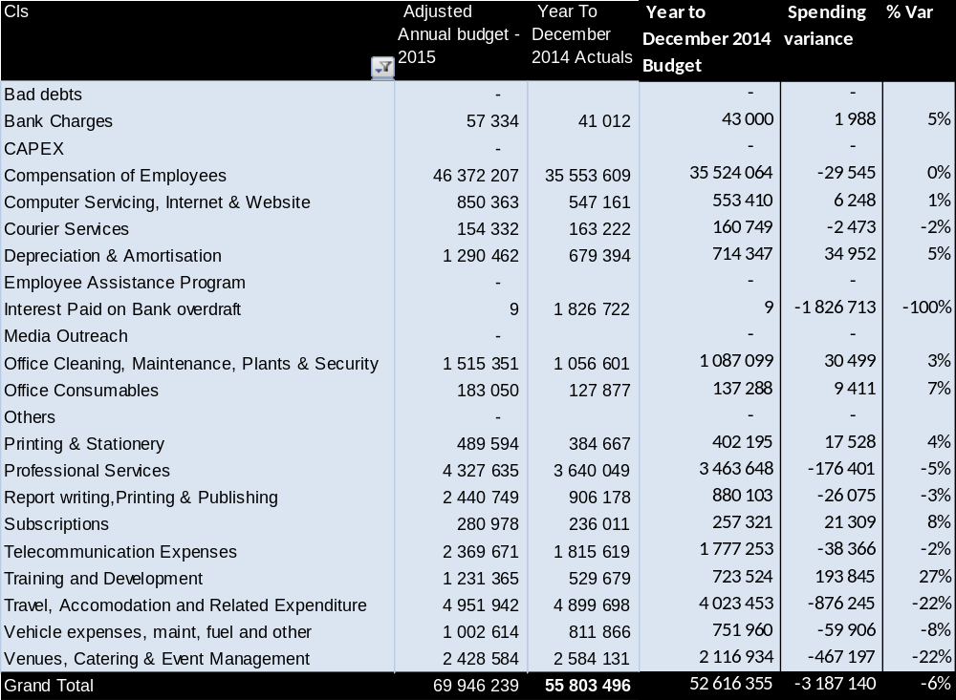
Cumulative spending against budget
Finance report – Q3 2014/15 year

Slide 12
Extra- ordinary transactions, contingencies, Litigation and other significant developments
Donor Income at R1, 2 million emanating from contributions by partners to the Gender Summit that was held in April of 2014.
Grant income conditionally received from National Treasury for the purchase of vehicles at R4, 3 million. Spent (Conditions met )
Penalties and interest charged by the South African revenue Services for a combined figure of R1, 8 million. Consequence management being implemented against liable officials
Litigations – (CGE v Gasa and Axolute v CGE). For the latter matter, an application made to court for the dismissal of claim by plaintiff following expiry of notice (not acted upon by plaintiff).
No fraud or related incidents whatsoever were reported in the period, either through fraud line or internal whistle blowing procedures during the period and the year long
Finance report – Q2 2014/15 year

Slide 13
Overview financial position
The health of the CGE finances is sound. The going concern assumption is still valid but for funding threads going forward (critical to follow through mitigation tactics : review funding model, operating model, cost control, fund raising)
Fixed assets increasing by R4,3 m due to acquisition of vehicles in the main – this exchanges cash for non-current assets thus diminishing liquidity. Cash at hand reducing dramatically
Receivables insignificant but linked to matters under litigation (Gasa – R271k) and SAPS investigation (PAL & Assoc – R135K). There is a corresponding impairment/provision for doubtful collectability
Liabilities largely provision for staff – leave, 13th and performance bonus overlapping the two financial years
Finance report – Q3 2014/15 year

Slide 14
Cash flow
For the same period in the previous year, cash & cash equivalents were R22, 2 million compared to R12, 4 million the current year
Cash balances movements accounted for in the main by:
  Cash utilised for investment in non-current assets – R4,6 m (vehicle purchase in the main)
  Cash utilised to pay suppliers and other payables – R4, 2 m ( bal. was R16,1 m in 2013/14 compared to R11,9 min 2014/15)
  R1 million attributable to outflows from operating activities mainly due to increased expenditure
Liquidity remain sound but comparably reduced between the two periods mainly as a result of CAPEX spending and increased spending on goods and services
Finance report – Q3 2014/15 year

Slide 15
Other Financial management matters.....1
Risk management
Risk Mitigating action plans being regularly implemented by management
Regular Committee meetings held where oversight is exercised. The 3rd quarterly meeting was held on 29 January 2015
All top risks were reviewed and discussed in-depth by the Committee in each meeting
Emerging and critical risks identified and/or updated are;
  BCP especially as is affected by electricity blackouts – the area ranked high
  Funding – owing to the budget cut, the risk is directly impacted (likelihood certain with significant impact) – high
  Accommodation condition and availability – moderate to high on reassessment
Insurance RFQ to be evaluated during the fourth quarter of current year, to cover office content and vehicles
Finance report – Q3 2014/15 year

Slide 16
Other Financial management matters.....2
Supply Chain management
Tenders and RFQ were issued in December 2014 to fulfil the Procurement plan as well as the ICT infrastructure project needs. These are been evaluated and set to finalize adjudication in the latter quarter for implementation ASAP at commencement of the 2015/2016 period. Investment estimated at R4m
Audit Issues
All Audit action plans previously committed by management were implemented with success
Finance report – Q3 2014/15 year

Slide 17

end
        Thank you
CGE Free Call Hotline
0800 007 709
Finance report – Q3 2014/15 year

