Slide 2
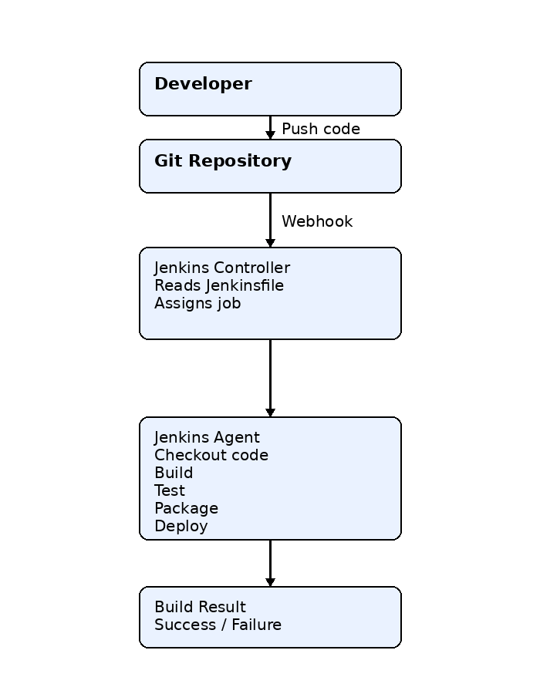

Slide 3
Jenkins Controller (Master):
  Manages the Jenkins web UI.
  Schedules and monitors jobs.
  Assigns jobs to available agents.
Jenkins Agent:
  Receives jobs from the controller.
  Executes the build steps (compile code, run tests, create artifacts, deploy applications).
  Sends the build status and logs back to the controller.

Slide 4
Using agents provides several benefits:
Scalability: Run multiple builds in parallel.
Platform support: Use different operating systems (Linux, Windows, macOS) for different jobs.
Resource isolation: Keep heavy build workloads off the controller.
Specialized environments: Configure agents with specific tools like Java, Maven, Docker, Node.js, Android SDK, etc.

Slide 5
A Jenkins script usually refers to the Pipeline script written in Groovy that tells Jenkins what steps to execute during a CI/CD pipeline.
This script is typically stored in a file named Jenkinsfile in project's source code repository. It is stored in the root of Git repository

Slide 6
Basic structure of a Jenkins Pipeline script
      pipeline {
      agent any
      stages {
      stage('Stage Name') {
      steps {
      // Commands to execute
      echo 'Executing stage...'
      }
      }
      }
      post {
      success {
      echo 'Pipeline executed successfully.'
      }
      failure {
      echo 'Pipeline execution failed.'
      } } }

Slide 7
Components of the Pipeline
pipeline
  The root block that defines the entire pipeline.
agent
  Specifies where the pipeline should run.
  Example:
    agent any – Runs on any available Jenkins agent.
stages
  Groups the major phases of the pipeline.
stage
  Represents a single phase of the process, such as Build, Test, or Deploy.
steps
  Contains the actual commands executed within a stage.
echo
  Prints a message to the Jenkins console output.

Slide 8
jar cfm factorial.jar manifest.txt Factorial.class
jar → Java Archive tool.
c → Create a new JAR file.
f → Specify the output JAR file name.
m → Include a custom manifest file.
factorial.jar → The output JAR file.
manifest.txt → The manifest file.
Factorial.class → The compiled Java class to include.

Slide 9
A manifest is a metadata file stored inside a JAR
It contains information about the JAR, especially the Main-Class, which tells Java which class to execute when you run:

Slide 10
archiveArtifacts artifacts: 'factorial.jar’
is a Jenkins Pipeline step that tells Jenkins to save (archive) the specified file as a build artifact after the build completes.

