Slide 1

BLOOD DONATION
MANAGEMENT SYSTEM
Professional Database & API Presentation
C# • ASP.NET Core Web API • Entity Framework Core • SQL Server

Slide 2




Project Overview
This system manages blood donors and recipients end-to-end.
Stores donor information
Tracks blood donations
Manages recipient requests
CRUD via ASP.NET Core API
Full donor profiles kept up to date
Every donation logged with date & quantity
Requests linked to hospitals in need
Create, read, update & delete through a clean REST API

Slide 3

Database Tables
Four main tables form the backbone of the system
Donor
BloodDonation
Recipient
BloodRequest
Donor profiles & contact info
Logged donations by donor
Recipient profiles & hospital
Blood requests by recipient

Slide 4
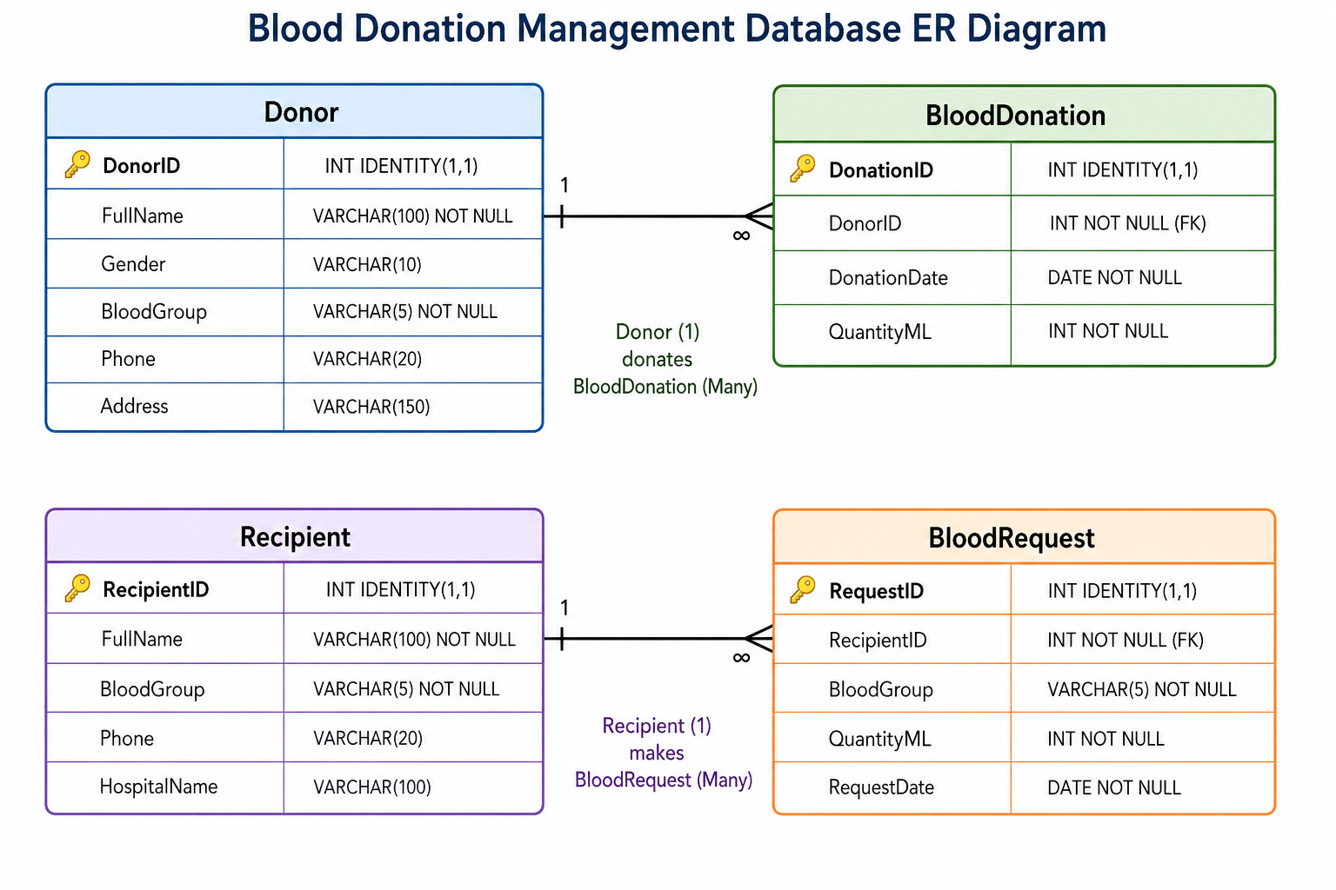
ER Diagram
Entity relationships across the four core tables

Slide 5
Relationships
One-to-many relationships link people to their activity records
Donor
1
BloodDonation
N
One Donor can donate many times.
Recipient
1
BloodRequest
N
One Recipient can request blood many times.

Slide 6




CRUD Operations
The system supports full lifecycle management of every record
Create
Read
Update
Delete
Add new donors, recipients, donations & requests
View & search existing records
Edit and correct existing data
Remove records no longer needed

Slide 7



Technologies Used
A modern, industry-standard Microsoft stack
C#
ASP.NET Core Web API
SQL Server
Entity Framework Core
Core application language
RESTful backend framework
Relational database engine
ORM for data access

Slide 8



Project Benefits
Easy blood management
One system for every donor, recipient & unit of blood
Secure data storage
Data safely stored and accessed through the API
Fast donor searching
Find the right donor by name in seconds
Efficient hospital coordination
Requests and donations stay linked & up to date

Slide 9

Thank You
Questions & Answers
Blood Donation Management System

