Slide 1
Yelp: Context Analysis (Text Reviews & Images)
Nasrin Khansari

Slide 2
Agenda
Problem & Motivation
Data Description
Exploratory Analysis

Slide 3
Problem & Motivation
Explore interesting data trends/patterns
Analyze context changes over time
Build a rating predictor based on review context

Slide 4
Dataset Description
Text Data
Business.json
Checkin.json
Review.json
Tip.json
User.json
Images Data
Photos.jpg
Photo.json
Notes:
Json -> csv
Merge
Pandas dataframe

Slide 5
Dataset Description
Text data
Image data
Business.json
Review.json
Checkin.json
Review.jsom
Tip.json
Photos.jpg
Photos. json

Slide 6
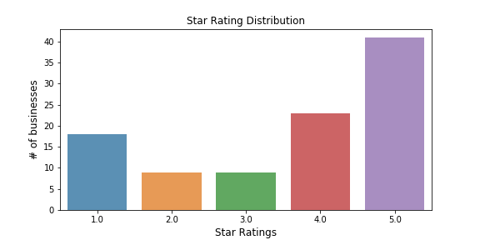
Dataset Description
Notes:
1= positive
0= negative
Overall number of review increase; more positive than negative

Slide 7
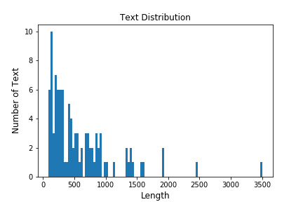
Dataset Description

Slide 8
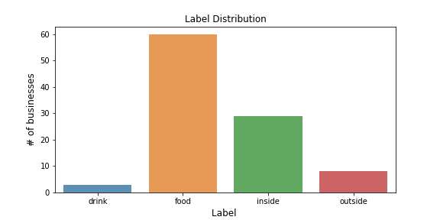
Dataset Description
Notes:
Filter:
Business review>10
User review > 5
Over 20 states represented; picked data from top 6 states

Slide 9
Future Directions
Prepare the data for Machine Learning algorithms
Select a model and train it
Fine-tune the model

