Slide 1

Statistical AI Agent for Advanced Dataset Analysis
Team: Nasrin Rahimi Zadeh , Ali Bavifard
Systems and Device Programming (A.Y. 2024-2025)

Slide 2
Motivation / Problem
Time-Consuming: Finding key features in sensor data takes hours.
Requires Expertise: Creating relevant plots requires coding knowledge.
Slow Insights: This process delays important, data-driven decisions.
Our Goal: To create an intelligent agent that automates this process, making sophisticated data analysis accessible through a simple, natural language interface.

Slide 3
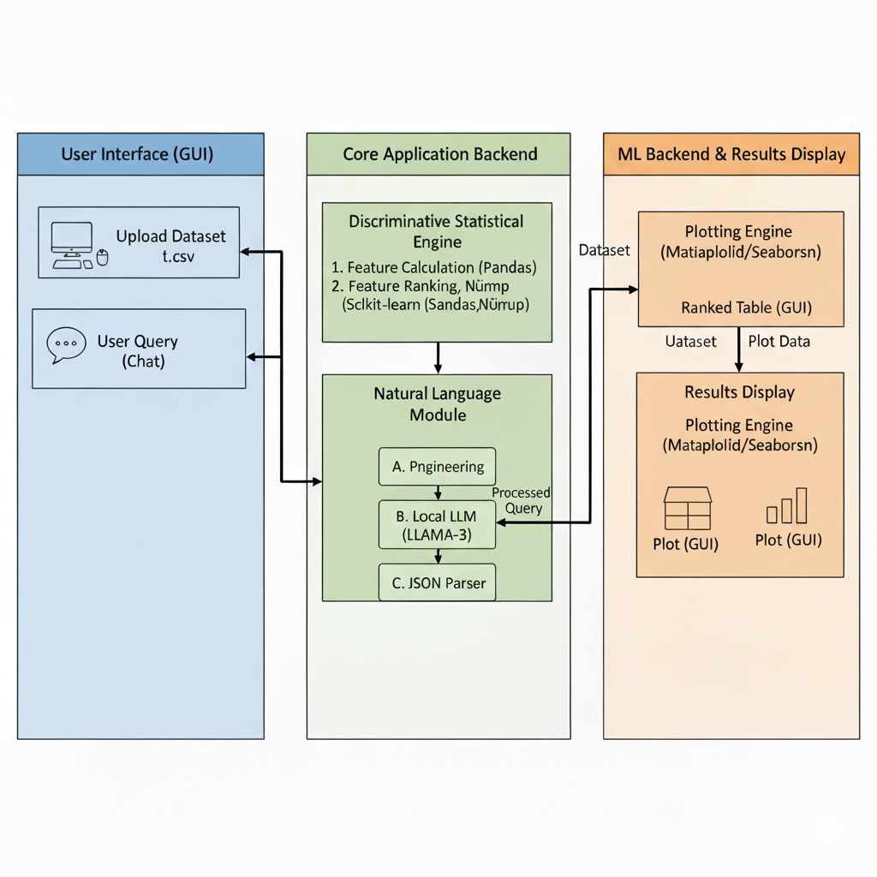
High-Level System Architecture

Slide 4
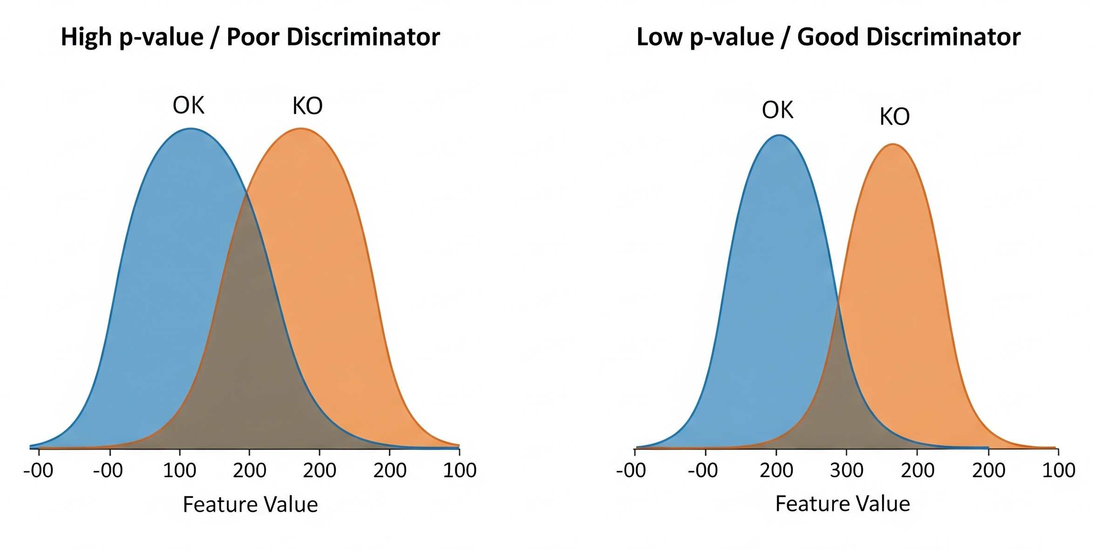
The Discriminative Statistical Engine: Methodology
Goal: Automatically rank features by their power to distinguish 'OK' from 'KO'.
Approach: Filter-Based Selection, a fast method that evaluates each feature independently.
Statistical Test: Student's t-test, compares the average value of a feature between the OK and KO groups.
Key Metric: The p-value, measures our confidence that the observed difference is real, not just random chance

Slide 5
The Discriminative Statistical Engine: Scoring & Output
The Challenge: A low p-value confirms a difference is real, but not how large it is.
Solution: A Combined separation_score
Combines Effect Size (the magnitude of the difference) with Significance (our confidence).
Formula: Score = Effect Size * (1 - p-value)
Output: Ranked Feature Table
The engine outputs a simple table, ranking features by their separation_score.
ML-Based Validation:
To confirm the rankings, the engine also trains Logistic Regression and Random Forest models.
Their feature importance scores provide a "second opinion," adding confidence to the results.

Slide 6
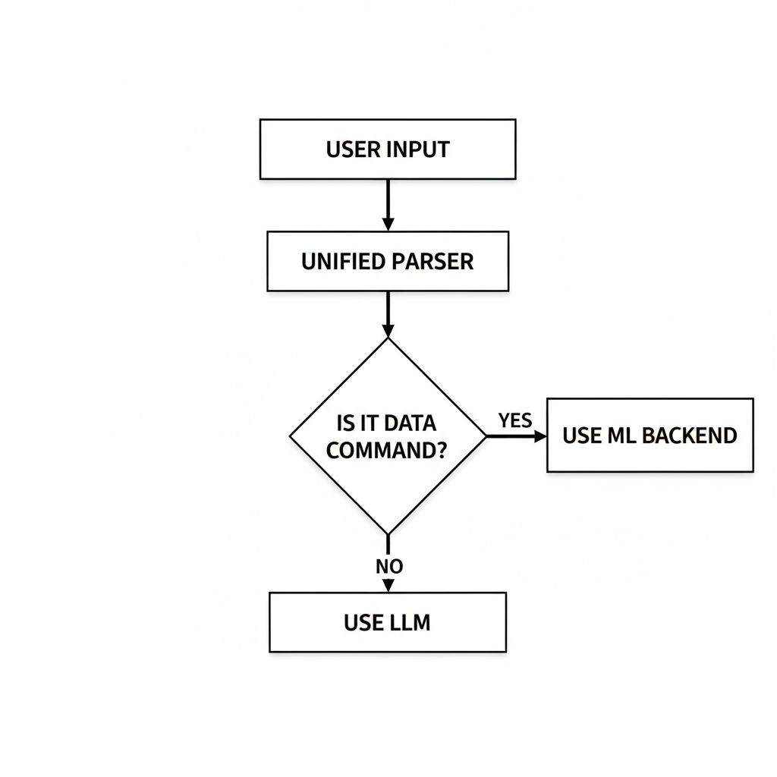
Natural Language Command Processing: A Hybrid Architecture
Our Solution: A Dual-Path Architecture
We use a hybrid system for the best of both worlds: the precision of a parser and the flexibility of an LLM.
Path 1: The UnifiedParser for Data Commands
Any request for a plot or statistic is first analyzed by our custom-built, regex-powered parser.
This provides fast, reliable, and precise interpretation of technical commands.
Path 2: LLM Fallback for General Conversation
If the parser determines the request is not a data command, it's passed to the local
LLAMA-3 model for a conversational reply.

Slide 7
Validation Setup & Performance Metrics
Benchmark Dataset:
Analyzed a proprietary industrial sensor dataset provided by AROL, containing real-world machine operational data.
Validation Approach:
Since public baselines are not applicable, we focused on two areas: correctness of the analysis and application performance.

Slide 8
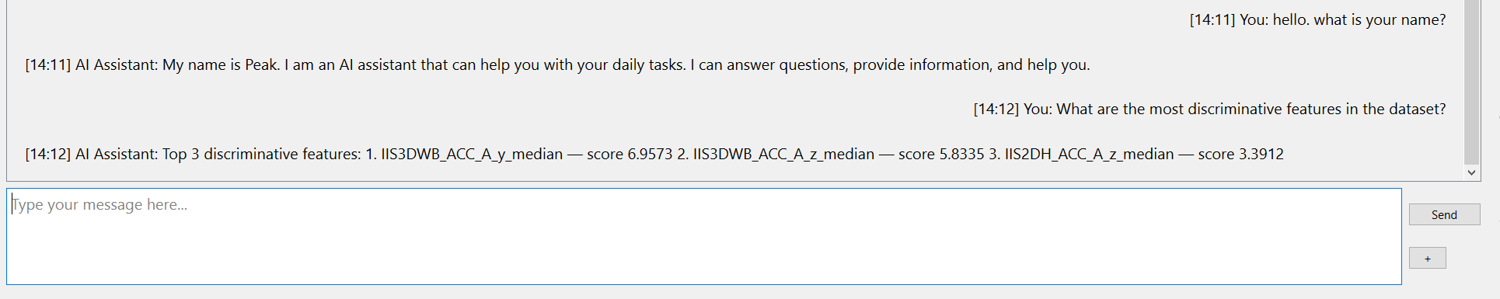
Results: Engine Performance & Efficiency
Key Finding:
The statistical engine precisely identified accelerometer features as the top fault indicators, specifically the median of the Y (vertical) and Z (axial) axes.
Logical Validation:
This result is highly logical, as mechanical faults directly manifest as significant changes in the machine's vibration profile, which is exactly what these features measure.

Slide 9
Results: Engine Performance & Efficiency
Efficient Performance:
The application processes the entire dataset
Calculation of top features and data loading memory
Time measurement | seconds
Wall-clock time | 0.1994
User time | 0.1875
CPU time | 0.1875
Memory usage | Peak usage
Running the application | 3 GB
Adding the dataset (depend on size) | 4 GB

Slide 10
The UnifiedParser in Action
Core Task: The parser analyzes sentence structure and keywords to convert unstructured text into a structured command object.
Intelligent Entity Recognition: It identifies multiple components in a single request:
Command Type: (e.g., PLOT, STATISTIC)
Plot/Statistic Type: (e.g., HISTOGRAM, MEAN)
Target Features & Class Filters: (e.g., Vibration_Z_Axis, KO)
This structured command is then sent directly to the ML backend for execution.

Slide 11
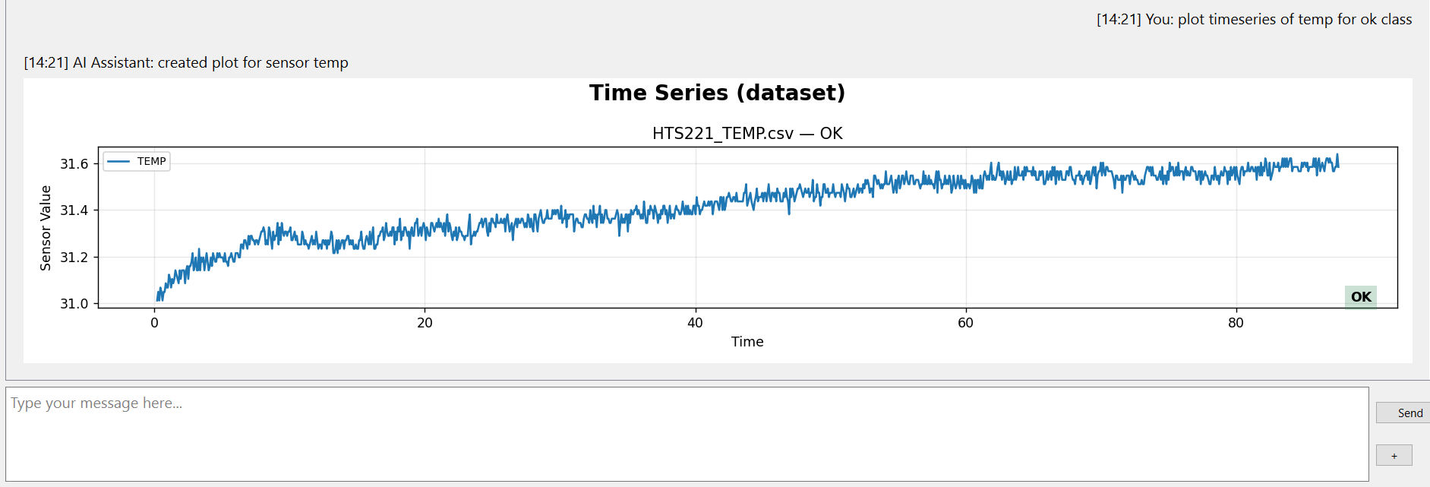
Results: Natural Language Module Performance
High Accuracy: The UnifiedParser successfully interpreted 88% of the test commands correctly.
Robustness: The parser correctly handled variations in phrasing and identified the correct command type, features, and class filters.
Efficiency: The deterministic, regex-based approach provides near-instantaneous command parsing, which is significantly faster and more reliable than a purely LLM-based solution for this task.

Slide 12
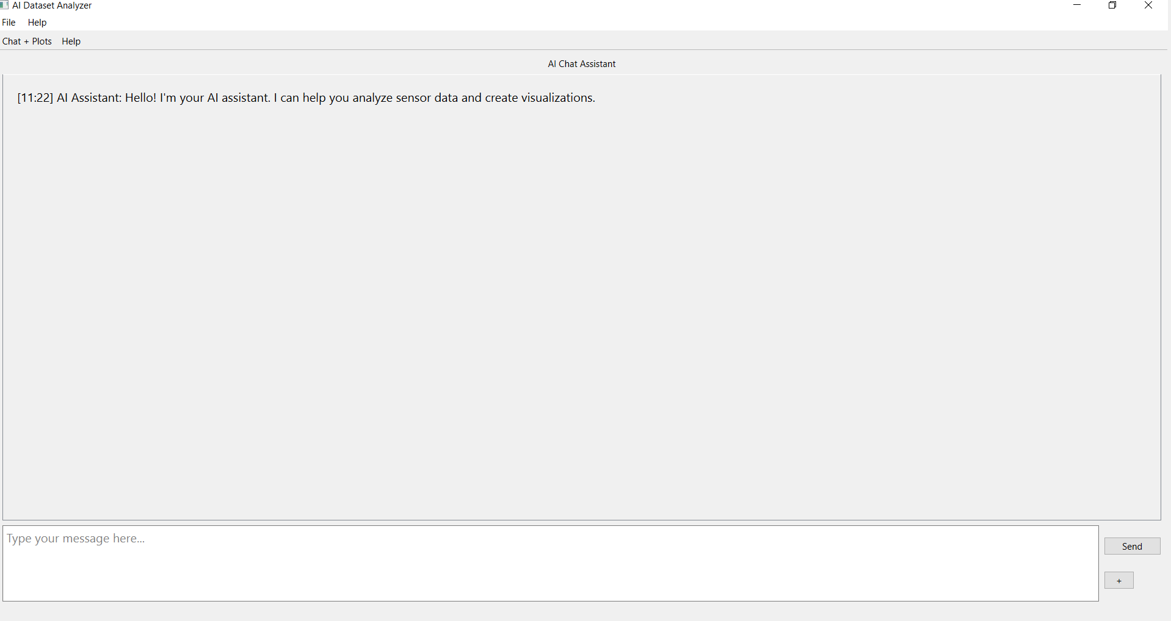
Live Demonestration

Slide 13
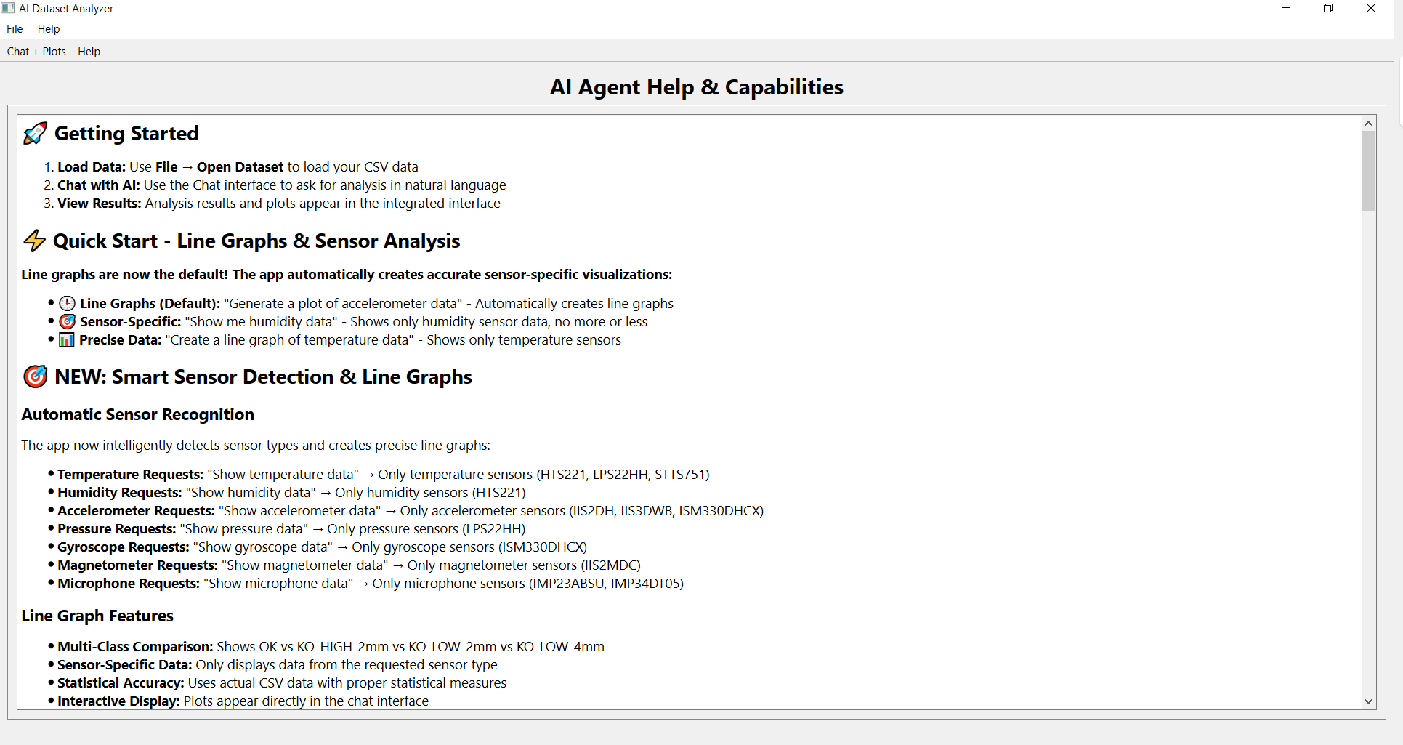
Help Screen

Slide 14
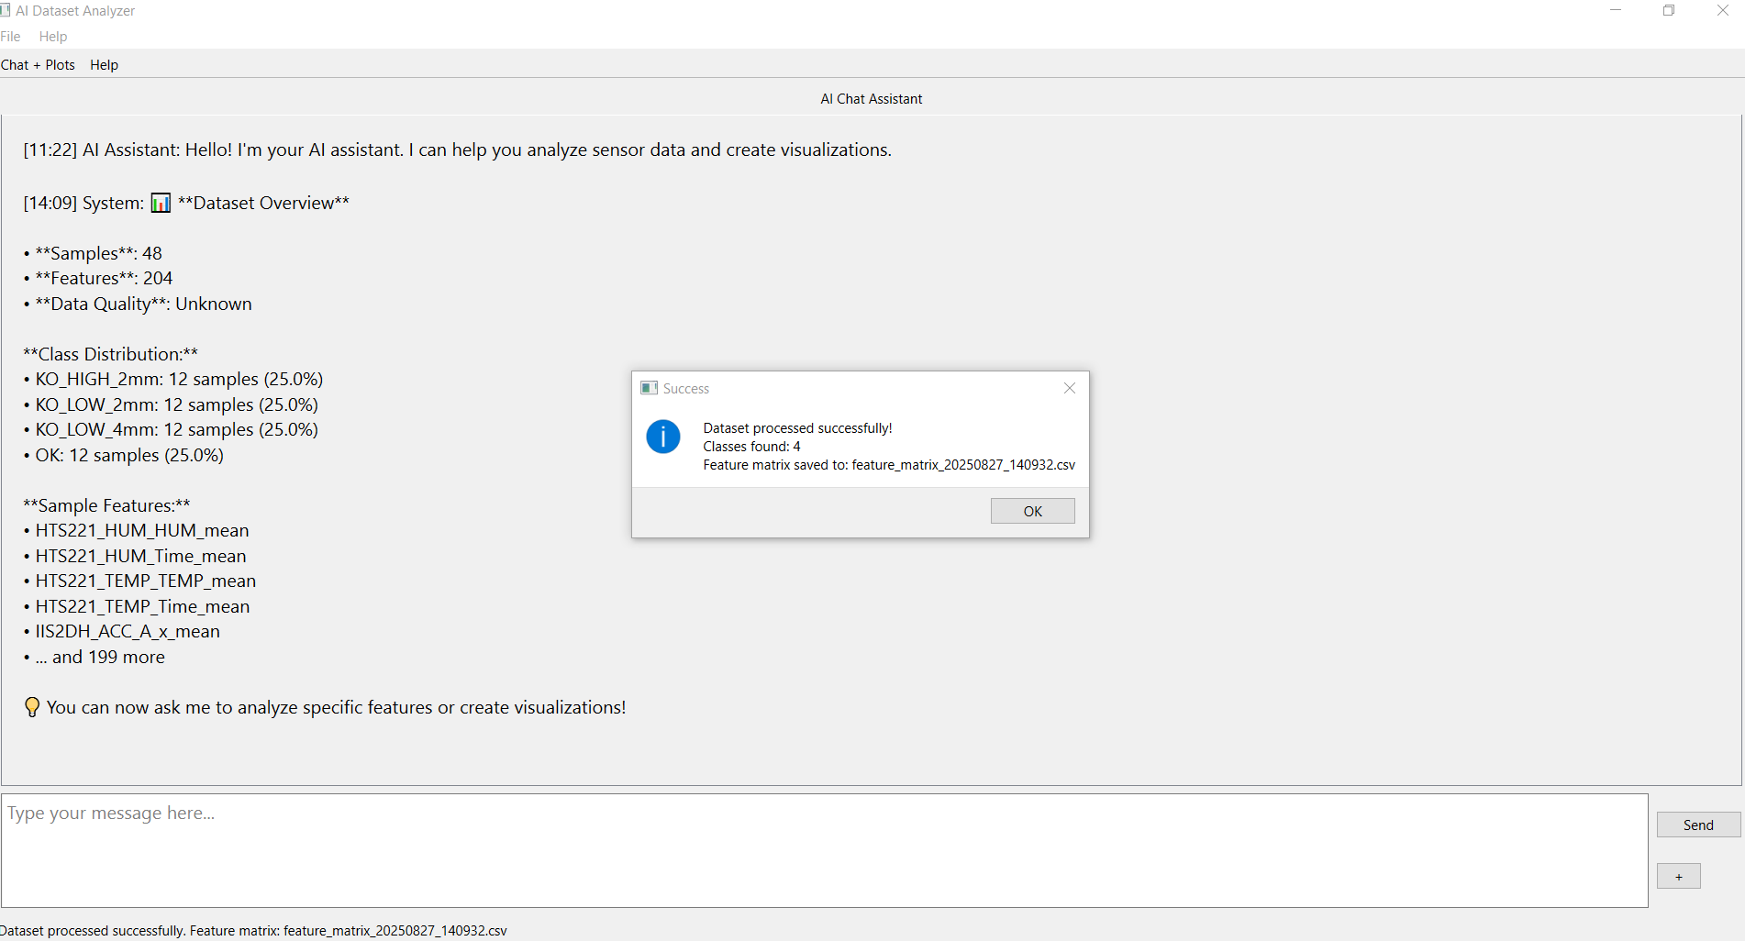
Data Pipeline
Parallelized preprocessing (faster)
Feature matrix auto-built
Basis for discriminative stats

Slide 15

General Conversation

Slide 16
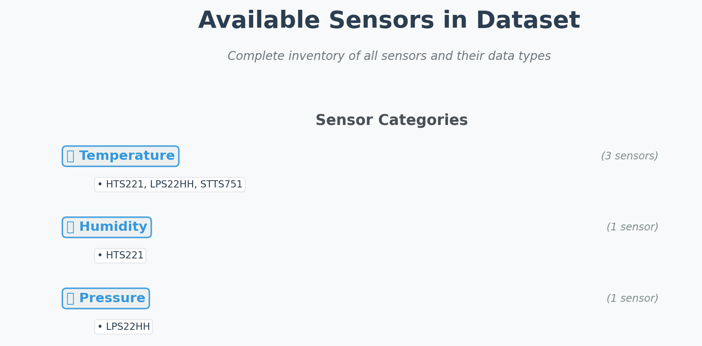
AI Commands & Examples
What is the mean temperature for KO_HIGH_2mm samples from HTS221?
show available sensors

Slide 17
Conclusion
Successfully developed a hybrid AI agent that automates statistical feature discovery.
Implemented a robust, parser-first natural language interface for reliable data visualization.
Demonstrated a complete, end-to-end solution that runs locally, ensuring data privacy and efficiency.

Slide 18
Future work
Expand Plotting Capabilities: Integrate a wider variety of plot types (e.g., box plots, heatmaps) to handle more diverse analytical questions.
Scale for Large Datasets: Develop strategies for handling datasets with too many features to fit into an LLM's context window for conversational queries.
Enhance the Statistical Engine: Incorporate more advanced discriminative models (e.g., permutation importance, SHAP) for deeper feature analysis.

Slide 19


Thank you
Any question?
https://github.com/nasrinrahimizade/AI_agent

