Slide 1

Web SearchEngines (Web IR)
Handout #1: Introduction
Ali Mohammad Zareh Bidoki
Computer Engineering, Yazd University
alizareh@yazd.ac.ir

Slide 2
Outline
Web challenges
Search engines
Web crawling
Indexing
Web ranking

Slide 3
Web & Internet
What is difference between Web & Internet?
Why the web is successful?
Huge Graph
  What is edges?
  What is nodes?
ut.ac.ir
Yazd.ac.ir

Slide 4
Web Challenges
Huge size of information
  11.5 billions pages (2005)
  64 billions pages (05 June, 2008)
  150 billions pages ( 2013)
  300 billions pages ( 2019)
Proliferation and dynamic nature
  New pages are created at the rate of 8% per week
  Only 20% of the current pages will be accessible after one year
  New links are created at rate 25% per week
Heterogeneous contents
  HTML/Text/Audio/…

Slide 5
Web Retrieval
Search Engine
Matching
User Space
Information Space
  Index terms
  Full text
  Full text + Structure (e.g. hypertext)
  Retrieval
  Browsing

Slide 6
Search Engines Trends
5 billion search queries are received by major search engines each day
80% of web surfers discover the new sites that they visit through search engines
Web search currently generates more than 85% of the traffic to most web sites

Slide 7
Components of Search Engines
Crawling
Indexing
Ranking
NLP (Natural Language Processing)

Slide 8

Architecture of Search Engines
Page Repository
Client
Queries
Results
Crawler(s)
Web
Indexer
Module
Collection
Analysis
Module
Query
Engine
Ranking
Indexes :
Text
Structure
Utility

Slide 9
Web Crawling Issues
Coverage
  Google, the biggest search engine, covers only 70% of web content
  We must focus on high quality pages
Freshness
  Keep the copy in synchronize with the source pages
Politeness
  Do it without disrupting the web and obeying the webmasters constrains

Slide 10
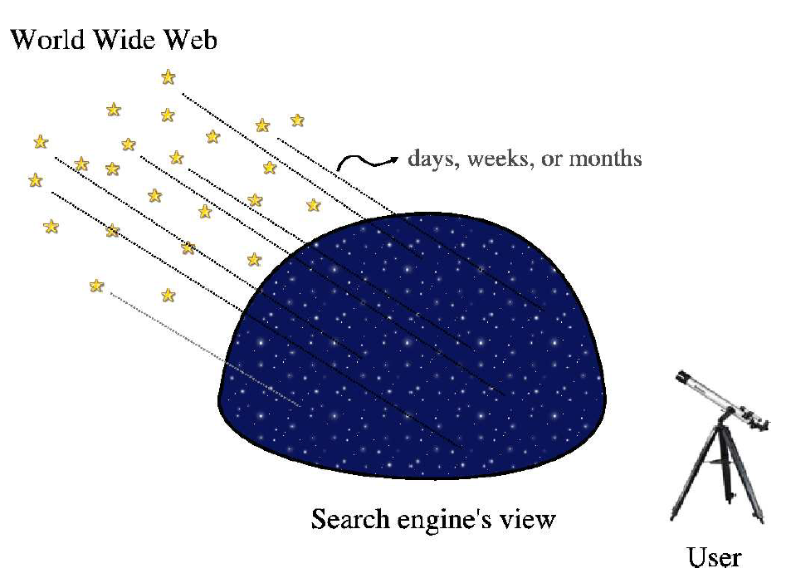
Web Crawling Issues

Slide 11
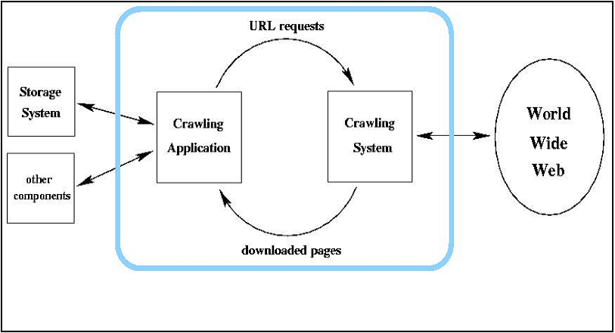
Web crawling
Crawler

Slide 12
Crawling Scheduling
Breadth-First
Back-link count
PageRank,…

Slide 13
Crawling scheduling
Web
Ranking
Algorithm
Downloader
Repository
URLs and Links

Slide 14
Indexing
Text Operations forms index words (tokens).
  Stopword removal
  Stemming
Indexing constructs an inverted index of word to document pointers.

Slide 15
Comparing IR to databases (vs data retrieval)
 | Databases | IR
Data | Structured | Unstructured
Fields | Clear semantics (SSN, age) | No fields (other than text)
Queries | Defined (relational algebra, SQL) | Free text (“natural language”), Boolean
Query specification | Complete | Incomplete
Matching | Exact (results are always “correct”) | Imprecise (need to measure effectiveness)
Error response | Sensitive | Insensitive

Slide 16
Indexing Systems
Google file system
MG4J (Managing Gigabytes for Java)
Lucene (Java-GPL)
Swish-e (C++-Linux)

Slide 17
Ranking : Definition
Ranking is the process which estimates the quality of a set of results retrieved by a search engine
Ranking is the most important part of a search engine

Slide 18
Ranking Types
Content-based
  Classical IR
Connectivity based (web)
User-behavior based

Slide 19
Classical Information Retrieval
Ranking is a function of query term frequency within the document (tf) and across all documents (idf)
  Vector space
  Probabilistic
Docs
Words
1
1
2
2
Query
n
w

Slide 20
Classical Information Retrieval
This works because of the following assumptions in classical IR:
  Queries are long and well specified
  Documents (e.g., newspaper articles) are coherent, well authored, and are usually about one topic
  The vocabulary is small and relatively well understood

Slide 21
Web information retrieval
Queries are short: 2.35 terms in avg.
Huge variety in documents: language, quality, duplication
Huge vocabulary: 100s millions terms
Deliberate misinformation
Spamming!
  Its rank is completely under the control of Web page’s author

Slide 22
Ranking in Web IR
Docs
Docs
Words
Ranking is a function of the query terms and of the hyperlink structure
  Using content of other pages to rank current pages
It is out of the control of the page’s author
  Spamming is hard
1
1
1
2
2
2
Query
n
n
w
Web graph

Slide 23
Grading
Projects (Midterm): 50%
  Two/three projects
Final:50%
+1 (<=3 Absence in class)

Slide 24
Books
  Introduction to Information Retrieval, by Christopher D. Manning, Prabhakar Raghavan, and Hinrich Schuetze

Slide 25

Course Channel https://t.me/+eZS022IiXLNlZGI0

