Slide 1

Ranking based on connectivity
Ali Mohammad Zareh Bidoki
Computer Engineering, Yazd University
alizareh@yazd.ac.ir

Slide 2
Architecture of Search Engines
Page Repository
Client
Queries
Results
Crawler(s)
Web
Indexer
Module
Collection
Analysis
Module
Query
Engine
Ranking
Indexes :
Text
Structure
Utility

Slide 3
Ranking : Definition
Ranking is the process which estimates the quality of a set of results retrieved by a search engine
Ranking is the most important part of a search engine

Slide 4
Ranking Types
Content-based
Classical IR
tf-idf
Connectivity based (web)

Slide 5
Web information retrieval
Queries are short: 2.35 terms in avg.
Huge variety in documents: language, quality, duplication
Huge vocabulary: 100s millions terms
Deliberate misinformation
Spamming!
Its rank is completely under the control of Web page’s author

Slide 6
Huge Web graph
Node: web pages
Edge: Hyper link between pages
<a
<a href="url">link text</a>
<a href=http://yazd.ac.ir>دانشگاه یزد </a>
A directed graph
Average in/out degree=40 in Persian

Slide 7
Ranking in Web IR
Docs
Docs
Words
Ranking is a function of the query terms and of the hyperlink structure
Using content of other pages to rank current pages
It is out of the control of the page’s author
Spamming is hard
1
1
1
2
2
2
Query
n
n
w
Web graph

Slide 8
Use graph in Ranking
Simple Idea:
Indegree?
Outdegree?
Implementation?
How save in Index?

Slide 9
Connectivity-based Ranking
Query independent
PageRank

Slide 10
Google’s PageRank Algorithm
Idea: Mine structure of the web graph
Each web page is a node
Each hyperlink is a directed edge

Slide 11
PageRank
Assumption: A link from page A to page B is a recommendation of page B by the author of A (we say B is successor of A)
Quality of a page is related to its in-degree
Recursion: Quality of a page is related to
its in-degree, and to
the quality of pages linking to it
PageRank
A
B
Successor

Slide 12
Definition of PageRank
Consider the following infinite random walk (surf):
Initially the surfer is at a random page
At each step, the surfer proceeds to a randomly chosen successor of the current page (With probability 1/outdegree)
The PageRank of a page p is the fraction of steps the surfer spends at p in the limit.
Random surfer model
Surfer
s
p

Slide 13
PageRank (cont.)
By previous theorem:
PageRank = stationary probability for this Markov chain, i.e.

Slide 14
PageRank (cont.)
A
B
P
PageRank of P is
P(A)/4 + P(B)/3

Slide 15
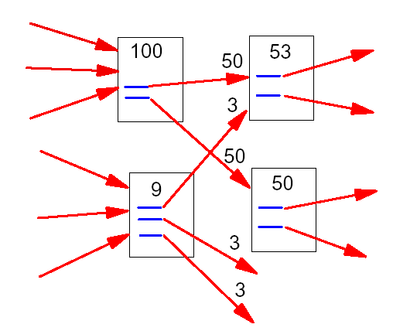
PageRank (cont.)

Slide 16
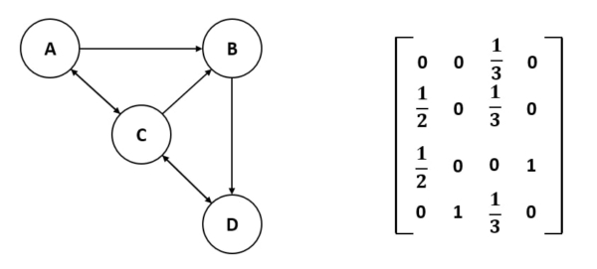
PageRank Implementation
Sec. 1.2
R=vector of all pages
R=[pr₀,pr₁,pr₂,…,pr_{n}]
How find R?
R₀=[1/n,1/n,…]
A: a_{ij}=1/Outdegree(i)
R_{n}=A^{t} *R_{n-1}
Until |R_{n}-R_{n-1}|<e
R=[PR(A),PR(B),PR(C),PR(D)]
PR(B)=PR(A)/2+PR(C)/3=1/4*1/2+1/4*1/3
PR(D)=P(B)/1+PR(C)/3=1/4*1+1/4*1/3
….

Slide 17
PageRank Complexity
Sec. 1.2
E= number of edges
K=number of iteration
O(E*K)
PageRank Challenges

