Slide 1

Indexing in Search Engines
Ali Mohammad Zareh Bidoki
Computer Engineering, Yazd University
alizareh@yazd.ac.ir

Slide 2

Architecture of Search Engines
Page Repository
Client
Queries
Results
Crawler(s)
Web
Indexer
Module
Collection
Analysis
Module
Query
Engine
Ranking
Indexes :
Text
Structure
Utility

Slide 3
Fast search in Unstructured data
Sec. 1.1
Which plays of Shakespeare contain the words Brutus AND Caesar but NOT Calpurnia?
Query: Yazd AND university AND NOT Computer
Solution 1: forward Indexing
  Query Len=q, Number of docs=n, Average number of words in doc=m
  Complexity=O(?)
Why is that not the answer?
  Slow (for large corpora)
  NOT Calpurnia is non-trivial
  Other operations (e.g., find the word Romans near countrymen) not feasible
  Ranked retrieval (best documents to return)
    Later lectures
Notes:
Grep is line-oriented; IR is document oriented.

Slide 4
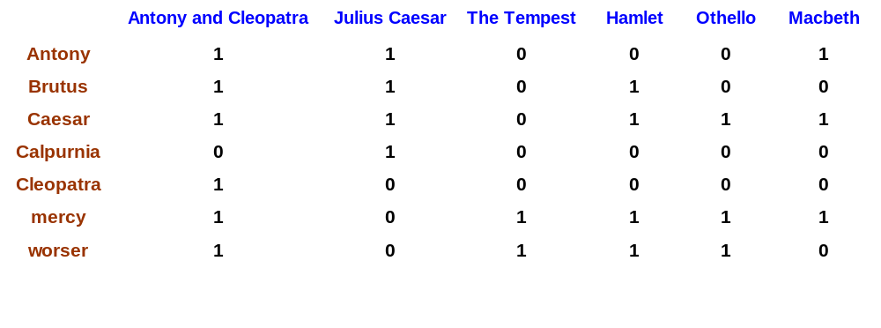
Term-document Matrix
Sec. 1.1
1 if play contains word, 0 otherwise
Brutus AND Caesar BUT NOT Calpurnia

Slide 5
Term vectors
Sec. 1.1
So we have a 0/1 vector for each term.
To answer query: take the vectors for Brutus, Caesar and Calpurnia (complemented) ➔ bitwise AND.
110100 AND 110111 AND 101111 = 100100.

Slide 6
Advantages & Disadvantages
Speed?
  Bit wise and
Memory?
  Sparse matrix
No ranking

Slide 7
Can’t build the matrix (1M docs, 500K dic)
Sec. 1.1
500K x 1M matrix has half-a-trillion 0’s and 1’s.
But it has no more than one billion 1’s.
  matrix is extremely sparse.
What’s a better representation?
  We only record the 1 positions.
Why?

Slide 8
Inverted index
Sec. 1.2
For each term t, we must store a list of all documents that contain t.
  Identify each by a docID, a document serial number
Can we used fixed-size arrays for this?
Brutus
1
2
4
11
31
45
173
174
Caesar
1
2
4
5
6
16
57
132
Calpurnia
2
31
54
101
What happens if the word Caesar is added to document 14?

Slide 9
Inverted index
Sec. 1.2
We need variable-size postings lists
  On disk, a continuous run of postings is normal and best
  In memory, can use linked lists or variable length arrays
    Some tradeoffs in size/ease of insertion
Posting
Brutus
1
2
4
11
31
45
173
174
Caesar
1
2
4
5
6
16
57
132
Calpurnia
2
31
54
101
Dictionary
Postings
Notes:
Linked lists generally preferred to arrays
Dynamic space allocation
Insertion of terms into documents easy
Space overhead of pointers

Slide 10
Example
Sec. 1.2
D1: Yazd uni is the best
D2: Yazd is a historical city
D3: I like yazd uni?
Yazd
D1
D2
D3
uni
D1
D3
city
D2
q=yazd uni (default is And)

Slide 11
Urls or ID
Urls
  200 byte per url
  Index size
id
  4/8 bytes
  Fast & low index size
  Convert URL to id and id to url
  Which data structure?
Save: url, title, time, body (Snippet)

Slide 12
Query processing: AND
Sec. 1.3
Consider processing the query:
  Brutus AND Caesar
  Locate Brutus in the Dictionary;
    Retrieve its postings.
  Locate Caesar in the Dictionary;
    Retrieve its postings.
  “Merge” the two postings:
2
4
8
16
32
64
128
Brutus
1
2
3
5
8
13
21
34
Caesar

Slide 13
The merge
Sec. 1.3
Walk through the two postings simultaneously, in time linear in the total number of postings entries
2
2
4
4
8
8
16
16
32
64
128
32
64
128
Brutus
2
8
1
Caesar
1
2
2
3
5
5
8
8
13
13
21
21
34
3
34

Slide 14
Search complexity
If the list lengths are x and y, the merge takes O(x+y) operations.
Crucial: postings sorted by docID.

Slide 15
Boolean queries:
More general merges
Sec. 1.3
Exercise: Adapt the merge for the queries:
Brutus AND NOT Caesar
Brutus OR NOT Caesar
Can we still run through the merge in time O(x+y)?
What can we achieve?

Slide 16
Data Structure for Posting List
Linked list
  size
  Insert and delete/update
Array
  fast
  Fixed length
Which is better?

Slide 17
Disk or Memory
Disk
  Size
  Seek time
Memory
  fast
Hybrid
  caching

Slide 18
Doc freq
Sec. 1.2
D1: Yazd uni is the best
D2: Yazd is a historical city
D3: I like yazd uni this?
Yazd
3
D1
D2
D3
2
uni
D1
D3
city
1
D2
q=yazd uni (default is And)

Slide 19
Query optimization
Sec. 1.3
What is the best order for query processing?
Consider a query that is an AND of n terms.
For each of the n terms, get its postings, then AND them together.
Brutus
2
4
8
16
32
64
128
Caesar
1
2
3
5
8
16
21
34
Calpurnia
13
16
Query: Brutus AND Calpurnia AND Caesar

Slide 20
Query optimization example
Sec. 1.3
Process in order of increasing freq:
  start with smallest set, then keep cutting further.
This is why we kept
document freq. in dictionary
Brutus
2
4
8
16
32
64
128
Caesar
1
2
3
5
8
16
21
34
Calpurnia
13
16
Execute the query as (Calpurnia AND Brutus) AND Caesar.

Slide 21
Search scenario
Sec. 1.2
D1: Yazd uni is the best
D2: Yazd is a historical city
D3: I like yazd uni this?
Yazd
3
D1
D2
D3
2
uni
D1
D3
city
1
D2
q=yazd uni (default is And)

Slide 22
Index Size
N=1M docs, Vocab size(Uniq words)=500K, Mean uniq words per doc=1000, mean word size = 6byte
Size=dic size+postings list size
  Dic size=(6+4+4)*500K=7MB
  Posting size (linked list)=(1M*1000*(4+4))=8GB

Slide 23
FASTER POSTINGS MERGES:
SKIP POINTERS/SKIP LISTS

Slide 24
Recall basic merge
Sec. 2.3
Walk through the two postings simultaneously, in time linear in the total number of postings entries
2
4
8
41
48
64
128
Brutus
2
8
1
2
3
8
11
17
21
31
Caesar
If the list lengths are m and n, the merge takes O(m+n)
operations.
Can we do better?
Yes (if index isn’t changing too fast).

Slide 25
Augment postings with skip pointers (at indexing time)
Sec. 2.3
41
128
2
4
8
41
48
64
128
11
31
1
2
3
8
11
17
21
31
Why?
To skip postings that will not figure in the search results.
How?
Where do we place skip pointers?

Slide 26
Query processing with skip pointers
Sec. 2.3
41
128
2
4
8
41
48
64
128
11
31
1
2
3
8
11
17
21
31
Suppose we’ve stepped through the lists until we process 8 on each list. We match it and advance.
We then have 41 and 11 on the lower. 11 is smaller.
But the skip successor of 11 on the lower list is 31, so
we can skip ahead past the intervening postings.

Slide 27
Where do we place skips?
Sec. 2.3
Tradeoff:
  More skips → shorter skip spans ⇒ more likely to skip. But lots of comparisons to skip pointers.
  Fewer skips → few pointer comparison, but then long skip spans ⇒ few successful skips.

Slide 28
Placing skips
Sec. 2.3
Simple heuristic: for postings of length L, use √L evenly-spaced skip pointers.
This ignores the distribution of query terms.
Easy if the index is relatively static; harder if L keeps changing because of updates.
Notes:
Because of cache

Slide 29
PHRASE QUERIES AND POSITIONAL INDEXES

Slide 30
Phrase queries
Sec. 2.4
Want to be able to answer queries such as “stanford university” – as a phrase
Thus the sentence “I went to university at Stanford” is not a match.
  The concept of phrase queries has proven easily understood by users; one of the few “advanced search” ideas that works
  Many more queries are implicit phrase queries
For this, it no longer suffices to store only
<term : docs> entries

Slide 31
A first attempt: Biword indexes
Sec. 2.4.1
Index every consecutive pair of terms in the text as a phrase
For example the text “Friends, Romans, Countrymen” would generate the biwords
  friends romans
  romans countrymen
Each of these biwords is now a dictionary term
دانشکده کامپیوتر دانشگاه یزد
Two-word phrase query-processing is now immediate.

Slide 32
Longer phrase queries
Sec. 2.4.1
Longer phrases are processed as we did with wild-cards:
دانشکده کامپیوتر دانشگاه یزد can be broken into the Boolean query on biwords:
دانشکده کامپیوتر AND کامپیوتر دانشگاه AND دانشگاه یزد
Without the docs, we cannot verify that the docs matching the above Boolean query do contain the phrase.

Slide 33
Issues for biword indexes
Sec. 2.4.1
False positives, as noted before
Index blowup due to bigger dictionary
  Infeasible for more than biwords, big even for them
Biword indexes are not the standard solution (for all biwords) but can be part of a compound strategy

Slide 34
Solution 2: Positional indexes
Sec. 2.4.2
In the postings, store, for each term the position(s) in which tokens of it appear:
  <term, number of docs containing term;
  doc1: position1, position2 … ;
  doc2: position1, position2 … ;
  etc.>

Slide 35
Positional index example
Sec. 2.4.2
<be: 993427;
1: 7, 18, 33, 72, 86, 231;
2: 3, 149;
4: 17, 191, 291, 430, 434;
5: 363, 367, …>
Which of docs 1,2,4,5
could contain “to be
or not to be”?
For phrase queries, we use a merge algorithm recursively at the document level
But we now need to deal with more than just equality

Slide 36
Processing a phrase query
Sec. 2.4.2
Extract inverted index entries for each distinct term: to, be, or, not.
Merge their doc:position lists to enumerate all positions with “to be or not to be”.
  to:
    2:1,17,74,222,551; 4:8,16,190,429,433; 7:13,23,191; ...
  be:
    1:17,19; 4:17,191,291,430,434; 5:14,19,101; ...
Same general method for proximity searches

Slide 37
Positional Index
Sec. 1.2
D1: Yazd uni is the best uni
D2: Yazd is a historical city
D3: I like yazd city and Tehram uni this?
Yazd
3
D1,0
D2,0
D3,2
2
uni
D1,1,5
D3,6
city
1
D2,4
D3,3
q=yazd uni

Slide 38
Rules of thumb
Sec. 2.4.2
A positional index is 2–4 as large as a non-positional index
Positional index size 35–50% of volume of original text
Speed?
  Depends on words freq in docs

Slide 39
Dynamic Indexing
Sec. 2.4.2
Web content is dynamic
  New pages
  Update Pages
  Delete Pages
Solution?

Slide 40
New Pages
Add new words to Dic
Add doc to end of lists
  New id

Slide 41
Dead Pages
Check list for delete pages
  True & false
  [true, false, true….]
Re index in m hours
Update Pages
  Delete+New

Slide 42
Auxiliary Index
We have two indices
  A small index
  Large Index

Slide 43
Parallel Searching (1 Server)
Multi search on one Index
  Multi threading
Multi search performance (Number of thread)
  Number of CPU cores
  16 Core , Mean(Search Time)=200ms
One Index or multi Index?
  Server load
  (One 10M Or 10 1M index)
  Server A 10M, Server B 10 1M

Slide 44
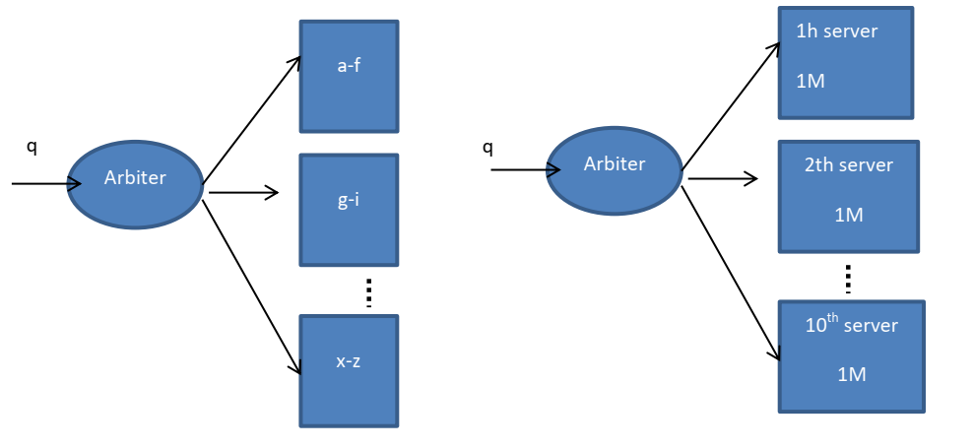
Distributed Indexing (Local/Global) 10M_10Server

Slide 45
Documents Parts (zones)
Each document have several parts
  Title
  Body
  Author
  Keywords/Description
What is index solution
  Merge in one part? (title+body+…)

Slide 46
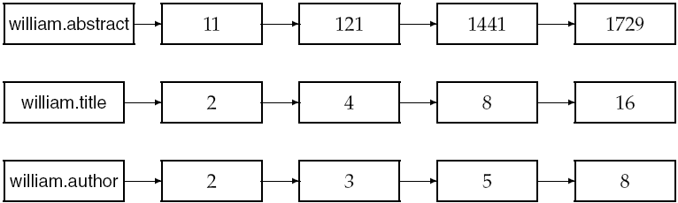
Example zone indexes
Sec. 6.1
Encode zones in dictionary vs. postings.

Slide 47
Final Document Score
Score=alpha*S_body+Beta*S_Title+gama*…
How for all in one?
  Iterate important parts?

Slide 48
مثال برای پروژه (دانشگاه یزد)
 | Body | Title | سند
0.5*(0.5*1+0.5*0)+ 0.5*(0.5*1+0.5*0) | دانشگاه تهران دانشگاه تهران | دانشگاه تهران | 1
0.5*(0.5*2+0.5*1)+ 0.5*(0.5*2+0.5*1) | دانشگاه یزد دانشگاه یزد | دانشگاه یزد | 2
2b | .... | دانشگاه در یزد | 3
0.5*(0.5*1+0.5*0)+ 0.5*(0.5*2+0.5*1) | دانشگاه یزد | شهر یزد | 4
 |  |  | 5
 |  |  | 6
wTitle*(wboolean*value Boolean+wPhrase*Value Phrase)+ wBody*(wboolean*value Boolean+wPhrase*Value Phrase)

Slide 49
نرمال سازی
  ی: سینی سیني
  ک عربی و فارسی
  همزء
  آ و ا
  نیم فاصله

Slide 50
N-gram indexing
Sec. 1.2
D1: Yazd uni is the best
D2: Yazd is a historical city
D3: I like yazd uni this?
2-gram: D1: Ya,az,zd,d-,-u,un,ni,i-….
Ya
3
D1
D2
D3
D4
2
az
D1
D2
D3
zd
1
D1
D2
D3
D8
q=yazd uni (default is And)
Pros& cons (Dic & posting list)?

