Slide 1

Ranking in Search Engines
Ali Mohammad Zareh Bidoki
Computer Engineering, Yazd University
alizareh@yazd.ac.ir

Slide 2
Architecture of Search Engines
Page Repository
Client
Queries
Results
Crawler(s)
Web
Indexer
Module
Collection
Analysis
Module
Query
Engine
Ranking
Indexes :
Text
Structure
Utility

Slide 3
Term-document Matrix
Sec. 1.1
1 if play contains word, 0 otherwise
Brutus AND Caesar BUT NOT Calpurnia

Slide 4
Ranking
Sec. 1.2
q= yazd uni
D1(Yazd#10, Uni 10): Yazd uni is the best yazd uni…
D2 (Yazd#1, uni#1): Yazd is a historical city, I like uni..
Score (q,d)=?

Slide 5
Term-document count matrices
Sec. 6.2
Consider the number of occurrences of a term in a document:
Each document is a count vector in ℕ^{v}: a column below

Slide 6
Term frequency tf
The term frequency tf_{t,d} of term t in document d is defined as the number of times that t occurs in d.
We want to use tf when computing query-document match scores. But how?
Raw term frequency is not what we want:
A document with 10 occurrences of the term is more relevant than a document with 1 occurrence of the term.
But not 10 times more relevant.
D1: yazd:15 uni:15 D2: yazd 1 uni 100

Slide 7
Log-frequency weighting
Sec. 6.2
The log frequency weight of term t in d is
0 → 0, 1 → 1, 2 → 1.3, 10 → 2, 1000 → 4, etc.
Score for a document-query pair: sum over terms t in both q and d:
score

Slide 8
Document frequency
Sec. 6.2.1
Rare terms are more informative than frequent terms
Recall stop words
روش پخت پیتزا
روش تعمیر دوچرخه
آموزش و پرورش

Slide 9
idf weight
Sec. 6.2.1
df_{t} is the document frequency of t: the number of documents that contain t
df_{t} is an inverse measure of the informativeness of t
df_{t} ≤ N
We define the idf (inverse document frequency) of t by
We use log (N/df_{t}) instead of N/df_{t} to “dampen” the effect of idf.

Slide 10
tf-idf weighting
Sec. 6.2.2
The tf-idf weight of a term is the product of its tf weight and its idf weight.
Best known weighting scheme in information retrieval
Note: the “-” in tf-idf is a hyphen, not a minus sign!
Alternative names: tf.idf, tf x idf
Increases with the number of occurrences within a document
Increases with the rarity of the term in the collection

Slide 11
tfidf example, suppose N = 1 million
Sec. 6.2.1
term | df_{t} | idf_{t} | tf | 1+logtf | Tfidf
دانشگاه | 10000 | Log(100)=2 | 10 | 2 | 4
یزد | 1000 | Log(1000)=3 | 10 | 2 | 6
تهران | 100000 | Log(10)=1 | 1 | 1 | 1
روش | 500000 | Log(2)=0.3 | 2 | 2.3 | 0.69
تعمیر | 4000 | Log(250)=2.3 | 0 | 0 | 0
دوچرخه | 2000 | Log(500)=2.6 | 0 | 0 | 0
Notes:
6 4 3 2 1 0

Slide 12
Tf-idf in Index
Sec. 1.2
D1: Yazd uni is the best uni
D2: Yazd is a historical city
D3: I like yazd city and Tehram uni this?
Yazd
3
D1,1
D2,1
D3,1
2
uni
D1,1+log2
D3,1
city
1
D2
D3
N=1000
q=yazd uni
Score(d1,q)=1*(log(1000/3)) +1.3*log(1000/2)

Slide 13
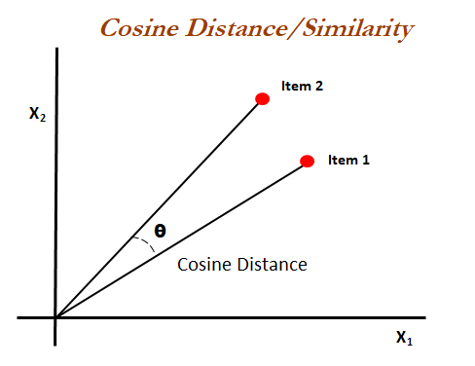
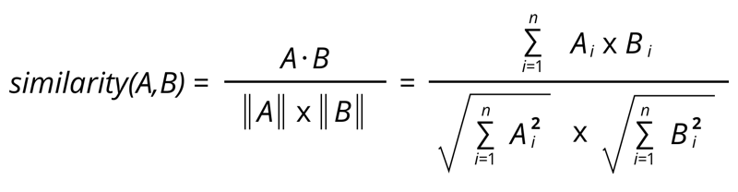
Vector Space
Sec. 2.4.2
Similarity between two vector
Q vector={tfidfq1, tifidfq2,…}
D vector={tfidfd1, tifidfd2,…}
Score (Q,D)= cos(Q,D)

Slide 14
Positional Index
Sec. 1.2
D1: Yazd uni is the best uni
D2: Yazd is a historical city
D3: I like yazd city and Tehram uni this?
Yazd
3
D1,0
D2,0
D3,2
2
uni
D1,1,5
D3,4
city
1
D2,4
D3,3
q=yazd uni

Slide 15
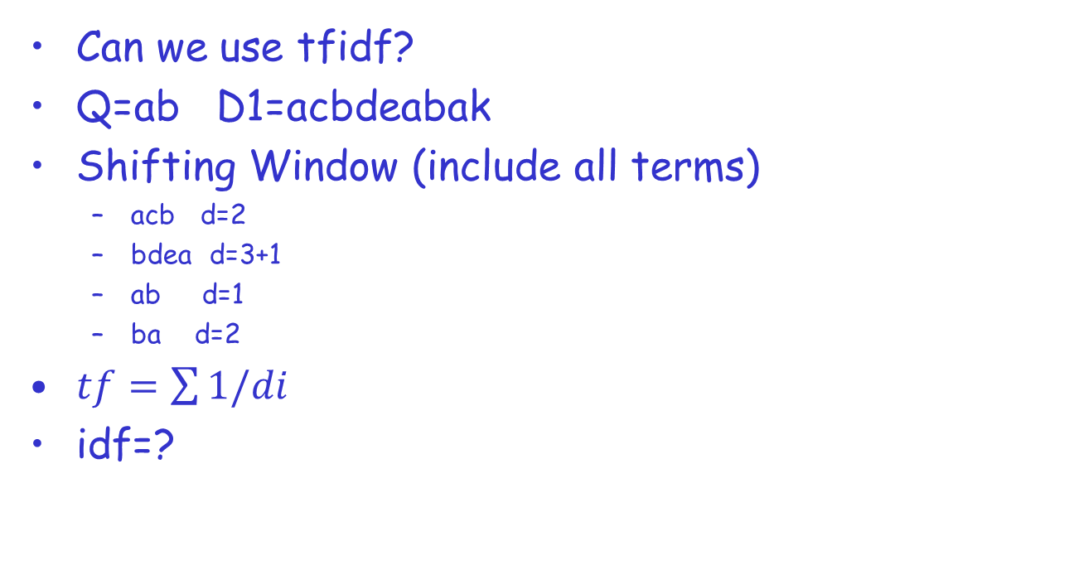
Positional Ranking
Can we use tfidf?
Q=ab D1=acbdeabak
Shifting Window (include all terms)
acb d=2
bdea d=3+1
ab d=1
ba d=2
$tf=\sum{1/di}$
idf=?

Slide 16
Example
Q:abcd D1: aefbc#2000#de
D2: a #10#b #10#c #10#d

