Slide 1
FINAL YEAR PROJECT • 2025 — 2026
ForsaDrive
A Tunisian-context carpooling platform — Web, Mobile, and a unified backend
Presented by
Supervised by
Youssef BEN ABID & Anas YOUNES
Mr. Khalil SELMI (ATOMIC IT)
Ms. Ines BEN NASR (Academic)
ATOMIC IT • Kelibia, Nabeul, Tunisia
Notes:
Bonjour, je suis Youssef, voici Anas. Nous allons vous présenter ForsaDrive, notre PFE réalisé chez ATOMIC IT sous la supervision de Mr. Khalil Selmi et Mme Ines Ben Nasr. ~30 s.

Slide 2
PLAN
Outline of the defense
01
Project context & problem
Why mobility in Tunisia is a real problem
02
Existing solutions
What people use today and where it falls short
03
Proposed solution & methodology
ForsaDrive concept and the Scrum process
04
Conception
Architecture, use cases, class diagram
05
Realization — sprint by sprint
From foundations to community features
06
Tests & demo
What works and a live walk-through
07
Conclusion & future work
What we delivered and what comes next
ForsaDrive • Final Year Project Defense • ATOMIC IT
2 / 21
Notes:
Walk the 7 sections quickly. Contexte, solutions existantes, notre proposition, méthodologie Scrum, conception, réalisation sprint par sprint, tests/demo, conclusion. ~30 s.

Slide 3
CONTEXT & MOTIVATION
Mobility in Tunisia — a real, daily problem
Public transport is irregular. Private cars travel half empty. Existing apps are not built for the local market.
Public transport
Informal carpooling
International apps
Overcrowded buses, irregular schedules, weak coverage of secondary cities.
Facebook groups, no identity verification, no payment trace, no rating.
BlaBlaCar/inDrive/Bolt — payment models and language not adapted to Tunisia.
PROBLEM STATEMENT
Tunisia lacks a secure, affordable digital ride-sharing solution adapted to local payment habits, available on web and mobile, and capable of building genuine trust between drivers and passengers.
ForsaDrive • Final Year Project Defense • ATOMIC IT
3 / 21
Notes:
Two anchors: students/workers travel a lot but have small budgets, and private cars travel half empty. Read the problem statement quote at the bottom — it's the thesis of the whole project. ~45 s.

Slide 4
INTERNSHIP FRAMEWORK
ATOMIC IT — host company
▸ IT engineering services: web and mobile development, software consulting.
▸ Modern stack: Linux/Windows, .NET, Java, Android/iOS, PHP.
▸ Located in Kelibia, Nabeul. Director: Mr. Khalil SELMI.
▸ Flat structure — short feedback loops between developers and management.
▸ Internship inside the engineering team, mentored by senior developers.
▸ Agile Scrum applied: daily stand-ups, weekly reviews with the supervisor.
AT A GLANCE
Activity
Web & mobile development
Director
Mr. Khalil SELMI
Location
Kelibia, Nabeul
Phone
+216 55 343 224
Email
contact@atomicitpro.com
Methodology
Agile / Scrum
ForsaDrive • Final Year Project Defense • ATOMIC IT
4 / 21
Notes:
Brief. They provided technical supervision AND the agile process. Don't dwell, the jury cares about the project. ~30 s.

Slide 5
CRITICAL STUDY
What people use today
Criterion | Facebook | inDrive | Bolt | BlaBlaCar | ForsaDrive
Identity verification | — | Partial | ✓ | ✓ | ✓
In-app payment | — | — | ✓ | ✓ | ✓
Long-distance rides | ✓ | — | — | ✓ | ✓
Rating system | — | ✓ | ✓ | ✓ | ✓
Adapted to local context | ✓ | Partial | Partial | — | ✓
Student discount (50%) | — | — | — | — | ✓
Wallet-based balance | — | — | — | — | ✓
No existing option combines local fit with structured trust mechanisms. ForsaDrive sits exactly in that gap.
ForsaDrive • Final Year Project Defense • ATOMIC IT
5 / 21
Notes:
Don't read the whole table. Pick one row: 'Look at student discount — none of these have it. Wallet — none of these have it. That's our gap.' End with the bold sentence. ~45 s.

Slide 6
PROPOSED SOLUTION
ForsaDrive — what we built
An integrated ecosystem: web app, mobile app, and a shared backend, covering the full lifecycle from registration to post-trip rating.
Local fit
Trust
Smart features
50% prepayment + cash settlement, French/English/Arabic with RTL, Tunisian-recognized university domains.
Identity & student verification, ratings on both sides, complaint workflow, reliability score.
Compatibility score, driver analytics, ride boosting, social feed, in-app chat, AI-assisted helpdesk.
3
4
20+
3
coordinated apps
functional sprints
domain entities
supported languages
ForsaDrive • Final Year Project Defense • ATOMIC IT
6 / 21
Notes:
Three pillars structure the rest of the talk. Numbers to memorize: 3 apps, 4 sprints, 20+ entities, 3 languages. ~45 s.

Slide 7
METHODOLOGY
Scrum — five iterations grouped into two releases
Sprint 0 prepared the ground. Four functional sprints then delivered two coherent releases of the product.
S0
S1
S2
S3
S4
Architecture
& Conception
Foundations
(Auth + Profiles)
Rides
& Bookings
Payments
& Intelligence
Community
& Finalization
RELEASE 1 — usable booking loop
RELEASE 2 — intelligence + community
▸ Daily stand-ups inside the team — weekly reviews with the supervising engineer.
▸ Each sprint produced a usable increment, reviewed and demonstrated.
▸ Trello board kept the backlog visible — story points on a Fibonacci scale.
ForsaDrive • Final Year Project Defense • ATOMIC IT
7 / 21
Notes:
THIS is the slide your supervisor cares about. Walk the timeline: Sprint 0 was preparatory, four functional sprints, grouped into two releases. Mention daily stand-ups and weekly reviews. ~1 min.

Slide 8
SPRINT 0 · CONCEPTION
Architecture — client / server, three tiers
▸ Two clients (web + mobile) consume one REST API.
▸ Backend in PHP, exposed under /api/, secured with bearer tokens.
▸ Three tiers: presentation, application, data.
▸ External services (payment, notifications, file storage) only reached through the backend — no client secrets.
▸ HTTPS in production. Passwords with bcrypt. Audit log on sensitive operations.
Web App
Mobile App
Backend
(REST API)
SQLite (WAL)
ForsaDrive • Final Year Project Defense • ATOMIC IT
8 / 21
Notes:
Two clients, one backend, one DB. The business rules live in the backend so they cannot be bypassed from the mobile side. Bearer tokens, bcrypt, HTTPS. ~1 min.

Slide 9
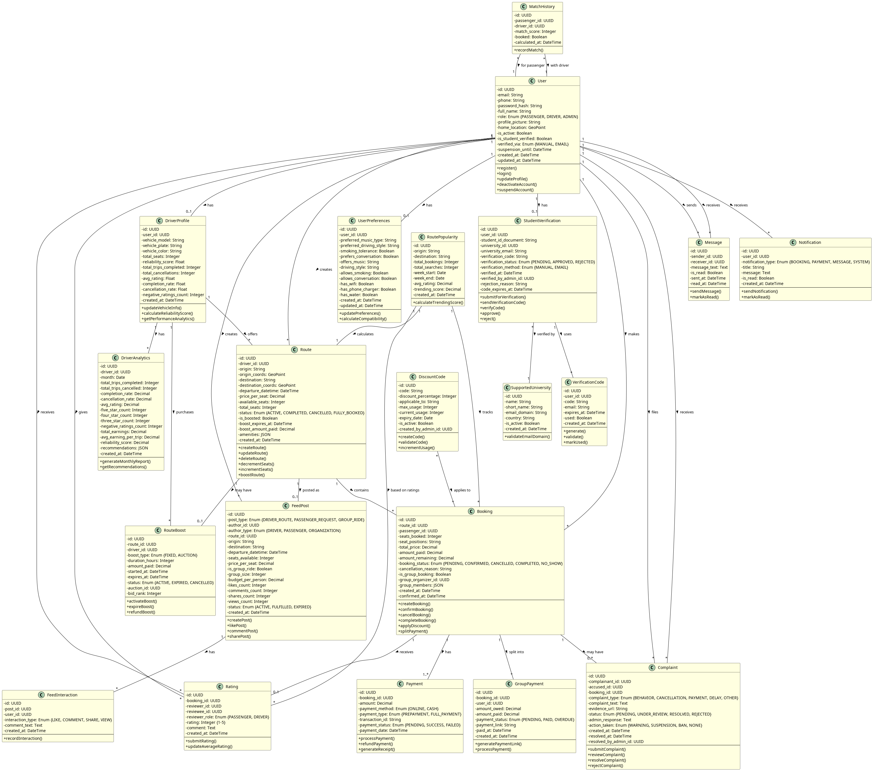
SPRINT 0 · CONCEPTION
Class diagram — 20+ entities, 5 logical groups
Users & Profiles · Trips & Bookings · Payments & Ratings · Verification & Discounts · Communication & Moderation
ForsaDrive • Final Year Project Defense • ATOMIC IT
9 / 21
Notes:
Do NOT read every class. Say: 20-something entities, organized into five logical groups — users, trips, payments, verification, communication. Refer the jury to the report for the detail. ~30 s.

Slide 10
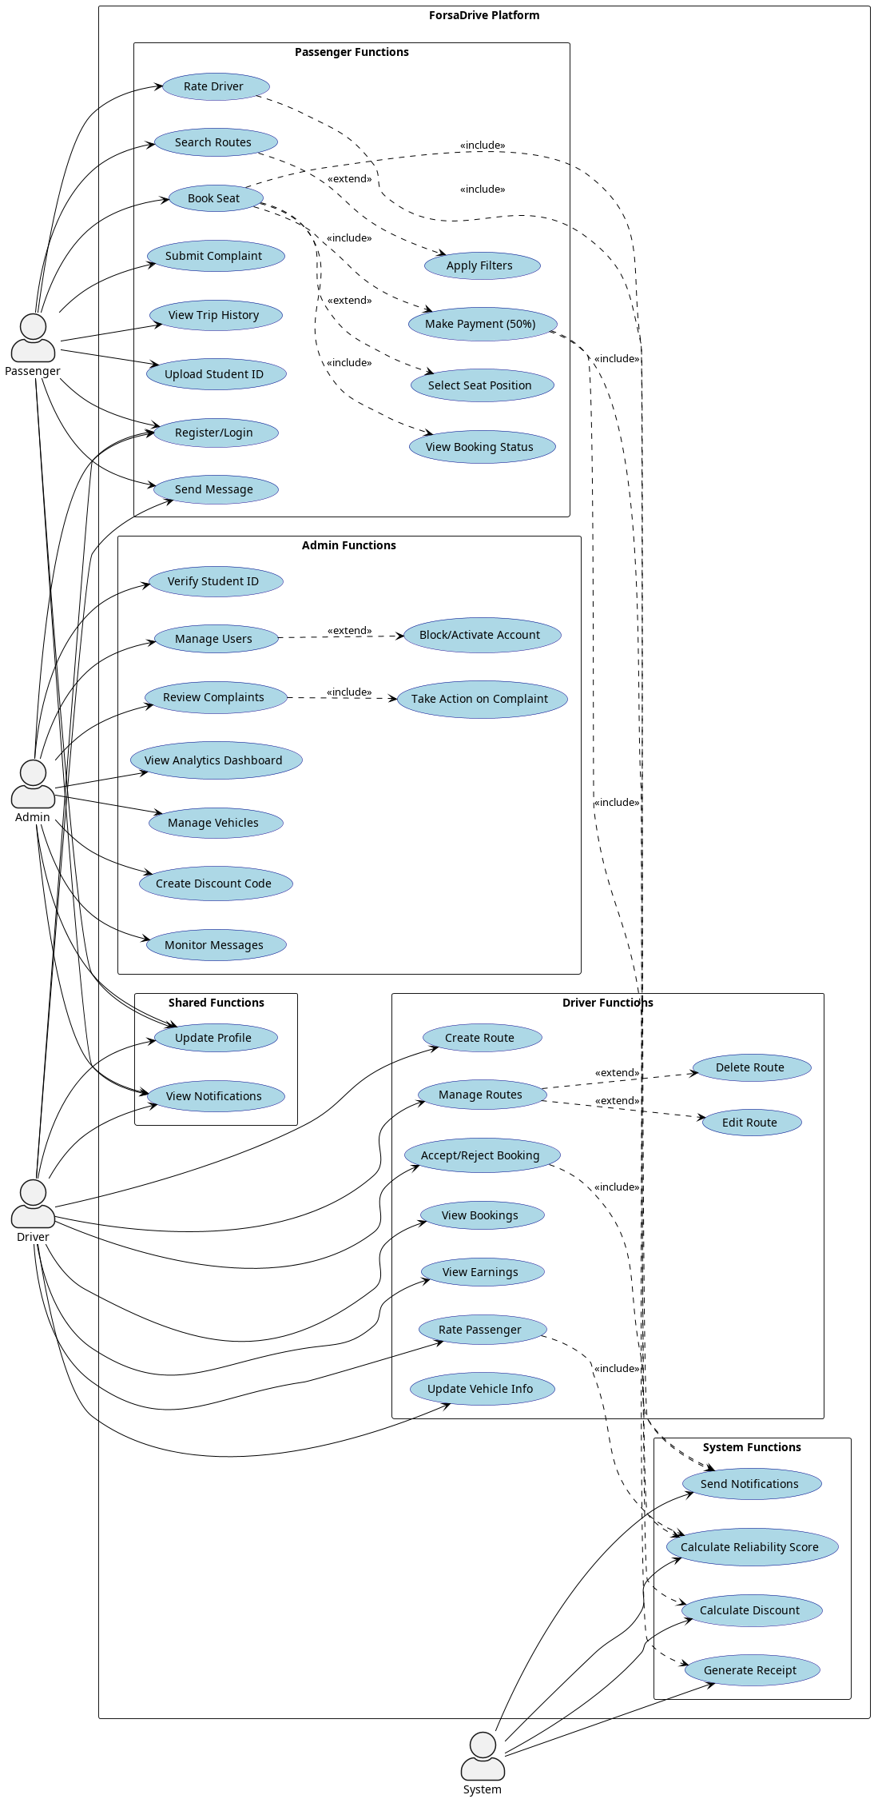
SPRINT 0 · CONCEPTION
Global use case — four actors
Passenger · Driver · Administrator · System (automated)
ForsaDrive • Final Year Project Defense • ATOMIC IT
10 / 21
Notes:
Same idea: don't enumerate. 'Four actors — passenger, driver, admin, and the system itself for automated operations like discount calculation and reliability scoring.' ~30 s.

Slide 11
Sprint backlog (extract)
SPRINT 1
Foundations
# | User story | Pts
US1.1 | Register an account | 5
US1.2 | Login with email + password | 3
US1.3 | View / update profile | 3
US1.4 | Student verification via university email OTP | 8
US1.5 | Apply to become a driver (license + vehicle) | 8
US1.6 | Admin reviews driver applications | 5
US1.7 | Admin manages recognized university domains | 3
MISSION
Account creation, authentication, profile, student verification, driver application & admin approval.
Deliverables
▸ Self-service OTP flow (10-min code, 5-attempt cap, 30s cooldown).
▸ Driver application creates DriverProfile + Vehicle on approval.
▸ Audit log entry on every verification event.
ForsaDrive • Final Year Project Defense • ATOMIC IT
11 / 21
Notes:
Read the mission (left rail). Highlight US1.4 (OTP) and US1.5 (driver app) — they're the most interesting. Read the 3 deliverables. ~1 min.

Slide 12
Sprint backlog (extract)
SPRINT 2
Rides & Bookings
# | User story | Pts
US2.1 | Publish a ride (origin, destination, date, price, seats) | 5
US2.2 | Modify or cancel a ride | 3
US2.3 | Search rides by origin / destination / date | 5
US2.4 | Filter by price, departure time, driver rating | 5
US2.5 | View ride detail and driver profile | 3
US2.6 | Book seats with 50% prepayment | 8
US2.7 | Group booking for friends | 5
US2.8 | Driver accepts / rejects booking requests | 5
MISSION
Driver publishes a ride. Passenger searches, filters, books with 50% prepayment.
Deliverables
▸ Booking persisted only if prepayment succeeds — no orphan bookings.
▸ Search response indexed on origin, destination, departure_date.
▸ Activity diagram covered cash collection at end of trip.
ForsaDrive • Final Year Project Defense • ATOMIC IT
12 / 21
Notes:
Mission, then highlight US2.6 (50% prepayment) and US2.7 (group booking). Mention the cash collection step in the activity diagram — shows you thought about the full flow, not just the happy path. ~1 min.

Slide 13
Sprint backlog (extract)
SPRINT 3
Payments & Intelligence
# | User story | Pts
US3.1 | View wallet balance and history | 5
US3.2 | Top up wallet | 3
US3.3 | Auto-apply 50% student discount on booking | 3
US3.4 | Apply organizational promo code | 3
US3.5 | Boost a ride to top of search/feed | 5
US3.6 | Driver dashboard with reliability + revenue + ratings | 8
US3.7 | Compatibility score badge per ride | 5
US3.8 | Recompute reliability after every completed trip | 3
MISSION
Wallet, promo codes, ride boosting, driver analytics, compatibility score.
Deliverables
▸ Price pipeline: base × seats → student 50% → promo % → 50% prepayment.
▸ Reliability score: rating × completion × (1 − cancellation).
▸ Bug caught at sprint review: promo applied before student discount — fixed.
ForsaDrive • Final Year Project Defense • ATOMIC IT
13 / 21
Notes:
Highlight: 'The price pipeline bug found at the sprint review — we applied the promo BEFORE the student discount, slightly favoring the passenger. Fixed same evening + unit test added.' Shows you do real reviews. ~1 min.

Slide 14
Sprint backlog (extract)
SPRINT 4
Community & Finalization
# | User story | Pts
US4.1 | Real-time in-app chat (poll-based) | 5
US4.2 | Push notifications (FCM) | 3
US4.3 | Social feed (posts, likes, comments) | 8
US4.4 | Rate the other party after a trip | 3
US4.5 | File a complaint after a trip | 5
US4.6 | AI-assisted HelpDesk with bot escalation | 5
US4.7 | Switch interface FR / EN / AR (RTL) | 5
US4.8 | Admin panel — 7 tabs | 8
MISSION
Chat, ratings, complaints, social feed, helpdesk, multilingual interface, admin panel.
Deliverables
▸ Chat polled every 3 s — sufficient for current scale, no WebSocket dep.
▸ HelpDesk bot covers 14 FAQ categories, escalates to human agent.
▸ Arabic flips the layout automatically through Flutter localizations.
ForsaDrive • Final Year Project Defense • ATOMIC IT
14 / 21
Notes:
Mention: chat is 3-second polling, no WebSocket — a deliberate trade-off, not a limitation. HelpDesk bot covers 14 FAQ categories with escalation. Arabic flips the layout automatically. ~1 min. (You should be at ~12 min total by end of this slide.)

Slide 15
REALIZATION
Selected screens
[mobile_auth.png]
[mobile_search.png]
[mobile_trip_details.png]
[mobile_driver_dashboard.png]
Authentication
Search + match score
Trip details + map
Driver dashboard
Web counterparts cover the same workflows for desktop users and the administration panel.
ForsaDrive • Final Year Project Defense • ATOMIC IT
15 / 21
Notes:
Walk left to right: auth → search with match score → trip detail with map → driver dashboard with reliability gauge. ~45 s.

Slide 16
MOBILE-SPECIFIC FEATURES
What only the mobile makes possible
Push notifications
Interactive map
Firebase Cloud Messaging delivers booking, message, and ride alerts even when the app is in the background.
OpenStreetMap tiles + OSRM routing draw the driving line between origin and destination on each ride detail screen.
Real-time chat
Multilingual + RTL
Conversations linked to bookings — bubble UI, date dividers, read receipts. 3-second polling, no WebSocket dependency.
FR / EN / AR with automatic right-to-left layout flipping for Arabic, no manual override in any widget.
ForsaDrive • Final Year Project Defense • ATOMIC IT
16 / 21
Notes:
If running long, SKIP this slide — the jury can read it. Otherwise: push (FCM), interactive map (OSM + OSRM), in-app chat, multilingual with auto RTL. ~30 s.

Slide 17
REALIZATION
Technology stack
Web frontend
Backend / data
Mobile
PHP 8 (server-rendered)
PHP REST API
Flutter (Dart)
Routing, sessions, page rendering.
Front-controller under /api/, JSON responses.
Single codebase, native rendering on Android & iOS.
HTML5 + Bootstrap 5
PDO + bearer tokens
Provider + go_router
Responsive layout, consistent components.
Parameterized queries, 32-byte hex tokens.
State management + declarative navigation.
Vanilla JavaScript
SQLite (WAL mode)
FCM, flutter_map, l10n
Form validation, AJAX, admin tab switching.
Shared file between web and mobile.
Push, OSM map, FR/EN/AR with RTL.
ForsaDrive • Final Year Project Defense • ATOMIC IT
17 / 21
Notes:
If running long, SKIP this too. One sentence per column: Web (PHP + Bootstrap), Backend (PHP REST + bearer + SQLite WAL), Mobile (Flutter + Provider + go_router + FCM). ~30 s.

Slide 18
QUALITY
Testing — continuous, not deferred
Strategy
Results
▸ Unit tests on the price pipeline, prepayment, booking state machine.
▸ Postman collections replay end-to-end scenarios after each backend change.
▸ Manual cross-device tests on three Android phones.
▸ Weekly demo with the supervising engineer caught usability issues.
Scenario | Result
Registration + student OTP | ✓ Passed
Token-based session | ✓ Passed
Driver application + approval | ✓ Passed
Publish / cancel a ride | ✓ Passed
Book with 50% prepayment | ✓ Passed
Student discount + promo code | ✓ Passed
Wallet top-up + history | ✓ Passed
Ratings + complaints | ✓ Passed
Real-time chat + push (FCM) | ✓ Passed
Multilingual + RTL | ✓ Passed
ForsaDrive • Final Year Project Defense • ATOMIC IT
18 / 21
Notes:
'Tests were continuous, not deferred.' Mention the price-pipeline unit suite specifically — that's where the Sprint 3 bug was locked. ~45 s.

Slide 19
LIVE DEMO
ForsaDrive in action
Walk-through: registration → student verification → search → book → driver acceptance → cash collection.
ForsaDrive • Final Year Project Defense • ATOMIC IT
19 / 21
Notes:
DEMO SCRIPT (3 min, 11 steps): (1) Register passenger on mobile. (2) Type recognized university email → green banner. (3) Trigger OTP verification. (4) Switch to web → driver session → publish Tunis-Sfax ride. (5) Mobile → search Tunis Sfax → ride appears with match badge. (6) Open ride detail → map + price breakdown with student discount. (7) Book one seat → 50% prepayment confirmation. (8) Web → driver accepts. (9) Mobile → booking confirmed in My Rides. (10) Open chat → send 'On arrive dans 5 minutes'. (11) Show driver dashboard → reliability gauge. FALLBACK: switch to PDF of screenshots and narrate.

Slide 20
HONEST ASSESSMENT
Limitations & roadmap
What's missing today
Next steps
▸ Wallet uses manual top-ups — no real payment gateway integrated yet.
▸ SQLite is suited for development, not high-traffic production.
▸ Mobile tested only on Android — iOS build not verified.
▸ No forgot-password email flow yet.
▸ Performance under concurrent load was not measured.
▸ Migrate to PostgreSQL or MySQL for production.
▸ Integrate a Tunisian payment gateway (Konnect or Paymee).
▸ Deploy backend behind HTTPS on a VPS, automated backups.
▸ Publish the Flutter app on the Google Play Store.
▸ Add 2FA for driver and admin accounts + offline cache on mobile.
ForsaDrive • Final Year Project Defense • ATOMIC IT
20 / 21
Notes:
BE HONEST — jurors test honesty here. Acknowledge: wallet uses manual top-ups, SQLite is for dev not production, iOS not verified. Then pivot to the roadmap. ~1 min.

Slide 21
QUESTIONS & DISCUSSION
Thank you for your attention.
We are now ready for your questions.
Youssef BEN ABID & Anas YOUNES · ForsaDrive · 2025 — 2026
ForsaDrive • Final Year Project Defense • ATOMIC IT
21 / 21
Notes:
Nous vous remercions pour votre attention. Nous sommes prêts pour vos questions. ~15 s.

Slide 22
BACKUP MATERIAL
Annexes — for questions
The following slides are not part of the main presentation. They are kept available in case the jury asks for deeper detail.

Slide 23
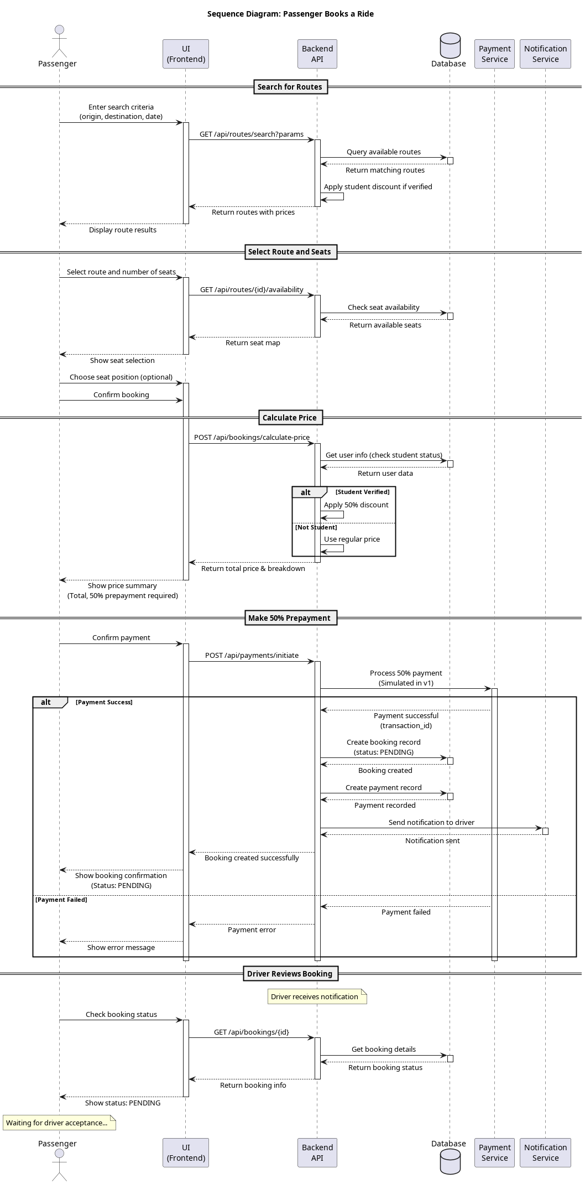
BACKUP A · BOOKING FLOW
Sequence — passenger books a ride
Prepayment is deducted from the wallet BEFORE the booking is persisted — guarantees no orphan bookings.
ForsaDrive • Final Year Project Defense • ATOMIC IT
A / 21

Slide 24
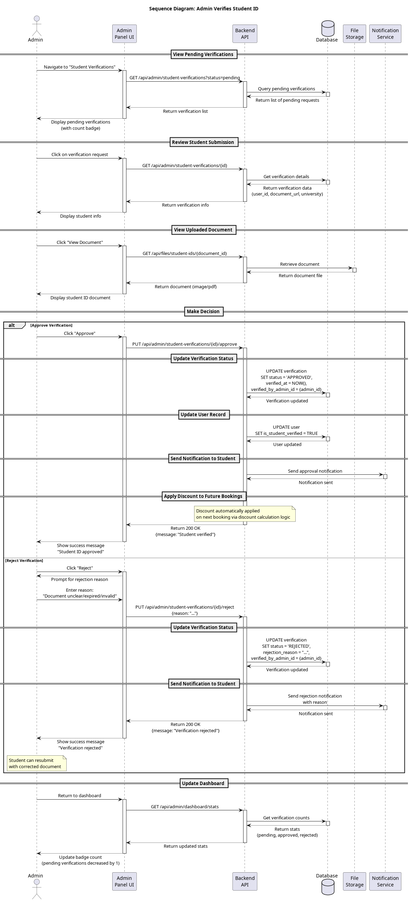
BACKUP B · TRUST FLOW
Sequence — student OTP verification
Domain checked against student_domains • 6-digit OTP, 10-min expiry, 5-attempt cap, 30s cooldown between sends.
ForsaDrive • Final Year Project Defense • ATOMIC IT
B / 21

Slide 25
BACKUP C · ONBOARDING
Sequence — driver application & admin approval
[image: ForsaDrive_Sequence_DriverApplication.png]
On approval: DriverProfile + Vehicle are created and the user role is switched to DRIVER atomically.
ForsaDrive • Final Year Project Defense • ATOMIC IT
C / 21

Slide 26
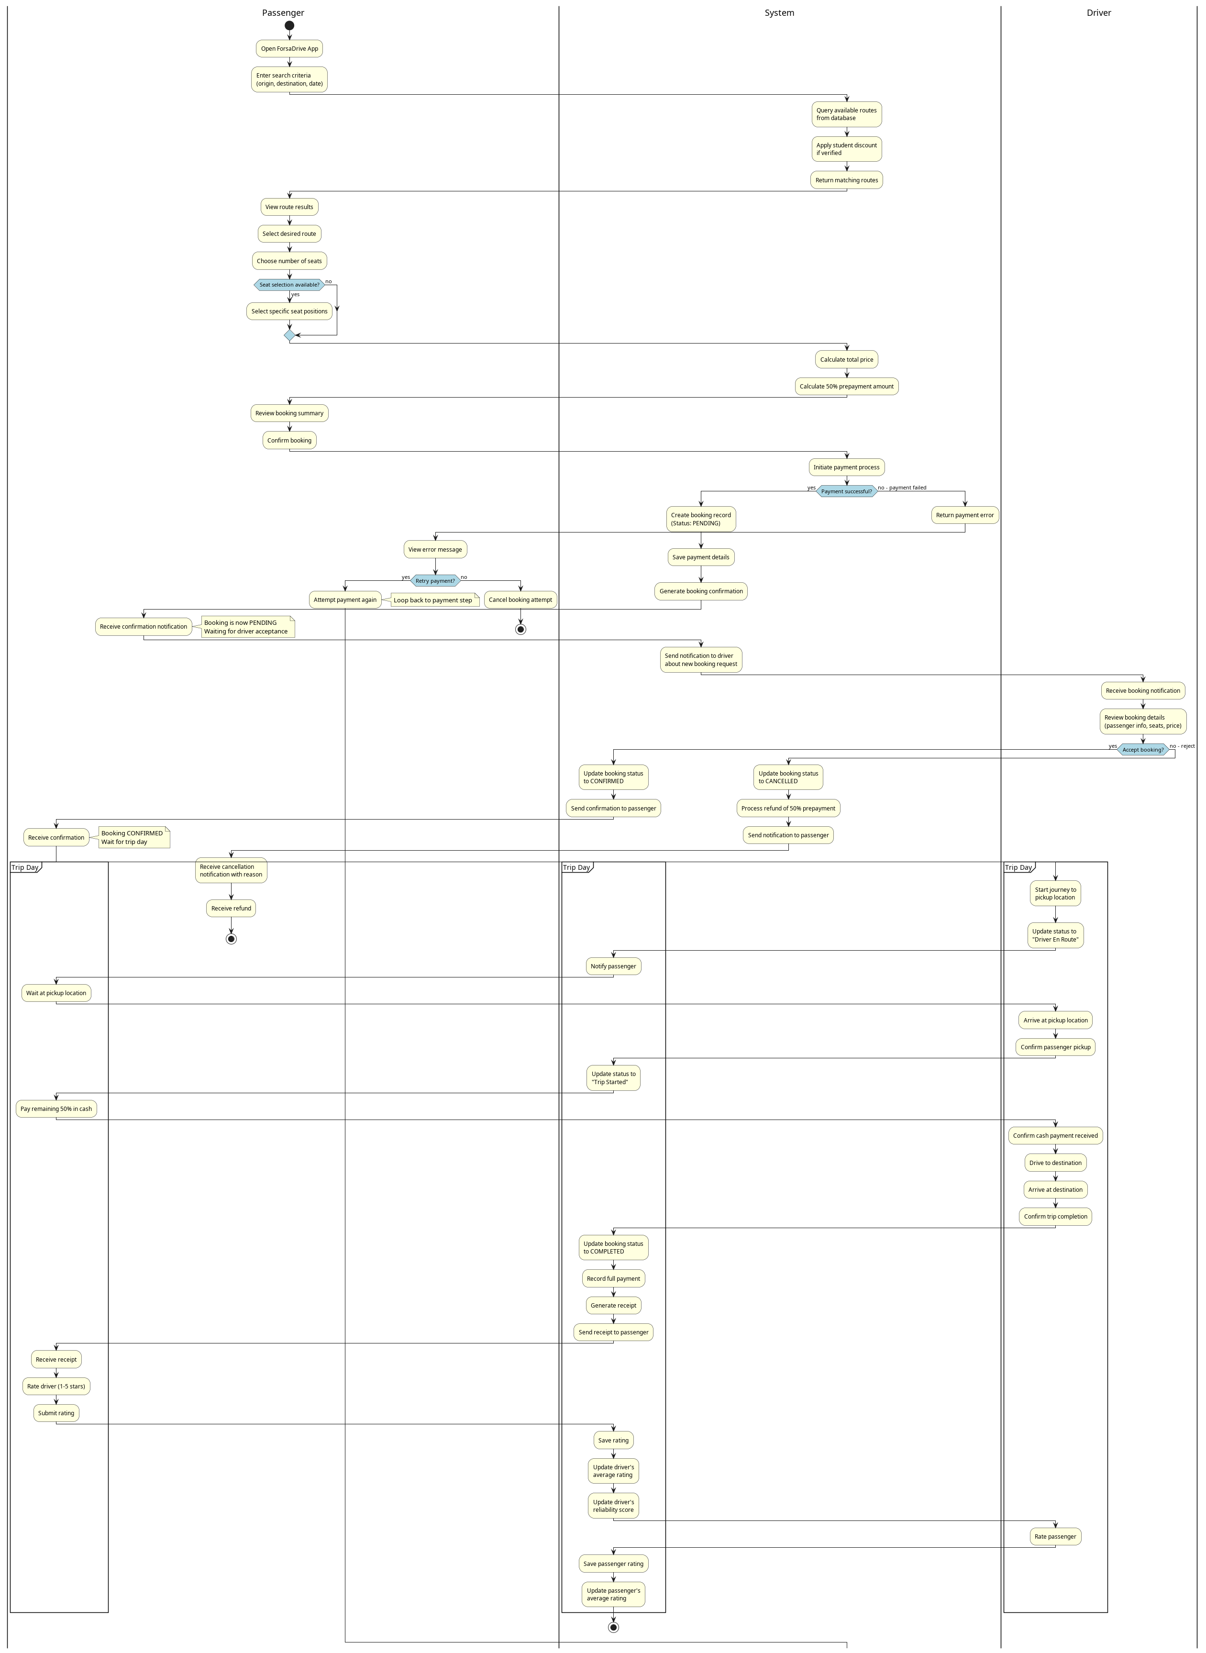
BACKUP D · FULL LIFECYCLE
Activity diagram — end-to-end booking journey
Three swimlanes: passenger / system / driver. Decision points: retry payment, accept/refuse, depart, arrive, cash collection.
ForsaDrive • Final Year Project Defense • ATOMIC IT
D / 21

Slide 27
BACKUP E · BUSINESS RULE
Price computation pipeline
Order matters. Reviewed and validated with the supervising engineer.
1
base price
price_per_seat × seats_booked
2
student discount
if is_student_verified: price × 0.5
3
promo code
if org code valid: price × (1 − pct/100)
4
prepayment
prepayment = price × 0.5
5
persist
store all 5 values on the booking row
Bug caught at Sprint 3 review: steps 2 & 3 were inverted. Fixed same evening, locked by a unit test.
ForsaDrive • Final Year Project Defense • ATOMIC IT
E / 21

Slide 28
BACKUP F · DATA MODEL
Core relational schema (extract)
Table | Columns
users | id, username, email, password, is_driver, is_student, balance, score
driver_profiles | id, user_id*, license_number, avg_rating, total_trips, reliability
vehicles | id, user_id*, type, make, model, plate_number, seats, has_ac, has_wifi
rides | id, driver_id*, vehicle_id*, from_location, to_location, departure_time, price, available_seats, status
bookings | id, ride_id*, passenger_id*, seats, paid_amount, status
payments | id, user_id*, amount, type, description, ref_id
ratings | id, ride_id*, from_user_id*, to_user_id*, score, comment
student_verifications | id, user_id*, university_email, status, verified_at
organizations | id, name, type, contact_email, email_domain, discount_percent, discount_code, status
complaints | id, from_user_id*, against_user_id*, type, text, status, admin_note
messages | id, conversation_id*, sender_id*, body, is_read, sent_at
* foreign key. ~20 tables total in the live schema. Indexes on origin, destination, departure_time, foreign keys.
ForsaDrive • Final Year Project Defense • ATOMIC IT
F / 21

Slide 29
BACKUP G · API CONTRACT
REST API surface (extract)
Method | Path | Purpose
POST | /api/auth/register | Create account
POST | /api/auth/login | Returns 32-byte bearer token
GET | /api/rides | Search with from/to/date/filters
POST | /api/rides | Driver publishes a ride
DELETE | /api/rides/{id} | Driver cancels
POST | /api/bookings | Passenger books — 50% prepayment
POST | /api/bookings/group | Group booking
POST | /api/bookings/validate-promo | Org promo code lookup
POST | /api/bookings/requests/{id} | Driver accepts/rejects
POST | /api/student/send-otp | Send OTP to university email
POST | /api/student/verify-otp | Verify OTP, mark verified
GET | /api/admin/organizations | List org accounts (admin)
POST | /api/admin/organizations/{id}/review | Approve / reject org
GET | /api/feed | Social feed (posts + interactions)
All protected endpoints require the Authorization: Bearer <token> header.
ForsaDrive • Final Year Project Defense • ATOMIC IT
G / 21

Slide 30
BACKUP H · RISK & MITIGATIONS
Security posture
Concern | Mitigation
Password storage | bcrypt via PHP password_hash
Session | Random 32-byte hex bearer token, 30-day TTL
Transport | HTTPS in production (XAMPP HTTP for dev)
SQL injection | PDO with parameterized queries everywhere
XSS | Server-rendered output is escaped (htmlspecialchars)
CSRF (web admin) | Same-origin admin panel + session-based auth
Admin separation | Admin login blocked on the mobile API (web-only)
File uploads | Mime + size validation; served from /Src under XAMPP
Audit trail | Sensitive ops (verification, suspension) logged server-side
Rate limiting | OTP send has a 30s per-account cooldown
ForsaDrive • Final Year Project Defense • ATOMIC IT
H / 21

