Slide 1


Empowering our workforce, The Frito Lay Way!
Always Analytics
Nicole Assenza
Notes:
Bunn

Slide 2
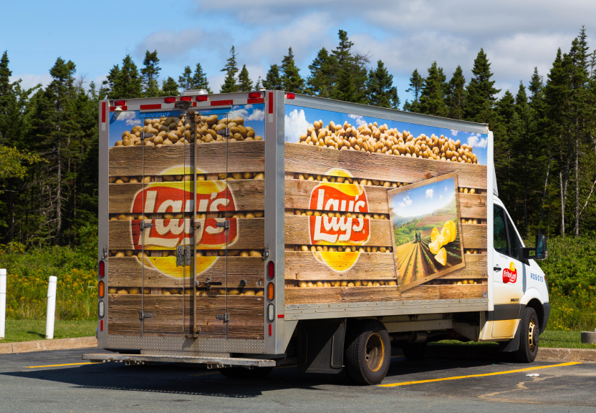
Purpose
As a consultant for Frito Lay, the Always Analytics team has worked hard to answer important questions: What are the factors contributing to employee attrition?
The results might surprise you. We have completed the analysis of the dataset on employee attrition dataset you've provided. Hopefully this will help your HR department greatly in improving employee retention rates. We've explored the data and built a model to predict what factors contribute to employees leaving the company or staying on.
Notes:
2,3- Girard

Slide 3


Attrition by the numbers
84% of Employees stay on
16% of Employees leave the company
The dataset provided has great wealth of info regarding 870 employees who've either chosen to quit or stay with the company. There are 36 features we've investigated to see which ones are most meaningful and impactful.
Before we start modelling, we really need to explore the data and play around with the information to see what jumps out at us as possibly leading to some insights. What data correlates? What doesn't? We will answer those questions in this presentation.
Notes:
1- Edwin

Slide 4
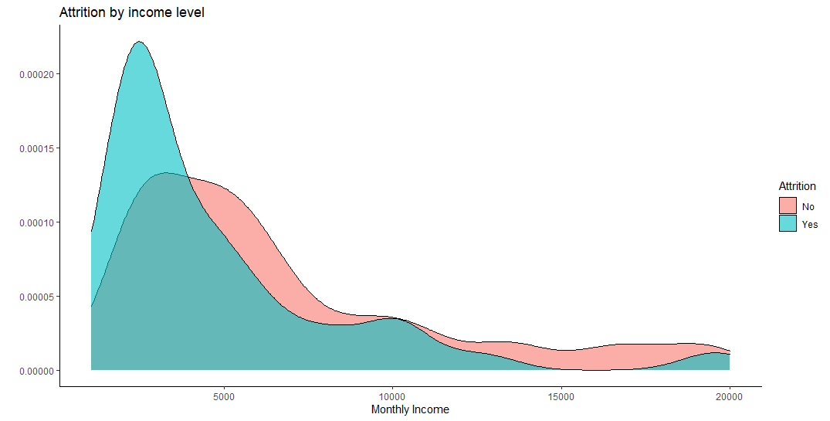
Monthly Income
Income in a major factor in levels of attrition, strangely enough the employees with higher salaries tend to stay. As we get into the 500-1000 monthly income range, attrition sees a huge spike.
Notes:
4- Edwin

Slide 5
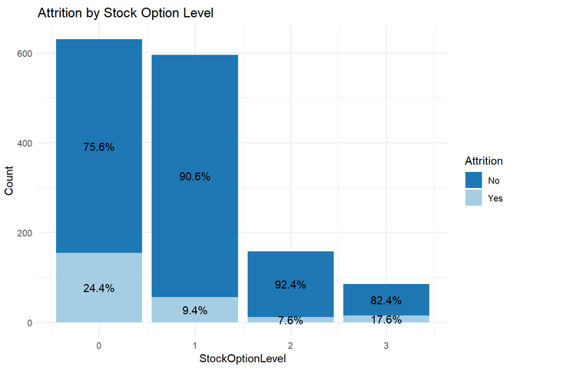
Stock Options
Stock options, especially higher level ones, are one of the largest contributors to attrition.
Notes:
5-ZB

Slide 6
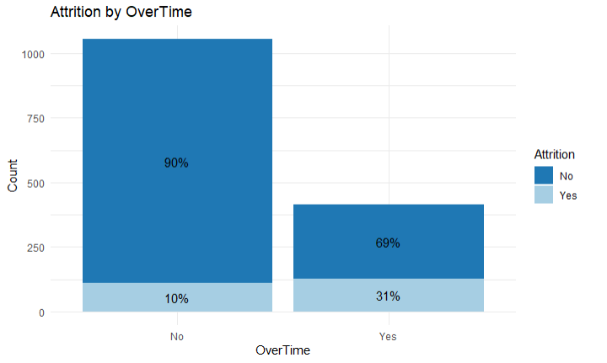
Overtime
Finally, a little less puzzling results! Apparently people love overtime! Nearly 80 percent of retained employees do not work overtime, with a small 24% of those who do. The employees who quit must really hate working overtime. If working overtime does keeps you away from resting, your family, and maybe even a lack of overtime pay may play a huge role in why people choose to quit.
Notes:
5-ZB

Slide 7
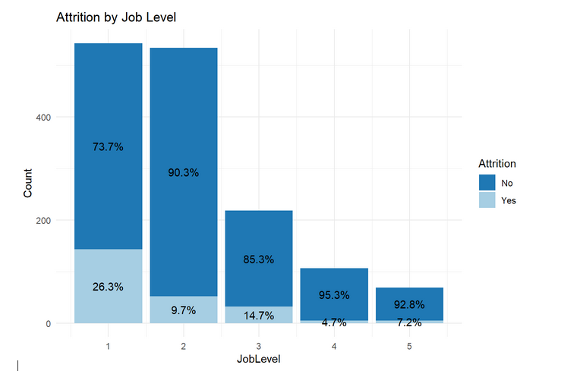
Job Level
The proportion of attrition is more than twice as high for individuals with a job level of 1 than it is for the combined population of all other possible job levels.
Notes:
5-ZB

Slide 8
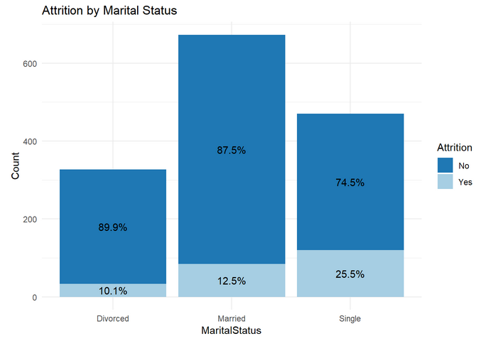
Marital Status
Single people at any age seem to quit more, while the married regardless of age stay on and even divorced people tend to quit less.Salary is a large indicator for married people since they might (this is speculation) have families to support and require a higher paying salary or a more balanced relationship between work and home life. Single people are unattached so maybe they want to keep their options open.
Notes:
5-ZB

Slide 9
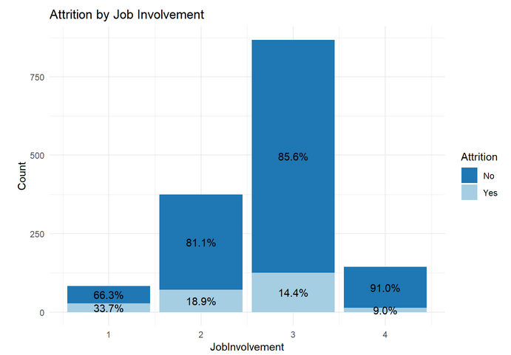
Job Involvement
The proportion of Attrition is more then 3x higher for individuals with a job involvement score of 1 than all other possible scores combined.
Notes:
5-ZB

Slide 10
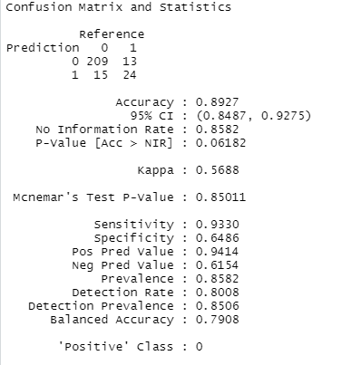
Testing and Modeling
Testing method results:
89.27% Accuracy
93.30% Sensitivity
64.86% Specificity
Linear model results:
RMSE: $1186.999
Notes:
7- Girard

Slide 11


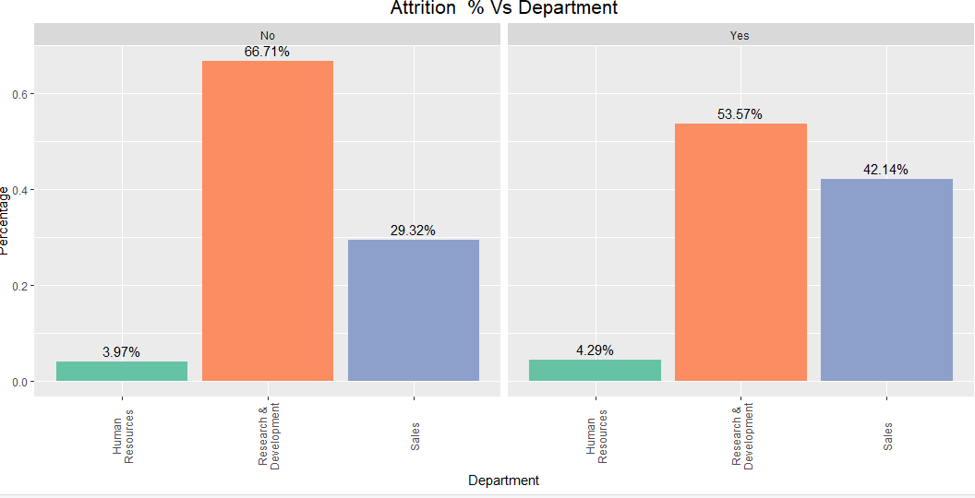
Closing Remarks
The top variables that contribute to employee attritition are: Overtime, Salary Job Involvement, Job Level, Stock Options as well as Martial Status.
Data doesn't lie: Sales and R%D have very high attrition rates: 53.57% and 41.14% respectively.HR has low attrition rates at around 4%.Future Research:
It may behoove Frito to get more data involving attrition since most of the data came from retained employees! As large company with many subsidiary companies, data collection could be obtained from those entities.
Thank you for your business. We at Always Analytics are excited to work with you team on future endeavors!
Notes:
Girard

