Slide 1

HR Project EDA
Presented By. Nasser Alqahtani

Slide 2
Outlines
1- Introduction
2- Data
3- Data cleaning & preparation
4- Graphs
5- Conclusion

Slide 3
Introduction
The main purpose of this analytical report is to provide clear insights into financial management about how to manage the company's budget and include nominations and rewards for employees. The first stage of analyzing the HR data is to clean, prepare, and handle data. The second stage is to apply the feature selection to the HR data frame and to reduce the compositional processing in such a way that we achieve the goals of this analysis. Lastly, provide a clear visualization to make the data easier to understand and pull insights from.

Slide 4
Data
Dataset for Human Resources. The datasets are generated through random logic in VBA. This data set categorized under "Human Resources" category. The dataset from E for Excel. In project data was collected, pre-processed, and Visualized for hiring in all years from 1979 to 2017, Comparison the mean salaries of each year from 1979 to 2017, The mean of Age in Company (Years) and Salary from 1979 to 2017, The percentage of Male & Female in the company, top 10 States in hiring, and compare of Gender & Years in the company for all States.
Data cleaning & preparation
Check for null and duplicates.
Find anomalies and features don't need it and drop it.

Slide 5
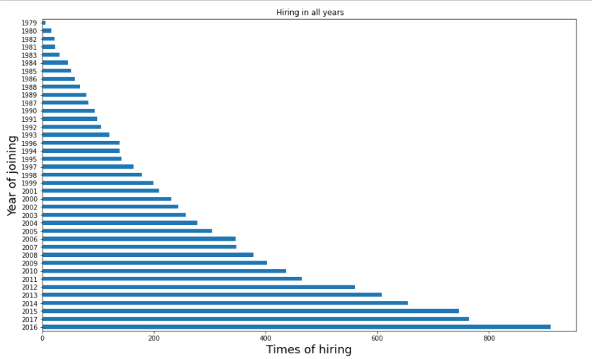
Numbers of Hiring from 1979-2017

Slide 6
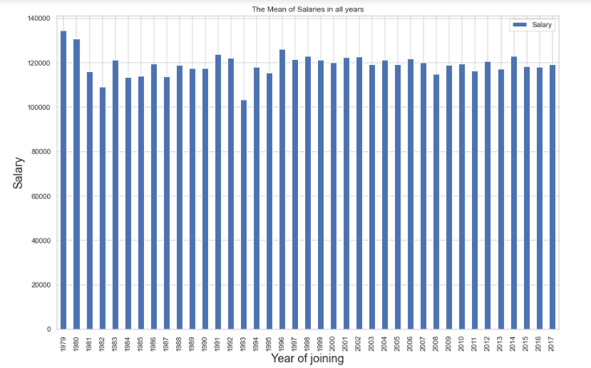
Comparison the mean salaries of each year from 1979 to 2017.

Slide 7
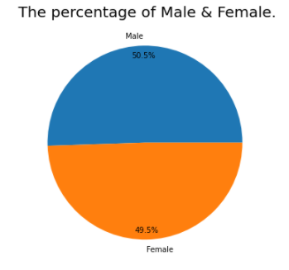
The percentage of Male & Female.

Slide 8
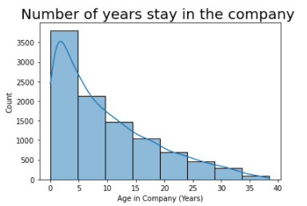
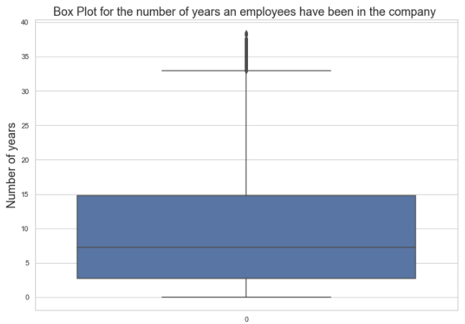
How many years the employees have been in the company?

Slide 9
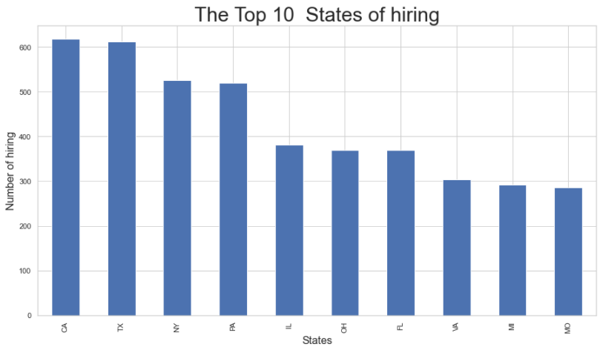
Top 10 States in hiring

Slide 10
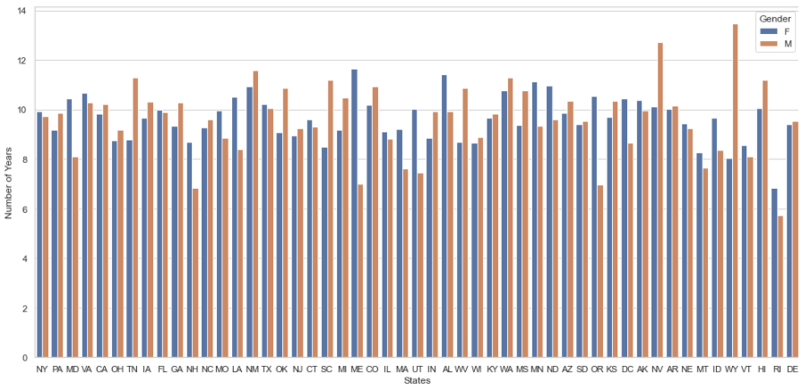
Compare of (Gender & Years in company) for all States

Slide 11
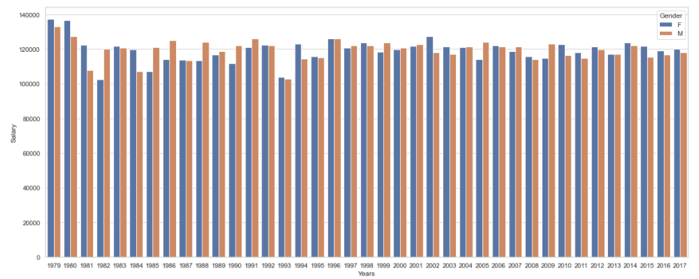
Compare between Males and Females in all years 1979-2017

Slide 12
Conclusion
The 3 highest paid employees:
1- Mrs. Kenna Rothrock
1985-2017
Salary: 199971 $
2- Mr. David Sun
1987-2017
Salary: 199969
3-Mr. Sol Pellegrino
2013-2017
Salary: 199958
Top 3 of states in hiring:
1- California (CA)
has been hired = 618
2- Texas (TX)
has been hired = 612
3- New York (NY)
has been hired = 526
Top 3 of years in hiring:
1- 2016
This year, 910 employees were hired
2-2017
This year, 764 employees were hired
3-2015
This year, 746 employees were hired

Slide 13
Thank you.

