Slide 1

Sentiment Analysis for Movie Reviews
Nasser B. Al-Bani
nasserbbk@gmail.com
nasserb@splonline.com.sa
00966 544336336

Slide 2

Table of Content
Introduction.
Objective
Dataset
Exploratory Analysis
Feature Extraction:
Result.
Conclusions.

Slide 3
Introduction
Movie reviews are an important way to gauge the performance of a movie, and it can tell or give us:
Deeper qualitative insight on different aspects of the movie.
Strong and weak points of the movie.
In general if the movie meets the expectations of the reviewer.
Sentiment Analysis is a major subject in machine learning which aims to extract subjective information from the textual reviews.
It can be used to determine the attitude of the reviewer
Strong and weak points of the movie.
the state of mind of the reviewer while providing the review and understand if the person was “happy”, “sad”, “angry” and so on.

Slide 4
Objective
In this project we aim to use Sentiment Analysis on a set of movie reviews given by reviewers and try to understand what their overall reaction to the movie was, i.e. if they liked the movie or they hated it. We aim to utilize the relationships of the words in the review to predict the overall polarity of the review.

Slide 5
Dataset
It contains 50,000 training examples collected from IMDb.
Review is labelled with the rating on scale of 1-10. As sentiments are usually bipolar like good/bad or happy/sad or like/dislike.
categorized these ratings as either 1 (like) or 0 (dislike) based on the ratings.
If the rating was above 5, we deduced that the person liked the movie otherwise he did not.
Dataset was divided into two subsets containing 25,000 examples each for training and testing.
Division to be sub-optimal as number of training examples was very small and leading to under-fitting, as 40,000 for training and 10,000 for testing.
Use Cross Validation in which the complete dataset is divided into multiple folds with different samples for training and validation.

Slide 6
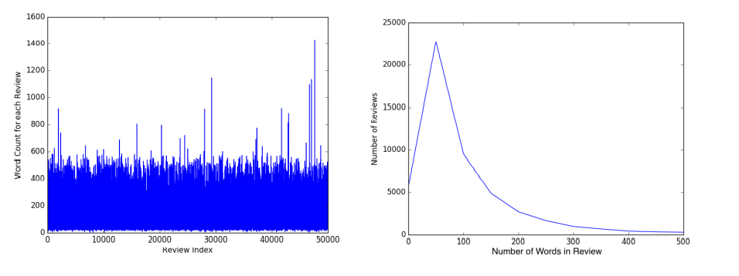
Exploratory Analysis
Calculate the average size of reviews to get some insight on quality of reviews.
Average number of words per review is around 120.
General people tend to write pretty descriptive reviews, also, people write reviews when they have strong opinions about a movie; they either loved it or hated it.

Slide 7
Feature Extraction:
We used 3 methods for extraction of meaningful features from the review text Average number of words per review is around 120.
Bag of Words.
N-Gram Modelling.
TF-IDF Modelling.

Slide 8
Results:
As discussed above, we tried multiple classification models on various feature representations of the textual information in the reviews. Out of these SVM Classifier failed to even converge for all of our feature sets and hence we could not get a satisfactory answer for it. Among the remaining models, Logistic Regression model seemed to have best performance across all feature representations with classification accuracy around 89%. Also, k-Nearest Neighbors classifier had the worst accuracy of around 60% across all feature representations. The general order of performance for the model was LogisticRegression > NaïveBayes > SGDClassifier > RandomForestClassifier > kNNClassifier. For a given classifier, the model that performed best used a feature set of a mixture of unigrams and bigram.

Slide 9
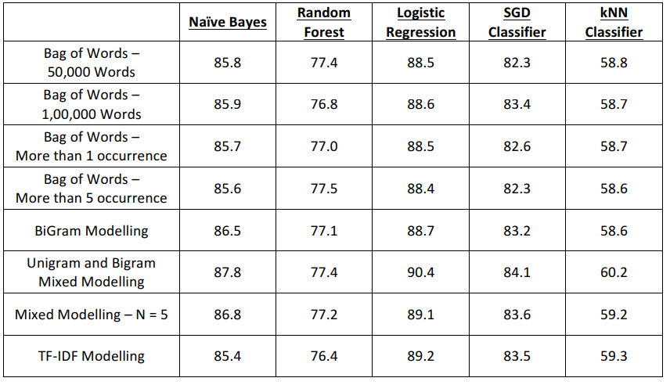

Slide 10
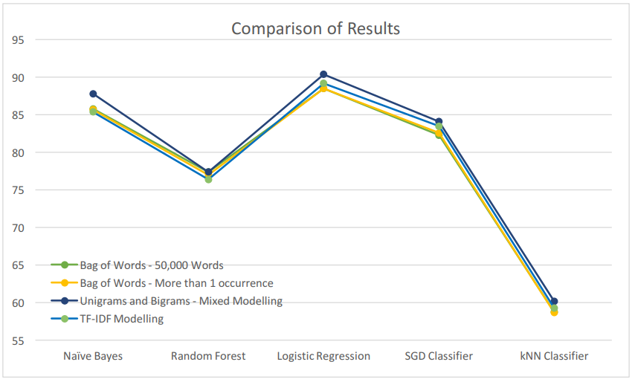

Slide 11
Conclusions:
From the results above, we can infer that for our problem statement, Logistic Regression Model with feature set using mixture of Unigrams and Bigrams is best. Apart from this, one can also use a Naïve Bayes’ Classifier or a SGD classifier as they also provide good accuracy percentage. One peculiar thing to note is low accuracy with Random Forest classifier. This might be because of over-fitting of decision trees to the training data. Also, low accuracy of kNN Classifiers shows us that people have varied writing styles and kNN Models are not suited to data with high variance. One of the major improvements that can be incorporated as we move ahead in this project is to merge words with similar meanings before training the classifiers[3]. Another point of improvement can be to model this problem as a multi-class classification problem where we classify the sentiments of reviewer in more than binary fashion like “Happy”, “Bored”, “Afraid”, etc[14]. This problem can be further remodeled as a regression problem where we can predict the degree of affinity for the movie instead of complete like/dislike.

Slide 12

End
Thank you

