Slide 1



Operations Intelligence
A ServiceNow Intelligent Automation Initiative — Infosys Operations

Slide 2
Prototype — Portal Showcase
What you are about to see
The following slides present the Operations Intelligence portal prototype running on the development ServiceNow instance. Each slide captures one of the eight navigation modules, demonstrating the unified role-based interface as built.
Portal access and roles
All authenticated ServiceNow users reach the portal at a single URL. Navigation adapts to role: Operations Team members see the service catalog; Creators access Creator Studio; Governance, Leadership, Developer, and Administrator roles each see their designated module.
Eight modules in scope
Operations Workspace · Automations Workspace · Agentic Workspace · Creator Studio · Governance Control · Leadership Insights · Developer Hub · Administrator Hub
Development status
Early-stage prototype under active development. Core portal, governance, creator studio, and the operations assistant are deployed. UI refinements and end-to-end workflow validation are in progress.
2

Slide 3
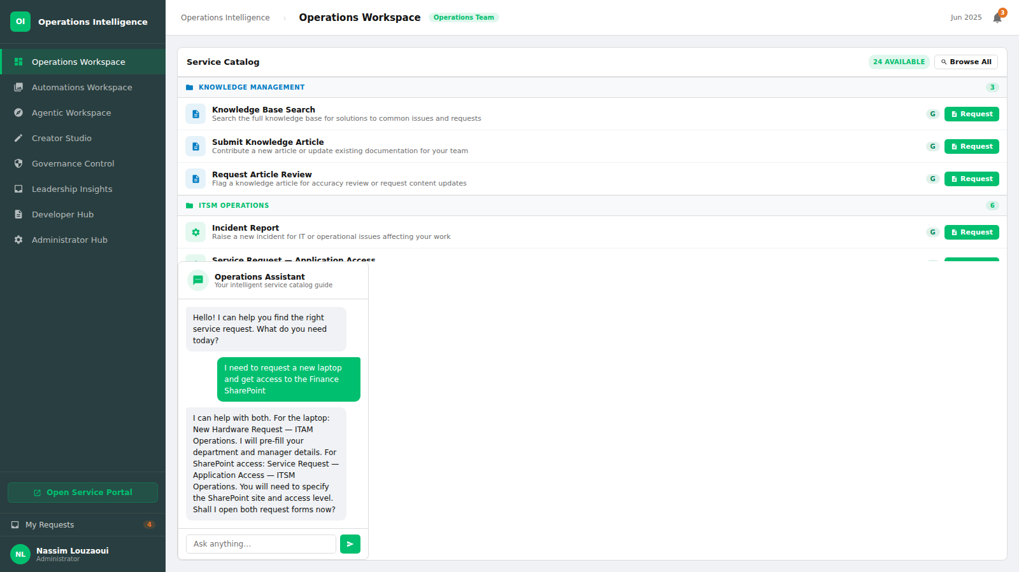
Operations Workspace — the unified service catalog where operations team members browse and submit service requests across Knowledge Management, ITSM, ITAM, HR Services, and Finance categories, with an intelligent assistant providing guidance.
3

Slide 4
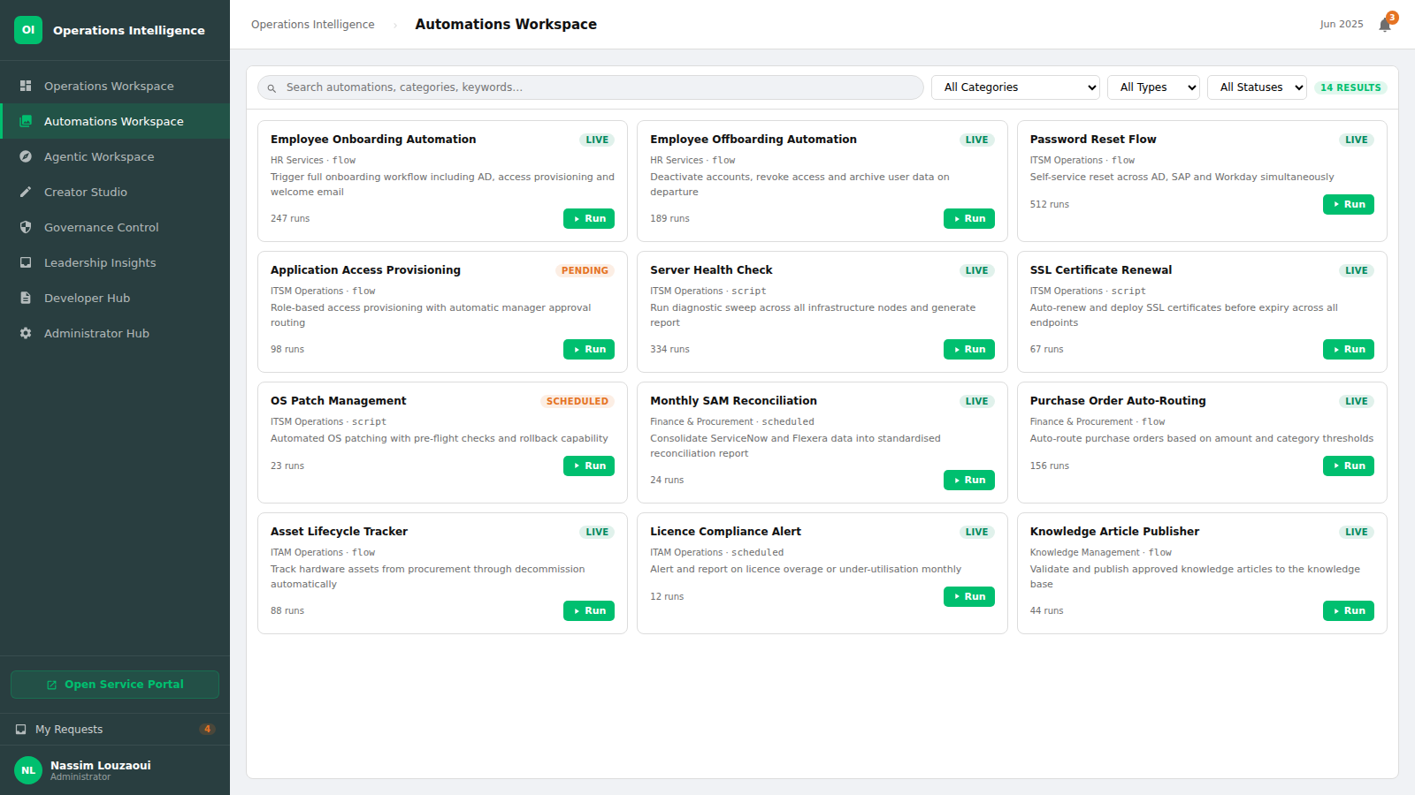
Automations Workspace — a searchable, filterable catalog of all platform automations across service categories, giving every authorised user complete visibility of available automated capabilities.
4

Slide 5
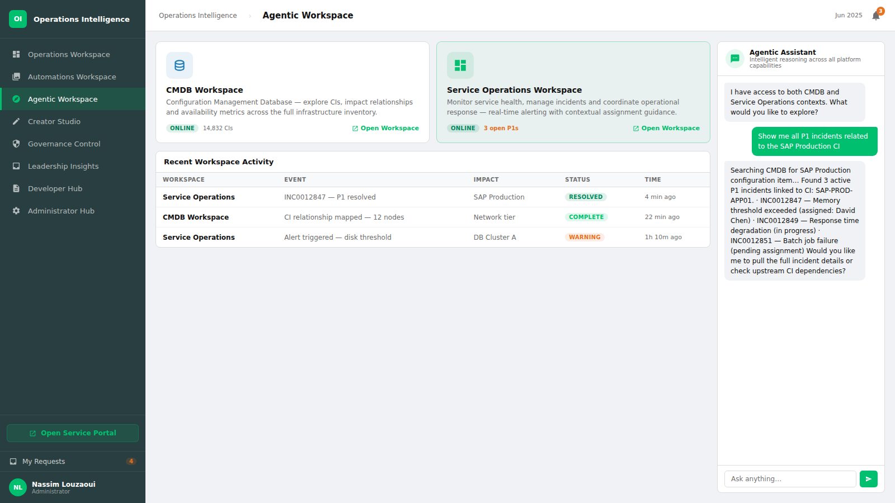
Agentic Workspace — a launch pad for embedded platform workspaces (CMDB and Service Operations) paired with an intelligent agentic assistant capable of cross-platform reasoning and real-time incident correlation.
5

Slide 6
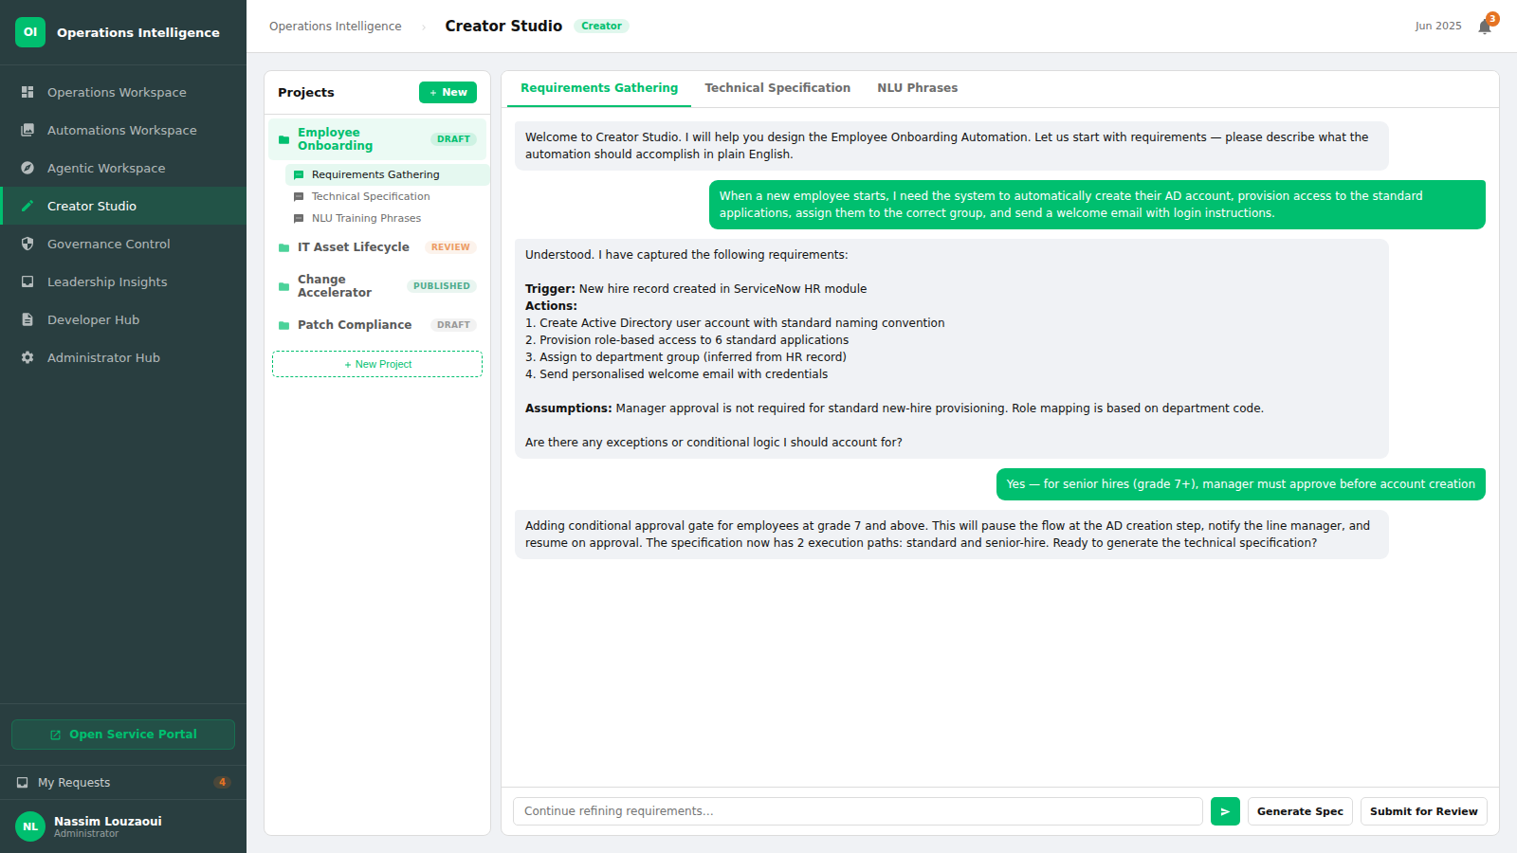
Creator Studio — a structured three-pane environment where designated creators design automation initiatives through AI-guided conversations, producing technical specifications and NLU training phrases ready for governance review.
6

Slide 7
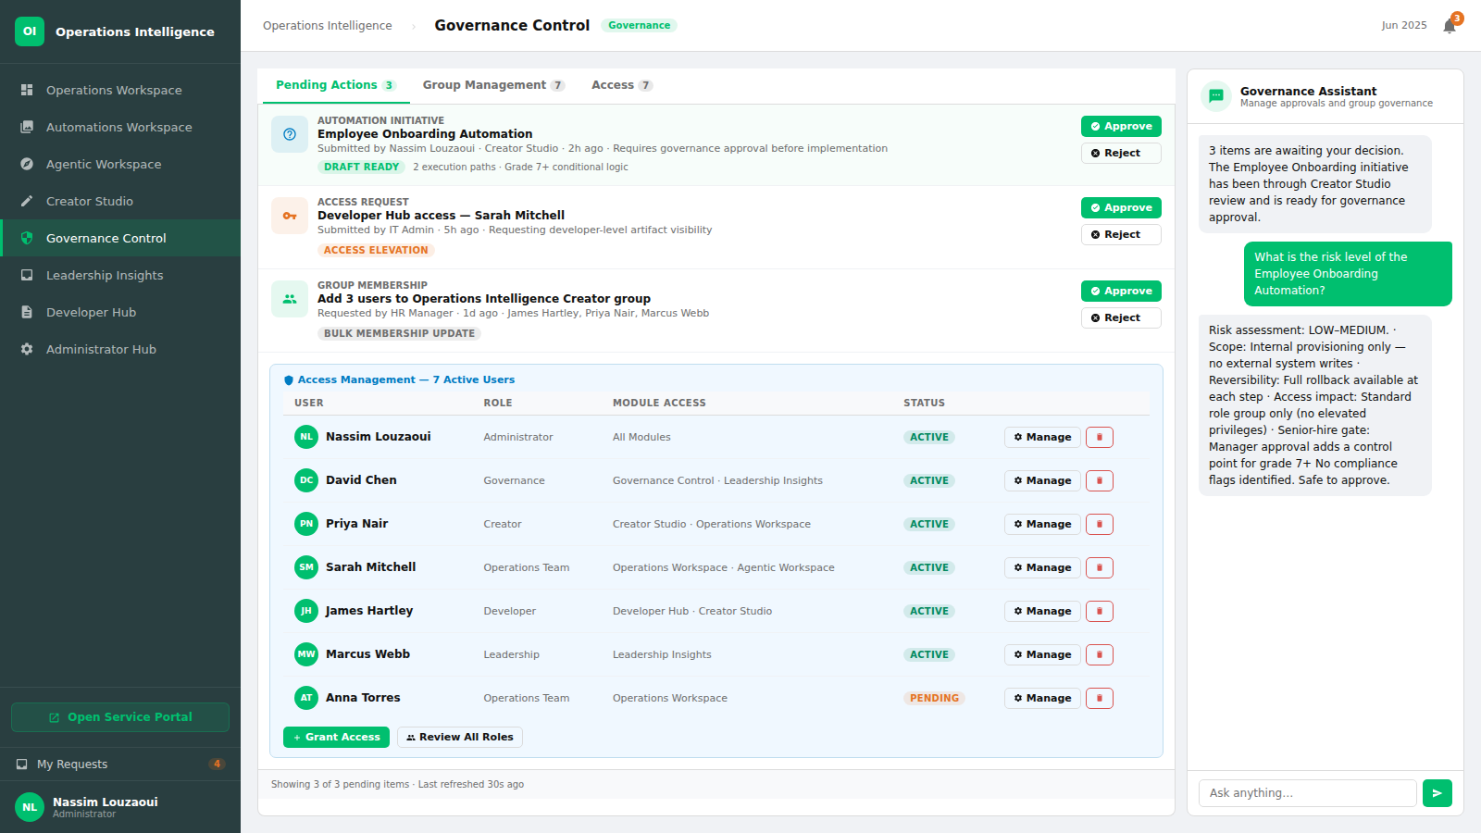
Governance Control — the approval and access management hub where governance administrators review pending initiatives, manage user access to platform roles, and control group membership.
7

Slide 8
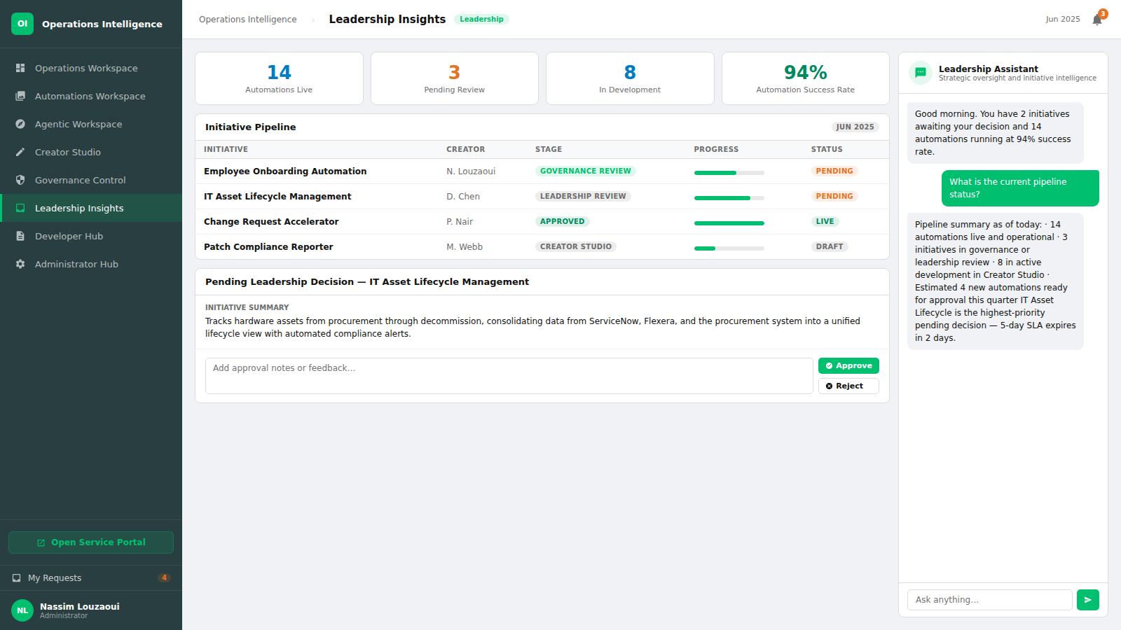
Leadership Insights — an executive dashboard presenting real-time KPIs, the full initiative pipeline, and a review interface for leadership to approve or provide feedback on pending automation proposals.
8

Slide 9
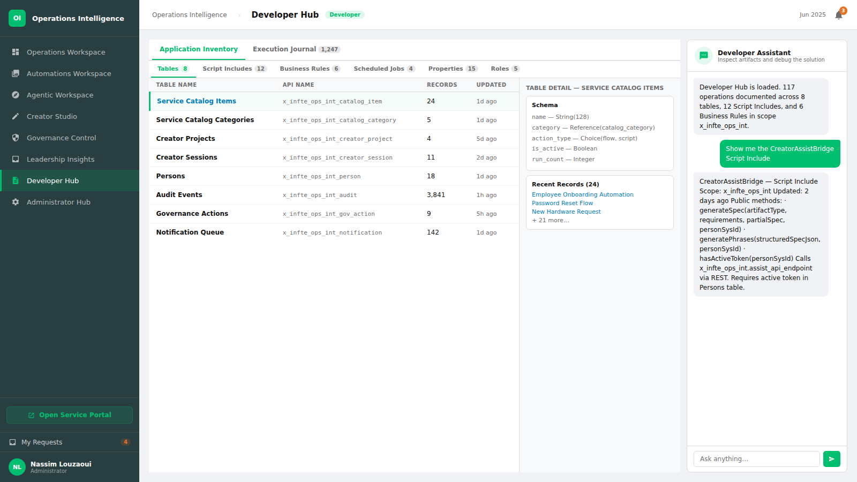
Developer Hub — a technical artifact browser providing developers with full visibility of all tables, Script Includes, Business Rules, Scheduled Jobs, and system properties within the scoped application.
9

Slide 10
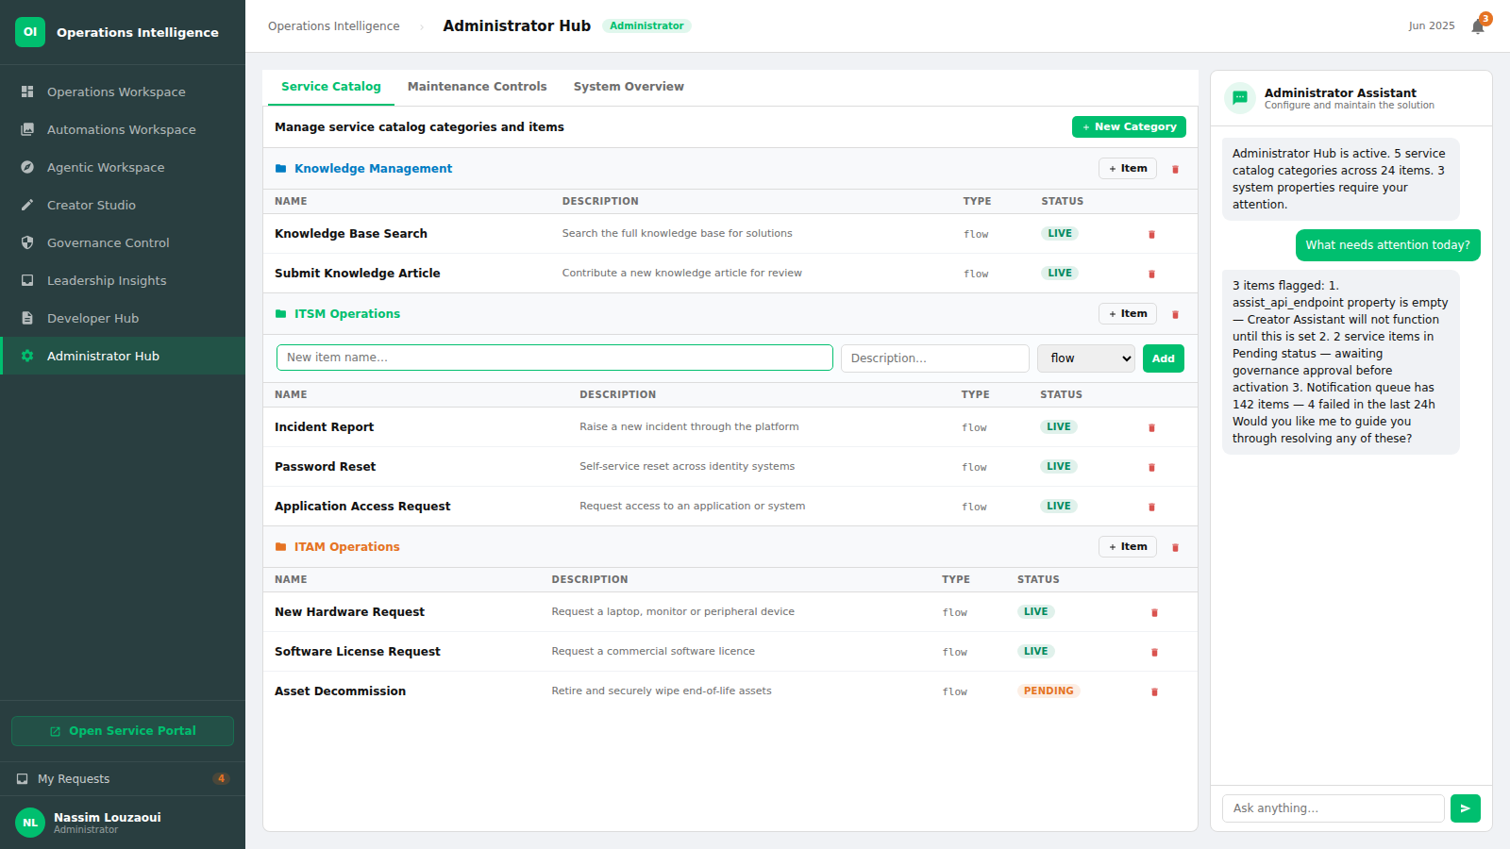
Administrator Hub — the administration console for managing the service catalog structure, configuring system maintenance controls, and monitoring overall platform health and notification status.
10

Slide 11
THANK YOU
© 2026 Infosys Limited. All rights reserved. Operations Intelligence is a proprietary initiative of Infosys Limited.

