Slide 1



Possible Worlds
Cathy Legg
University of Waikato

Slide 2
Day 2 TOPICS
Temporal parts
Paradoxes of Time Travel
Relationship between time and change
Why you can’t change the past (or the future either!)
The Grandfather paradox
Does Time Pass?
Is Time Unreal?
Two understandings of time: The A and B Series
Argument that for time to be real, the A series needs to be real, but it isn’t.

Slide 3
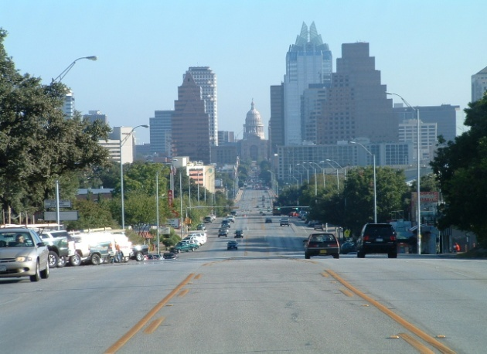
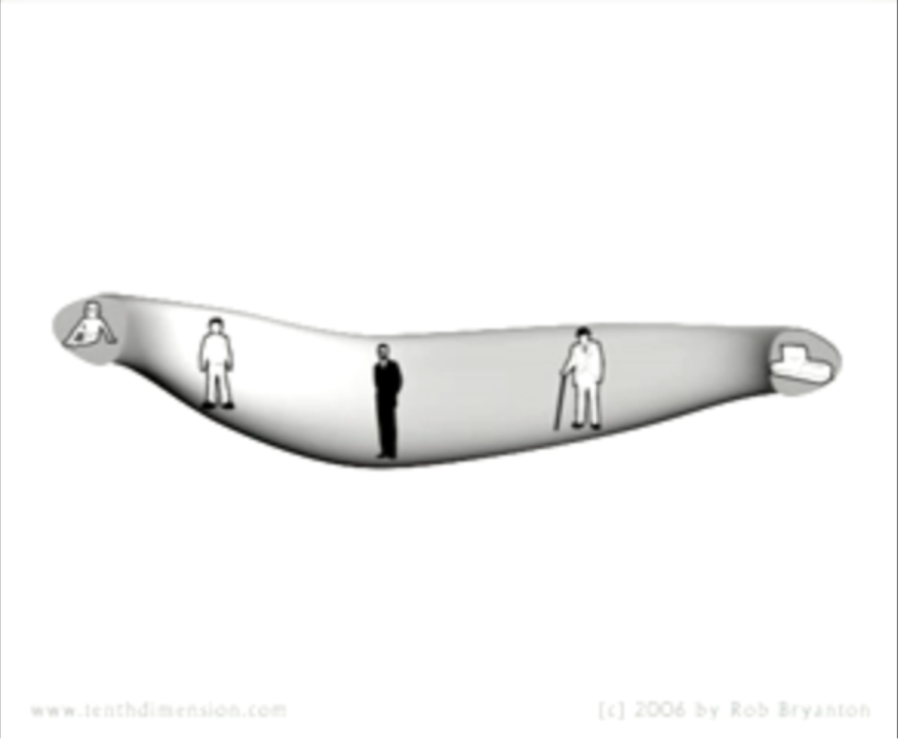
Day 2
Temporal parts
Paradoxes of Time Travel
Does Time Pass?
Is Time Unreal?
We think of things as having spatial parts – e.g. a spatial part of me is my left hand. Congress St is a spatial part of Austin.
Question: What would a temporal part be?
The temporal parts of a person. Putting them all together, you get a ‘space-time worm’.

Slide 4
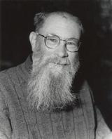
Day 2
Temporal parts
Paradoxes of Time Travel
Does Time Pass?
Is Time Unreal?
Time –travel has been thought to give rise to a number of paradoxes, which have been taken to show that the idea of time travel is logically impossible
Question: What might some of these ‘paradoxes’ be?
David Lewis, however wrote a famous paper, “The Paradoxes of Time Travel”, arguing that time travel is ‘odd…but not impossible’.
We will now look at some of his arguments

Slide 5
Day 2
Temporal parts
Paradoxes of Time Travel
Does Time Pass?
Is Time Unreal?
1) Why you can’t change the past (or, for that matter, the future. Or even the present…)
Lewis claims that it is logically impossible to change the past, the present or the future. Why??
To answer this, the first thing we need is a clear definition of change. You might think that change is a basic concept, ‘primitive’. Not so, we can define change using even simpler concepts.
Lewis: “Change is qualitative difference between temporal parts of something”
What does this mean?
Take an object – ‘x’. To say that x changes is just to say that at some time (‘t₁’), x has some property (‘P’) and at some other time (‘t₂’), x does not have P.
Another way of putting this is to say that one temporal part of x has P, and a later temporal part of x doesn’t have P.

Slide 6


Day 2
Temporal parts
Paradoxes of Time Travel
Does Time Pass?
Is Time Unreal?
Now consider a given event in the past that we might want to ‘change’. E.g.:
Even if I could succeed in preventing the coin from dropping (and Lewis has an argument that I can’t, more on this later), then this would not be changing the past!!!
Why not??
Standing on a tenth story balcony, I carelessly drop a quarter over the edge (at time ‘t₃’). The coin accelerates, hits someone on the head and kills them. I really wish I hadn’t done that. I go back in time…

Slide 7
Day 2
Temporal parts
Paradoxes of Time Travel
Does Time Pass?
Is Time Unreal?
We saw that for something to change, it has to have property P at some time and not have property P at another time.
Let’s say: property P is “Cathy dropping a quarter”, event E is “whatever happens on the balcony at t_{3”.}
We saw that at time t₃, E ‘instantiates’ P. We want to change this (somehow) so that at t₃, E does not instantiate P.
If I was able to achieve this, what would I achieve?
I would achieve that E does not have property P, and never did.
I would NOT achieve that E has P at one time and not-P at some later time. There is no later time here! All we have is t₃!!

Slide 8
Day 2
Temporal parts
Paradoxes of Time Travel
Does Time Pass?
Is Time Unreal?
Trying to say that something instantiates both P and not-P at a single time-point is not describing change, it is describing logical contradiction
(p & ~p)
Bottom line – change is something that happens across time. It is not something that can happen at (to?) a given time-point. Thus you can’t change the past, the future, or even the present.
Question: Is this a good argument? Why or why not?

Slide 9
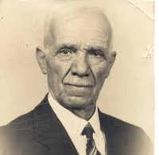
Day 2
Temporal parts
Paradoxes of Time Travel
Does Time Pass?
Is Time Unreal?
2) The grandfather paradox
Another argument that time travel is logically impossible is that if time travel were possible, then you could go back in time and kill your own grandfather (before he managed to conceive your parent)
Then, obviously you could no longer exist!!
So you would have to both exist and not exist, say at the time of your birth. Isn’t this as clear a logical contradiction as can be found?? Therefore, time travel is not logically possible.
Question: Could you kill your own grandfather if you went back in time?

Slide 10

Day 2
Temporal parts
Paradoxes of Time Travel
Does Time Pass?
Is Time Unreal?
Lewis has an ingenious argument that you couldn’t kill your own grandfather, if you time-travelled.
He has a lot of work to do to explain how it totally looks as though you could kill him.
For instance, it seems that you could buy a gun, walk up to the man, point the gun right at him….etc.
What is stopping you? “Do the forces of logic stay your hand?” (Lewis’ phrase)

Slide 11

Day 2
Temporal parts
Paradoxes of Time Travel
Does Time Pass?
Is Time Unreal?
Lewis makes a very clever move here. He says: actually it depends what you mean by ‘can’!!
‘Can’ in this context is actually ambiguous(!). The right answer to whether you can kill your own grandfather if you go back in time is actually “yes and no” using different senses of ‘can’.
Think about what we mean when we say that someone (‘A’) can do something (‘x’).
We mean that A’s doing x is consistent with certain other facts.
E.g. A can make breakfast because:
there is cereal in the cupboard and milk in the fridge
A is not lying in bed unconscious
A’s mother will not stop him making breakfast…and so on

Slide 12
Day 2
Temporal parts
Paradoxes of Time Travel
Does Time Pass?
Is Time Unreal?
But sometimes it is the case that A’s doing x is consistent with some facts but not others.
e.g. (Lewis’ example):
Lewis can speak Finnish because he is a human being not an ape.
But at the same time:
Lewis can not speak Finnish because he has never learned the language.
Thus Lewis both can and cannot speak Finnish. But this is not a logical contradiction! This is just a case of a proposition being logically consistent with some facts and not with others.
Now back to our time-traveller…

Slide 13
Day 2
Temporal parts
Paradoxes of Time Travel
Does Time Pass?
Is Time Unreal?
Tim (a time-traveller) can kill his grandfather because that killing is consistent with certain facts:
he has a gun,
he knows how to shoot
grandfather is right in the line of sight
no-one is around to stop him….etc.
However, Tim’s killing his grandfather is NOT consistent with certain other facts: namely (most importantly)
grandfather didn’t die!!
Tim himself was born in 1967…etc.
Question: But what stops him???
Answer: Who knows, we don’t know, but we do know that he can’t do it, given the information we have available.
Question: Is this argument satisfying? Why or why not?

Slide 14
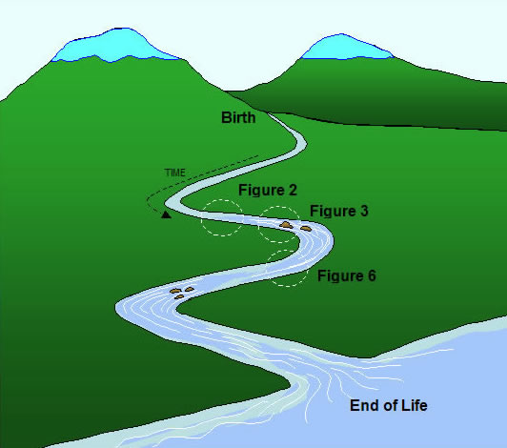
Day 2
Temporal parts
Paradoxes of Time Travel
Does Time Pass?
Is Time Unreal?
Warm-up Exercise (groups of 3-4) :
It is often said, “Time is like a river”. Is this a good analogy? If so, what facts does it capture about time? If not, in what ways is time not like a river?
(Please write down your answers)

Slide 15
Day 2
Temporal parts
Paradoxes of Time Travel
Does Time Pass?
Is Time Unreal?
An Argument for The Unreality of Time
We tend to think naively that time flows.
We use metaphors, such as ‘time is like a river’, which seem to suggest that time itself moves (from the future, through the present, to the past…)
But if time does really ‘move’, it seems we should be able to ask questions such as:
Where does time go to? and
How fast does time move? (about one second per second??)
And these questions don’t seem to make much sense.

Slide 16
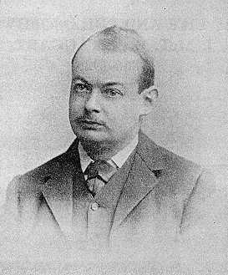
Day 2
Temporal parts
Paradoxes of Time Travel
Does Time Pass?
Is Time Unreal?
John McTaggart Ellis McTaggart
McTaggart has an argument whose broad structure is as follows:
Our concept of time is of something which flows or passes
Nothing which flows or passes in the way that time is supposed to flow or pass could exist (it is logically impossible, in fact!)
Therefore, time is not real.
He starts by arguing that time can be analysed into two fundamentally different concepts…

Slide 17
Day 2
Temporal parts
Paradoxes of Time Travel
Does Time Pass?
Is Time Unreal?
The B-series
The B-series consists in the relationships of earlier-than and later-than.
These relationships hold between all time-points, so that for any two different time-points, either the first is later than the second, or vice-versa.
a) 30 A.D. b) 1530 A.D. c) 2020 A.D.
a) Is earlier than b) and c); c) is later than a) and b)…etc.
EARLIER LATER
Logic Link: These relationships are also transitive and asymmetrical. (Can you state the transitivity and asymmetry of these relations between time-points in formal logic?)

Slide 18
Day 2
Temporal parts
Paradoxes of Time Travel
Does Time Pass?
Is Time Unreal?
The A-series
The A-series consists in the fact that (at any given time) some time-points are past, some are future, and just one (?) is present.
This view of time is sometimes referred to as ‘tensed’ view, while the B-series is referred to as a ‘tenseless’ view of time.
a) 30 A.D. b) 1530 A.D. c) 2020 A.D.
a) and b) are in the past; c) is in the future.
It is as though the A-series ‘slides along’ the B-series, as time passes. This however, does not change the B-series at all.
NOW
PAST
FUTURE

Slide 19
Day 2
Temporal parts
Paradoxes of Time Travel
Does Time Pass?
Is Time Unreal?
McTaggart’s argument proceeds in 2 main stages:
Stage 1 : In order for time to be real, we need the A-series to be real, not just the B-series. (Why?)
Because time involves change. If there were no change, there would be no time.
(Side question – is this true? We will question it tomorrow…)
There is no change in the B-series.
Why not? McTaggart:
“If N is ever earlier than O and later than M it will always be, and has always been, earlier than O and later than M, since the relations of earlier and later than are permanent.”

Slide 20
Day 2
Temporal parts
Paradoxes of Time Travel
Does Time Pass?
Is Time Unreal?
McTaggart’s argument, Stage 1, cont :
In fact, one might argue that the only thing that ever changes is the tense of events.
Consider for e.g. the death of Queen Anne. This event was always the death of a queen, it always happened (/ was going to happen) at a given place, and time. None of that ever changes.
The only thing that changes about the death of Queen Anne is that once it was going to happen, then (later on) it was happening, and now it has happened, and is passing further into the past all the time.
Thus we need a real A-series for real change / real time.

Slide 21
Day 2
Temporal parts
Paradoxes of Time Travel
Does Time Pass?
Is Time Unreal?
McTaggart’s argument, Objections to Stage 1 :
Objection 1 (Russell): Past, present and future are not absolute properties of time-points, but relative to an observer. What is ‘present’ to Henry VIII is not ‘present’ to us, and that is all there is to an event being ‘now’.
All we mean when we say that something changes is that it has some property P at one time, and does not have property P at a later time.
You can give an account of all this just using the B-series. Thus we don’t need the A-series to be real in order for time to be real.
How might McTaggart reply to this objection?

Slide 22
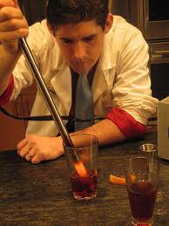
Day 2
Temporal parts
Paradoxes of Time Travel
Does Time Pass?
Is Time Unreal?
McTaggart’s argument, Objections to Stage 1 :
Reply to Objection 1 (McTaggart): Mere variation in properties across the B-series is not real change. It is just like variation in properties across space, and we don’t call that ‘change’.
An example of variation across space: “The poker is hot at one end and cold at the other”.
This does not mean that the poker is changing, it just means that the poker has one cold end and one hot end.
Does this reply answer the objection? What do you think?

Slide 23
Day 2
Temporal parts
Paradoxes of Time Travel
Does Time Pass?
Is Time Unreal?
McTaggart’s argument, Stage 2 :
The A-series is not real. There are 2 problems:
[less serious] Pastness, presentness and futurity would seem to be relations – but what are they relations to? It seems they must be relations to something outside time. But what could that thing be??
[more serious] The A-series implies a logical contradiction. We define pastness, presentness and futurity as logically incompatible – if an event E is past then it cannot be present or future, and if it is future it cannot be past or present…etc. And then we say that every event has all 3 properties! Isn’t this like saying that something is green AND red AND yellow all over?

Slide 24
Day 2
Temporal parts
Paradoxes of Time Travel
Does Time Pass?
Is Time Unreal?
Obvious objection: We say that events have all 3 properties, but they do not have all 3 properties at the same time!!
An event E is future at some times, and then LATER it is present and then LATER STILL it is past. Surely that removes the logical contradiction??
McTaggart: no it doesn’t. He says:
“…our first statement about M [a moment in time] – that it is present, will be past, and has been future – means that M is present at a moment of present time, past at some moment of future time, and future at some moment of past time, But every moment…is both past, present and future. And so a similar difficulty arises. If M is present, there is no moment of past time at which it is past. But the moments of future time, in which it is past, are equally moments of past time, in which it cannot be past….”

Slide 25
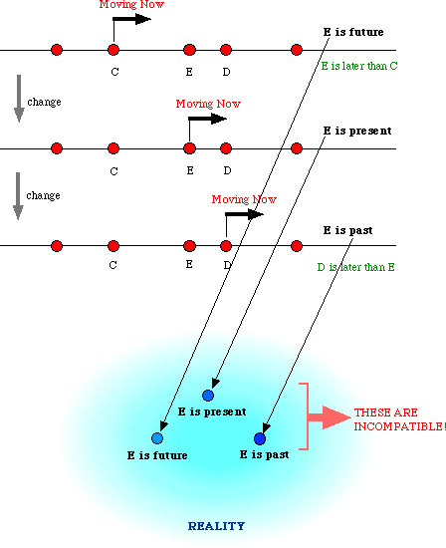
Day 2
Temporal parts
Paradoxes of Time Travel
Does Time Pass?
Is Time Unreal?
McTaggart is claiming that the problem reappears at a higher level. We are now saying not just that an event is past, present and future (contradictory properties), but that it is future in the past, present in the future, past in the present…etc.etc.
This merely creates an even more complicated set of logical contradictions!

Slide 26
Day 2
Temporal parts
Paradoxes of Time Travel
Does Time Pass?
Is Time Unreal?
Let’s think about it again in terms of our colour analogy:
PAST = GREEN, PRESENT = RED, FUTURE = YELLOW
THE A-SERIES: If an event is past then it cannot be present or future, if it is present then it cannot be past or future and if it is future it cannot be present or past.
JUST AS: If an object is green then it cannot be red or yellow, if it is red then it cannot be green or yellow and if it is yellow then it cannot be green or red.
Now, the objection to MacTaggart said something like:
In the PAST, event E was in the future. NOW it is present. In the FUTURE it will be past. In the colour analogy, this becomes…

Slide 27
Day 2
Temporal parts
Paradoxes of Time Travel
Does Time Pass?
Is Time Unreal?
In the PAST, event E was in the future. NOW it is present. In the FUTURE it will be past.
When the object is GREEN it is YELLOW, when it is RED it is RED, and when it is YELLOW it is GREEN
How does this help to make the A-series logically coherent? Doesn’t it make it even more incoherent….?!!
Exercise: Critically appraise this argument. Does it make you more inclined to believe that time is unreal? Why or why not?

Slide 28
Day 1
Temporal parts
Paradoxes of Time Travel
Does Time Pass?
Is Time Unreal?
Homework exercise for super-duper extra smart logicians:
Can you represent the second stage of McTaggart’s argument (that the A-series is contradictory) so that it can be proven?
If you can do that, do you think your formalization begs any philosophical questions?

Slide 29
Day 2
Temporal parts
Paradoxes of Time Travel
Does Time Pass?
Is Time Unreal?
Mellor: “The Unreality of Tense”.
David Mellor acknowledges that many philosophers have dismissed MacTaggart’s argument, as the conclusion is so outrageous. Mellor, however, claims that MacTaggart’s argument is actually good: it just doesn’t prove what MacTaggart thinks it proves.
He says: MacTaggart is correct to argue that the A-series is contradictory. However, this does not prove that time is unreal, only that tense is unreal.
What does that mean? Recall the question presented earlier:
What is it that makes now now?

Slide 30
Day 2
Temporal parts
Paradoxes of Time Travel
Does Time Pass?
Is Time Unreal?
According to Mellor, the only thing that makes the present moment now is that we are (perceiving it and) calling it ‘now’. There is no more objective fact of the matter about ‘when now is’. There is no ‘real now’.
1532 is ‘now’ to Henry VIII. 2012 is ‘now’ to us.
In other words, ‘now’ is ‘token-reflexive’ (a.k.a. ‘indexical’). That just says:
the meaning of ‘now’ is just, ‘whatever time the word is uttered at’. Just like:
the meaning of ‘here’ is just, ‘whatever place the word is uttered at.’ Just like:
the meaning of ‘I’ is just, ‘whatever person is uttering the word.’

Slide 31
Day 2
Temporal parts
Paradoxes of Time Travel
Does Time Pass?
Is Time Unreal?
Bottom line:
There is no objective fact about ‘where is here’. There is no objective fact about ‘who is I’. In the same way, then, there is no objective fact about ‘when is now’. …!
Mellor, like Lewis, is taking a ‘four dimensional’ (4-D) perspective on time. This is sometimes also referred to as a ‘block universe’.
Those who wish to oppose this view by claiming that there is a ‘real now’, are often called presentists.
Final Question: What do you think about this issue?

Slide 32
Day 2
Temporal parts
Paradoxes of Time Travel
Does Time Pass?
Is Time Unreal?
FURTHER READING:
Philosophy:
Stephen Law, “Is Time Travel Possible?”, The Philosophy Gym (Headline, 2003), pp. 34-45 [simple introduction to the key issues]
David Lewis, “The Paradoxes of Time-Travel”, Philosophical Papers, vol. II (Oxford, 1986), pp. 67-80 [‘state of the art’ paper on this topic]
J.M.E. McTaggart, “The Unreality of Time”, in Le Poidevin, Robin, and McBeath, Murray (eds.), The Philosophy of Time (Oxford, 1993), pp. 23-34.
D.H. Mellor, “The Unreality of Tense”, in Le Poidevin, Robin, and McBeath, Murray (eds.), The Philosophy of Time (Oxford, 1993), pp. 47-59.
Robin Le Poidevin, Travels in Four Dimensions: The Enigmas of Space and Time (Oxford, 2005) [beautifully written – lucid and engaging]

Slide 33
Day 2
Temporal parts
Paradoxes of Time Travel
Does Time Pass?
Is Time Unreal?
FURTHER READING / VIEWING:
Fiction:
[All the below are time-travel stories – are they logically consistent or inconsistent? You decide.]
Ray Bradbury, “A Sound of Thunder”: http://www.onebee.com/writing/2005/07/sound_of_thunder
Robert Heinlein, “By His Bootstraps”: http://www.xs4all.nl/~pot/scifi/byhisbootstraps.pdf
The Terminator (Terminator 1) (dir. James Cameron, 1984) [classic!]
12 Monkeys (dir. Terry Gilliam, 2005)
Back to the Future (dir. Robert Zemeckis, 1985) [hmmmm - watch last ☺]

