Slide 1



Possible Worlds
Cathy Legg
University of Waikato

Slide 2
Day 3 TOPICS
Time without Change?
Introduction to Causation
The Regularity Theory of Causation
Problems with the Regularity Theory of Causation

Slide 3
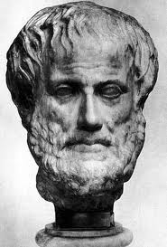
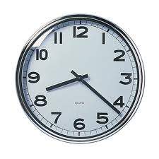
Day 3
Time without Change?
Introduction to Causation
The Regularity Theory of Causation
Problems with the Regularity Theory
Sydney Shoemaker: “Time Without Change”
There is generally thought to be a very close logical relationship between time and change.
We saw that McTaggart claimed that without ‘real change’ there is no real time. Though McTaggart’s understanding of what change is was perhaps a little unusual. (What was McTaggart’s understanding again?)
Aristotle defined time as: “the measure of change”. (Why?)
Take a clock for example. A clock is a mechanism that changes in a very even and predictable way (e.g. the hands go round the face, or recently, ‘atomic clocks’ work by measuring an even more reliable process – atomic vibrations). We all accept that those measurements of change allow us to measure time.

Slide 4
Day 3
Time without Change?
Introduction to Causation
The Regularity Theory of Causation
Problems with the Regularity Theory
Does that mean that if a clock stops, time stops?
If just one clock stops, then time doesn’t stop, because other clocks are still operating and measuring time. But if every clock were to stop, and every process in the Universe which might be used as a clock were to stop (e.g. every atom stopped vibrating), then surely time would have stopped….? Or would it?
If we accept Aristotle’s definition of time, we must say that it is not logically possible for time to pass without change. That possibility is ruled out by the meaning of the concept of time itself.
Sydney Shoemaker, however, has an argument that it is logically possible for time to pass without change...

Slide 5
Day 3
Time without Change?
Introduction to Causation
The Regularity Theory of Causation
Problems with the Regularity Theory
Shoemaker describes a possible world which seems logically consistent where not only is it possible for time to pass without change, we would even have very good reason to believe that time had passed without change!
Preliminary point: Shoemaker distinguishes:
real change: some actual alteration in properties in some physical object
McTaggart change: an event ‘changing’ by getting further and further in the past.
The second type of change is consistent with there being no real change, just the passage of time itself. Shoemaker notes he cannot show that time would pass without that sort of change. (He can’t show that time could pass without time passing.)
His argument will be that it is logically possible to have time without real change.

Slide 6
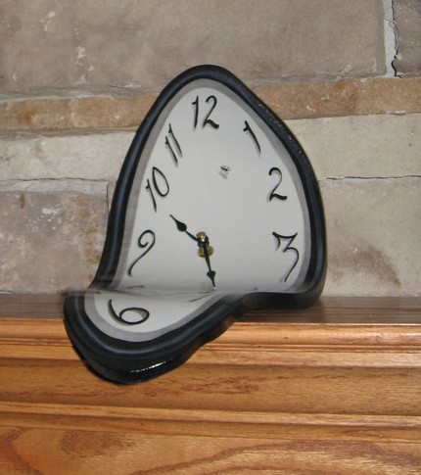

Day 3
Time without Change?
Introduction to Causation
The Regularity Theory of Causation
Problems with the Regularity Theory
Exercise (groups of 3-4):
Think of a possible world where it is not only the case that time passes without real change, but we would have a very good reason to believe that time had passed without real change.

Slide 7
Day 3
Time without Change?
Introduction to Causation
The Regularity Theory of Causation
Problems with the Regularity Theory
Imagine a possible world which can be divided into 3 main (spatial) regions: A, B and C. It is possible to pass from one region to another, but only by a small connecting ‘passage’.
Imagine that a ‘local freeze’ happens in the different regions from time to time, such that every single causal process in that region is interrupted for a period of time (people stop talking mid-sentence, fruit stops decaying, atoms stop vibrating….). When the local freeze ends, causal processes suddenly resume as if they had never been interrupted.
Thus it is as though time stops in that region, although it doesn’t really, because the other regions carry on as before, and people in the frozen region can talk to people in the other regions (once they un-freeze!) and be told that, actually, a year passed while they were frozen….

Slide 8
Day 3
Time without Change?
Introduction to Causation
The Regularity Theory of Causation
Problems with the Regularity Theory
Imagine that a local freeze happens….
in region A every 3 years (for a year)
in region B every 4 years (for a year)
in region C every 5 years (for a year)
Now, what is going to happen every 60 years?
A
Tunnel
C
Tunnel
B
Tunnel

Slide 9
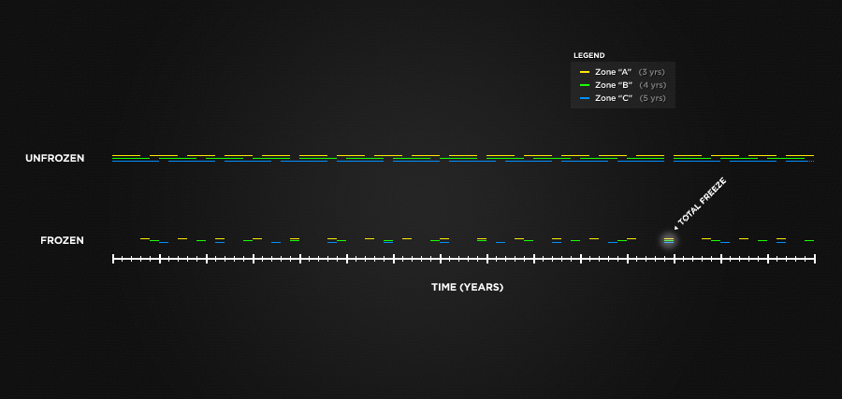
Day 3
Time without Change?
Introduction to Causation
The Regularity Theory of Causation
Problems with the Regularity Theory
Shoemaker claims that if we lived in such a Universe we would have very good reason to believe that every 60 years we were ALL frozen for a year, during which time passed while nothing changed.
Why? Because science should always choose the simplest hypothesis.

Slide 10
Day 3
Objections to this argument?
1) But how could this ever actually happen? If everything in the Universe was frozen for a year, how could it ‘start up again’? Surely something would need to cause it to start up again, and nothing could because it was frozen.
Shoemaker: Maybe so, but is this (he calls it ‘causation at a temporal distance’) logically impossible (i.e. self-contradictory) or just physically impossible (i.e. it contradicts the laws of physics as we know them)? He argues that it is only physically impossible because we can imagine causation at a temporal distance, even if we think it would never happen in our (possible) world. Thus it is logically possible to have time without change….
Objections to this argument?
1) But how could this ever actually happen? If everything in the Universe was frozen for a year, how could it ‘start up again’? Surely something would need to cause it to start up again, and nothing could because it was frozen.
Shoemaker: Maybe so, but is this (he calls it ‘causation at a temporal distance’) logically impossible (i.e. self-contradictory) or just physically impossible (i.e. it contradicts the laws of physics as we know them)? He argues that it is only physically impossible because we can imagine causation at a temporal distance, even if we think it would never happen in our (possible) world. Thus it is logically possible to have time without change….
Time without Change?
Introduction to Causation
The Regularity Theory of Causation
Problems with the Regularity Theory
Objections:
1) But how could this ever actually happen? If everything in the Universe was frozen for a year, how could it ‘start up again’? Surely something would need to cause it to start up again, and nothing could because it was frozen.
Shoemaker: Maybe so, but is this (he calls it ‘causation at a temporal distance’) logically impossible (i.e. self-contradictory)? Or is it just physically impossible (i.e. it contradicts the laws of physics as we know them)? Shoemaker argues that it is only physically impossible because we can conceive (i.e. imagine) causation at a temporal distance, even if we think it’d never happen in our possible world.
Thus it is logically possible to have time without change…
Other objections?

Slide 11
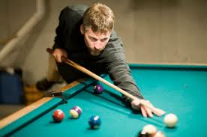
Day 3
Time without Change?
Introduction to Causation
The Regularity Theory of Causation
Problems with the Regularity Theory
What is Causation?
Causation: ‘things making other things happen’ − is surely one of the most fundamental relationships which structures the Universe. David Hume called it “the cement of the Universe”.
Warm-up exercise: Watch This video of billiard ball behaviour Observe very closely! Ask yourself the following questions:
- Do you ‘see causation happening’?
- When you see the ball hit the side of the table, or another ball, do you see that that the ball must behave in the way that it does behave? And if so, what does that mean?

Slide 12
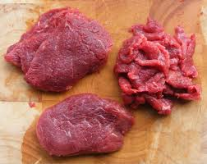
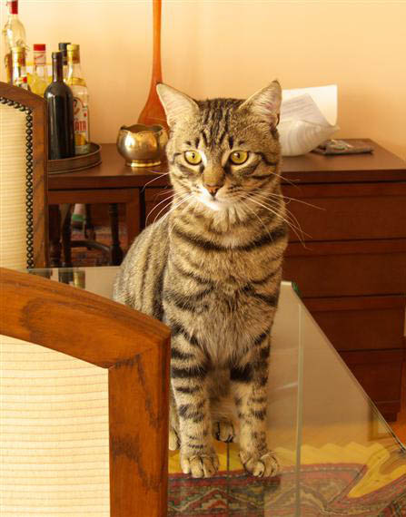

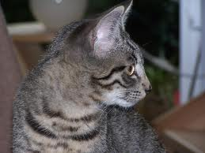
Day 3
Time without Change?
Introduction to Causation
The Regularity Theory of Causation
Problems with the Regularity Theory
Our understanding of causation is a very large part of how we structure our understanding of reality.
For instance, I come home and find that a steak I left defrosting on the kitchen bench is half-chewed!!!
Immediately, without thinking about it, I assume a whole causal chain of events. It goes something like this:
CAUSES
CAUSES
Cat sees steak
EVENT
Cat decides to get steak
EVENT
Cat chews steak
EVENT

Slide 13
Day 3
Time without Change?
Introduction to Causation
The Regularity Theory of Causation
Problems with the Regularity Theory
But what do we mean by causation?
Can we give this concept any kind of definition? Or is it too basic (i.e. ‘primitive’)? Some have argued this (e.g. Richard Taylor).
However, many philosophers have thought a definition could be given for causation.
Preliminary point: Causation is usually understood as a relationship which holds between events, rather than, say, physical objects.
What is the difference between an event and a physical object?
Thus for instance, it wasn’t the knife (an object) that caused John to die – it was Mary’s stabbing him with the knife (an event) that caused John to die.

Slide 14
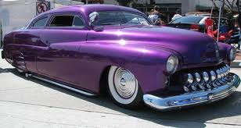
Day 3
Time without Change?
Introduction to Causation
The Regularity Theory of Causation
Problems with the Regularity Theory
Exercise: (groups of 3-4)
Part 1. Consider the following scenarios. For each of these, does the first event (or set of events) genuinely cause the second event (or set of events)? You can answer: i) “yes”, ii) “no”, iii) “it depends” (in which case, say what ‘it' depends on).
1: I pull up at the traffic lights on 30th and Lamar.
A purple car pulls up beside me.
2: I pull up at the traffic lights on 30th and Lamar, exit the car
and swing an axe at the window of the car next to me.
The car window breaks.
3: The 9/11 terrorist attacks.
The war in Iraq.
4: I stop eating.
40 days later, I die of malnutrition
5: 5000 times in a row (day and night), I pull up at 30th&Lamar.
5000 times in a row, a purple car pulls up beside me.

Slide 15
Day 3
Time without Change?
Introduction to Causation
The Regularity Theory of Causation
Problems with the Regularity Theory
Exercise: (groups of 3-4)
Part 2: (The hard, philosophical part.) Examine the scenarios you have chosen as cases of genuine causation. ‘In virtue of what’ are these cases of genuine causation, while the others are not?
Use your answer to this question to write a definition of causation in the format:
X is a genuine cause of Y if and only if...
(If and only if is of course, the logical ‘biconditional’: ≡)
Logic Link, for the logically sophisticated: Write your definition in formal logic. Don’t forget to include a lexicon! ☺

Slide 16
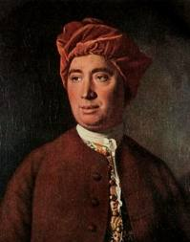
Day 3
Time without Change?
Introduction to Causation
The Regularity Theory of Causation
Problems with the Regularity Theory
The Regularity Theory of Causation
David Hume wrote this famous definition of causation:
This quotation has inspired a popular metaphysical theory, according to which (the event) X causing (the event) Y consists in nothing over and above the fact that X happened before Y and events like X are always followed by events like Y. In other words:
X is a genuine cause of Y iff there is a constant conjunction between events like X and events like Y.
We may define a cause to be an object followed by another, and where all the objects, similar to the first, are followed by objects similar to the second.

Slide 17
Day 3
Time without Change?
Introduction to Causation
The Regularity Theory of Causation
Problems with the Regularity Theory
This view has been very influential in metaphysics.
However Hume’s argument for it draws on consider-
ations from epistemology (theory of knowledge).
Here is the broad structure of Hume’s argument:
1. We tend to think that causation consists in something more than mere regularity (This ‘something more’ is sometimes referred to using terms such as ‘causal necessity’.)
2. However, when we look at how we actually gain knowledge of the world, we see that we could never gain knowledge of causal necessity, only of regularity.
3. Therefore, all there is to causation is causal regularity.

Slide 18
Day 3
Time without Change?
Introduction to Causation
The Regularity Theory of Causation
Problems with the Regularity Theory
1. We think that causation consists in something stronger than mere regularity
Why? We tend to want to say things like this:
“The scenario where I break the car window with the axe is a case of genuine causation because the first event made the second event happen. If events of the first kind happen, then events of the second kind must happen (If someone smashes something fragile with an axe, then it has to break). But that is not the case in, say, scenario 1. Just because a car pulls up at traffic lights, that doesn’t mean a purple car must pull up beside it.”
Words such as ‘must’ and ‘has to’ are generally used to indicate necessity.
We saw on Day 1 however that a distinction can be drawn between logical and physical necessity.

Slide 19
Day 3
Time without Change?
Introduction to Causation
The Regularity Theory of Causation
Problems with the Regularity Theory
2. However, when we look at how we actually gain knowledge of the world, we see that we could never gain knowledge of causal necessity. We only gain knowledge of regularity.
(Why?) Hume: All knowledge falls into two categories:
i) Relations of Ideas (known a priori, a matter of definitions, not reality) Key criterion: does denying it produce a contradiction. Can be proven using ‘demonstrative’ (deductive) proof. Certain.
ii) Matters of Fact (known a posteriori, knowledge of reality) Key criterion: do you need to get experience in order to know it? No demonstrative proof → Much less certain.
Exercise: Relations of Ideas or Matters of Fact?
i) Some swans are black. ii) All husbands are married.
iii) Octagons are not round. iii) Inflation is currently at 3%.

Slide 20
Day 3
Time without Change?
Introduction to Causation
The Regularity Theory of Causation
Problems with the Regularity Theory
Unlike our knowledge of logical necessity, our knowledge of ‘causal necessity’ does not consist in Relations of Ideas. Why?
1) In a case of causation there is no contradiction in supposing otherwise:
2) If we had no experience we would have no knowledge of cause and effect:
A baby doesn’t know that submerging himself in water will cause him to drown or that putting his hand in the fire will burn him. We like to kid ourselves that we could ‘work out’ causes and effects if seeing them for the first time, but we really couldn’t.
A stone or piece of metal raised into the air, and left without any support, immediately falls: but to consider the matter a priori, is there anything we discover in this situation which can beget the idea of a downward, rather than an upward, or any other motion, in the stone or metal? (Hume, Enquiry, p. 29)

Slide 21
Day 3
Time without Change?
Introduction to Causation
The Regularity Theory of Causation
Problems with the Regularity Theory
One of the main themes of Hume’s philosophy is that we imagine that we know all kinds of things through reason that we really don’t know through reason.
How then do we know those things? Merely via custom and habit – i.e. regularities in our experience.
We are apt to imagine that we could discover these effects by the mere operation of our reason, without experience. We fancy, that were we brought on a sudden into this world, we could at first have inferred that one Billiard-ball would communicate motion to another upon impulse; and that we needed not to have waited for the event, in order to pronounce with certainty concerning it. Such is the influence of custom, that, where it is strongest, it not only covers our natural ignorance, but even conceals itself, and seems not to take place, merely because it is found in the highest degree (Hume, Enquiry, pp. 28-9).

Slide 22
Day 3
Time without Change?
Introduction to Causation
The Regularity Theory of Causation
Problems with the Regularity Theory
Objection 1: ‘Too accidental’
But doesn’t that mean that if we take Hume seriously we have to say that we know that events where an axe hits a window have always been followed by events where the window smashes in the past (i.e. we know the regularity), but nevertheless, we don’t know that the next time an axe hits a window the window must smash?
Yes (!)
(this philosophical move is known as ‘biting the bullet’)
What objections can you think of to the Regularity Theory of Causation?

Slide 23
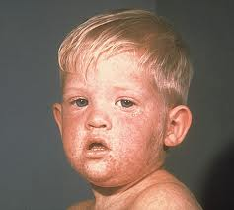
Day 3
Time without Change?
Introduction to Causation
The Regularity Theory of Causation
Problems with the Regularity Theory
David Lewis’ Objections:
Lewis highlights 3 further types of scenarios which he says are counter-examples to Hume:
Effects
The Humean definition means that effects cause their causes if there is no other way that the effect could be brought about other than being caused by that cause.
For example, contact with the measles virus causes measles, and that is the only way you can get measles, so everyone who has measles has had contact with the measles virus. This is a universal regularity.
Thus the Humean theory has to say:
Having measles caused me to have contact with the measles virus (?)

Slide 24
Day 3
Time without Change?
Introduction to Causation
The Regularity Theory of Causation
Problems with the Regularity Theory
David Lewis’ Objections:
2) Epiphenomena.
Sometimes an event (C), as well as causing an effect (E), also causes something else to happen (X), which has no effects of its own (is ‘causally inefficacious’) – at least with respect to E. According to the Regularity Theory, X will appear to be a cause of E.
For example, catching measles (C) causes a high fever (E) and it also always causes a distinctive pattern of spots on the body (X). But:
Having measles spots caused me to have a high fever ?
Can you think of another example of epiphomena which are not genuine causes?

Slide 25
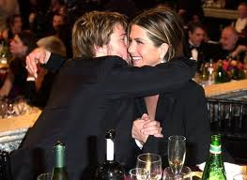
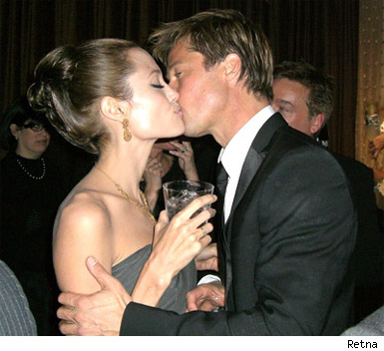
Day 3
Time without Change?
Introduction to Causation
The Regularity Theory of Causation
Problems with the Regularity Theory
David Lewis’ Objections:
3) Pre-empted Potential Causes
Sometimes a situation occurs where two things happen (C1 and C2), each of which always appears with an effect of type E, but in this particular situation one of them ‘gets in first’.
According to the regularity theory, both C1 and C2 would be the cause of E, when in fact only one of them was the cause (the one that got in first).
For example, Brad kisses Jennifer (C1) and kisses Angelina (C2). Both of them have the measles virus, and either C1 or C2 would have been enough to cause Brad to get the measles (E). But in fact Brad kissed Jennifer first so:
Brad’s kissing Angelina caused him to get the measles
- is not true in this case.

Slide 26
Day 3
Time without Change?
Introduction to Causation
The Regularity Theory of Causation
Problems with the Regularity Theory
FURTHER READING:
Philosophy:
Sydney Shoemaker, “Time Without Change”, The Journal of Philosophy, 66(12) (June 1969), pp. 363-381. (erraticwisdom.com/file_download/12)
David Hume, section iv), Enquiries Concerning Human Understanding http://www.earlymoderntexts.com/f_hume.html
Charles Taylor, “The Metaphysics of Causation”, Causation and Conditionals, ed. Sosa (Oxford: Oxford University Press, 1975), pp. 39-43.
William Edward Morris, “David Hume”, Stanford Encyclopedia of Philosophy, http://plato.stanford.edu/entries/causation-metaphysics/ [sections 10-12 discuss Hume’s account of causation]
Jonathan Schaeffer, “The Metaphysics of Causation”, Stanford Encyclopedia of Philosophy, http://plato.stanford.edu/entries/causation-metaphysics/ [comprehensive]

Slide 27
Day 3
Time without Change?
Introduction to Causation
The Regularity Theory of Causation
Problems with the Regularity Theory
FURTHER READING / VIEWING:
Fiction:
Jorge-Luis Borges, “The Garden of Forking Paths” http://www.coldbacon.com/writing/borges-garden.html [in this story it is extremely difficult to work out what is going on. I had to read it 3 times before I knew. But IMO it is totally brilliant]
Groundhog Day (dir. Harold Ramis, 1993)

