Slide 1

Analog Implementation of a Gaussian Mixture Model Classifier
National Technical University of Athens
Liakopoulos Athanasios

Slide 2




Analysis of GMM
Unsupervised Learning (Clustering)
Normal Distribution
Probability from input Vector of size N
Bayes Theorem
Winning class determined by highest posterior probability

Slide 3
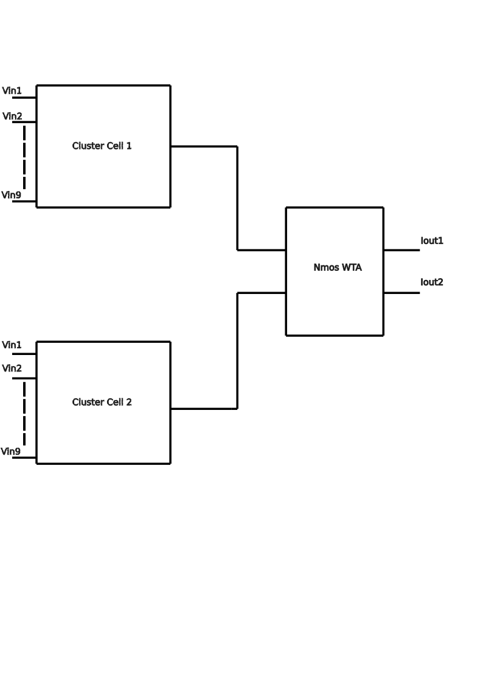
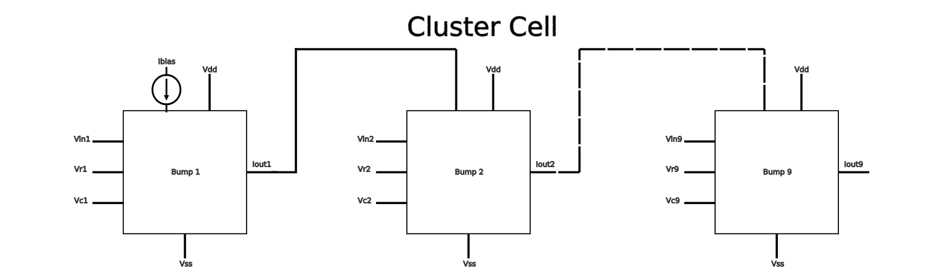
System Level Implementation (2 classes)

Slide 4
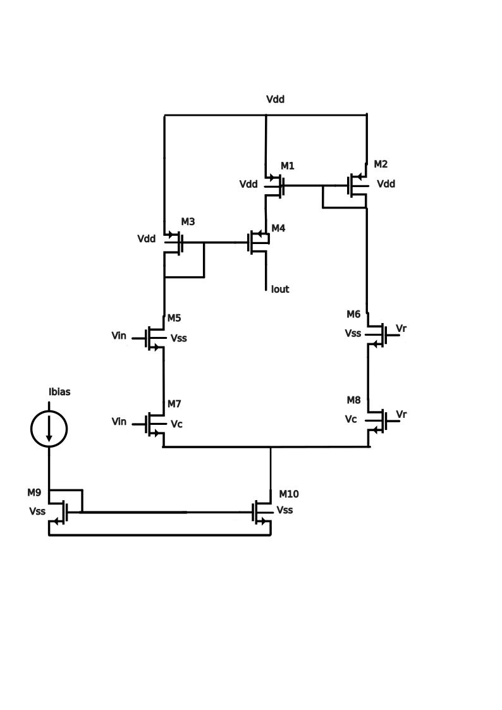
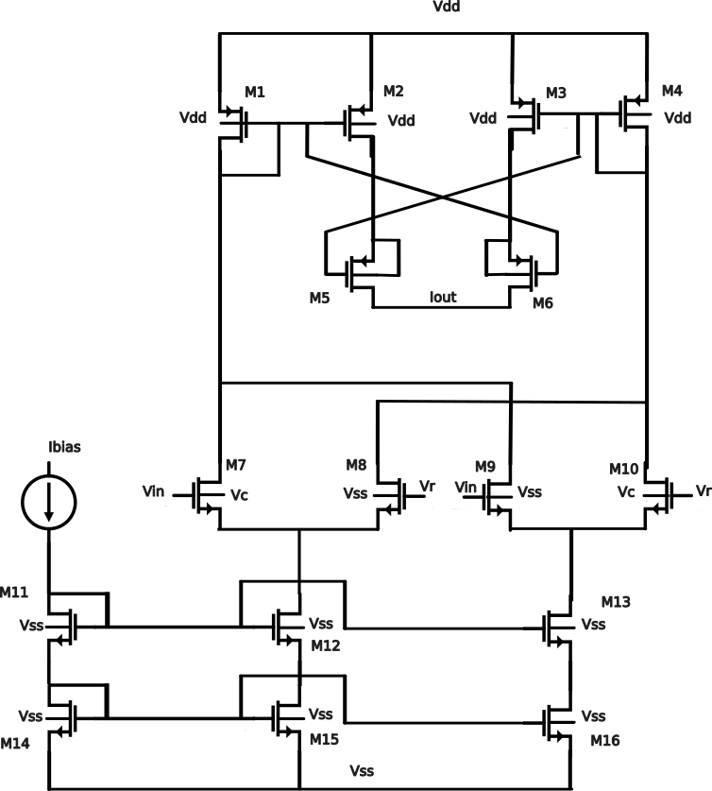
Bump Circuits
Modified Bump
Tunable Delbruck’s Bump

Slide 5
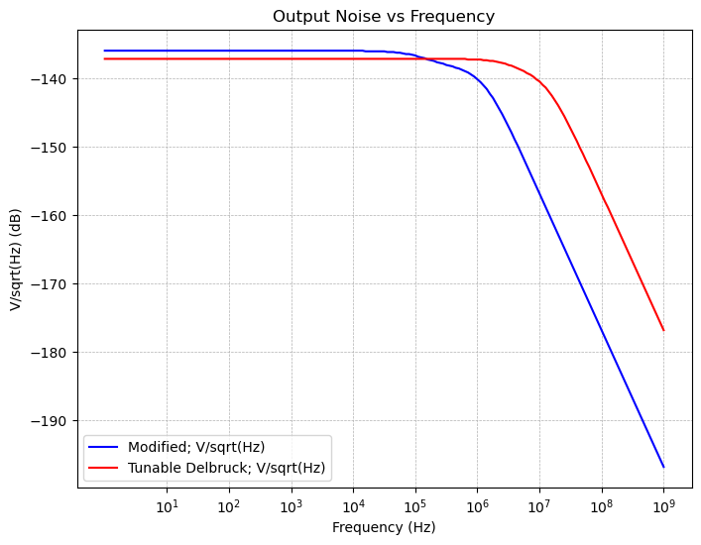
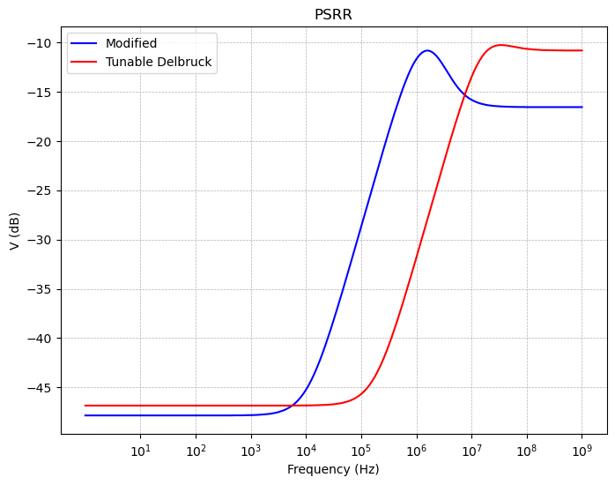
Noise and Psrr Comparison

Slide 6
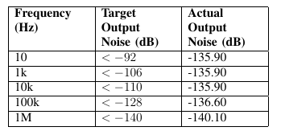

Noise and Psrr for Modified Bump

Slide 7
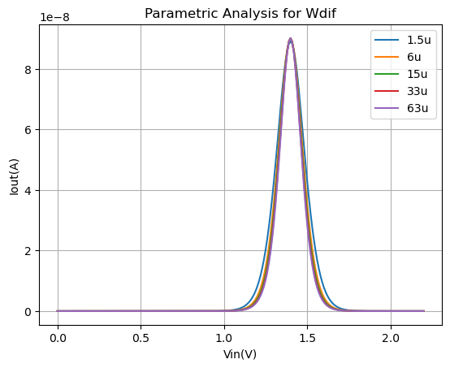
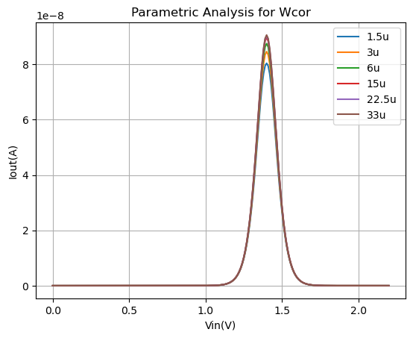
Parametric Analysis

Slide 8
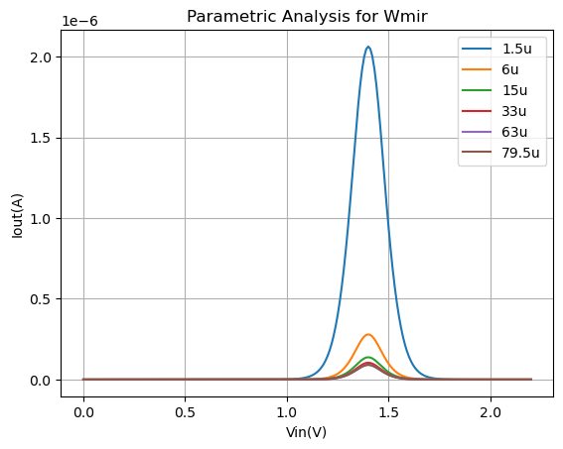
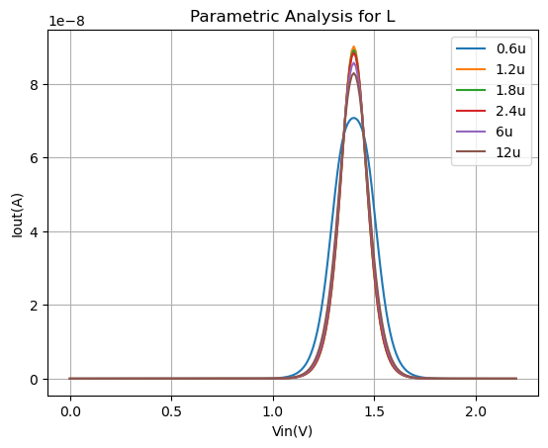

Slide 9
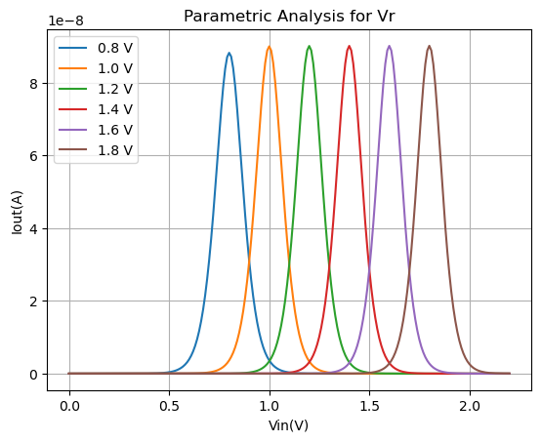
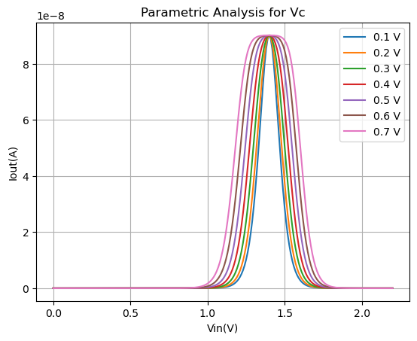

Slide 10
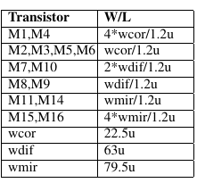
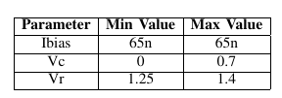
Parameters

Slide 11
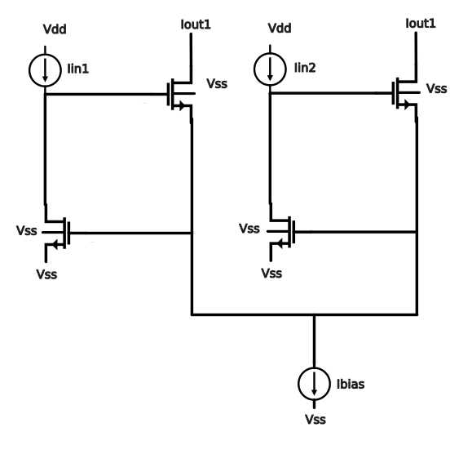
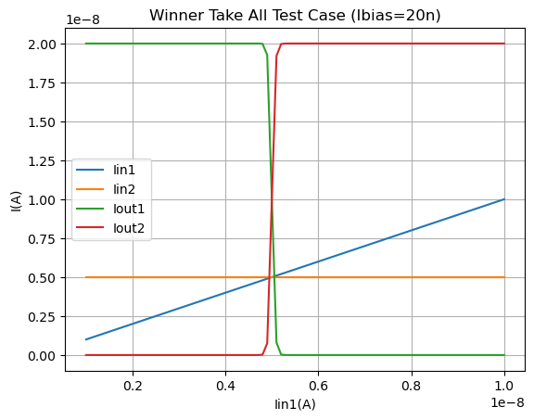
Lazzaro Nmos Wta

Slide 12
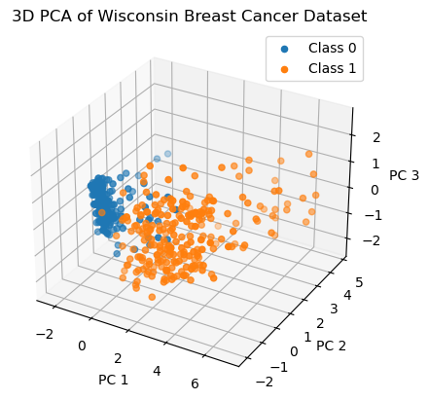
Evaluation of Classifier
Wisconsin Breast Cancer Dataset
2 classes (Benign and Malignant)
9 features
699 instances
Missing Values handled with mean imputation
Normalization
211 samples test size

Slide 13
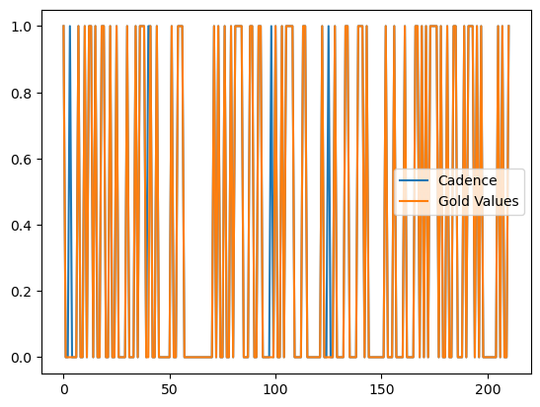

Software vs Hardware

Slide 14
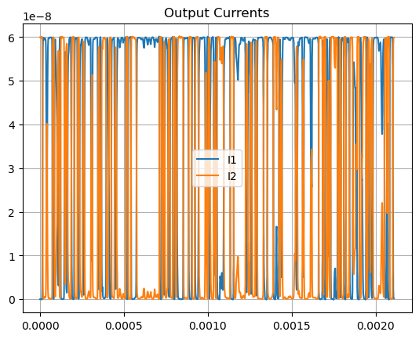
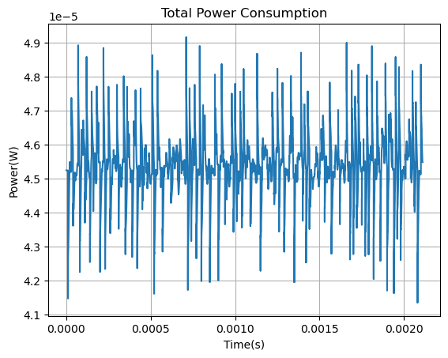
Power Consumption and Output Currents

Slide 15
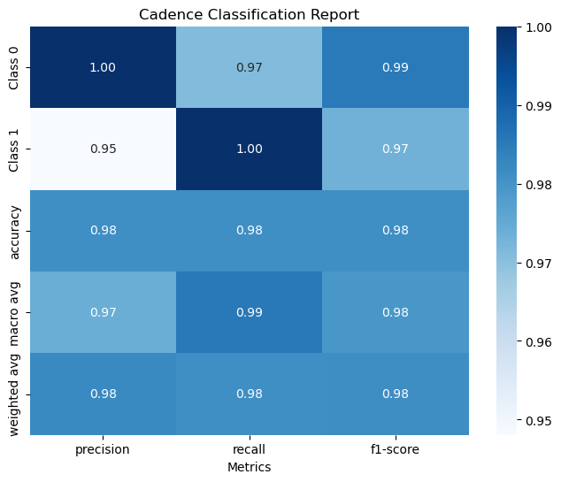
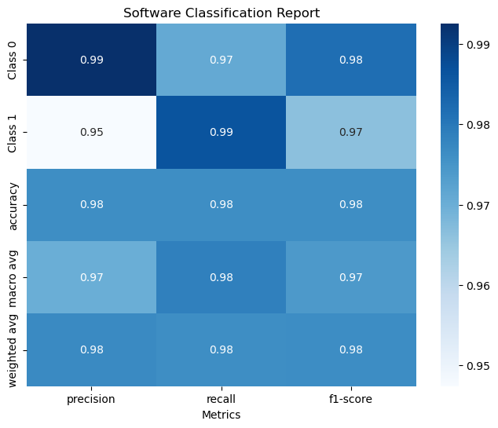
Classification Reports

Slide 16
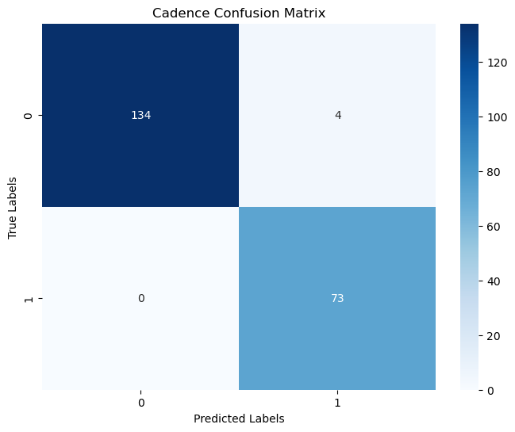

Confusion Matrices

Slide 17
Conclusion
Hardware implementation of GMM
Low power consumption (Sub-threshold operation, Ibias=65nA, Vdd=2.2V)
High classification accuracy (surpassing software)
High expectations for future applications and many uses

