Slide 1
SailAlign Tutorial
Nassos Katsamanis
Signal Analysis and Interpretation Laboratory (SAIL)
University of Southern California
http://sipi.usc.edu/~nkatsam

Slide 2
robust long speech-text alignment
Conventional Viterbi-based forced alignment suffers from the following limitations:
  The transcription has to be accurate
  Audio has to be relatively noise-free
SailAlign circumvents these restrictions by implementing an alignment scheme which builds upon the iterative segmental application of a large vocabulary continuous speech recognition system, that was introduced by Moreno et al. in ICSLP ‘98.
January 28th, 2011
http://sail.usc.edu/software/SailAlign

Slide 3
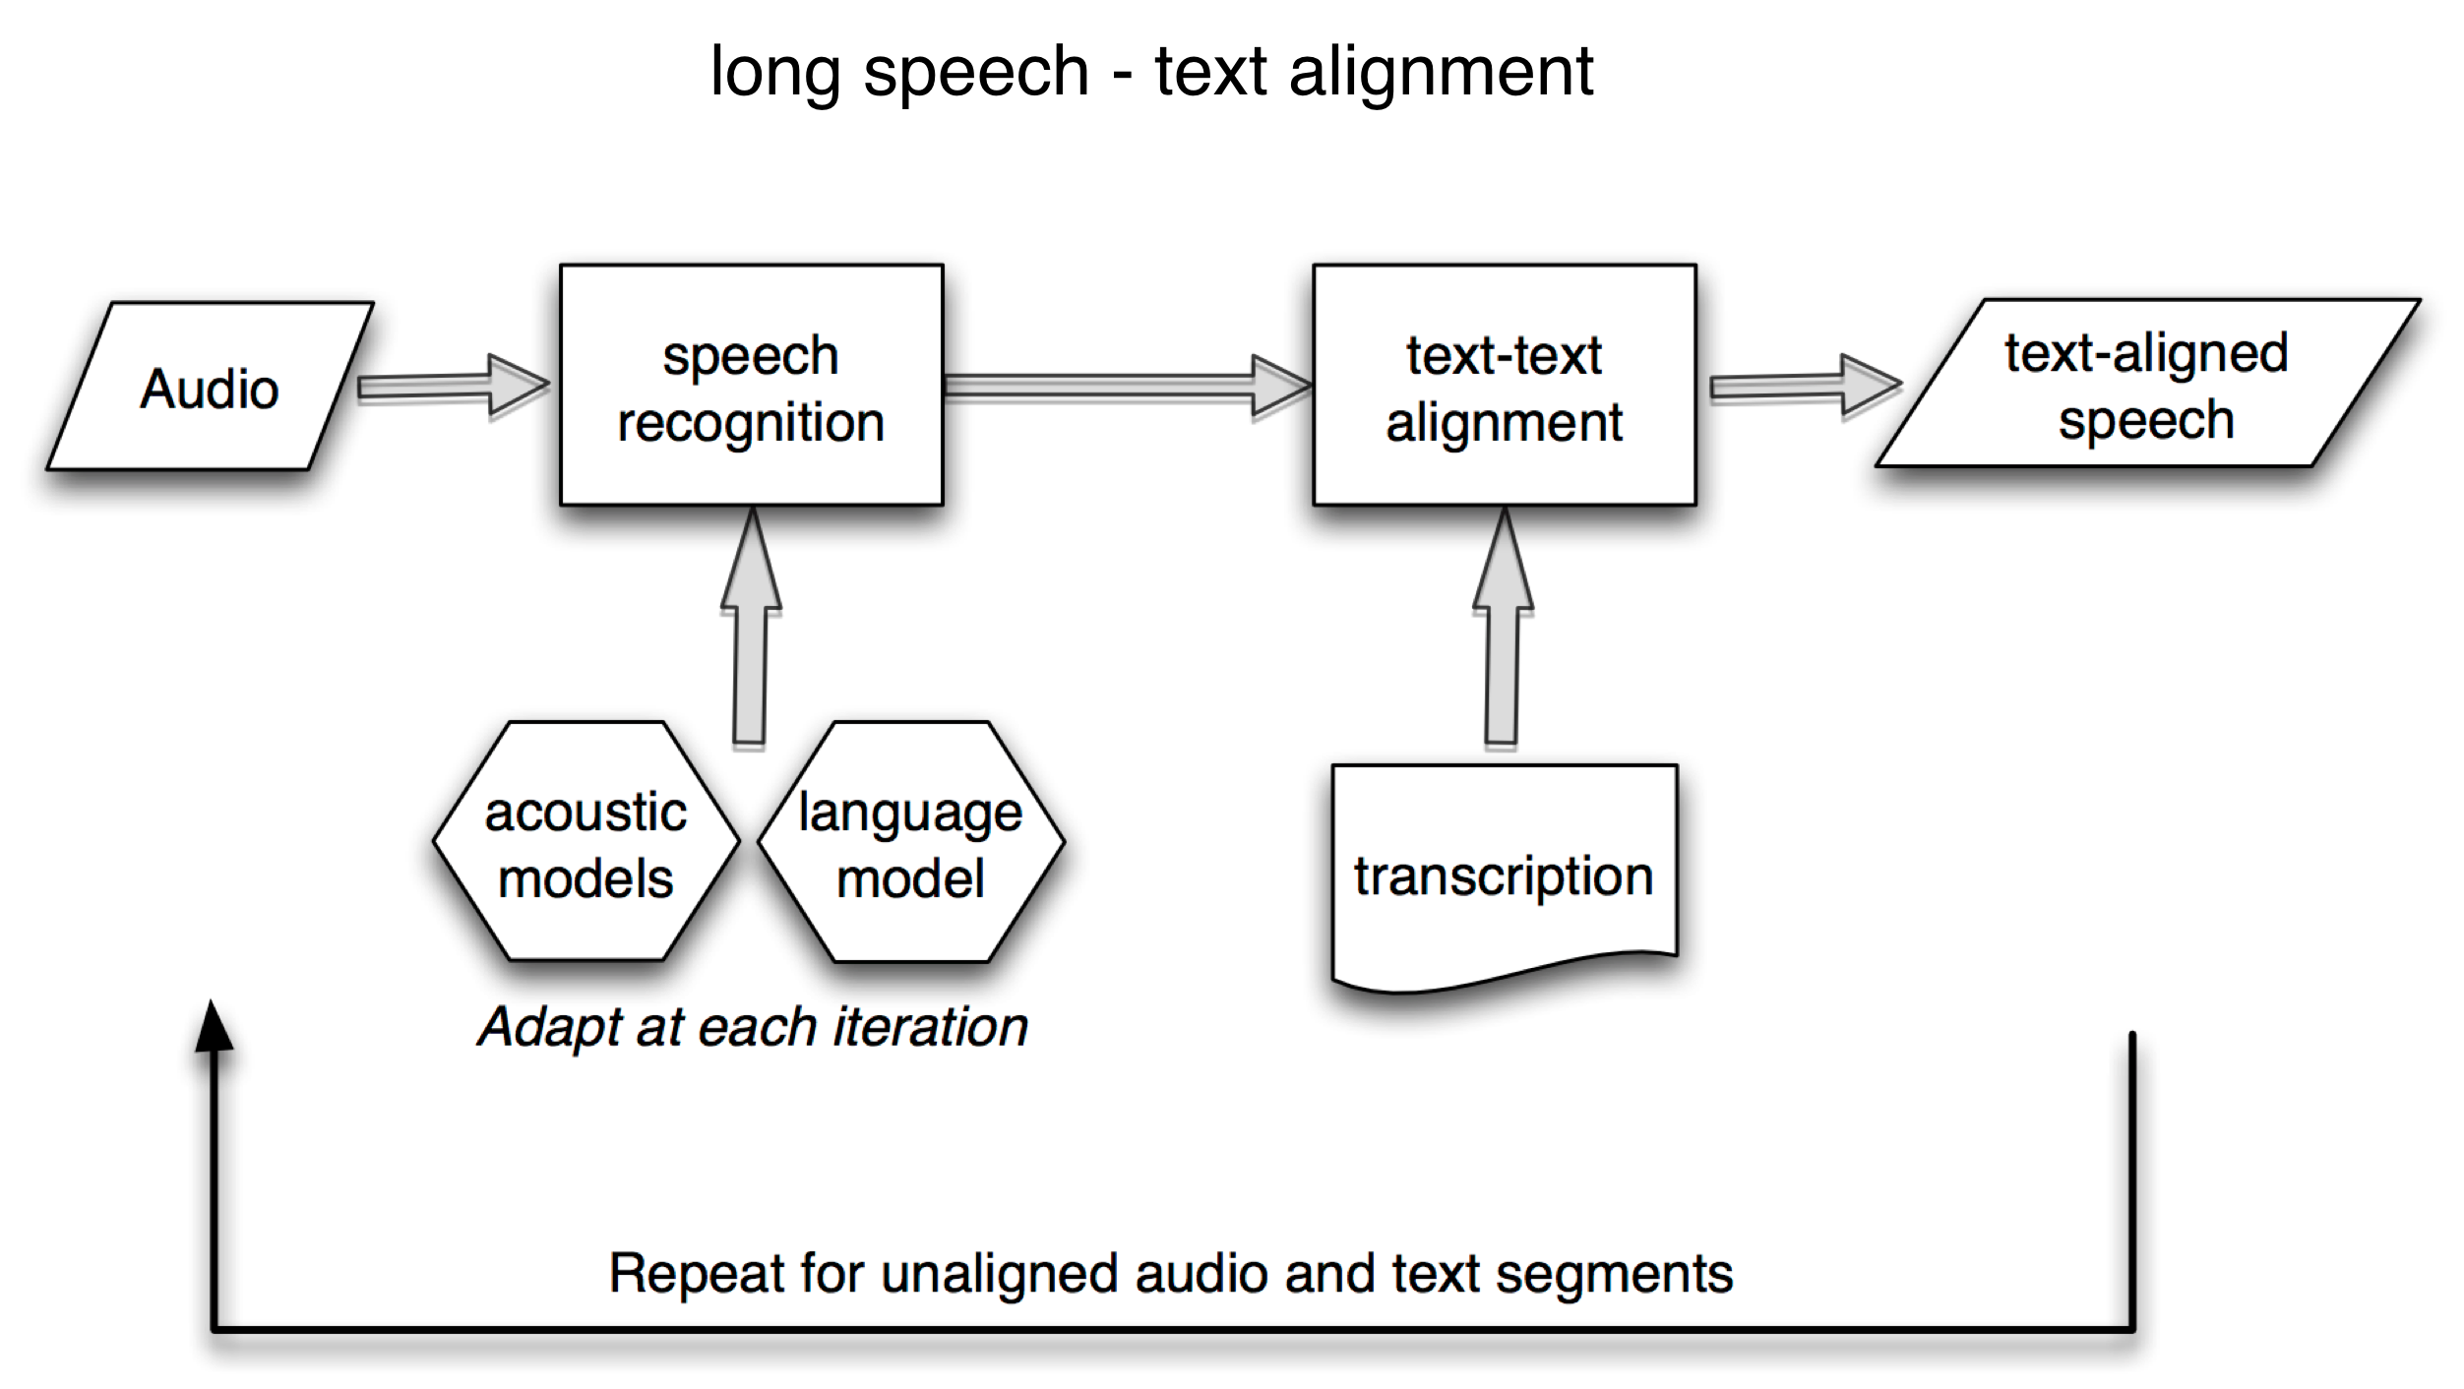
Katsamanis, M. Black, P. Georgiou, L. Goldstein and S. Narayanan,
SailAlign: Robust long speech-text alignment,
in Proc. of Workshop on New Tools and Methods for Very-Large Scale Phonetics Research, Jan. 2011.
SailAlign is freely distributed: http://sail.usc.edu/software/SailAlign
January 28th, 2011
http://sail.usc.edu/software/SailAlign

Slide 4
the architecture
SailTools
  Library of perl packages, implementing the overall speech-text alignment scheme
  Has been designed to allow integration of custom speech recognition, acoustic adaptation and language modeling tools
  Currently SailAlign has only been tested with HTK, SRILM, SCTK.
Hidden Markov Model Toolkit (HTK)
  HDecode and HVite are used as speech recognition engines.
  HERest is used for the adaptation of the acoustic models.
  HCopy is used for acoustic feature extraction from audio.
SRI Language Modeling Toolkit (SRILM)
  ngram and ngram-count are used for language model building.
SCTK
  sclite is used for text-text alignment.
January 28th, 2011
http://sail.usc.edu/software/SailAlign

Slide 5
usage
>> sail_align –i support/data/timit_5.wav –t support/data/timit_5.txt
–w support/data/test/timit_sample_test –e timit_sample_test
–c config/timit_alignment.cfg
switch | corresponding option
-i | audio file (wav format, 16kHz, 16bits, 1 channel)
-t | text file with the audio transcription in one line
-w | working directory where output files will be stored
-e | an experiment id for easy reference to a specific alignment run
-c | configuration file
January 28th, 2011
http://sail.usc.edu/software/SailAlign

Slide 6
the transcription
support/data/timit_5.txt:
tradition requires parental approval for under age marriage don't ask me to carry an oily rag like that it's healthier to cook without sugar few rural areas are protected by zoning rector was often curious often tempted to ask questions but he never did mom strongly dislikes appetizers the cranberry bog gets very pretty in autumn brown eyes eyebrow mustache she had your dark suit in greasy wash water all year pizzerias are convenient for a quick lunch don't ask me to carry an oily rag like that nowadays we talk as though the blitz were just a short skirmish elderly people are often excluded her wardrobe consists of only skirts and blouses drop five forms in the box before you go out put the butcher block table in the garage jars are assembled in bowl of butter mold propriety was synonymous with ritual observance the mark of a true gentleman she had your dark suit in greasy wash water all year don't ask me to carry an oily rag like that a flame would use up air shaving cream is a popular item on halloween they own a big house in the remote countryside help greg to pick a peck of potatoes his history is his alone yet each man must recognize his own history in it michael colored the bedroom wall with crayons every movement she made seemed unnecessarily noisy the misquote was retracted with an apology planned parenthood organizations promote birth control she had your dark suit in greasy wash water all year a boring novel is a superb sleeping pill…
No punctuation
All text in one line
January 28th, 2011
http://sail.usc.edu/software/SailAlign

Slide 7
alignment results
support/test/ref/timit_sample_test/timit_5.lab:
0.71 1.12 TRADITION
1.12 1.6 REQUIRES
1.6 1.98 PARENTAL
1.98 2.42 APPROVAL
2.42 2.58 FOR
2.58 2.87 UNDER
2.87 3.56 AGE MARRIAGE
3.91 4.08 DON'T
4.08 4.31 ASK
…
Each line corresponds to an aligned segment.
Start and end times are in seconds
The .lab file is compatible with transcription browsing software, e.g., Wavesurfer.
January 28th, 2011
http://sail.usc.edu/software/SailAlign

Slide 8
configuration
config/timit_alignment.cfg
%cfg = (
…
alignment => {
do_adaptation => 1, # Adapt acoustic models at each iteration
do_phon_alignment => 1, # Do forced phonetic alignment in the end
do_forced_word_alignment => 1, # Do forced word alignment in the end
min_n_aligned_words => 4, # Min number of words for reliably aligned region
acoustic_model => {
defs => catdir(
$ROOTPATH,
'models/ac_models/english/htk/wsj_si84_2750_8/hmmdefs'
), …
January 28th, 2011
http://sail.usc.edu/software/SailAlign

Slide 9
forced alignment & the .wrd file
In the configuration file:
…
word_forced_alignment => {
…
utt_duration => 600, # Duration in seconds for each segment # to be forced aligned
tool => 'htk',
…
},
…
January 28th, 2011
http://sail.usc.edu/software/SailAlign

Slide 10
the .phn file & .wrd files
support/test/ref/timit_sample_test/timit_5.forced.phn:
0.71 0.73 sil
0.73 0.77 t
0.77 0.8 r
0.8 0.83 ah
0.83 0.88 d
0.88 0.95 ih
0.95 1.06 sh
1.06 1.09 ih
1.09 1.12 n
1.12 1.12 sp
…
The result of the word-level forced alignment is in the .wrd file and is in the same format as the .lab file.
January 28th, 2011
http://sail.usc.edu/software/SailAlign

Slide 11
the dictionary (1)
In the configuration file (config/timit_alignment.cfg):
dictionary => {
tool => 'htk',
reference => [
'language/cmu_dictionary.dic’ ,
'language/timit_dictionary.dic’
],
apply_phone_map => 1,
phone_map_direct => 'language/timit2cmu_phones.map’,
phone_map_inverse => 'language/cmu2timit_phones.map’,
file => catfile( $WORKINGDIR, 'dictionary' ),
},
January 28th, 2011
http://sail.usc.edu/software/SailAlign

Slide 12
the dictionary (2)
language/cmu_dictionary.dic
ACADEMIA ae k ah d iy m iy ah
ACADEMIC ae k ah d eh m ih k
ACADEMICALLY ae k ah d eh m ih k l iy
ACADEMICIAN ae k ah d ah m ih sh ah
language/timit_dictionary.dic
AMBIGUITY ae m b ax g y uw ix t iy
AMBIGUOUS ae m b ih g y uw ax s
AMBITIONS ae m b ih sh ix n z
AMBITIOUS ae m b ih sh ix s
language/timit2cmu_phones.map
eng ih
ax ah
ix ih
el l
em m
en n
axr er
January 28th, 2011
http://sail.usc.edu/software/SailAlign

Slide 13
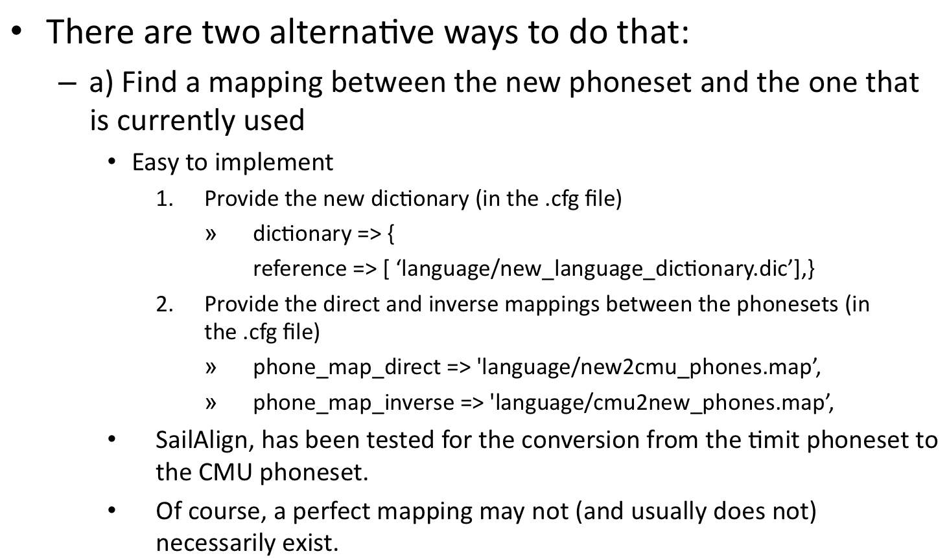
porting to a new language/phoneset (1)
January 28th, 2011
http://sail.usc.edu/software/SailAlign

Slide 14
porting to a new language/phoneset (2)
  b) So, train acoustic models based on the new phoneset/language may be a better solution.
    This is a solution that is a bit more involved.
    Acoustic models have to be HTK models. For further details check Ketih Vertanen’s webpage and software for building HTK models, http://www.keithv.com/software/htk/ Of course, you will need transcribed acoustic data for your new language.
    Currently, the acoustic features used for the models are ‘MFCC_0_D_A_Z’. We assume that this does not change for the new models.
    We need to provide the new dictionary. No phonetic mappings are necessary.
    We need to provide the new acoustic model locations in the .cfg file, i.e., update all acoustic_model related structures in the file
January 28th, 2011
http://sail.usc.edu/software/SailAlign

Slide 15
the log file
support/test/ref/timit_sample_test/alignment.log:
…
DEBUG - audio:support/data/timit_5.wav text: support/data/timit_5.txt
DEBUG - Initialized experiment timit_sample_test, working dir: support/test/ref/timit_sample_test
DEBUG - Successfully initialized a SailSignal instance
DEBUG - Initialized transcription
DEBUG - Properly initialized alignment
DEBUG - Signal: support/data/timit_5.wav Number of transcribed words: 864
DEBUG - /home/work/speech_text_alignment/sail_align/bin/vad -m /home/work/speech_text_alignment/sail_align/models/vad/MattModel.bin -i support/data/timit_5.wav -o support/test/ref/timit_sample_test/vad/voice_activity.out --ST-window-size 0.02 --ST-window-shift 0.01
DEBUG - File's duration is: 301.16 sec
DEBUG - /home/work/speech_text_alignment/sail_align/bin/HCopy -T 1 -C support/test/ref/timit_sample_test/feature_extraction.cfg support/data/timit_5.wav support/test/ref/timit_sample_test/features/asr/htk/support/data/timit_5.mfc
DEBUG - Feature extraction finished OK
DEBUG - Starting feature file segmentation
…
INFO - Number of aligned words in the segment/total number of words: 11/11
INFO - Percentage of aligned words: 0.898148148148148
DEBUG - current_unaligned_index=7 ind = 3 number_of_segs = 22
…
January 28th, 2011
http://sail.usc.edu/software/SailAlign

Slide 16
SailAlign
More information on Sunday at 13:00 and at:
http://sail.usc.edu/SailAlign
To acquire SailAlign and for technical support, just send me an email:
nkatsam@sipi.usc.edu
Currently only working on linux
  Has been tested on 32 and 64 bits architectures
  There is a problem with HDecode on Mac I am trying to figure out
Installation
  It is installed as a perl package
  >>perl Build.PL
  >> ./Build
  >> sudo ./Build install
January 28th, 2011
http://sail.usc.edu/software/SailAlign

