Slide 1


Cluster capacity allocation
cluster size (memory)
wasteful allocation
total workload
memory resource
limits
sensible zone
if auto-scaling not an option
if auto-scaling is an option
total workload
memory resource requests
unstable workloads
cluster size (cpu)
total workload
CPU resource requests
total workload CPU resource limits

Slide 2
node
node
node
node
customer workload
pods
daemonset
pods

Slide 3
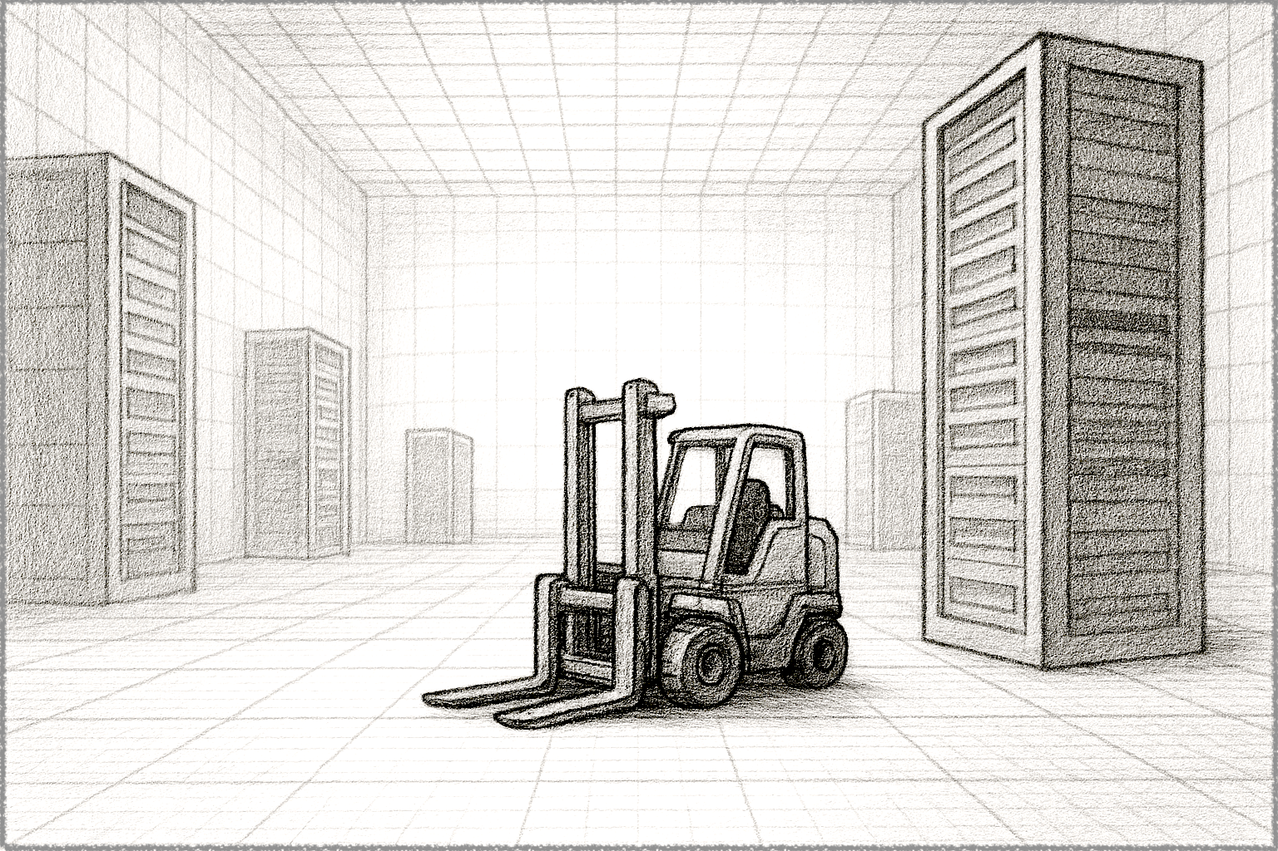
Account Limits
Instance Limits
Kubernetes Limits

