Slide 1
CYBERHUNTER AI
AI-Powered Automated Vulnerability Assessment Platform
Oleh Nastain · Team Ternakheck

Slide 2
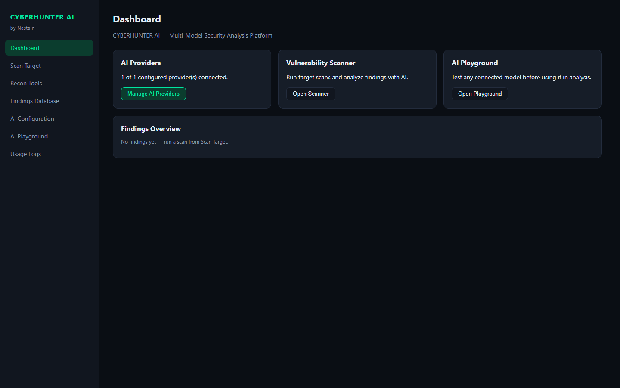
LATAR BELAKANG
Masalah
▪ Testing manual lambat — Ratusan input tersembunyi di aplikasi web modern mustahil dicek satu per satu dengan tangan.
▪ Scanner biasa hanya pasif — Cek header/banner saja — tidak melakukan active probing yang dibutuhkan assessment nyata.
▪ Parameter sering terlewat — POST body, JSON API, hidden fields, cookie, header, dan file .js diabaikan crawler konvensional.
▪ Anti-bot menghalangi — WAF modern memakai JavaScript challenge — scanner biasa langsung buta.
▪ Hasil mentah sulit dipakai — Tanpa payload, evidence, dan request/response lengkap — tidak bisa langsung ditindaklanjuti.
CYBERHUNTER AI — AI-Powered Automated Vulnerability Assessment Platform
02 / 17
Dashboard — overview hasil assessment

Slide 3
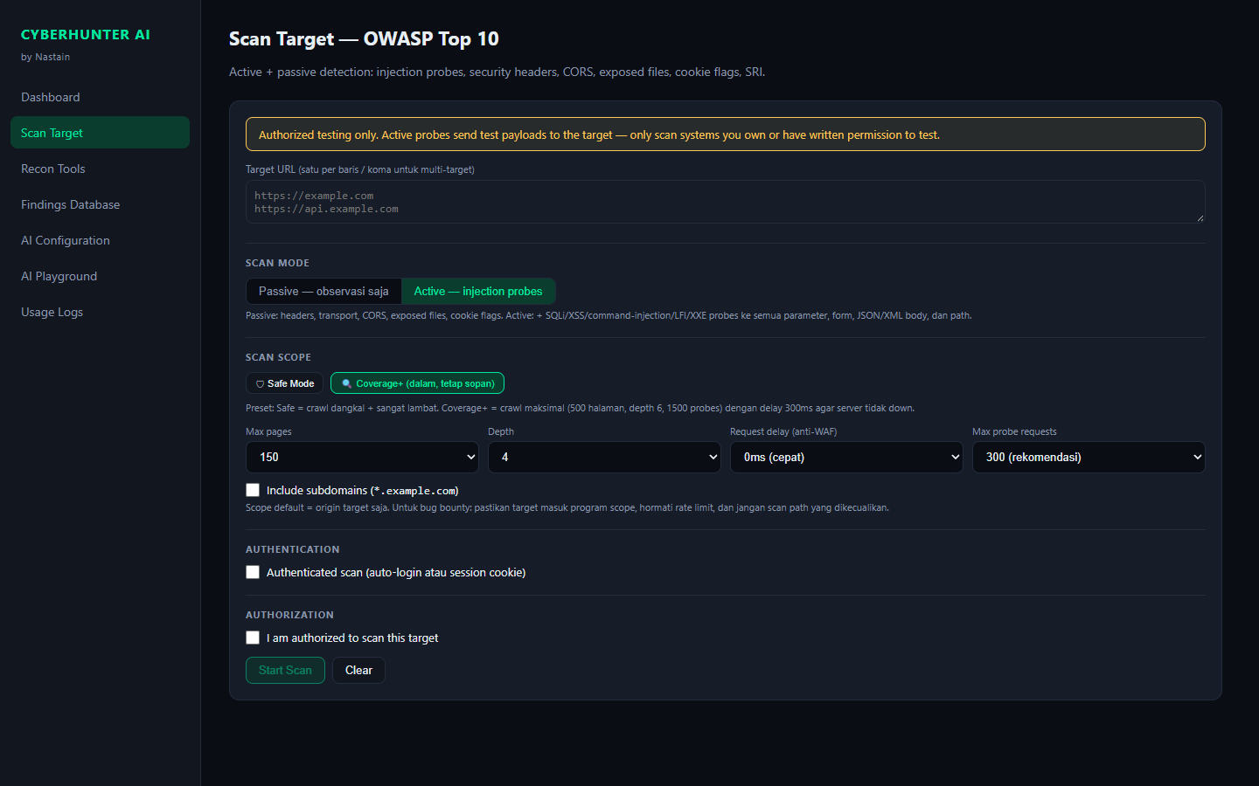
TENTANG KARYA
Deskripsi
▪ CYBERHUNTER AI adalah platform pengujian keamanan siber berbasis AI untuk mengidentifikasi, menganalisis, dan mengevaluasi kerentanan aplikasi web secara otomatis.
▪ Menyediakan automated vulnerability assessment pada sistem yang telah berizin diuji — menganalisis konfigurasi tidak tepat, kelemahan validasi input, security headers, dan potensi kerentanan berbasis standar OWASP.
▪ Hasil ditampilkan di dashboard interaktif: jenis kerentanan, tingkat risiko, bukti pengujian, dan rekomendasi perbaikan — dibantu AI untuk analisis dampak & prioritas mitigasi.
Tujuan: efektivitas pengujian, deteksi dini, terstruktur & bertanggung jawab.
CYBERHUNTER AI — AI-Powered Automated Vulnerability Assessment Platform
03 / 17
Scan console — assessment berjalan real-time

Slide 4
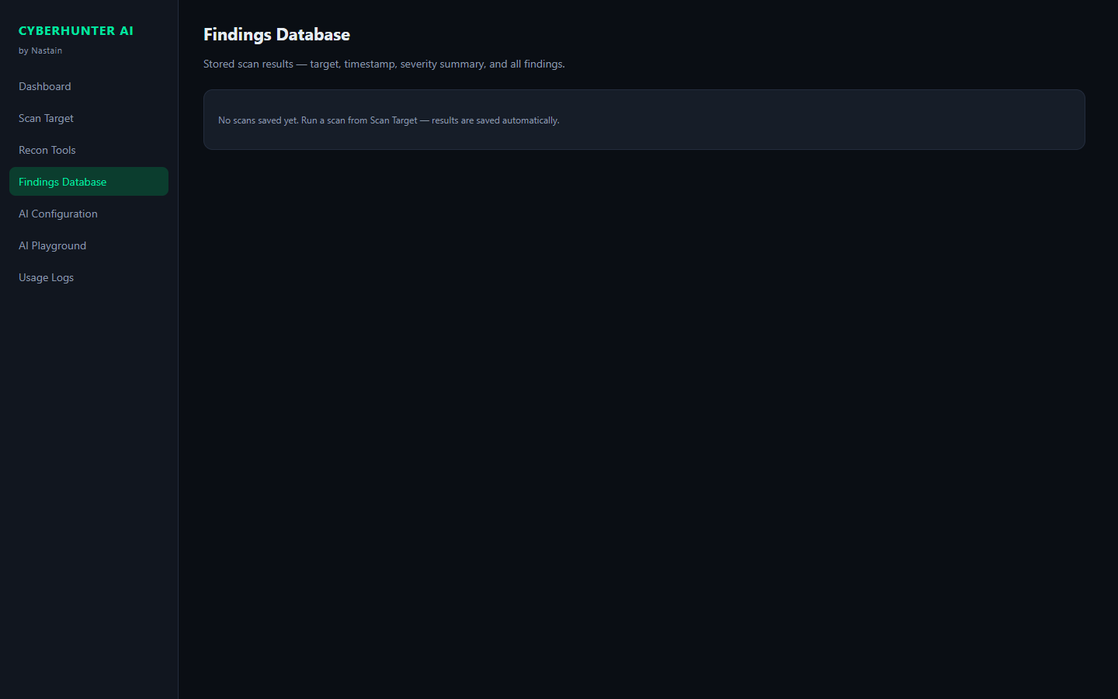
TUJUAN
Pengembangan
Efektivitas
Otomasi assessment — cakupan jauh lebih luas dari testing manual.
Deteksi Dini
Menemukan celah sebelum dieksploitasi pihak tidak bertanggung jawab.
Terukur
Setiap temuan: payload, request/response, severity & rekomendasi.
Bertanggung Jawab
Hanya untuk sistem berizin — etika & dampak minimal.
CYBERHUNTER AI — AI-Powered Automated Vulnerability Assessment Platform
04 / 17
Findings — kerentanan, risiko & rekomendasi

Slide 5
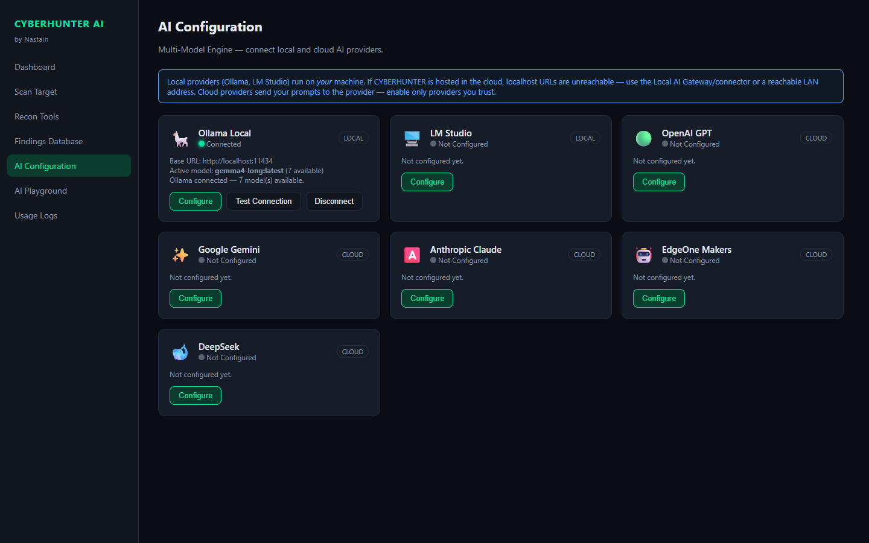
FITUR
Unggulan Platform
Crawler Cerdas
Multi-halaman, subdomain, form, JS bundle + parameter mining & filename mutation.
OWASP Top 10
SQLi, XSS, cmdi, LFI, SSRF, XXE, CORS, headers — aktif & pasif.
Anti-Bot Solver
JS challenge (WAF splash) di-solve otomatis via headless Chromium.
AI Analysis
6 provider model — triage temuan, dampak & prioritas mitigasi.
CYBERHUNTER AI — AI-Powered Automated Vulnerability Assessment Platform
05 / 17
AI Configuration — 6 provider model

Slide 6
CARA KERJA
Alur Assessment
01 Recon Crawl halaman, form, JS, subdomain.
02 Discover Ekstrak semua parameter & endpoint tersembunyi.
03 Probe Payload OWASP aktif ke setiap input.
04 Verify Konfirmasi error, eksekusi JS, CVE fingerprint.
05 Report Evidence lengkap → dashboard + laporan bilingual.
CYBERHUNTER AI — AI-Powered Automated Vulnerability Assessment Platform
06 / 17
Scan Target — alur assessment real-time

Slide 7
COVERAGE
Semua Input Diuji
▪ Input langsung — Query string, form GET/POST (input, select, textarea, hidden), JSON & XML body, headers (UA, Referer, X-Forwarded-*), cookies.
▪ Discovery otomatis — Parameter di file .js (fetch/axios/routes), ±75 nama param umum, endpoint tak ter-link (cetak/, unduh/, detail.php), filename mutation, subdomain enum.
▪ Hasil — Tidak ada input yang kelewat — semua masuk antrian probe aktif.
CYBERHUNTER AI — AI-Powered Automated Vulnerability Assessment Platform
07 / 17
Dashboard — ringkasan hasil assessment

Slide 8
DETECTION
Deteksi Kerentanan
SQL Injection
Error-based, blind time-based (konfirmasi ganda), UNION extraction 15 kolom.
XSS
Reflected, stored & DOM — diverifikasi eksekusi JS via headless browser.
Command Injection
Marker aritmatika → output CYBERHUNTER_49, bukan refleksi biasa.
CVE Surface
Fingerprint PHP/CMS → ruleset CVE (php2shell, Drupalgeddon2, Joomla, Laravel, WordPress).
CYBERHUNTER AI — AI-Powered Automated Vulnerability Assessment Platform
08 / 17
Live log — payload & evidence per probe

Slide 9
CVE
PHP2Shell
▪ Apa itu — CVE-2026-109618 & 109619 — memory corruption & use-after-free di PHP core. Unauthenticated, ~1 request untuk mod_php.
▪ Kenapa kritis — Flaw di runtime PHP — aplikasi aman pun rentan. PHP ≤8.1 (EOL) tidak akan dapat patch.
▪ Deteksi — Version fingerprinting (header, PHPSESSID, phpinfo) + behavioral probe multipart.
▪ Hasil — Versi rentan → CRITICAL. Indikasi behavioral → HIGH (probable). Fixed: 8.2.35/8.3.36/8.4.27/8.5.12.
CYBERHUNTER AI — AI-Powered Automated Vulnerability Assessment Platform
09 / 17
Finding PHP2Shell — severity & evidence

Slide 10
HASIL
Dashboard & Pelaporan
Jenis Kerentanan
SQLi, XSS, cmdi, LFI, SSRF, XXE, CORS, headers, CVE — terklasifikasi.
Tingkat Risiko
Critical/High/Medium/Low/Info — chart interaktif + filter.
Bukti
Payload persis, lokasi parameter, request & response mentah.
Rekomendasi
Panduan perbaikan + laporan HTML bilingual (EN/ID) format XRay.
CYBERHUNTER AI — AI-Powered Automated Vulnerability Assessment Platform
10 / 17
Findings Database — severity & evidence

Slide 11
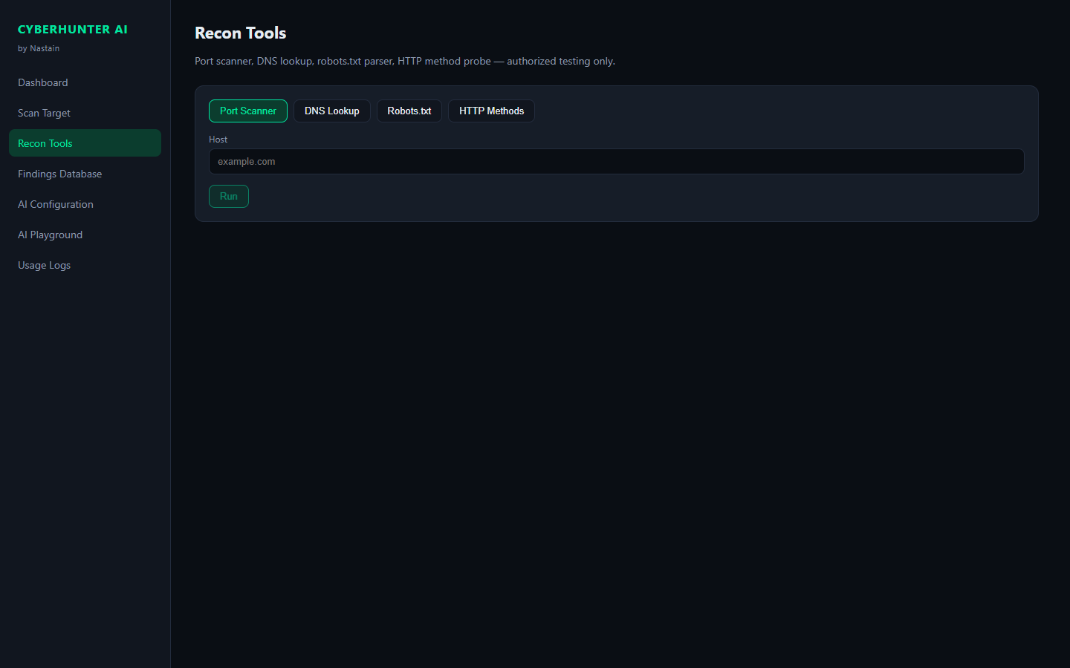
KEAMANAN
Etika & Authorized Testing
▪ Otorisasi wajib — Active probing hanya untuk sistem milik sendiri / berizin tertulis — gating eksplisit di UI.
▪ Cookie aman — Session cookie di-scope per-origin; nilai disensor di log, DB, dan laporan.
▪ Payload non-destruktif — Marker aritmatika, canary, error-based — tanpa exploit merusak.
▪ Rate limiting — Request delay dapat diatur — beban ke target tetap wajar.
▪ Scope awareness — robots.txt Disallow → peringatan; area terlarang tidak disentuh.
CYBERHUNTER AI — AI-Powered Automated Vulnerability Assessment Platform
11 / 17
Tools — utilitas pendukung assessment

Slide 12
STACK
Teknologi
Frontend
React 18 · TypeScript · Vite — dashboard, live log, severity chart.
Backend
Node.js · Express — crawler, probe engine, Puppeteer.
Deteksi
±90 payload OWASP · 75+ param mining · DOM XSS verified.
AI
6 provider (cloud & lokal) — key terenkripsi, usage logs.
CYBERHUNTER AI — AI-Powered Automated Vulnerability Assessment Platform
12 / 17
AI Configuration — 6 provider model

Slide 13
ARSITEKTUR
System Design
FRONTEND React 18 + TypeScript + Vite
Dashboard · Scan Console · Findings · AI Configuration · Laporan HTML
Scan
Probe
Verify
Report
BACKEND Node.js + Express (REST API + SSE live log)
crawler.js · scanner.js · cve.js · domxss.js · challenge.js · db.js
DATA & AI Findings DB (JSON persisten) + 6 AI Provider
OpenAI-compatible · Anthropic · Gemini · Ollama · LM Studio · EdgeOne
Frontend → REST API / SSE → Scanner Engine → Findings DB → Report Engine → AI Analysis
CYBERHUNTER AI — AI-Powered Automated Vulnerability Assessment Platform
13 / 17

Slide 14
INSTALASI
Cara Download
▪ Repository GitHub — github.com/nastainannas/cyberhunter-ai — public, langsung bisa di-clone.
▪ Opsi 1 — Git clone — git clone https://github.com/nastainannas/cyberhunter-ai.git lalu cd cyberhunter-ai.
▪ Opsi 2 — Download ZIP — GitHub → Code → Download ZIP → extract ke folder project.
▪ Prasyarat — Node.js 18+ dan npm — cek dengan node -v && npm -v di terminal.
CYBERHUNTER AI — AI-Powered Automated Vulnerability Assessment Platform
14 / 17
$ git clone https://github.com/nastainannas/cyberhunter-ai.git
$ cd cyberhunter-ai
# node -v # cek Node.js 18+
# npm -v
✓ Struktur: backend/ + frontend/

Slide 15
INSTALASI
Cara Instal & Menjalankan
▪ Backend dulu — cd backend → npm install → npm start. API jalan di http://localhost:8787
▪ Frontend — cd frontend → npm install → npm run dev. UI terbuka di http://localhost:5173
▪ Pertama kali — npm install mengunduh semua dependency (±1–2 menit).
▪ Konfigurasi AI (opsional) — Buka halaman AI Configuration → pilih provider → isi API key → Test Connection.
▪ Mulai scan — Scan Target → masukkan URL → pilih mode Passive/Active → Start Scan.
CYBERHUNTER AI — AI-Powered Automated Vulnerability Assessment Platform
15 / 17
$ cd backend
$ npm install
✓ npm start # API → :8787
$ cd ../frontend
$ npm install
✓ npm run dev # UI → :5173

Slide 16
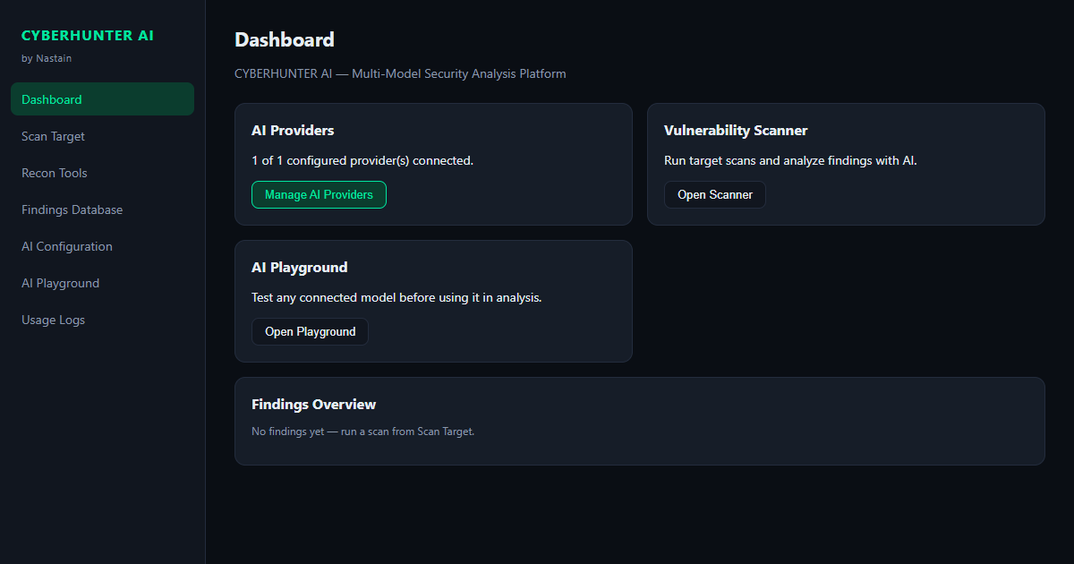
PENGEMBANGAN
Roadmap
Jangka Pendek
Template Nuclei · wizard authenticated scan · export PDF.
Menengah
Distributed queue · authenticated crawling · GraphQL fuzzing.
Jangka Panjang
Plugin custom · sinkronisasi scope bug bounty · AI triage otomatis.
CYBERHUNTER AI — AI-Powered Automated Vulnerability Assessment Platform
16 / 17
CYBERHUNTER AI

Slide 17
Terima Kasih
CYBERHUNTER AI — AI-Powered Automated Vulnerability Assessment Platform
Scan lebih dalam, temukan lebih banyak, amankan lebih awal.
github.com/nastainannas/cyberhunter-ai
Oleh Nastain · Team Ternakheck

