Slide 1

Marketing Department
[Date]
Summer Launch
Recap
Campaign performance review and strategic insights.
Your name
Company name

Slide 2
Executive Summary
Key Highlights
Contents
01.
02.
03.
02.
Goals
Channels
Results
Insights
Drive awareness and adoption.
Engage users via key channels.
Exceeded key campaign targets.
Optimize spend and targeting.

Slide 3

Sales rose.
Reach grew.
01
New Product
We successfully introduced our summer lineup, driving high engagement.
Your name
Company name

Slide 4


Key Campaign Results
Our multi-channel strategy exceeded goals, delivering strong growth in brand awareness and product sales.
Channel Growth
Audience Engagement Metrics
Social media channels saw a [XX%] increase in active followers.
Email open rates reached a record high of [XX%].
Summer Launch Campaign Recap

Slide 5


Ads drove traffic.
Reach grew.
Channel Strategy
Social Media Impact
Social campaigns exceeded targets by [XX%] via key partners.
Instagram drove the most referral traffic.
Paid search achieved a [XX%] conversion rate.
Open rates hit [XX%].
CTR increased.
PR outreach secured [XX] placements in top publications.
Part 01
Part 02
PR Push

Slide 6



Users love speed.
Price is fair.
Audience Feedback
Key Customer Insights
Post-launch surveys indicate high satisfaction with the new features and overall brand messaging.

Slide 7
02
Key Tactics
Targeted social ads and influencer partnerships drove high engagement.
Your name
Company name

Slide 8


Optimizing Channel Performance for Better ROI
New
Influencer Partnerships
Collaborated with 15 key creators.
This drove a [XX%] increase in referral traffic and brand mentions.
Campaign Performance
Core
Email marketing and organic search remained our baseline traffic drivers.
Newsletter CTR increased by [XX%].

Slide 9
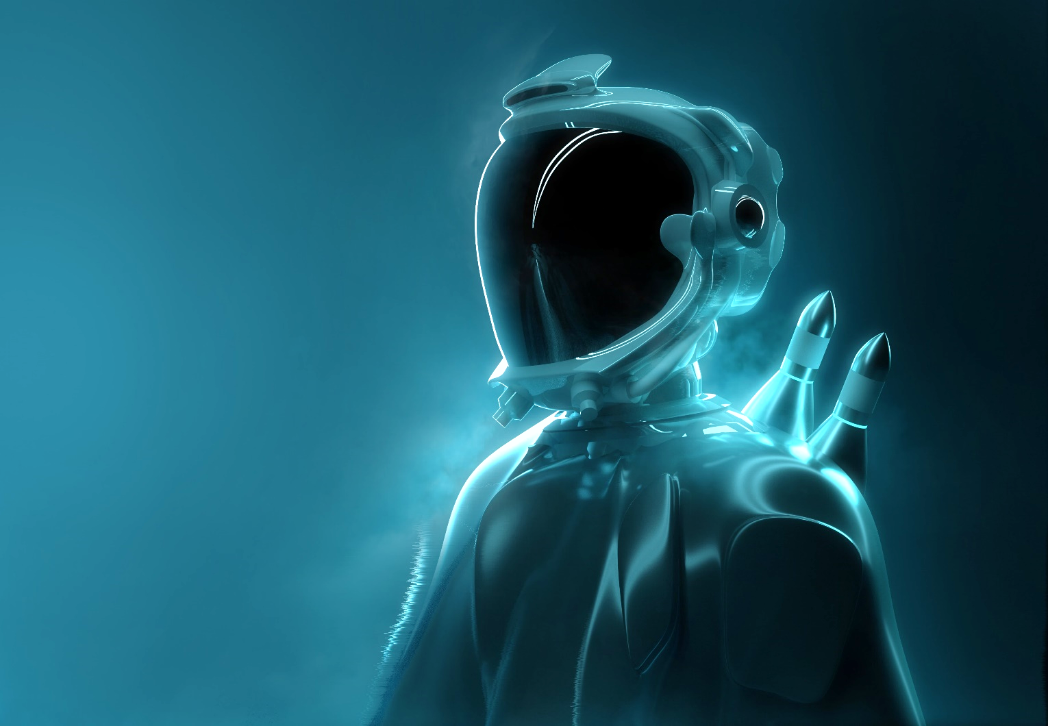
Digital Channels Drive Higher Engagement
Influencer campaigns expanded reach by [XX%].
Paid social ads drove [XX%] more conversions.
New
Legacy

Slide 10
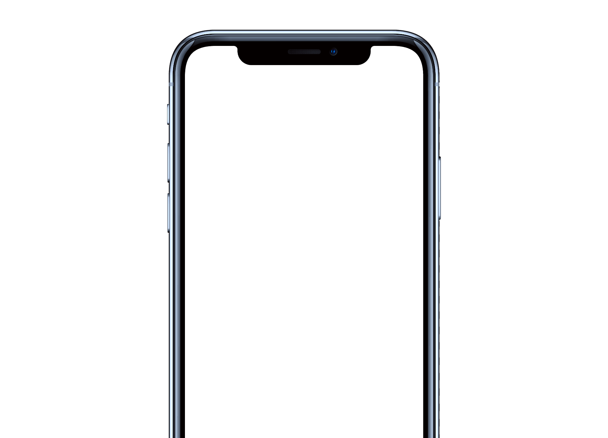



Optimizing Channel Performance
New Channels
Influencer partnerships drove [XX%] of total campaign conversions.
Owned Media
Email and web maintained steady engagement.

Slide 11


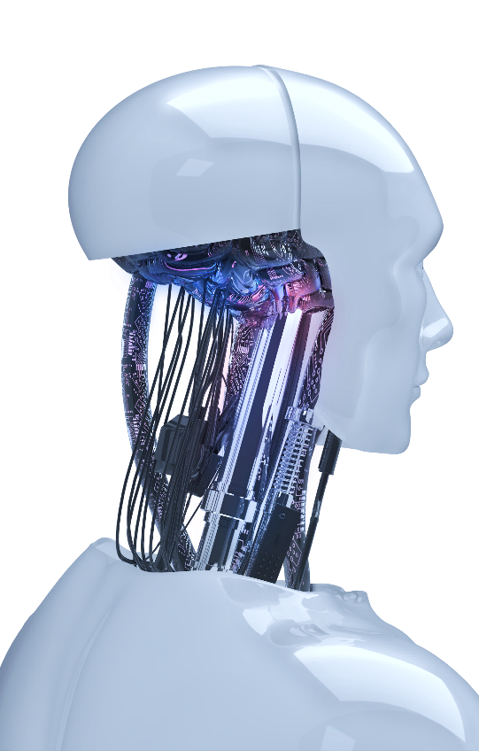
Key Takeaways and Future Opportunities
Content Strategy
Prioritize Short-Form Video
Audience Insights
Gen Z segment showed the highest conversion rate during the launch.

Slide 12
03
Key Success
The summer campaign exceeded our primary acquisition target by [XX%].
Your name
Company name

Slide 13


High demand.
Strong ROI.
Product Strengths Drove High Conversion
Core Strengths
Our summer campaign exceeded all engagement targets.
85%
24,457

Slide 14
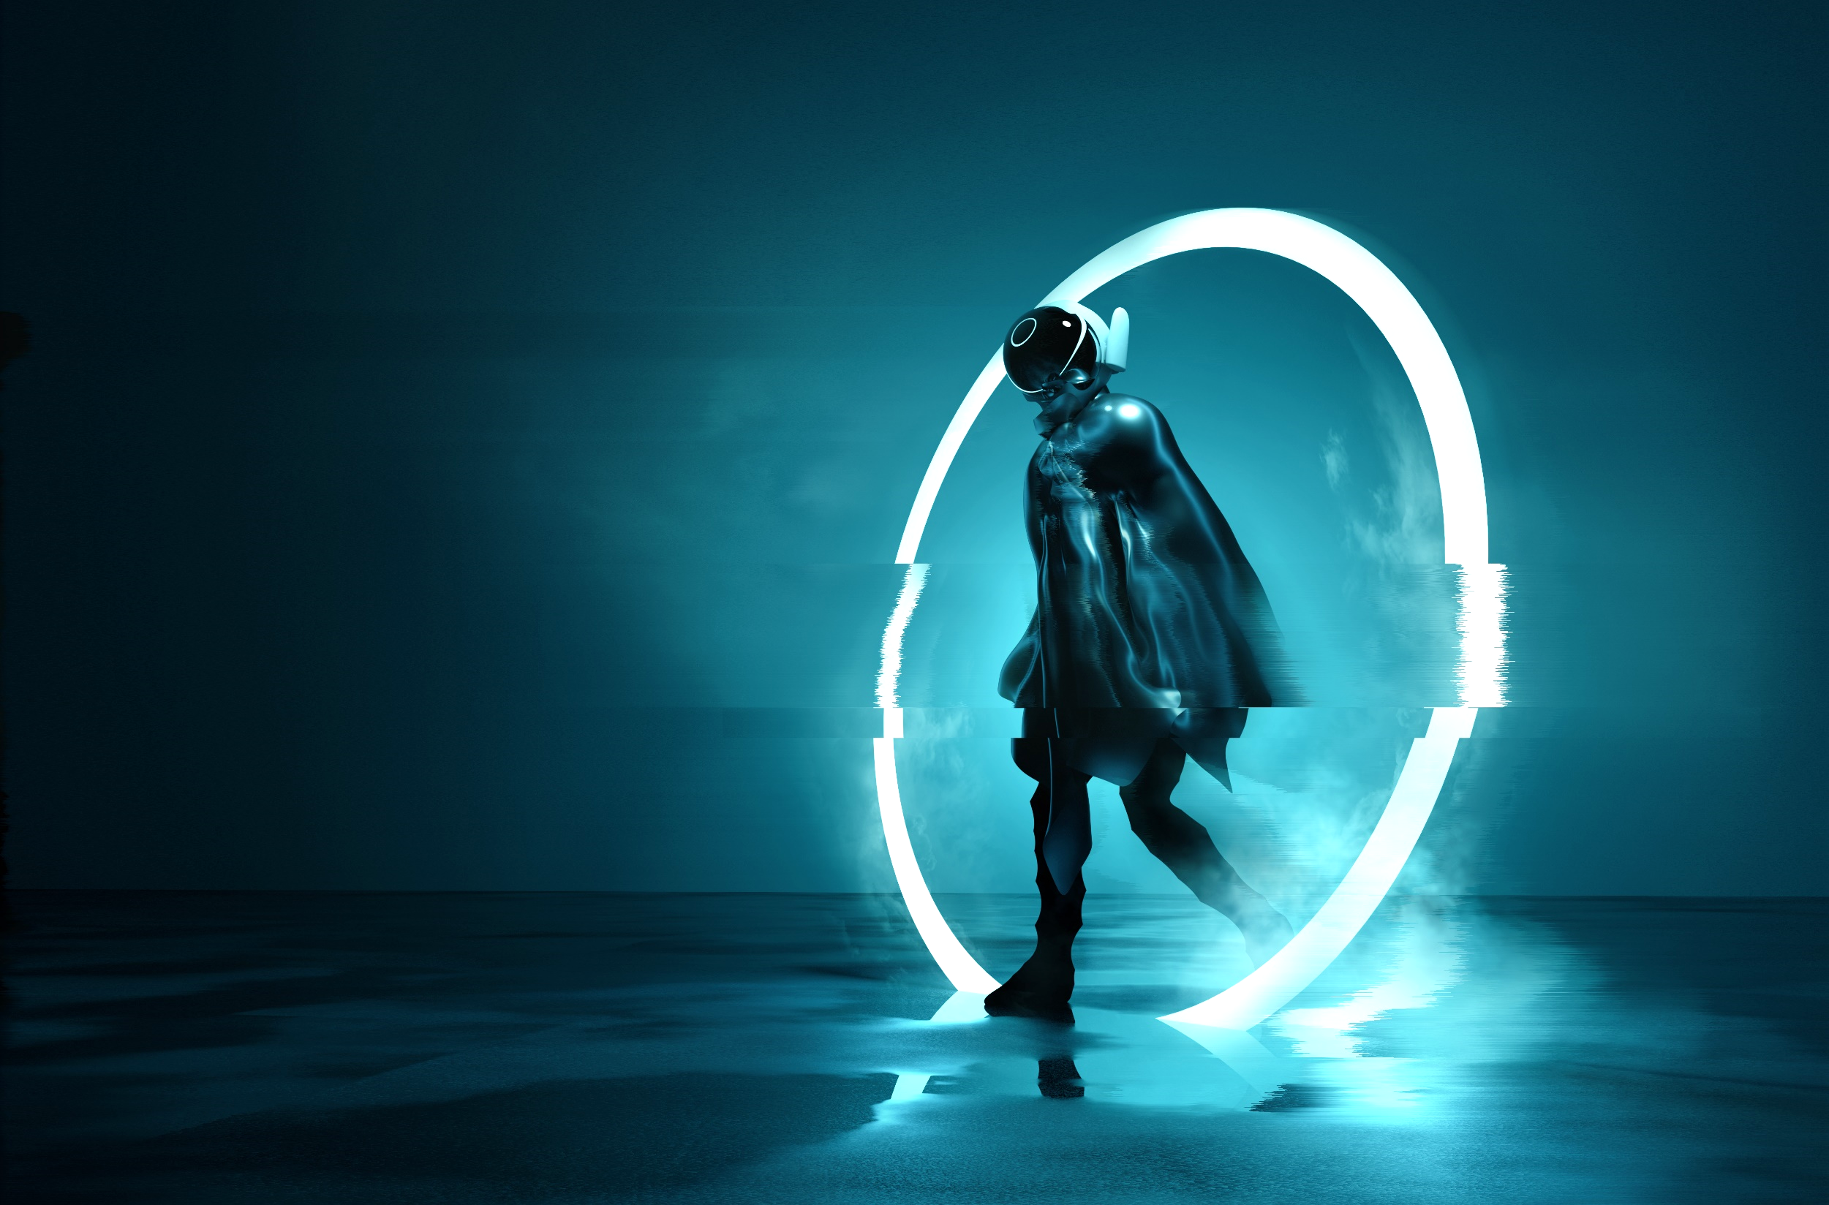

Sales grew.
Leads doubled.
Campaign Exceeded Key Performance Targets
Launch Recap
Reach
Leads
Sales
Social reach grew [XX%] over the target.
Inbound leads increased by [XX%] this quarter.
Direct sales surpassed our initial forecast.
Channel Performance Analysis

Slide 15


Focus on video.
Optimize spend.
Key Takeaways for Future Campaigns
Prioritize video creatives and reallocate budget to top-performing social channels.
Part 01
Part 02
Test new ad formats.
Expand custom audiences.
Improve landing pages.
Streamline checkout.

Slide 16
Social media.
Email outreach.
04
Channel Mix
Deploy promotional content across social, email, and partner channels.
Your name
Company name

Slide 17
Social reach.
Email opens.
Social Channels Drove Highest Engagement
Part 01
74%
Paid social exceeded benchmarks.
Influencers amplified brand buzz.
Part 02
Channel Metrics
52%
Newsletters saw high click rates.
Promo emails drove direct sales.
Retargeting ads did well.
Search ads captured intent.

Slide 18

Refine ads.
Scale spend.
Actionable Insights
Key Recommendations for Future Campaigns
Shift budget to top social channels to maximize conversions.
Optimization Opportunities

Slide 19

Social reach.
User growth.
Part 01
Part 02
Social campaigns exceeded reach targets by [XX%].
Influencer partnerships drove high engagement rates and boosted brand awareness across channels.
4.8M
1.2M
Part 03
Part 04
Paid ads delivered strong conversion rates.
Email marketing campaigns saw high open rates.
85%
2.4M

Slide 20
Next steps.
Key actions.
Thank You
Optimize ad spend. Refine target audience.
Your name
Company name

