Slide 1
CYBERHUNTER AI
Platform Automated Security Testing & Bug Bounty
Mendeteksi kerentanan OWASP Top 10 secara aktif & pasif — crawling, injeksi, verifikasi browser
oleh Nastain · Ternakheck

Slide 2
PROBLEM
Masalah
▸ Scanner keamanan umumnya mahal, rumit, atau hanya mendeteksi pasif (headers, banner)
▸ Bug bounty butuh active probing: SQLi, XSS, command injection — sulit dilakukan manual pada website besar
▸ Crawler konvensional melewatkan parameter tersembunyi: POST body, JSON API, hidden fields, endpoint tak ter-link
▸ Situs modern memakai anti-bot JS challenge (WAF splash) yang membuat scanner biasa buta total
▸ Hasil scan mentah sulit dibaca — butuh evidence, payload persis, dan laporan siap-kirim
CYBERHUNTER AI
02 / 11

Slide 3
SOLUTION
Solusi
CYBERHUNTER AI
03 / 11
Crawler Cerdas
Multi-halaman, subdomain, form, JS bundle — plus parameter mining (±75 nama) & filename mutation untuk endpoint tersembunyi.
Active + Passive OWASP Top 10
SQLi (error/blind/UNION extraction), XSS (reflected/stored/DOM via headless browser), cmdi, LFI, SSRF, XXE, CORS, headers.
Anti-Bot Solver
Challenge JavaScript (WAF splash) diselesaikan otomatis via headless Chromium — clearance cookie dibawa ke request berikutnya.
Report & Evidence
Payload pemicu, parameter, endpoint, request/response mentah — laporan HTML bilingual (EN/ID) format XRay.

Slide 4
COVERAGE
Cakupan Parameter
Query string — semua link crawled ✓
Form GET/POST — input, select, textarea, hidden non-CSRF ✓
JSON & XML body — API endpoints ✓
HTTP headers — UA, Referer, X-Forwarded-* ✓
Cookies ✓
Param tersembunyi di file .js — fetch/axios/route ✓ JS mining
Param nama umum di endpoint tanpa query ✓ ±75 nama
Endpoint tak terduga — cetak/, unduh/, detail.php… ✓ wordlist + mutation
CYBERHUNTER AI
04 / 11

Slide 5
DETECTION
Deteksi Vulnerability
CYBERHUNTER AI
05 / 11
SQL Injection
Error-based multi-DBMS, time-based blind dengan konfirmasi ganda anti-FP, UNION extraction hingga 15 kolom + marker database.
XSS
Reflected, stored, dan DOM XSS diverifikasi via browser headless — payload harus benar-benar mengeksekusi.
Command Injection
Marker aritmatika CYBERHUNTER_$((7*7)) → output CYBERHUNTER_49 — mustahil dari refleksi biasa.
CVE Surface
Fingerprint versi PHP/CMS → ruleset CVE (php2shell CVE-2026-109618/619, Drupalgeddon2, Joomla, Laravel, WordPress…).

Slide 6
ARCHITECTURE
Arsitektur
FRONTEND React + TypeScript + Vite
Dashboard · Scan · Findings · AI Config · Laporan HTML bilingual
BACKEND Node.js + Express
crawler · scanner (OWASP Top 10) · cve · domxss · db persistence
AI LAYER Multi-Provider
OpenAI-compatible · Anthropic · Gemini · Ollama · LM Studio · EdgeOne
CYBERHUNTER AI
06 / 11

Slide 7
STACK
Teknologi
CYBERHUNTER AI
07 / 11
Frontend
React 18, TypeScript, Vite, React Router — dark-theme dashboard, live scan log streaming, severity chart interaktif.
Backend
Node.js ES modules, Express, fetch manual-redirect, Puppeteer (Chromium) untuk challenge solver & DOM verification.
Deteksi
±90 payload SQLi/XSS/cmdi/LFI/SSRF/XXE, 75+ parameter mining, 60+ path wordlist + filename mutation, adaptive timeout.
AI Providers
6 provider model (cloud & lokal) — konfigurasi per-provider, model selector, playground, usage logs terenkripsi.

Slide 8
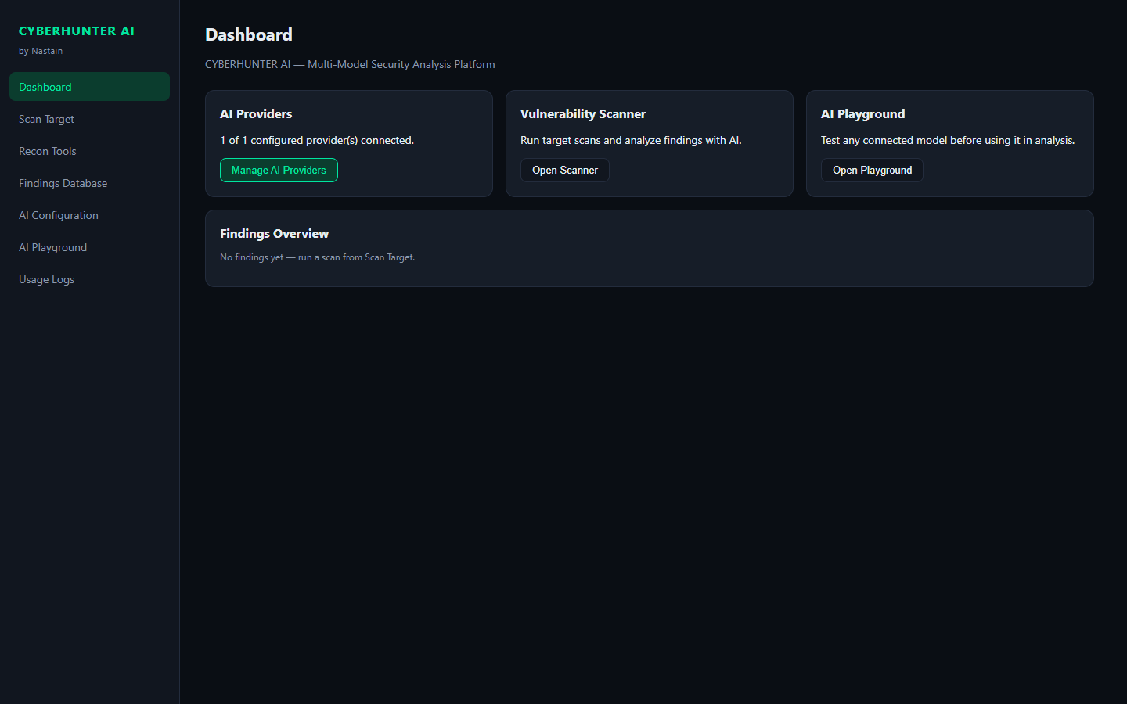
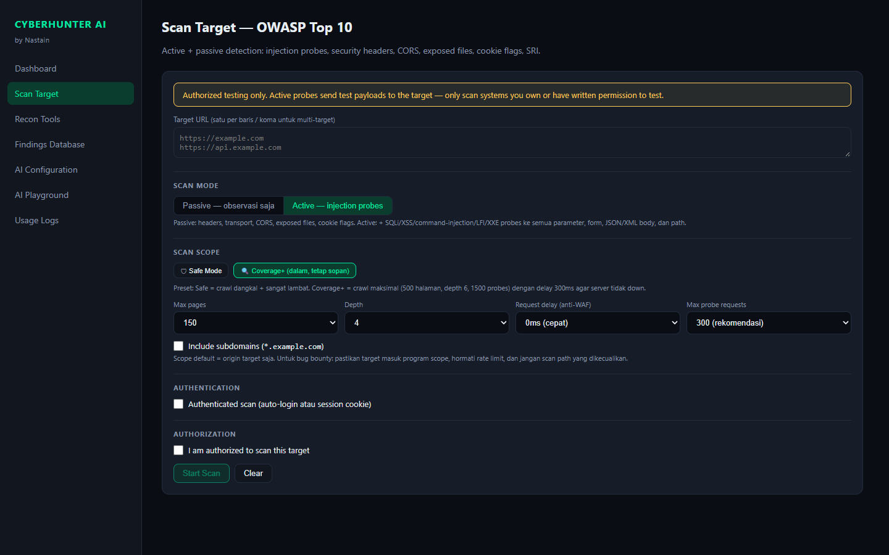
PREVIEW
Tampilan Aplikasi
Dashboard
Scan Target — live log
CYBERHUNTER AI
08 / 11

Slide 9
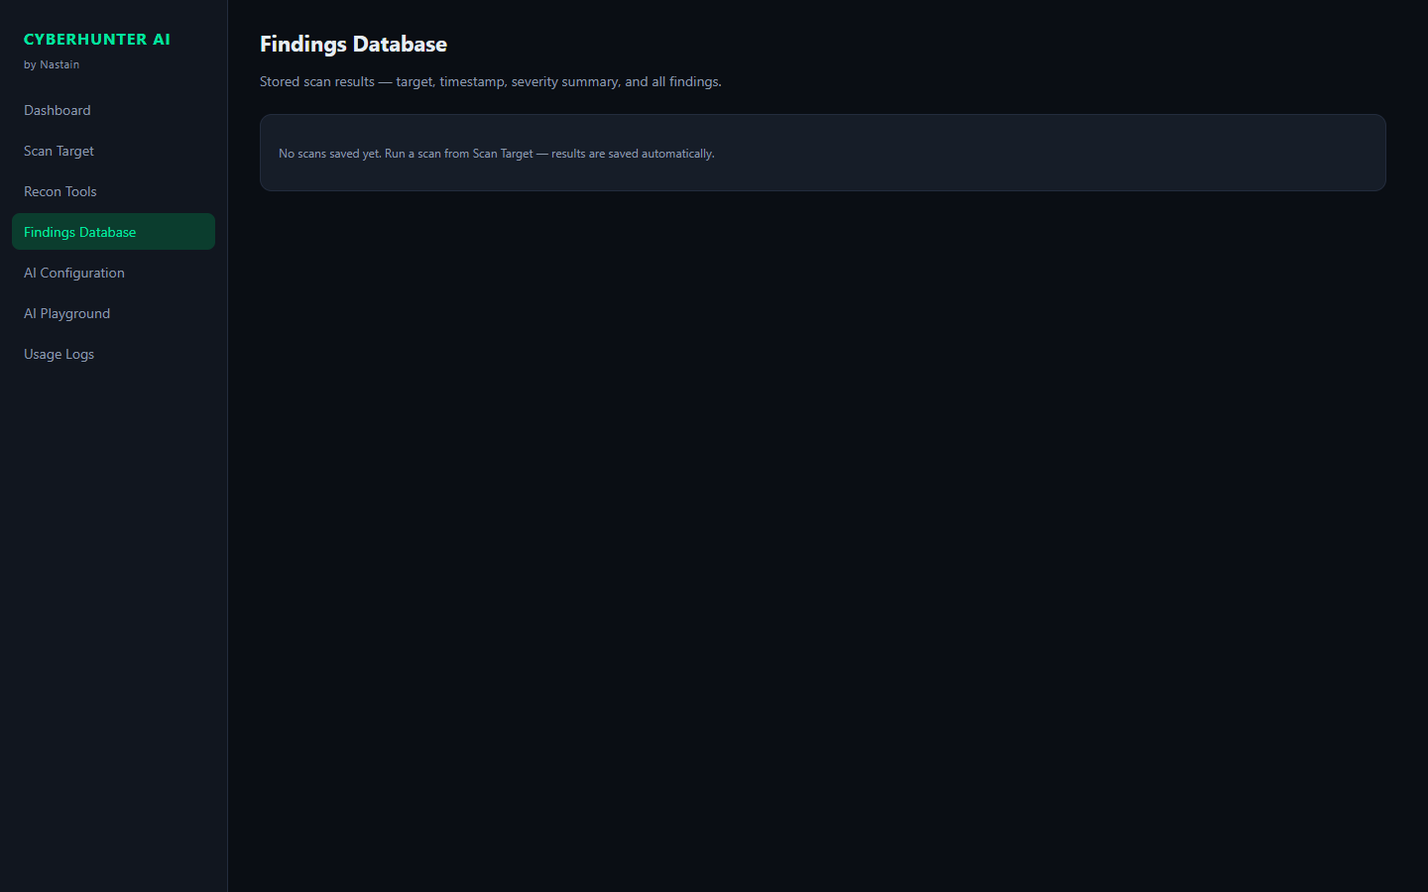
RESULTS
Hasil & Bukti
▸ Scan aplikasi PHP gov (PPID Brebes): 40+ parameter injectable — SQL error "Illegal mix of collations" terkonfirmasi manual
▸ Scan situs Joomla ber-WAF (PA Sibolga): anti-bot challenge ter-solve otomatis, crawl menembus splash page
▸ Setiap finding: URL, parameter, lokasi (query/body/header/cookie), payload persis, evidence, request & response mentah
▸ Export laporan HTML bilingual (EN/ID) format XRay — summary + detail Request1/Response1
▸ Findings persisten + dashboard severity chart + filter
CYBERHUNTER AI
09 / 11

Slide 10
ETHICS
Etika & Keamanan
▸ Active probing hanya untuk sistem milik sendiri atau dengan otorisasi tertulis — gating eksplisit di UI
▸ Cookie session di-scope per-origin — tidak pernah bocor ke domain lain
▸ Nilai cookie disensor di log, database, dan laporan export
▸ Payload non-destruktif: marker aritmatika, canary string, error-based — tanpa exploit berbahaya
▸ Deteksi robots.txt 'Disallow: /' → peringatan scope
▸ Rate limiting via request delay yang dapat diatur (0–500ms+)
CYBERHUNTER AI
10 / 11

Slide 11
ROADMAP
Roadmap
Jangka Pendek Nuclei template integration · authenticated scan wizard · report PDF export
Menengah Distributed scanning queue · authenticated crawling multi-step · GraphQL fuzzing mendalam
Jangka Panjang Plugin system check custom · integrasi HackerOne/Bugcrowd scope sync · AI-assisted triage
Terima kasih — github.com/nastainannas/cyberhunter-ai
CYBERHUNTER AI
11 / 11

