Slide 1
JJK Solutions Agile Inception Deck

Slide 2


One search – many possibilities
JJK Solutions Team
Scrum Master
Kauan Ribeiro
Product Owner
Jakub Nasta
Tester
Joy Howlader

Slide 3



Why are we here?
Students struggle to find part-time jobs that fit around classes
Current job sites are built for full-time workers
We want to help students by easing their stress regarding job-hunting and providing them with seamless, mobile experience.

Slide 4


Elevator Pitch
DreamWork helps students find flexible jobs and internships that match their skills, time, and career goals, quickly and easily.

Slide 5

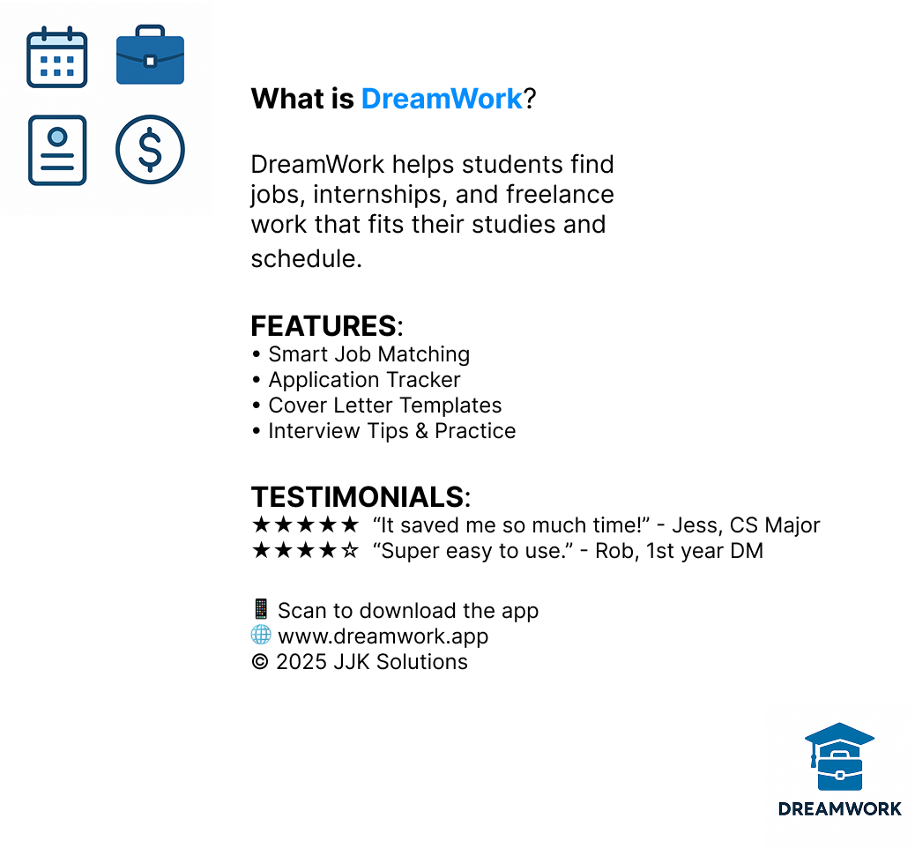
Product Box

Slide 6
Release Plan
Original: 12 sprints planned
Remaining time: 6 sprints
Team size: 3 members (Scrum Master, Product Owner, Tester - all devs)
Total backlog: 119 story points
Total user stories: 21
Theoretical velocity required: 119 / 6 = ~20
Because it would be too high of a workload for 3 members, it would contribute significantly towards burnout and quality drop. We need to prioritize our scope.
To deliver our Minimum Viable Product, we need to trim the scope and move some optional features to further releases beyond our current timeline.
Our approach:
Sprint 1-2: Foundation & MVP core
Sprint 3-5: Major Features
Sprint 6: Accessibility and Security
The achievable scope for our team should be around 70-80 story points in total, with velocity of about 13 story points per sprint.

Slide 7
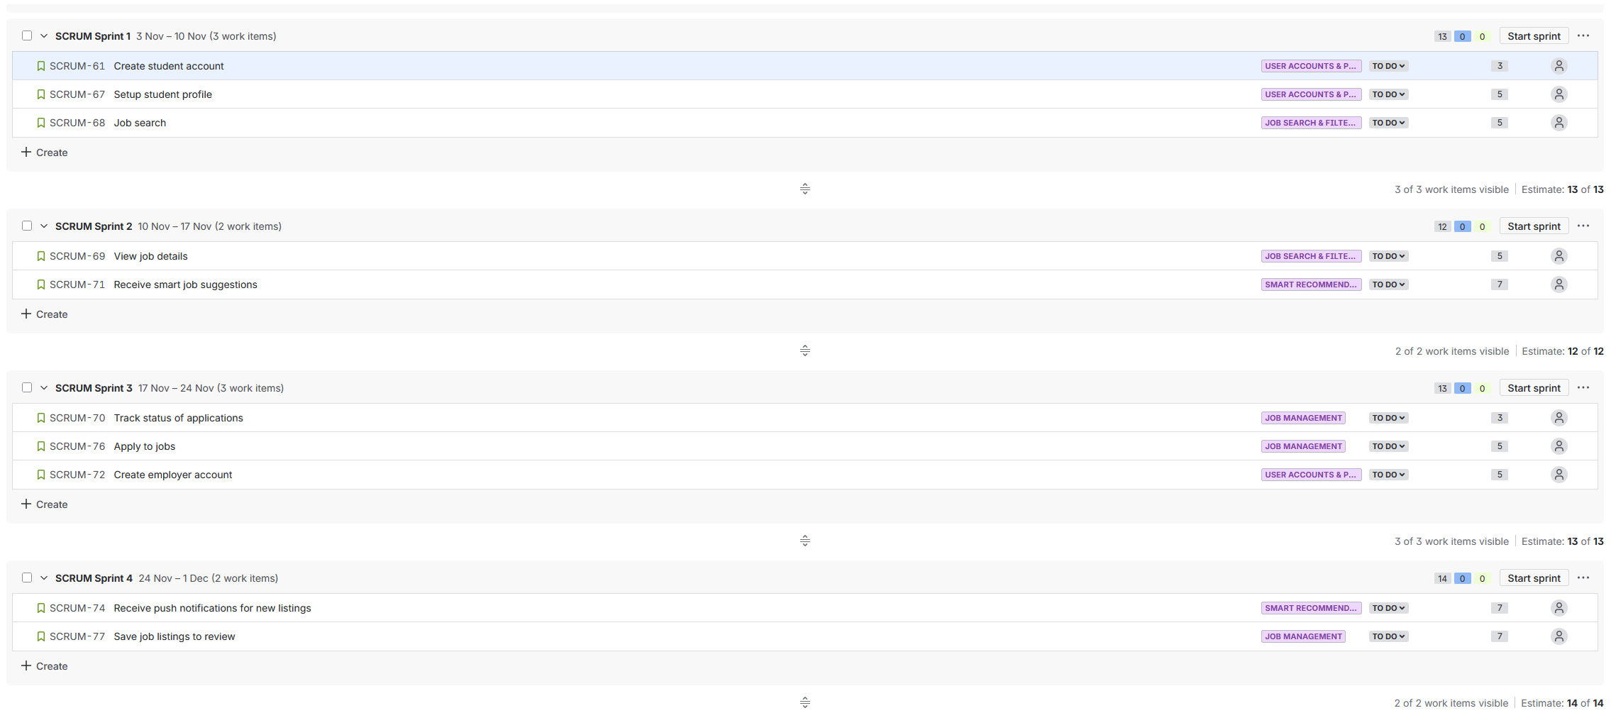
Release Plan

Slide 8
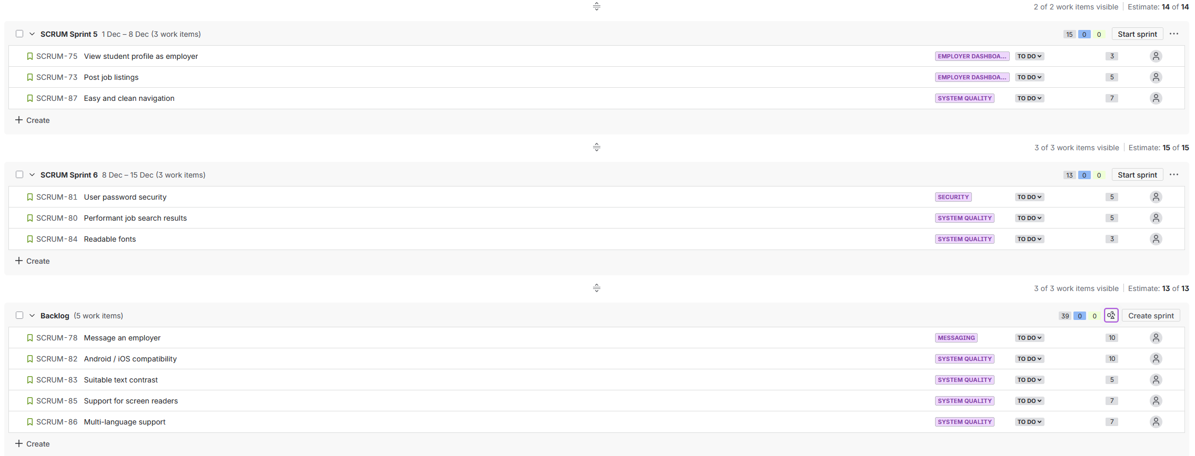
Release Plan

Slide 9
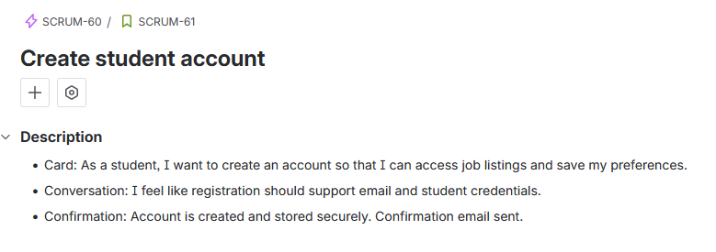
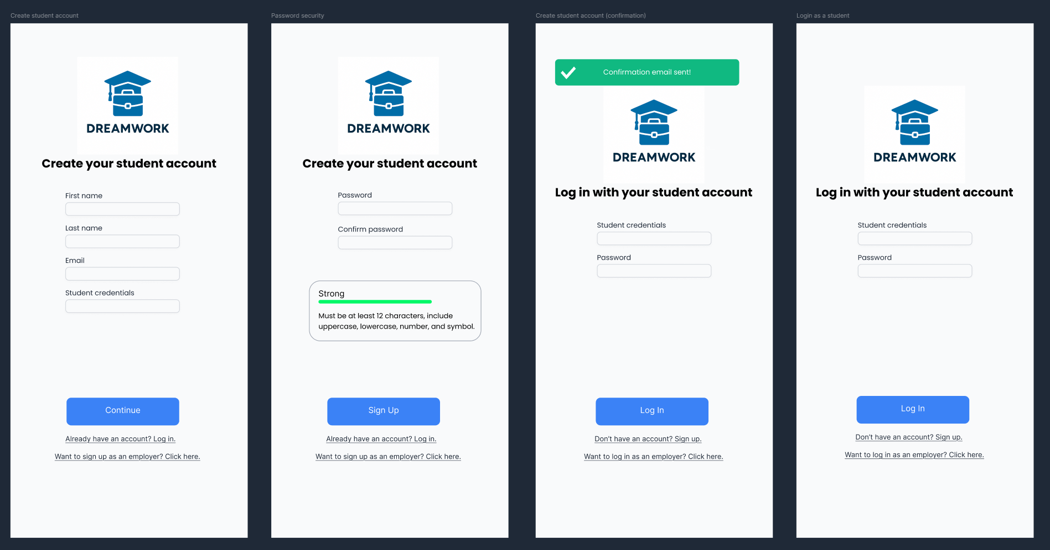

Slide 10
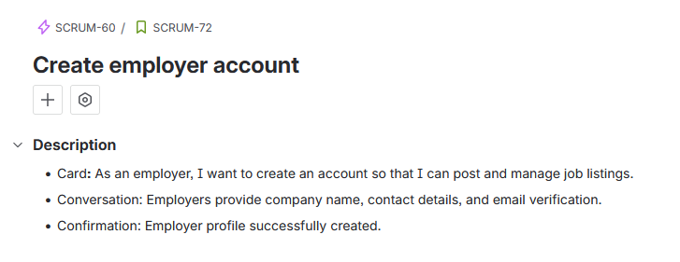
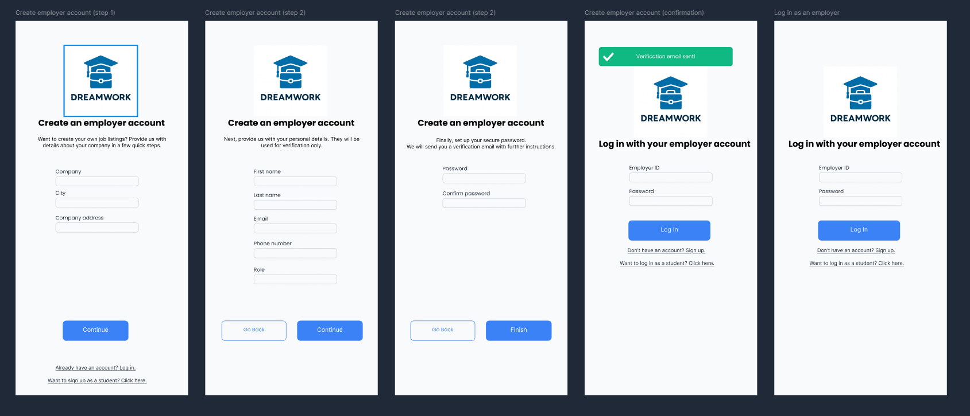

Slide 11
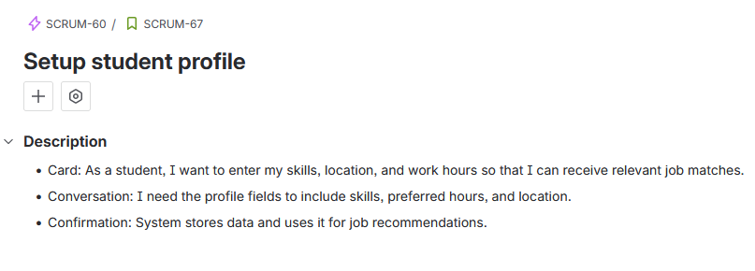
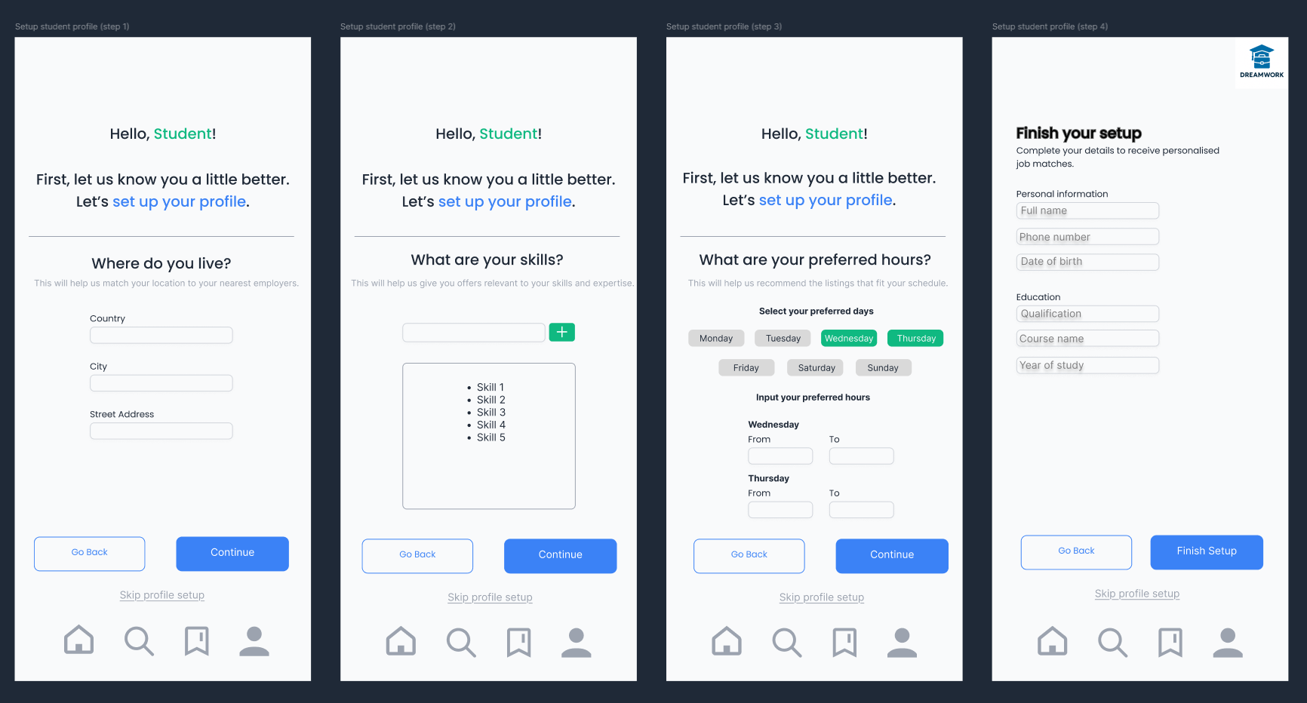

Slide 12
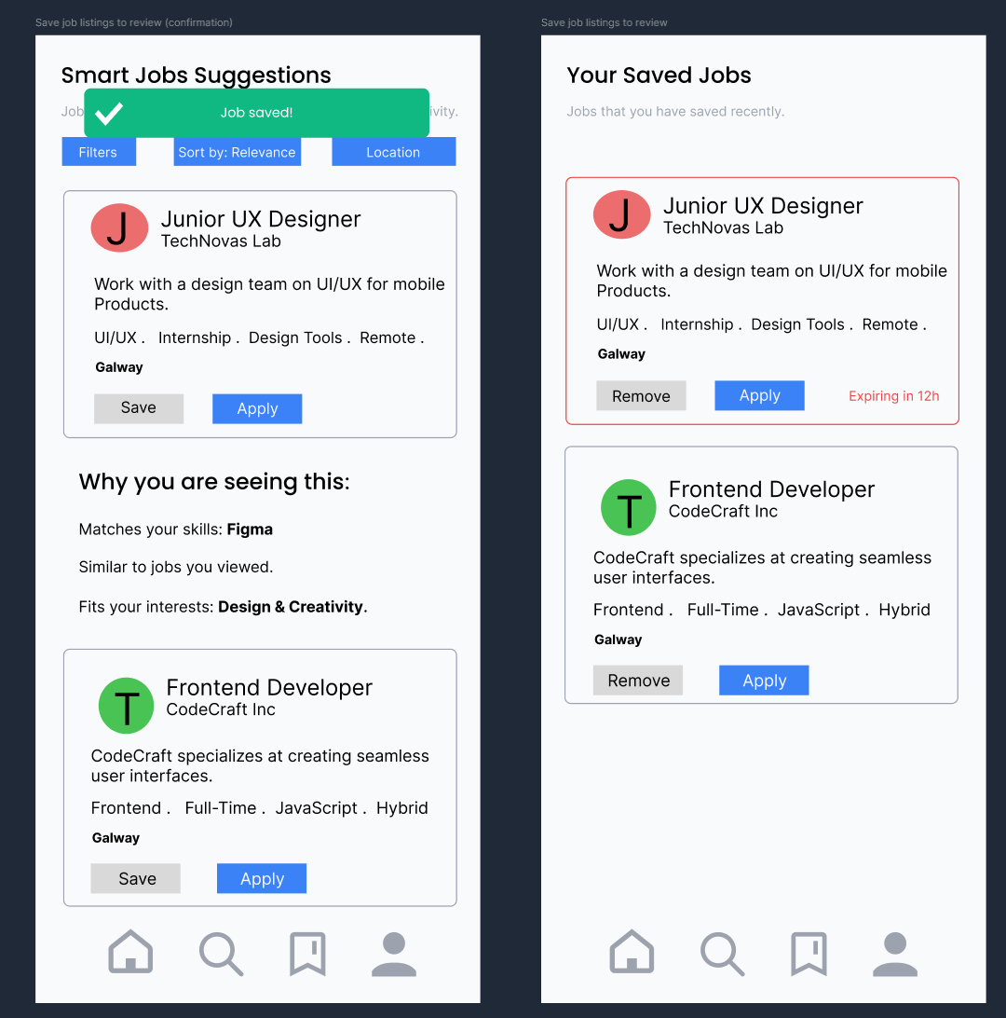
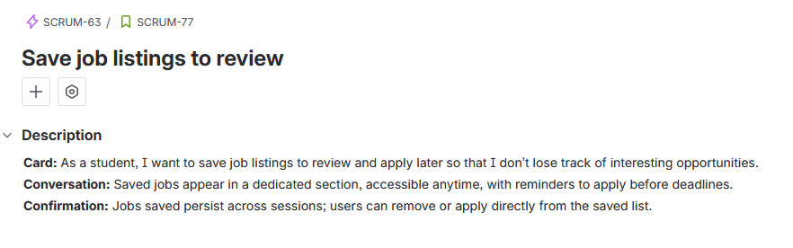

Slide 13
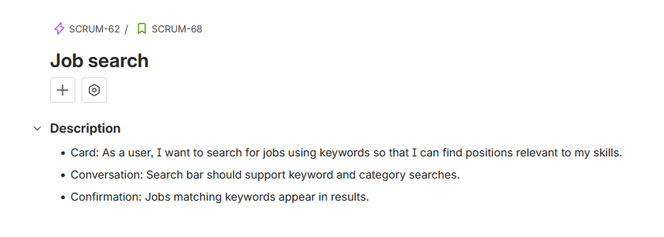
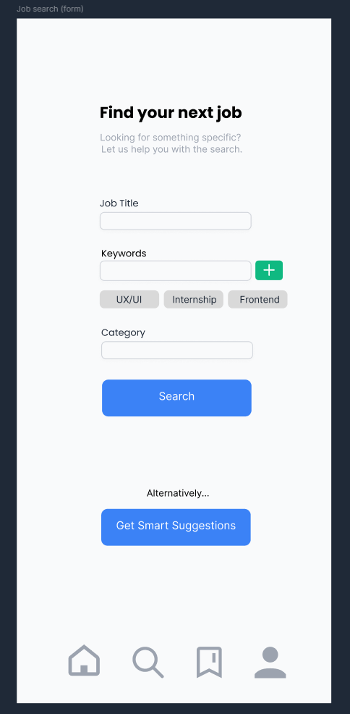

Slide 14
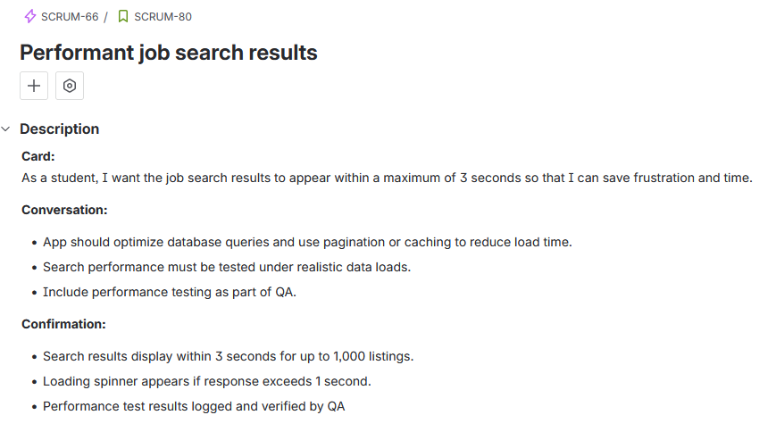

Slide 15
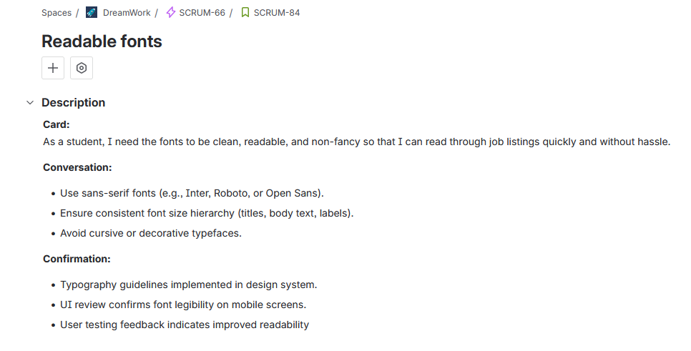

Slide 16
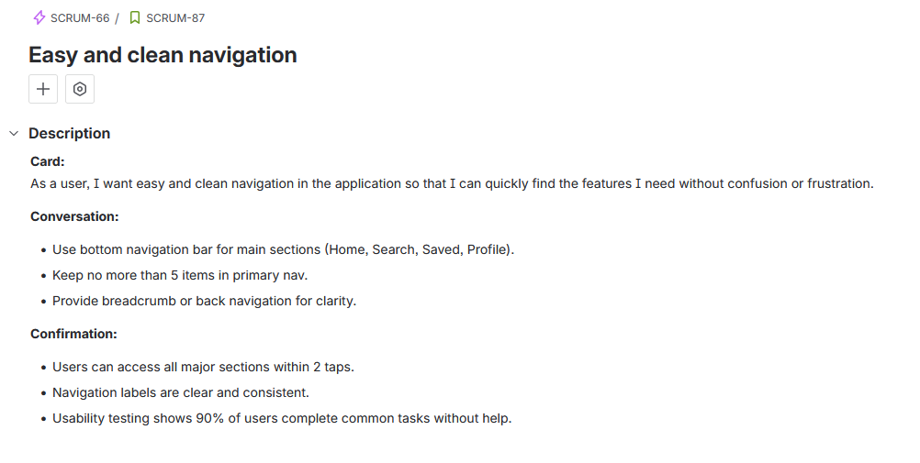


Slide 17
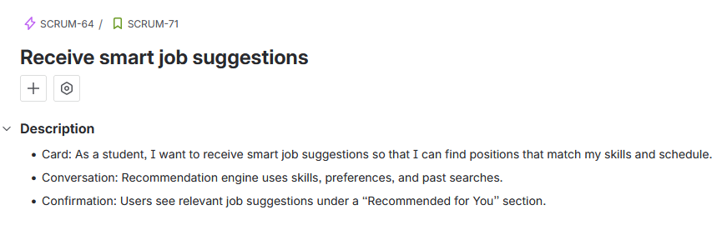
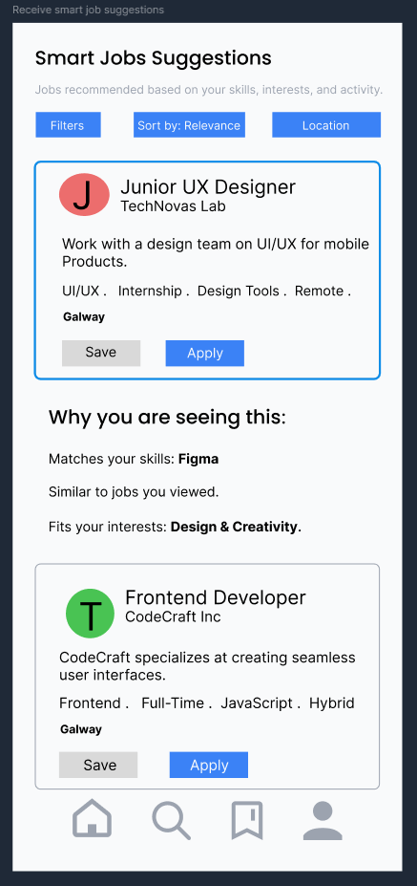

Slide 18
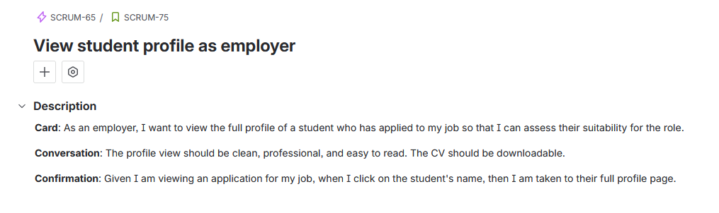
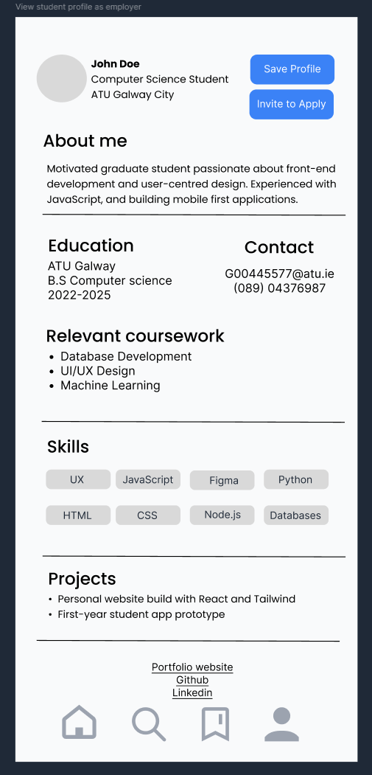

Slide 19
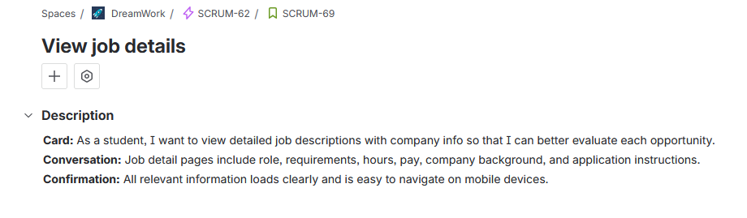
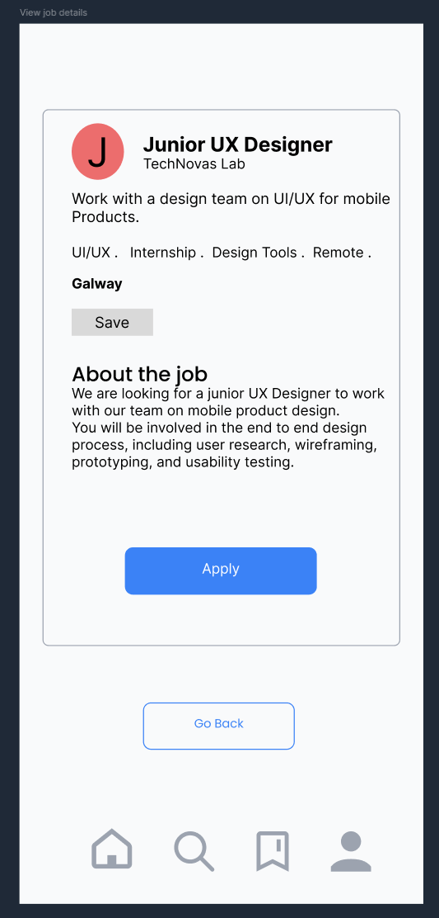

Slide 20
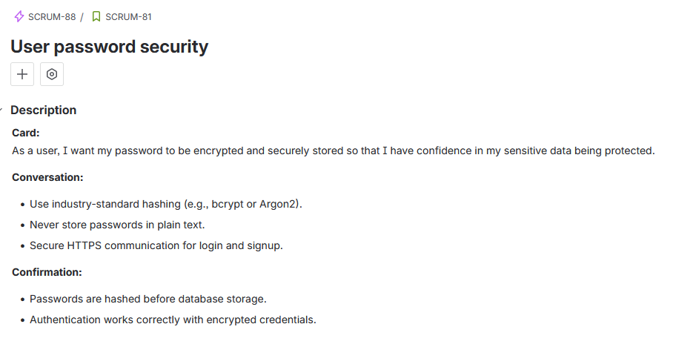
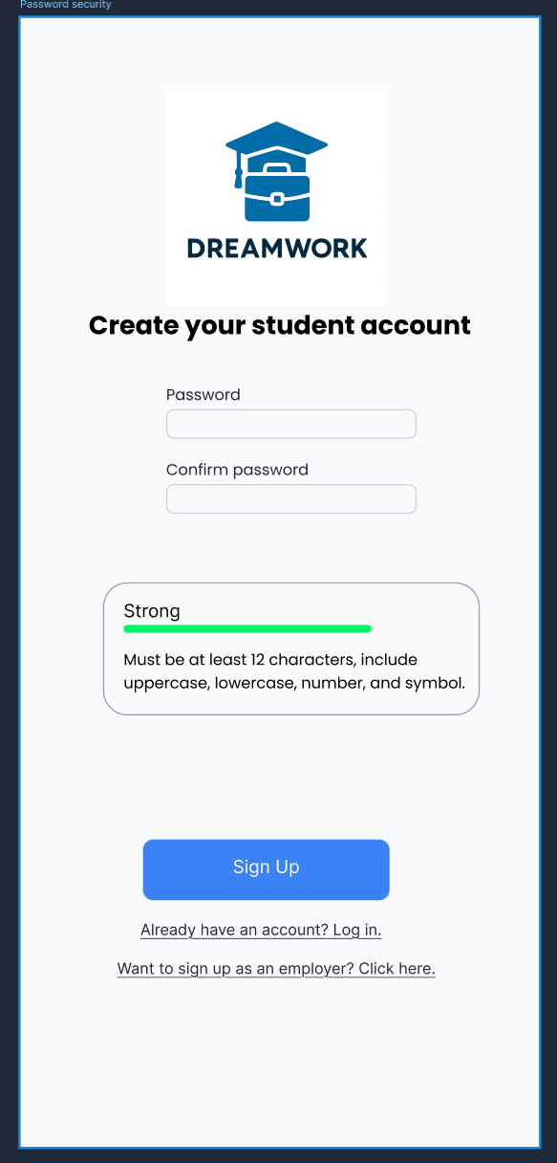

Slide 21
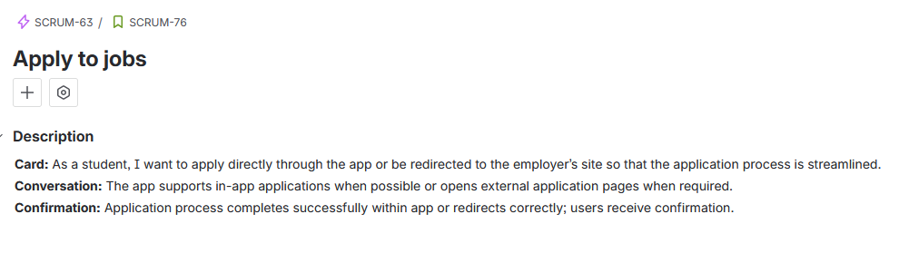
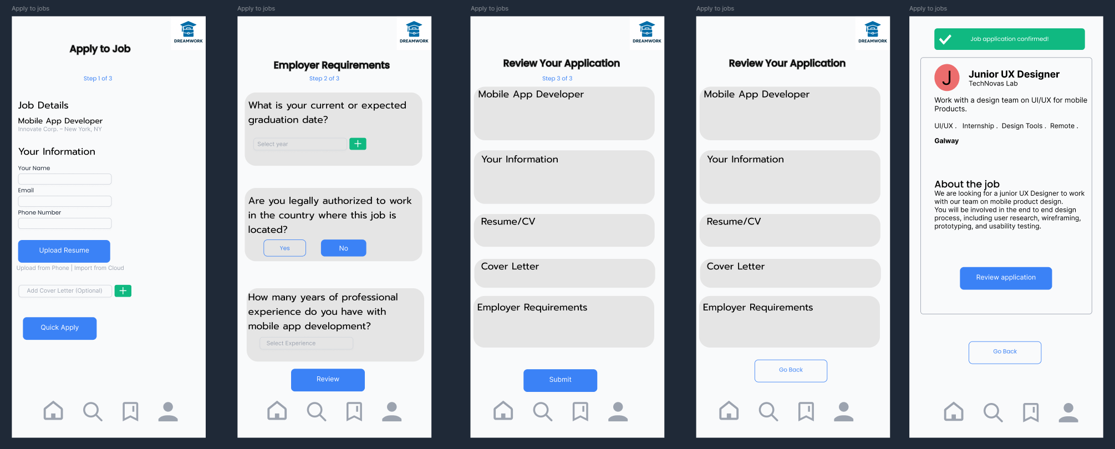

Slide 22
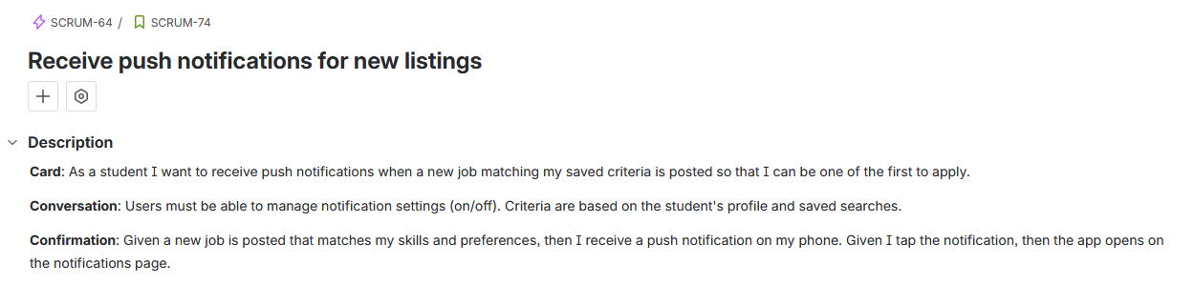
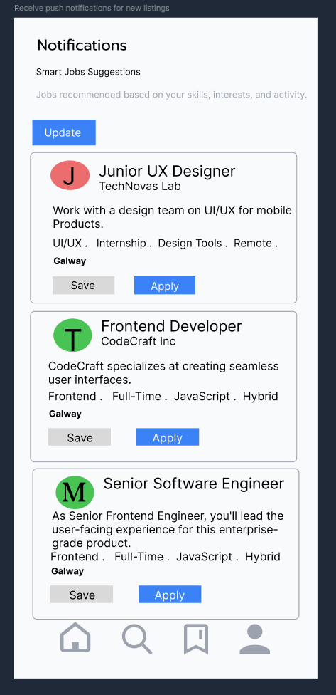

Slide 23
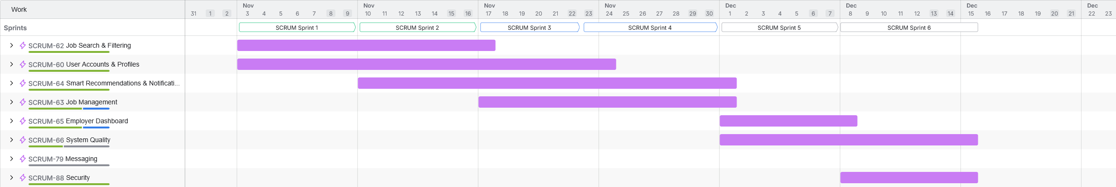
Timeline

Slide 24
Reflections Kauan
My Role
I made sure my team was on the right track and focused on their work.
Facilitated all team meetings and collaboration.
Supported the team in planning and tracking our work.
My Contributions
Organized our team's schedule and made sure everyone could meet.
Helped the team in deciding the project vision and core idea
Did the Definition of Ready and Definition of Done in One note.
Did eight user stories and helped the team in story sizing
Created early sketches, concepts, and brainstorming notes
Designed the product box
Supported the team with task assignment
Supported the team in prototyping and design activities

Slide 25
Reflections
Jakub
My Role
Defined product vision and ensured alignment with team goals
Managed the product backlog and prioritised user stories
Set acceptance criteria and supported estimation sessions
My Contributions
Created all epics, refined user stories, grouped requirements
Developed the sprint plan and calculated team velocity
Designed risk assessments, contingency plan, and Gantt timeline
Led creation of PowerPoint, architecture diagrams, and report content
Created design template for the prototype
Took part in prototyping the app
Coordinated tools setup (GitHub, Jira, OneNote)
Documented sprint reviews and retrospectives
Created README on GitHub
Maintained OneNote pages and burndown chart
Tracked sprint progress on Jira
Refined the prototype screens to better fit with design
Created interactions between prototype screens

Slide 26
Reflections
Joy
My Role
Ensured the quality and functionality of the prototype through testing.
Supported the team with UI design, screen creation, and prototype improvements.
Prepared and organised project documentation across all assignments.
Collected and maintained sprint evidence from Jira, OneNote, GitHub, and Figma.
My Contributions
Tested all prototype screens and checked that each feature met acceptance criteria.
Reviewed student and employer workflows to identify usability issues and inconsistencies.
Helped design and refine several screens for the DreamWork prototype.
Wrote detailed explanations for each prototype screen for Assignment 5.
Organised and updated the Assignment 05 final PDF, including formatting and structure.
Created and inserted the updated Table of Contents, introduction, sprint details, and prototype development sections.
Added Jira board screenshots, backlog screenshots, and sprint evidence to the report.
Helped maintain team documentation by organising OneNote and updating report sections.
Supported the team during sprints by giving feedback on UI, navigation, and flow.
Assisted with linking prototype screens and ensuring consistency in design and layout.

Slide 27
Thank you

