Slide 1

Support Vector Machine
Nastaran Shahparian |SHARCNET | Compute Ontario | Compute Canada |York University

Slide 2
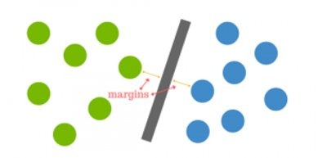
Definition
The original SVM algorithm was developed by Vladimir N Vapnik and Alexey Ya. Chervonenkis in 1963
Support Vector Machines are machine learning algorithms that are used for classification and regression, and outlier detection.
SVMs are based on the idea of finding a hyperplane that best divides a dataset into two classes, as shown in the image below.
https://www.kdnuggets.com/2016/07/support-vector-machines-simple-explanation.html

Slide 3
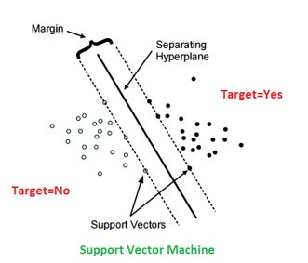
Concepts
Support Vectors
Data points of the dataset, nearest to the hyperplane
Hyperplane
A line that linearly separates and classifies a set of data
The further from the hyperplane data points lie, the more confident we are that they have been correctly classified
Margin
The distance between the hyperplane and the nearest data point from either set
https://www.kaggle.com/code/prashant111/svm-classifier-tutorial

Slide 4
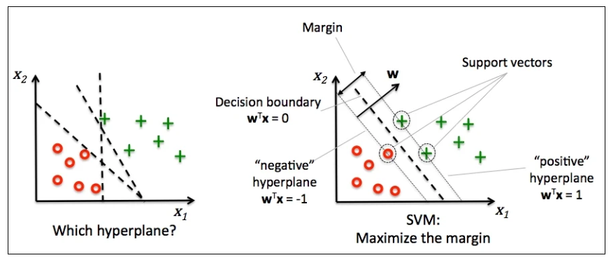
SVM Under the hood
Main objective is to select a hyperplane with the maximum possible margin
Generate hyperplanes which segregates the classes in the best possible way. There are many hyperplanes that might classify the data
So, we choose the hyperplane so that distance from it to the support vectors on each side is maximized.
https://www.kaggle.com/code/prashant111/svm-classifier-tutorial

Slide 5

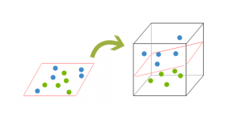
What if data isn't linearly separable?
It’s necessary to move away from a 2d view of the data to a 3d view
Mapping of data into a higher dimension. This is known as kernelling
Hyperplane can no longer be a line. It must now be a plane
The data will continue to be mapped into higher and higher dimensions until a hyperplane can be formed to segregate it.
https://www.researchgate.net/figure/Figure-C-Diagram-of-2D-Hyperplane-vs-3D-Dataset-6_fig1_345314400

Slide 6

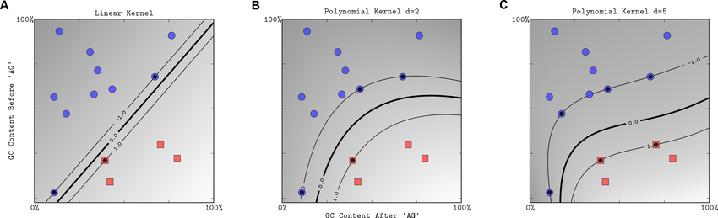
Kernels
Linear kernel
Polynomial Kernel
https://www.kaggle.com/code/prashant111/svm-classifier-tutorial

Slide 7
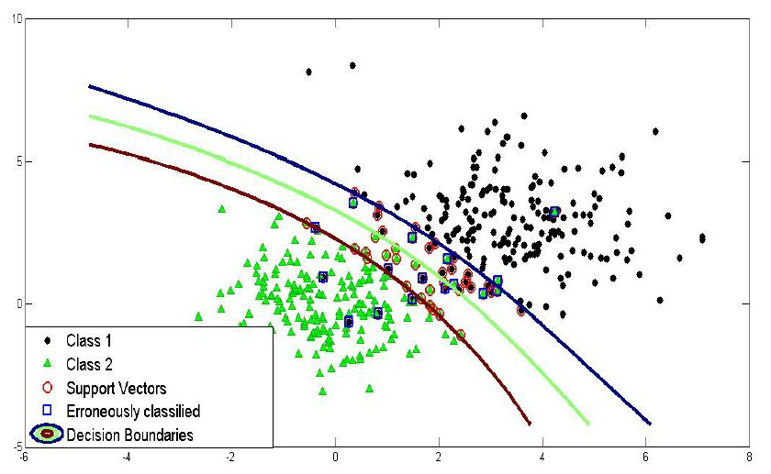
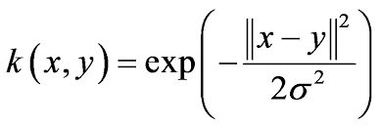
Kernels
3. Radial Basis Function Kernel
https://www.kaggle.com/code/prashant111/svm-classifier-tutorial

Slide 8
Pros & Cons
Pros
Accuracy
Works well on smaller cleaner datasets
It can be more efficient because it uses a subset of training points
Cons
Isn’t suited to larger datasets as the training time with SVMs can be high
Less effective on noisier datasets with overlapping classes

