Slide 1
Haskell

Slide 2
Data Types
The most advanced type system you’ve likely seen.
Very powerful
Uses Type Inferencing
Has a hierarchy of types: Type Classes
Allows a polymorphism

Slide 3
Primitive Types
Type | “Literals” | Info
Bool | True False
Int | 2 | Maximum possible Int is 2147483647 and the minimum is -2147483648.
Integer | 2 | Arbitrary precision Not bounded so it can be used to represent really, really big numbers
Float | 2 | IEEE single precision

Slide 4

Type | “Literals” | Info
Double | 2 | IEEE double precision
Char | ‘a’ | Enumeration of Unicode (ISO/IEC 10646)

Slide 5
Constructed Types
Type | Type Constructors | Info
Rational | 4 % 5 | Arbitrary precision rational numbers. In Data.Ratio module
Ordering | LT EQ GT
String | [‘a’..’z’] | List of Char

Slide 6
Constructed Types
Type | Type Constructors | Info
Maybe | data Maybe a = Nothing | Just a | Nothing or Just something
Either | Left a Right b | One or the other
… |  | Anything else you want to make

Slide 7
Composite Types
Type | Type Constructors | Info
[ ] | [] [1,2,3] [9..28] [1..] | Lists, must be homogeneous
() | () (‘a’,5,[1..]) | Tuple, can be Heterogeneous

Slide 8
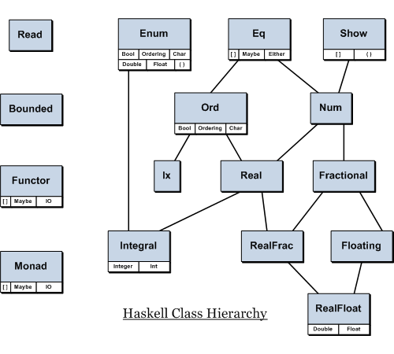
Type Classes Define Behavior

Slide 9
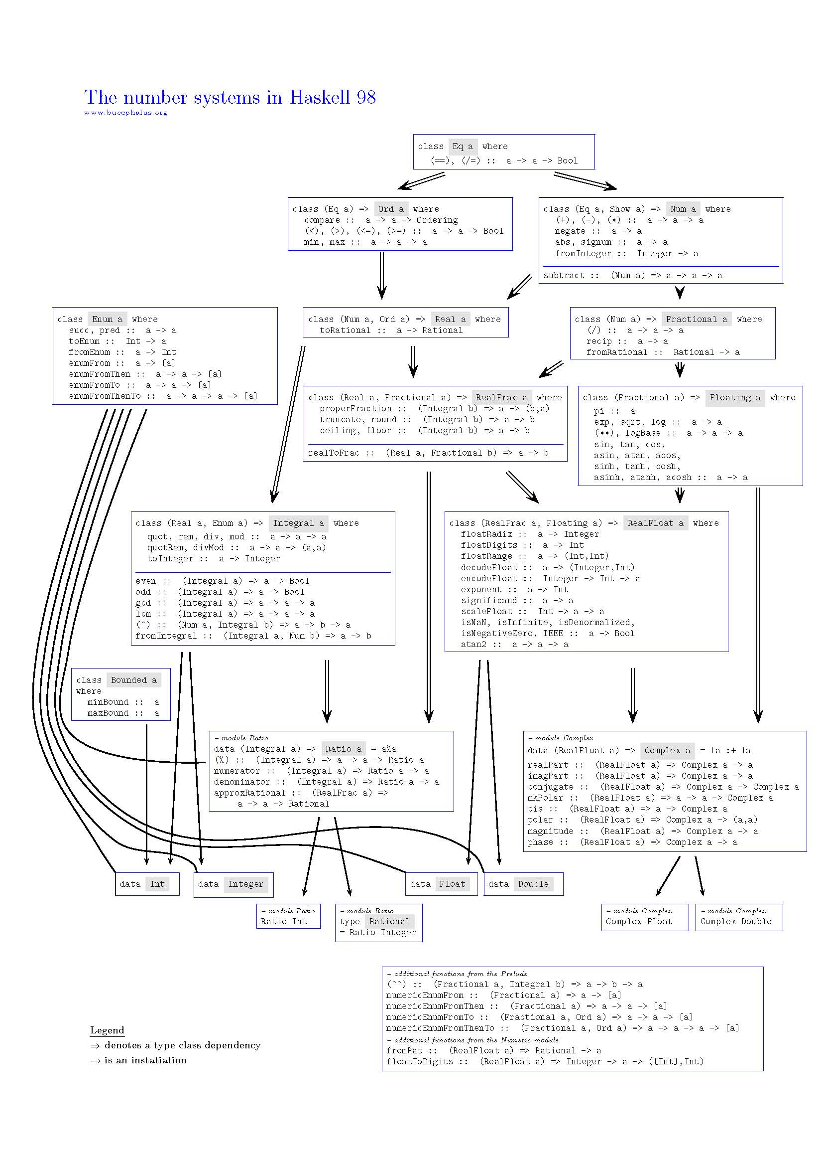

Slide 10
data Int
Library Int

Slide 11
Guess the Type?
54
54.9
True
4 < 9
‘a’
“Hello World”
(1,’a’)
[4.5,9]
Num a =>a
Fractional a =>a
Bool
Bool
Char
[Char]
Num t => (t, Char)
Fractional t => [t]

Slide 12
In Haskell, typing is
Very strongly typed
Try adding an Int and a Double
Static: All type checking done at compile time
Optional: Types can be inferred
If you don’t — you get the most general types
If you do specify it, then you get precisely that

Slide 13
Syntax
Syntax NOT similar to C based languages
Whitespace is important (like Python)
No parenthesis needed, but they’re nice sometimes
No curly braces
Understanding precedence is important

Slide 14
Control Flow
None (in the traditional sense)
Only the rules of precedence for operators and functions
Function calls
Pattern matching in function definitions
if then else expression
case expression

Slide 15
No loops — only recursion
I/O looks different (procedural like), but isn’t
Execution is lazy (you can write infinite data structures)
No variables; no persisting state information
NO side effects
Haskell is a pure functional language — what did you expect? You use functions to solve problems.

Slide 16
Functions
Function application
functionName arg1 arg2 arg3
Function definition
functionName :: type1 -> type2 -> type3 -> resultType
functionName x y z = body

Slide 17
Typical simple function
With a where clause

Slide 18
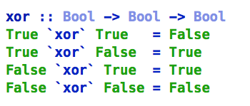
With multiple definitions, and as an infix operator
With guards

Slide 19
With pattern matching

Slide 20
More slides to follow:
recursion
lambda functions
Higher order functions, currying
first-class functions
folds

