Slide 1
Adaptive Skill and Stake
in Forecast Markets
Coupling Self-Financed Wagering with Online Skill Learning
Anastasia Cattaneo
Imperial College London — Dyson School of Design Engineering
2025

Slide 2
Why Forecast Aggregation Matters
Combining forecasts reduces error
Different sources capture different aspects of reality
Averaging out individual errors improves collective accuracy
Modern standard: probabilistic forecasts
Full distributions, not point estimates (Gneiting & Raftery, 2007)
Quality measured by strictly proper scoring rules (e.g. CRPS)
Strictly proper → only way to maximise score is to report true belief
Open question
How to incentivise participation?
How to decide whose forecast should count more?

Slide 3
Prediction Markets as a Solution
Mechanism
Data owners share predictions (not raw data)
Rewarded based on forecast accuracy after outcome observed
Market aggregates individual predictions into collective view
Real platforms
Numerai (data science tournaments), Polymarket, Kalshi
Evidence of problems
Wash trading ~60% of Polymarket weekly volume (Sirolly et al., 2025)
Prices driven by small core of active traders, not broad wisdom (Wu, 2025)
→ Need mechanisms with formal guarantees

Slide 4
Existing Work
Self-Financed Wagering
Lambert et al. (2008)
Weighted-score mechanism
7 properties; uniqueness result
Raja et al. (2024)
Added client + utility
Conditionally truthful
Wind energy case study
Limitation: history-free
Online Aggregation
OGD / Hedge algorithms
Learns time-varying weights
Regret guarantees
Non-strategic assumption
No payments or incentives
Intermittent Contributions
Vitali & Pinson (2025)
Correction matrix for missing
OGD on pinball loss
Shapley + scoring payoff
Belgian offshore wind
Relative weights on simplex
Different settlement structure

Slide 5
No existing design couples self-financed wagering with an online skill-learning layer
Contribution: effective wager = deposit × learned skill
• Absolute (not relative) • Pre-round (preserves truthfulness) • Handles intermittency

Slide 6
Solution
Mechanism Design and Implementation

Slide 7
The Mechanism: Round-by-Round
Five steps per round:
1. Submit
Player submits quantile forecast + deposit (wealth × confidence)
2. Skill Gate
Effective wager = deposit × skill factor; remainder refunded
3. Aggregate
Weighted combination using effective wagers as weights
4. Settle
Payoff redistributes wager pool by relative scores (budget-balanced)
5. Update
Loss → EWMA → skill recomputed; wealth updated
Same effective wager controls BOTH influence and exposure

Slide 8
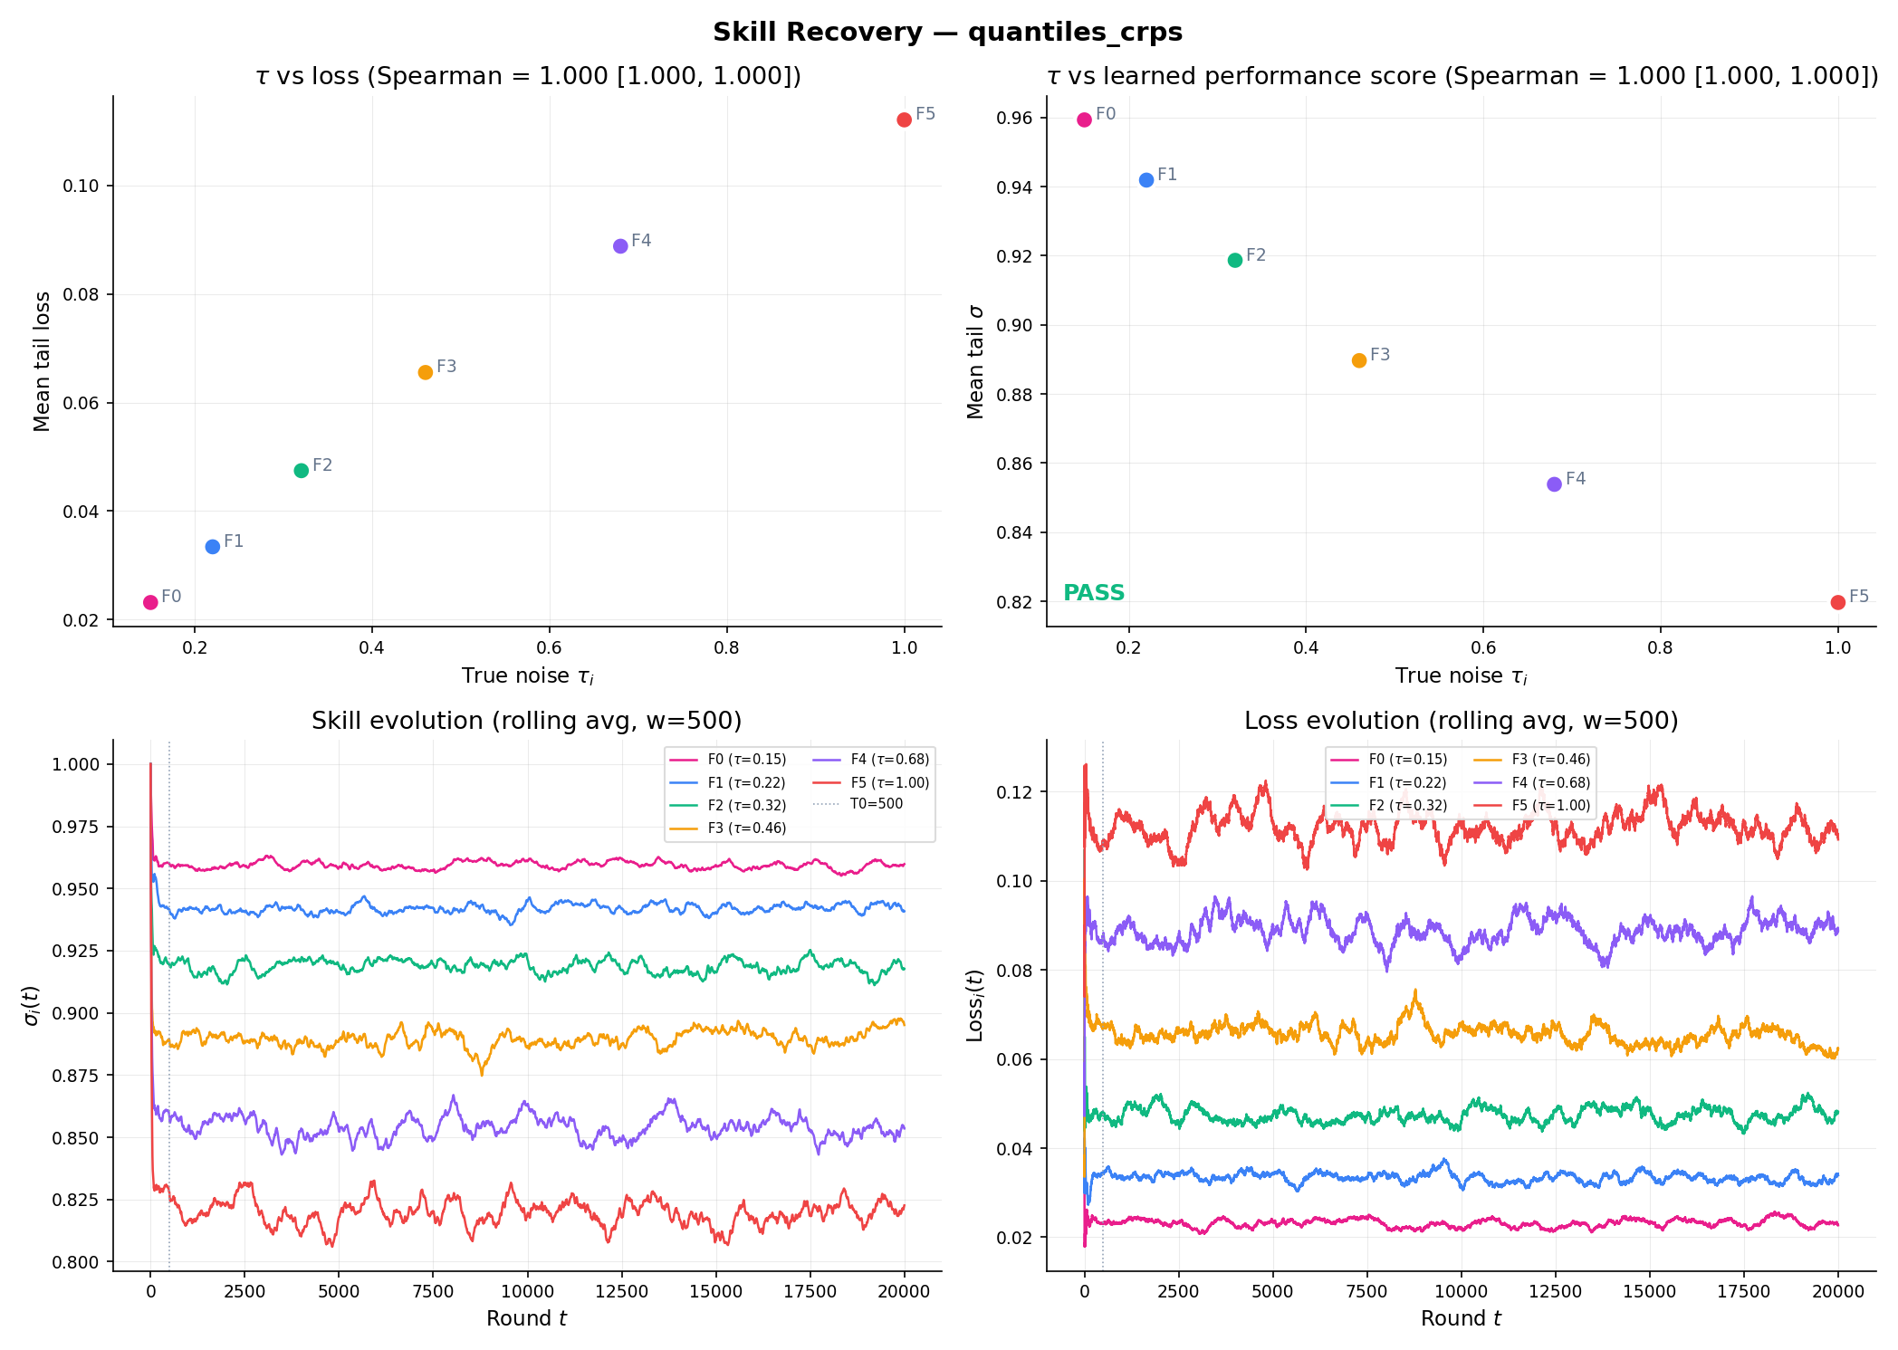
The Skill Signal
Core Innovation
When present:
Loss state blends previous
value with current round loss
(EWMA with learning rate ρ)
When absent:
Loss state reverts toward
neutral baseline (staleness decay)
Mapping:
Exponential: loss → skill ∈ [σ_min, 1]
Key difference from Vitali-Pinson:
Absolute skill (not relative)
One forecaster improves without
reducing another's weight

Slide 9
Architecture and Implementation
Three-layer modular separation:
Environment
Data-generating processes (exogenous/endogenous truth)
Agents
Behaviour policies: honest, noisy, risk-averse, sybil, arbitrageur, colluder, wash trader
Each outputs: (participate?, report, deposit) — core does not know motives
Platform (deterministic, side-effect-free)
Scoring → Aggregation → Settlement → Skill update
Implementation: onlinev2 Python package
20+ invariant tests; property-based testing (Hypothesis)
Experiment ladder: correctness → forecasting → dynamics → strategy

Slide 10
Validation
Experimental Results

Slide 11
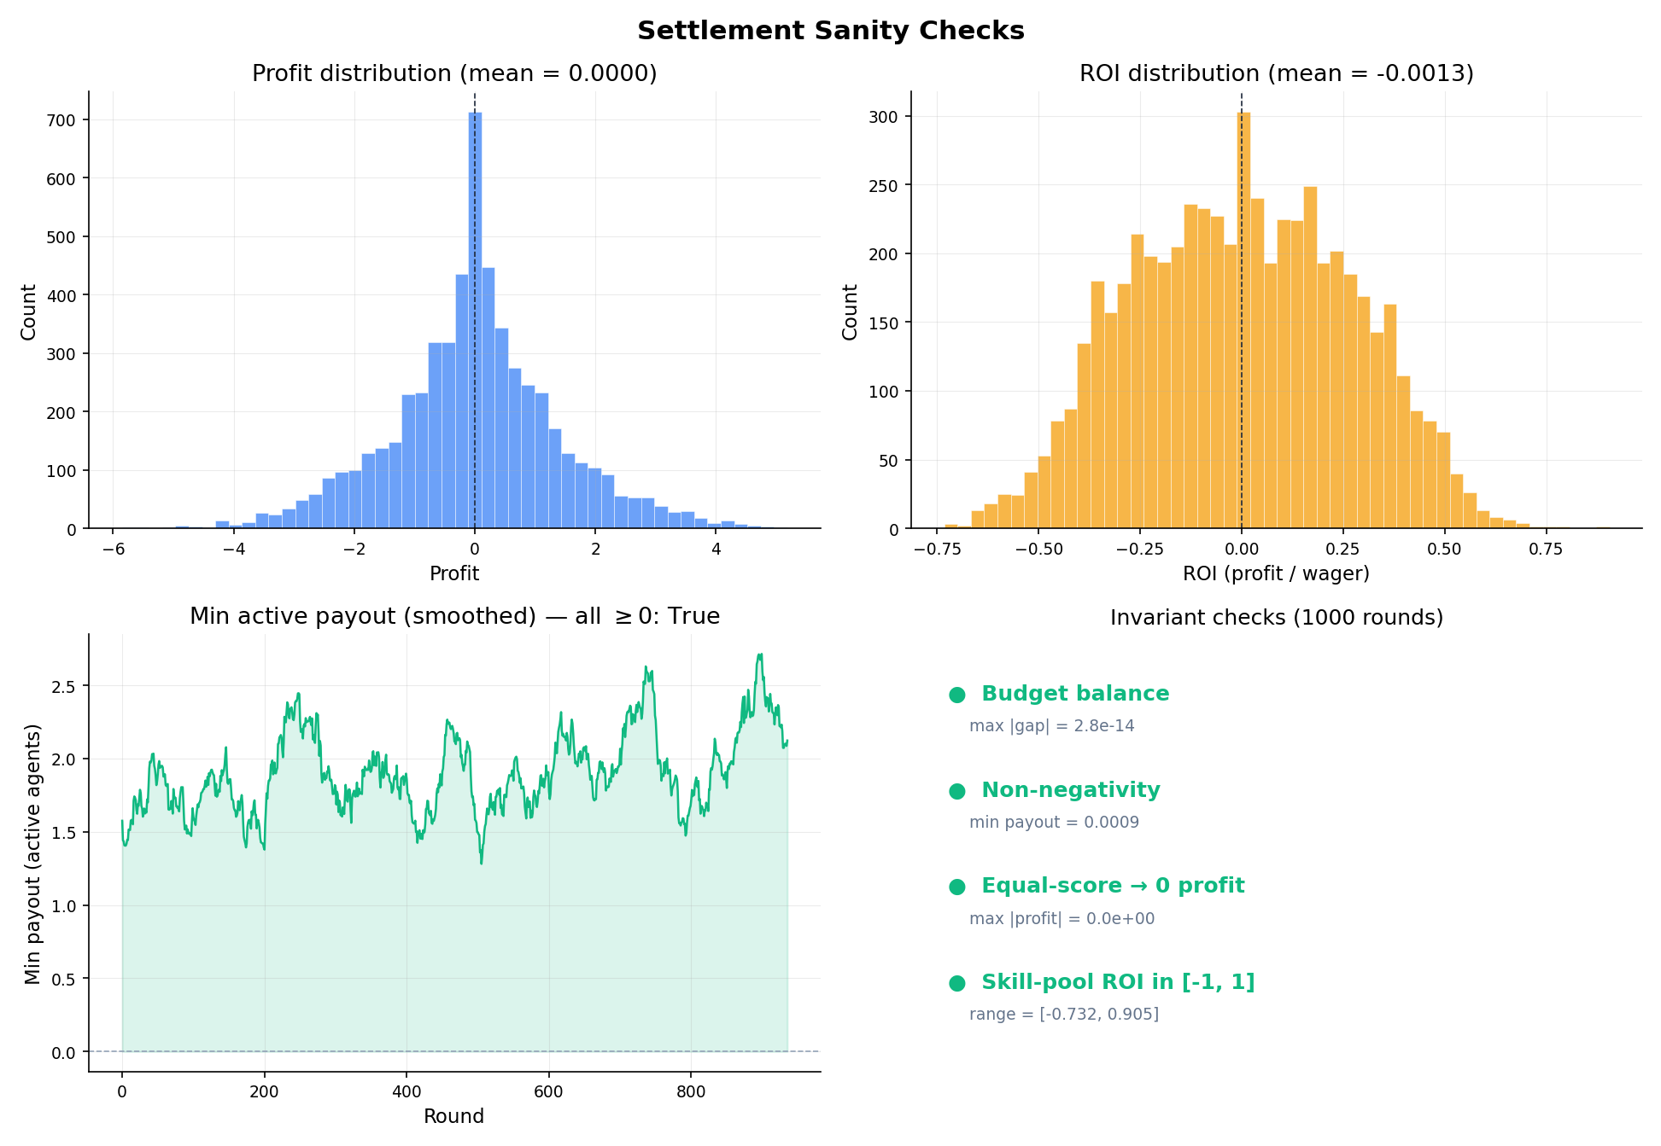
Correctness: The Mechanism Works
1000 rounds, 20 seeds
Budget Balance
Max gap: 2.84 × 10⁻¹⁴
Mean profit: 3.01 × 10⁻¹⁷
(machine precision)
Sybilproofness
Identical reports ratio: 1.000000
Max |Δ|: 2.07 × 10⁻¹⁷
Scoring Invariants
Pinball ≥ 0 ✓
CRPS ≥ 0 ✓
Perfect beats shifted ✓
CRPS bounded ✓
All 20+ tests PASS

Slide 12
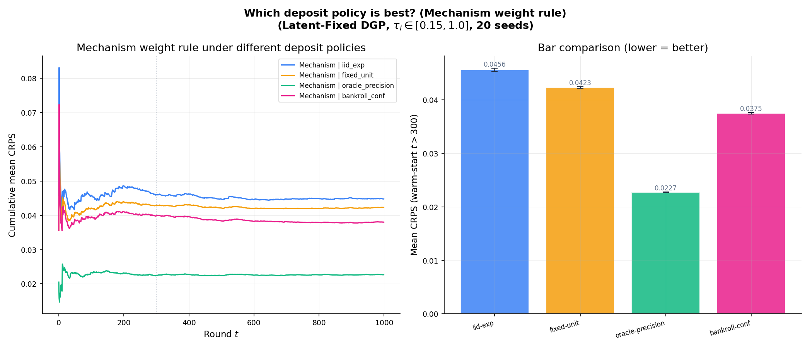
Deposit Design Is the Strongest Lever
Key Finding
Deposit policy comparison
(mechanism weight rule, 20 seeds)
IID Exponential: 0.0456 ± 0.0003
Fixed Unit (b=1): 0.0423 ± 0.0002
Bankroll + Conf: 0.0375 ± 0.0001
Oracle Precision: 0.0227 ± 0.0001
Bankroll vs Fixed: −11.3%
Oracle vs Fixed: −46.3%
Implication:
How stake enters the system
matters more than the
weighting rule

Slide 13
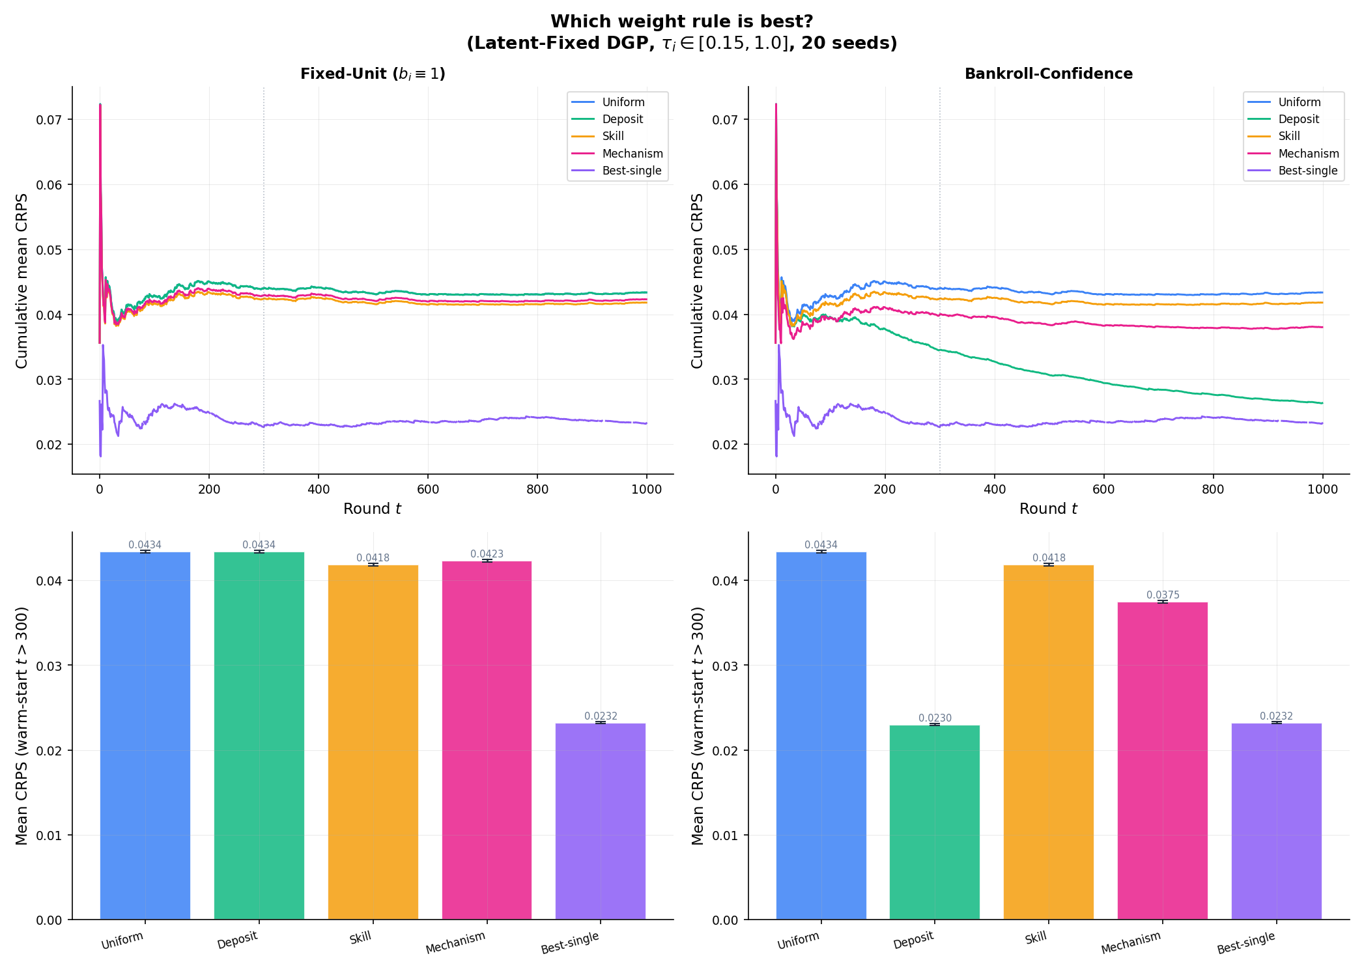
Weight Rules and the Combination Puzzle
Under fixed deposits:
Uniform: 0.0434 ± 0.0002
Deposit: 0.0434 ± 0.0002
Skill: 0.0419 ± 0.0002
Mechanism: 0.0423 ± 0.0002
Best single: 0.0232 ± 0.0001
Skill vs uniform: −3.5%
Under bankroll deposits:
Deposit only: 0.0230 ± 0.0001
Mechanism: 0.0375 ± 0.0001
Forecast combination puzzle:
Equal weights hard to beat
(Wang et al., 2023)

Slide 14
Skill Recovery and Dynamic Robustness
T=20000, 6 forecasters, 20 seeds
Skill recovery results (quantiles_crps mode):
f0: τ=0.15 → loss=0.023 → σ=0.959
f1: τ=0.22 → loss=0.033 → σ=0.942
f2: τ=0.32 → loss=0.047 → σ=0.919
f3: τ=0.46 → loss=0.066 → σ=0.890
f4: τ=0.68 → loss=0.089 → σ=0.854
f5: τ=1.00 → loss=0.112 → σ=0.820
Spearman rank correlation (τ vs σ): 1.0000
Perfect rank recovery in both point and quantile modes
Staleness decay:
Absent forecasters revert toward baseline
→ removes incentive for strategic absence

Slide 15
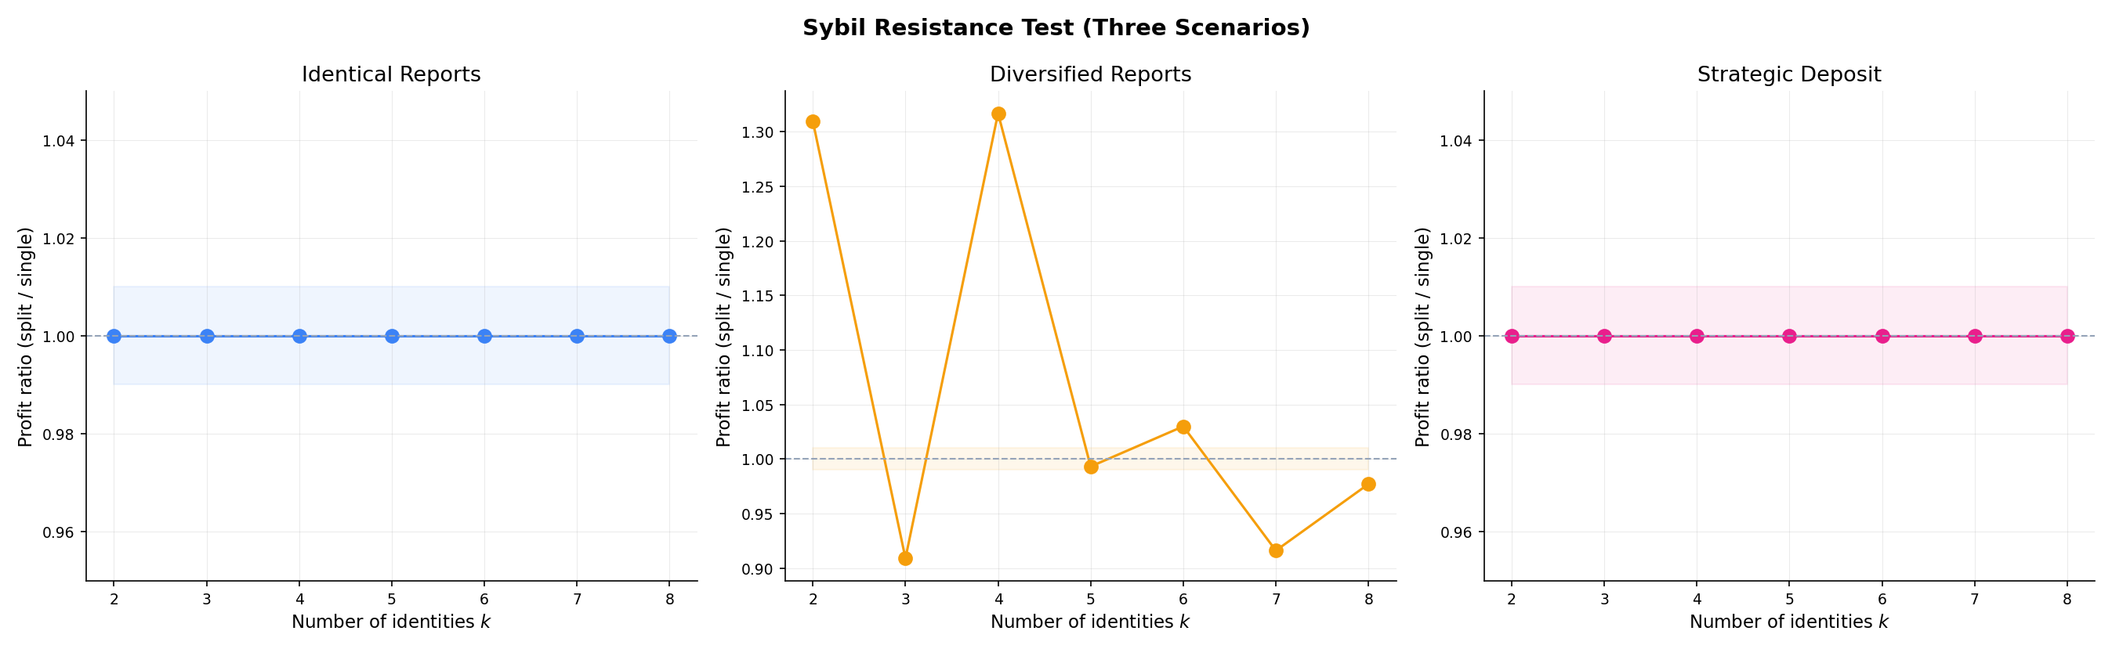
Strategic Robustness
Sybil attacks (identical reports):
Profit ratio: 1.000000
Max |Δ|: 2.07 × 10⁻¹⁷
No advantage from splitting
Sybil (diversified reports):
Ratio: 1.065
Slight advantage (known limit)
Strategic deposit manipulation:
Ratio: 1.000000
Arbitrage (Chen et al., 2014):
Zero profit in repeated setting
Skill gate limits sustained exploit
Adaptive adversaries: open challenge

Slide 16
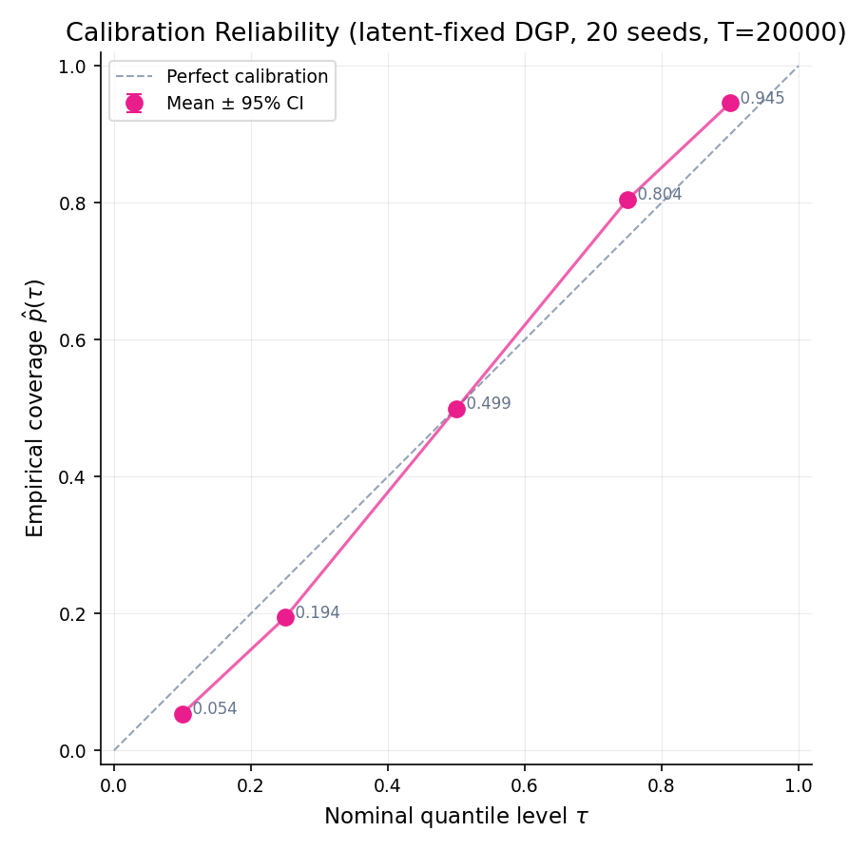
Calibration
Known Limitation
Reliability (latent-fixed DGP)
T=20000, 10 forecasters, 20 seeds
τ=0.10: p̂=0.054 (dev: −0.046)
τ=0.25: p̂=0.194 (dev: −0.056)
τ=0.50: p̂=0.499 (dev: −0.001)
τ=0.75: p̂=0.804 (dev: +0.054)
τ=0.90: p̂=0.945 (dev: +0.045)
Median: nearly perfect
Tails: ~5pp systematic under-dispersion
Inherent to quantile averaging
Shared across all weighting methods
Not specific to this mechanism

Slide 17
Contributions and Limitations
Contributions
1. Mechanism coupling wagering
with online skill learning
2. Budget balance < 10⁻¹⁴
Sybilproof (ratio = 1.000000)
3. Deposit design: −11.3% CRPS
4. Skill recovery: ρ = 1.0000
5. Sybil-resistant; no arbitrage
6. Modular platform + test suite
Limitations
Tail calibration: ~5pp under-dispersion
Equal weights competitive in some configs
Truthfulness: risk-neutrality assumption
All synthetic data — no deployment
Key takeaway:
Strongest lever is deposit design,
not the weighting rule

Slide 18
Thank you
Anastasia Cattaneo
Imperial College London — Dyson School of Design Engineering
2025

