Slide 1
Animanga
Introduction.
What our website is about.
Why we chose this topic.

Slide 2
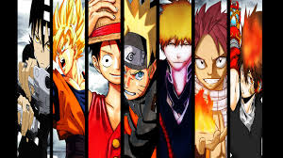
Anime is a Japanese style of animation. there is a lot of emphasison fantasy in this genre. Becoming widely popular in the western world.
Anime

Slide 3
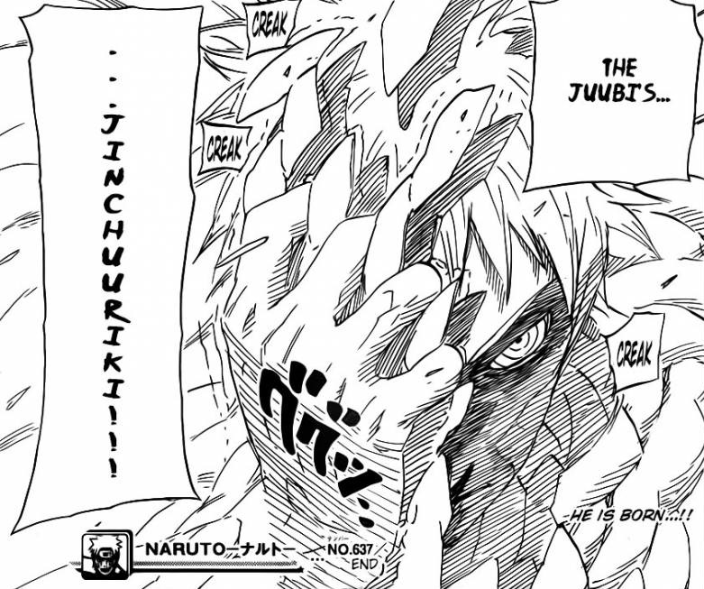
Manga is the comic version of anime. Most anime are adapted from manga. They are read differently than other comics.
Manga

Slide 4
We have a huge interest in the content. Its an interesting subject. Its not as widely known as we would like.
Why We Chose This Topic

Slide 5
We chose to combine both anime and manga because its not common to see them both together. Most sites do one or the other.
The Combination

Slide 6
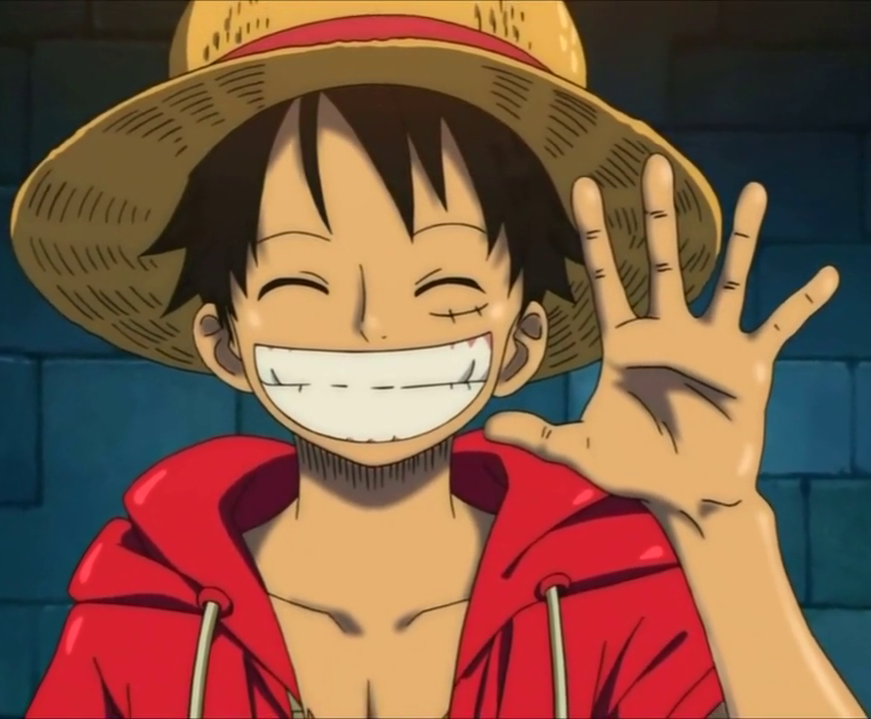
Overall, we made our project around this topic because it was fun. We hope you enjoyed our presentation!!!
Conclusion

