Slide 1
Trajectory estimation and step detection
Filippova Anastasia
Tamaz Gadaev

Slide 2
Plan
Problem statement
Motivation
Improvement baseline
Step detection
Instance velocity
Attention method
Result
Future work

Slide 3
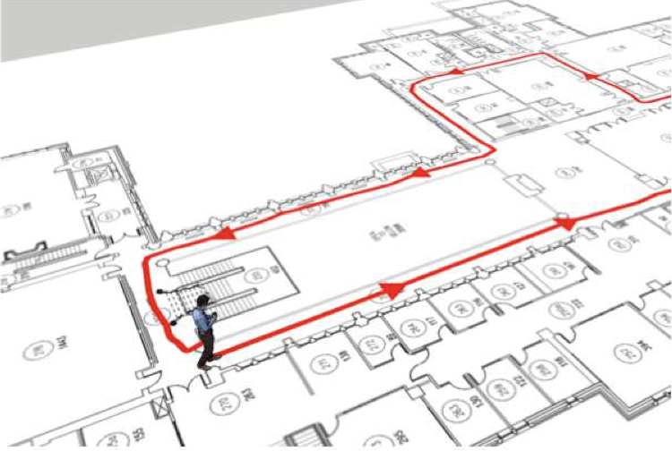
Problem statement
Task: to estimate the trajectory, detect steps, count number of steps
🚶🏻‍♂️
IMU sensors
time

Slide 4
Motivation
Indoor trajectory estimation
Step detection
disadvantage of GPS navigation
requires open space
depends on landscape
different type of shows
people with disabilities
simple mechanism can’t catch details
combine tasks

Slide 5
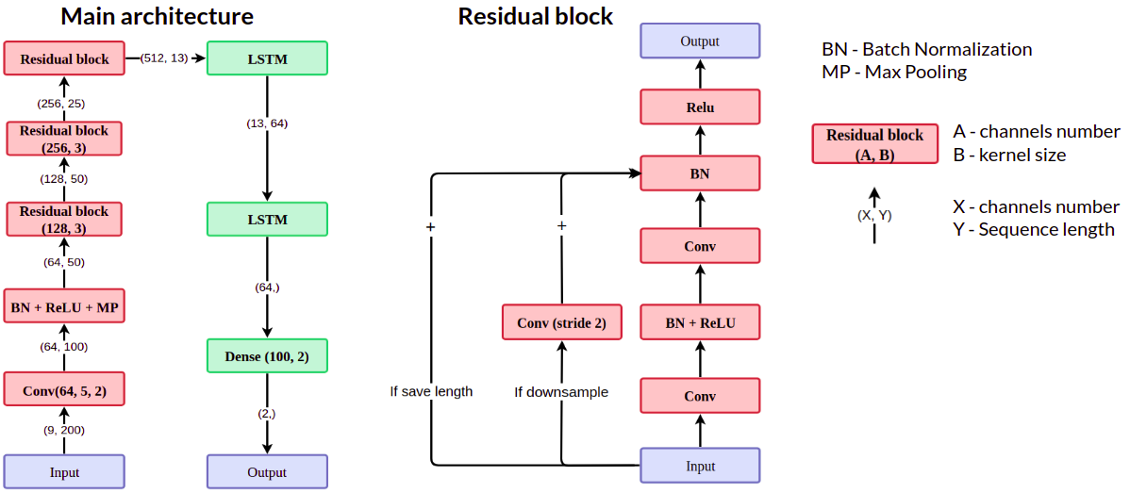
baseline model

Slide 6
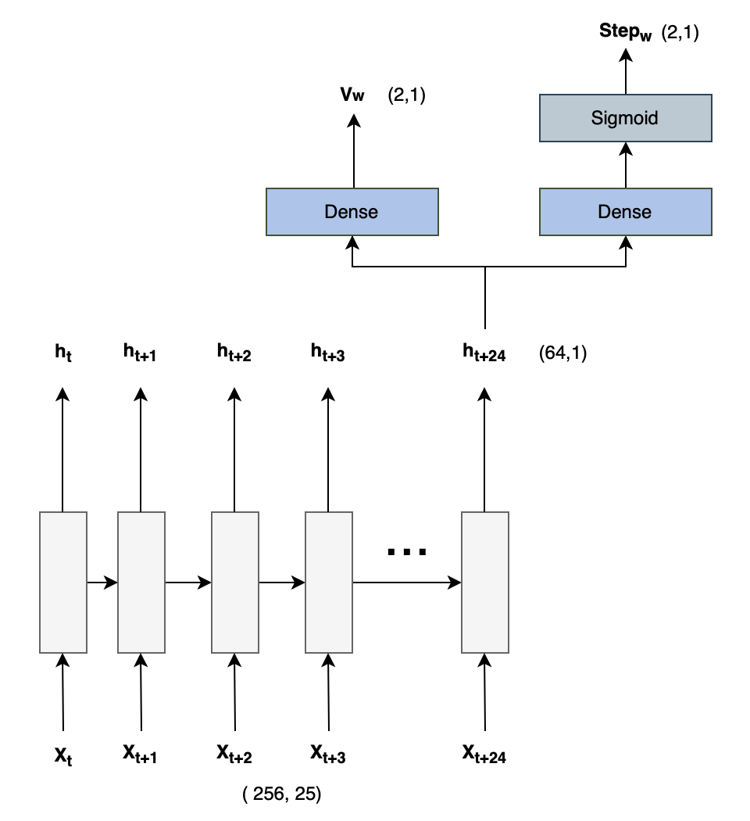
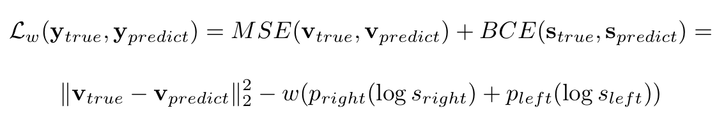
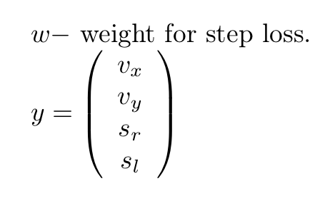

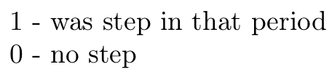
0 0 0 0 0 0 0 0 0 0 0 0 0 0 0 0 0 0
0 1 1 1 1 1

Slide 7
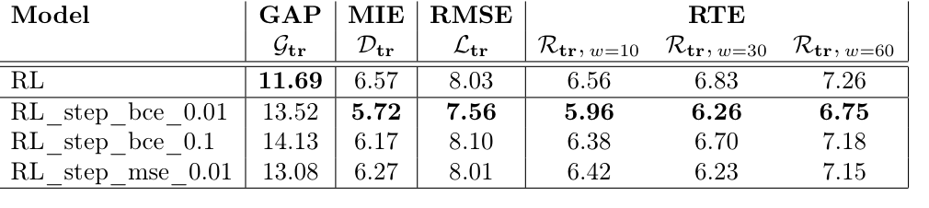
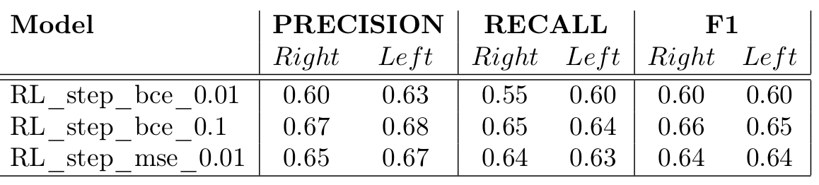
ResNetLSTM+step detection results

Slide 8
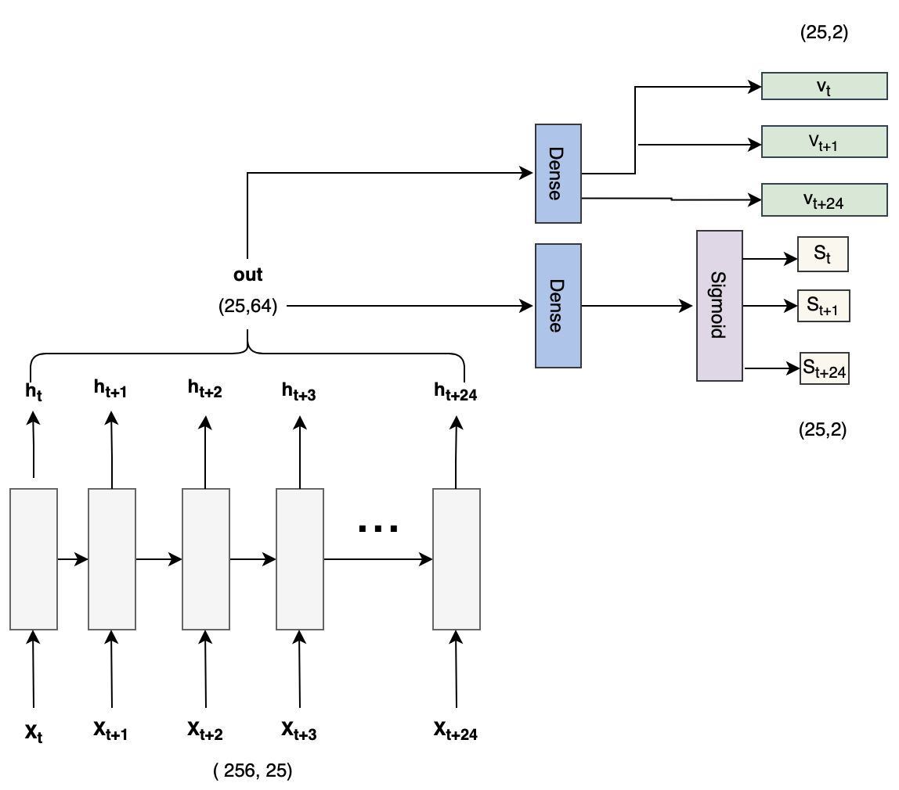
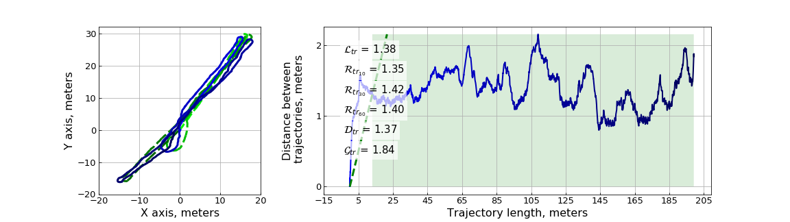
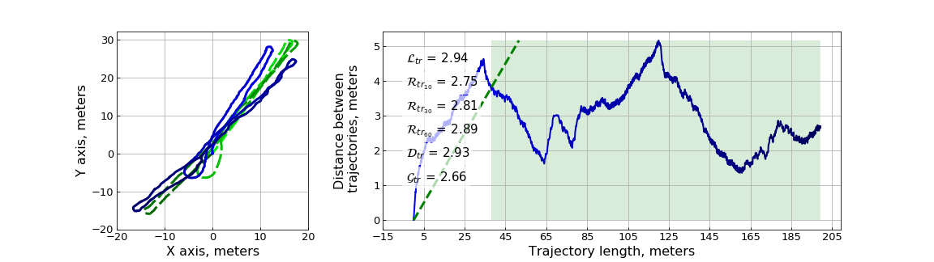
Instant Velocity

Slide 9
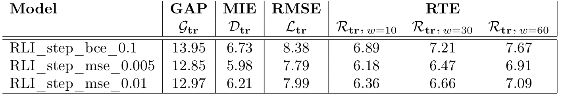
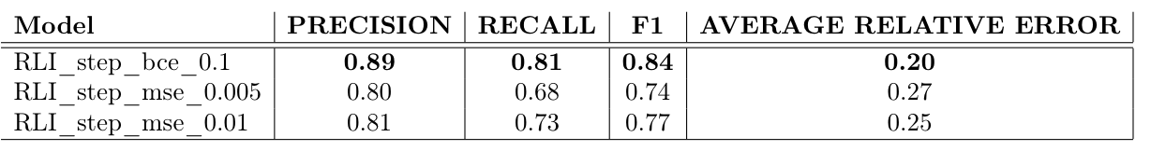
ResNetLSTM Instant velocity+step detection results

Slide 10
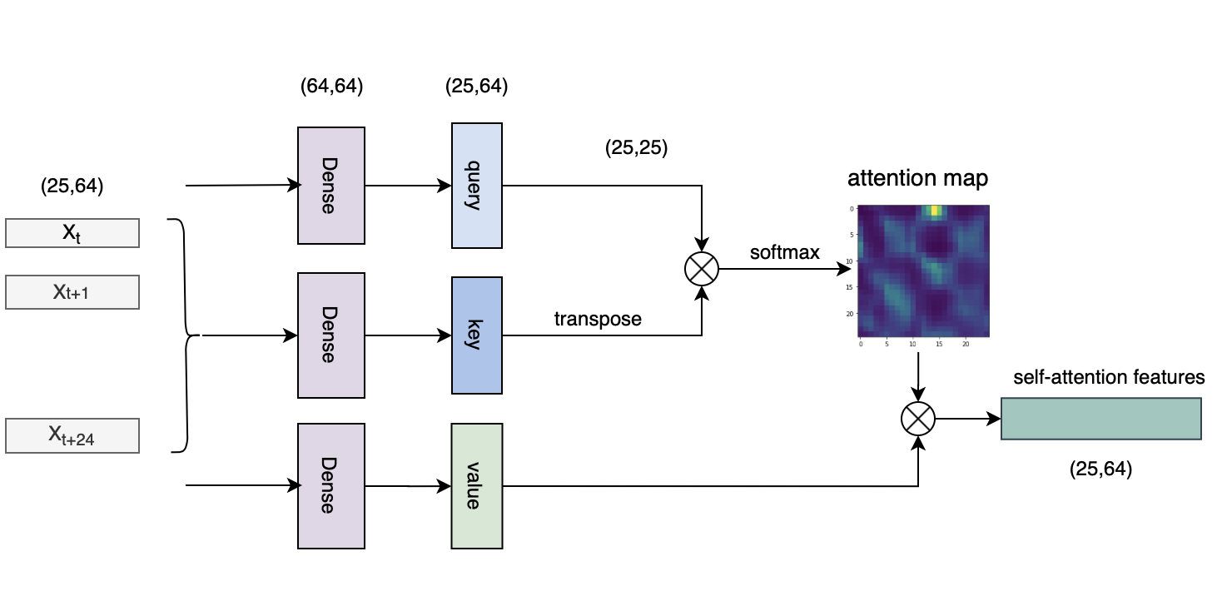
Attention

Slide 11
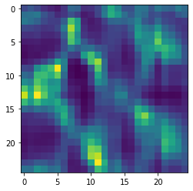
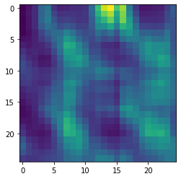
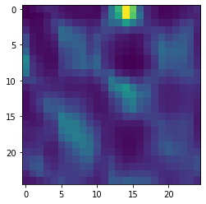
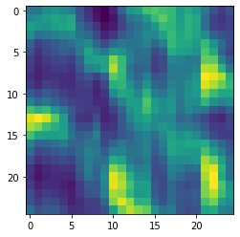
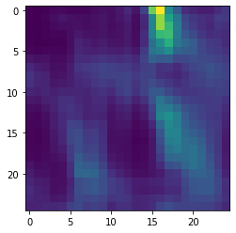
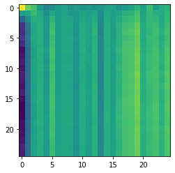
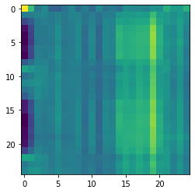
middle of trajectory
the importance of j at moment i
start
end

Slide 12
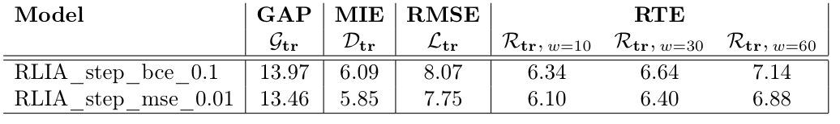
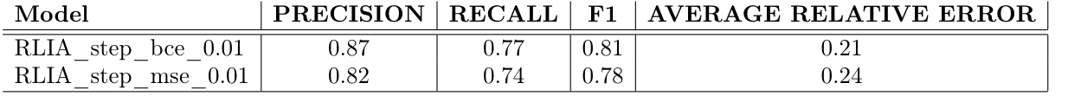
Attention results

Slide 13
Thank you for your attention!

