Slide 1

ML LAB
Can a Machine Recognize
Villains?
5 Supervised machine learning models to identify 5 villains — built in Orange

Slide 2


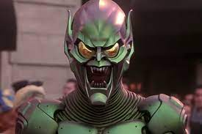
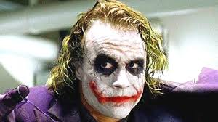
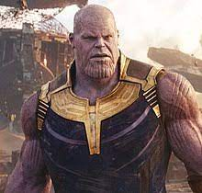
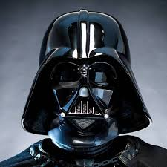

Our Goal
Look at a photo → guess the villain.
Darth Vader
Green Goblin
Joker
Thanos
Venom
100 photos • 5 villains • 5 ML models
ML Lab · Orange Data Mining
2

Slide 3

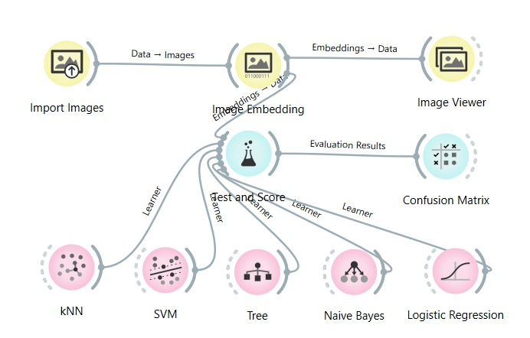




How Does It Work?
Import photos
Turn into numbers
Try 5 models
Test & score
Read results
ML Lab · Orange Data Mining
4

Slide 4

Which Model Wins for Each Villain?
"Winner" = the model with the highest F1 score for that villain (F1 balances precision and recall into one fair number).
Villain
Best Model
F1 Score
Why It Won
Darth Vader
Naive Bayes
0.95
Best mix of correct hits with very few mistakes
Green Goblin
Logistic Regression
0.84
Best balance of precision and recall
Joker
Naive Bayes
0.92
Perfect precision, strong recall
Thanos
SVM
0.84
Most balanced identification
Venom
Logistic Regression
0.92
Perfect precision, no false alarms
ML Lab · Orange Data Mining
7

Slide 5
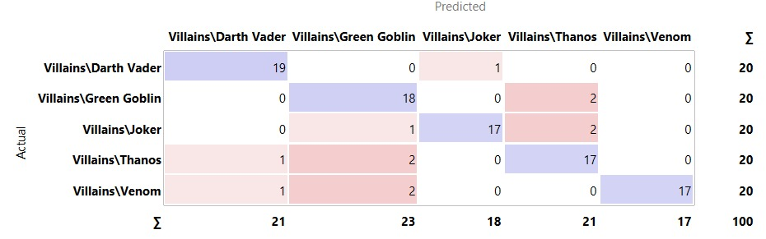
What Is a "Confusion Matrix"?
Think of it as a report card. Each row is a villain's real photos; each column is what the model guessed. Numbers running down the diagonal (top-left to bottom-right) are correct guesses — everything off the diagonal is a mix-up.
Quick example, read from the matrix on the right:
• Darth Vader: all 19 correctly matched, only 1 confused with Joker.
• Green Goblin: 18 correct, mostly confused with Thanos.
• This model got 88 out of 100 photos right overall.
Example: Logistic Regression's confusion matrix
ML Lab · Orange Data Mining
6

Slide 6
Best Model, Villain by Villain
Darth Vader
Green Goblin
Joker
Thanos
Venom
Naive Bayes
Logistic Regression
Naive Bayes
SVM
Logistic Regression
0.95
0.84
0.92
0.84
0.92
F1 SCORE
F1 SCORE
F1 SCORE
F1 SCORE
F1 SCORE
ML Lab · Orange Data Mining
7

Slide 7

Overall Model Ranking
% of all 100 photos correctly identified
ML Lab · Orange Data Mining
8

Slide 8

Key Takeaways
No single "best" model
Simple Tree struggled most
the winner changes per villain
only 59% correct overall
Probability models did best
Naive Bayes & Logistic Regression
ML Lab · Orange Data Mining
9

Slide 9
Yes — the Model You Choose Matters
Accuracy ranged from 59% (Tree) to 88% (Logistic Regression)
Recommended: Logistic Regression & Naive Bayes
Thank you! Questions?
ML Lab · Orange Data Mining
10

