Slide 1
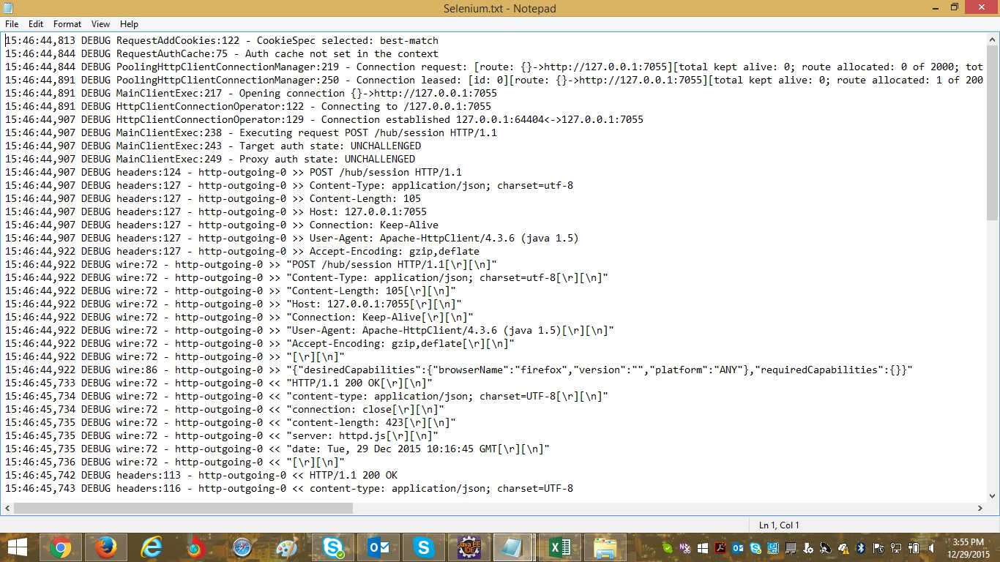
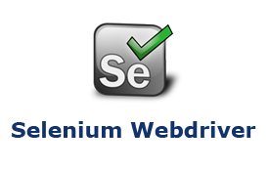
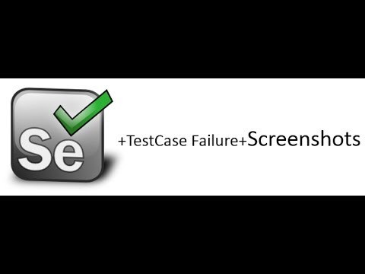
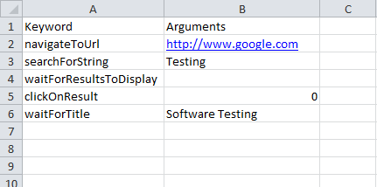
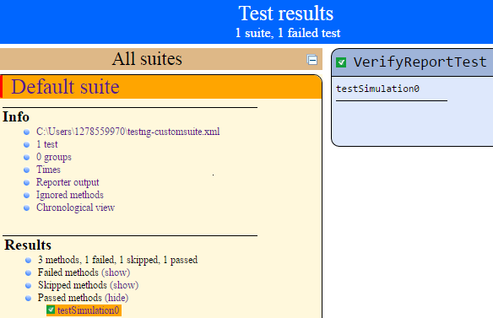
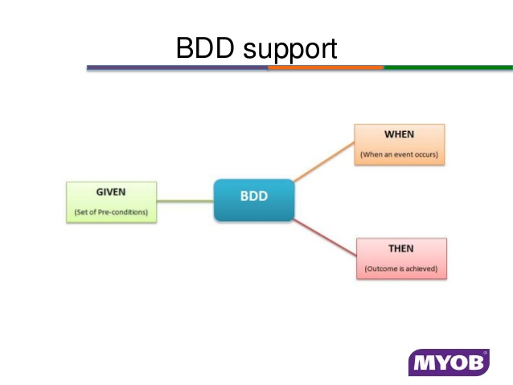
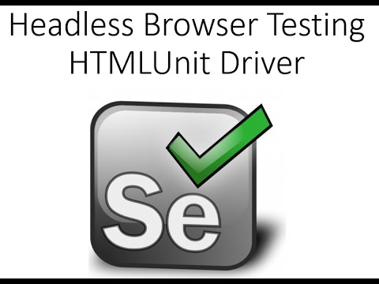
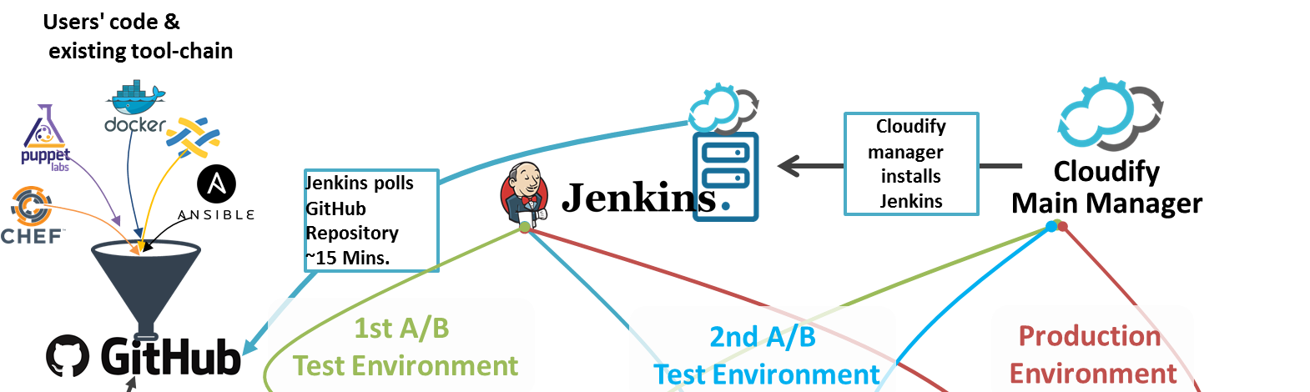

HyBrid Automation Framework :
Selenium Webdriver
Components of Framework :
Hybrid Driven XL – Keyword and data parameters
WebDriver_Master.java – Heart of framework
Test Evidences and Logs
Logs
Test evidence
Easy Web automation:
Fetching CSI id for the list of portfolio numbers and ING id
Employed JavaScript to converse with the application
Hybrid-driven XL
Road Ahead for Framework:
CI/CD integration – GitHub/Maven/Jenkins
Better reporting mechanisms
BDD support
Headless Browser testing

