Slide 1
The Unix Shell
Introduction

Slide 2
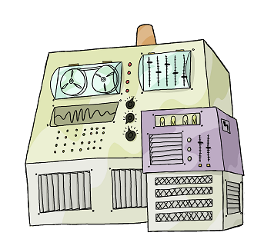

Slide 3
Run
Programs
Notes:
3

Slide 4
Run
Programs
Store
Data
Notes:
4

Slide 5
Run
Programs
Store
Data
Communicate
with each other
Notes:
5

Slide 6
Run
Programs
Store
Data
Communicate
with each other
Interact
with us
Notes:
6

Slide 7
Interact
with us
Notes:
7

Slide 8
Interact
with us
Telepathy
Notes:
8

Slide 9
Interact
with us
Telepathy
Speech
Notes:
9

Slide 10
Interact
with us
Telepathy
Speech
WIMP
(windows, icons, mice, pointers)
Notes:
10

Slide 11
Interact
with us
Rewiring
Telepathy
Speech
WIMP
Notes:
11

Slide 12
Interact
with us
Rewiring
Telepathy
Typewriter
Speech
WIMP
Notes:
12

Slide 13
Typewriter
Notes:
13

Slide 14
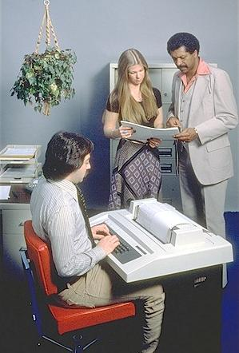
Typewriter
Line printer + keyboard
Notes:
14

Slide 15
Typewriter
Line printer + keyboard
Text only
Notes:
15

Slide 16
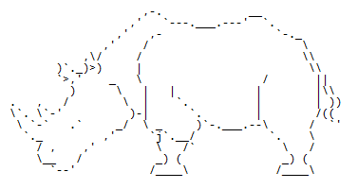
Typewriter
Line printer + keyboard
Text only
Notes:
16

Slide 17
Typewriter
Line printer + keyboard
Text only
CLUI: command-line user interface
Notes:
17

Slide 18

user logs in
Notes:
18

Slide 19
user logs in
user types command
Notes:
19

Slide 20
user logs in
user types command
computer executes command
and prints output
Notes:
20

Slide 21
user logs in
user types command
computer executes command
and prints output
user types another command
Notes:
21

Slide 22
user logs in
user types command
computer executes command
and prints output
user types another command
computer executes command
and prints output
Notes:
22

Slide 23
user logs in
user types command
computer executes command
and prints output
user types another command
computer executes command
and prints output
⋮
user logs off
Notes:
23

Slide 24
user logs in
user types command
computer executes command
and prints output
user types another command
computer executes command
and prints output
⋮
user logs off
Notes:
24

Slide 25
user logs in
user types command
computer executes command
and prints output
user types another command
computer executes command
and prints output
⋮
user logs off
shell
Notes:
25

Slide 26
user logs in
user types command
computer executes command
and prints output
user types another command
computer executes command
and prints output
⋮
user logs off
shell
Notes:
26

Slide 27
A shell is just a program that runs other programs
Notes:
27

Slide 28
A shell is just a program that runs other programs
Most popular is bash (the Bourne again shell)
Notes:
28

Slide 29

A shell is just a program that runs other programs
Most popular is bash (the Bourne again shell)
Notes:
29

Slide 30
A shell is just a program that runs other programs
Most popular is bash (the Bourne again shell)
Using it feels a lot more like programming
than using windows, a mouse, etc.
Notes:
30

Slide 31
A shell is just a program that runs other programs
Most popular is bash (the Bourne again shell)
Using it feels a lot more like programming
than using windows, a mouse, etc.
Commands are terse and often cryptic
Notes:
31

Slide 32
A shell is just a program that runs other programs
Most popular is bash (the Bourne again shell)
Using it feels a lot more like programming
than using windows, a mouse, etc.
Commands are terse and often cryptic
Use it because:
Notes:
32

Slide 33
A shell is just a program that runs other programs
Most popular is bash (the Bourne again shell)
Using it feels a lot more like programming
than using windows, a mouse, etc.
Commands are terse and often cryptic
Use it because:
– many tools only have command-line interfaces
Notes:
33

Slide 34
A shell is just a program that runs other programs
Most popular is bash (the Bourne again shell)
Using it feels a lot more like programming
than using windows, a mouse, etc.
Commands are terse and often cryptic
Use it because:
– many tools only have command-line interfaces
– allows you to combine tools in powerful new ways
Notes:
34

Slide 35

created by
Greg Wilson
August 2010
Copyright © Software Carpentry 2010
This work is licensed under the Creative Commons Attribution License
See http://software-carpentry.org/license.html for more information.

Slide 36
The Unix Shell
Files and Directories

Slide 37
Run
Programs
Store
Data
Communicate
with each other
Interact
with us
Notes:
37

Slide 38
Run
Programs
Store
Data
shell
Communicate
with each other
Interact
with us
Notes:
38

Slide 39
Store
Data
shell
Notes:
39

Slide 40
Store
Data
shell
file system
Notes:
40

Slide 41
Store
Data
shell
file system
files
Notes:
41

Slide 42
Store
Data
shell
file system
files
directories
Notes:
42

Slide 43
Store
Data
shell
Use the shell
to view and change
the file system
file system
files
directories
Notes:
43

Slide 44
Store
Data
Use the shell
to run commands
to view what's in
the file system
shell
file system
files
directories
Notes:
44

Slide 45
login:

Slide 46
login:
computer prompt in bold

Slide 47
login:
computer prompt in bold
explanatory text in blue

Slide 48
login: vlad
user input in green

Slide 49
login: vlad
password: ********
password

Slide 50
login: vlad
password: ********
$
shell prompt

Slide 51
login: vlad
password: ********
$
shell prompt
like Python's >>> and …

Slide 52
login: vlad
password: ********
$ whoami
check user ID

Slide 53
login: vlad
password: ********
$ whoami
check user ID
shell finds the whoami program

Slide 54
login: vlad
password: ********
$ whoami
check user ID
shell finds the whoami program
runs it

Slide 55
login: vlad
password: ********
$ whoami
vlad
check user ID
shell finds the whoami program
runs it
prints its output

Slide 56
login: vlad
password: ********
$ whoami
vlad
$
check user ID
shell finds the whoami program
runs it
prints its output
displays a new prompt

Slide 57
login: vlad
password: ********
$ whoami
vlad
$ pwd
what is the working directory

Slide 58
login: vlad
password: ********
$ whoami
vlad
$ pwd
what is the working directory
the directory used when no other
directory is explicitly specified

Slide 59
login: vlad
password: ********
$ whoami
vlad
$ pwd
/users/vlad
$

Slide 60

login: vlad
password: ********
$ whoami
vlad
$ pwd
/users/vlad
$
root

Slide 61
login: vlad
password: ********
$ whoami
vlad
$ pwd
/users/vlad
$
root
/

Slide 62
login: vlad
password: ********
$ whoami
vlad
$ pwd
/users/vlad
$
root
/

Slide 63
login: vlad
password: ********
$ whoami
vlad
$ pwd
/users/vlad
$
root
/
bin

Slide 64
login: vlad
password: ********
$ whoami
vlad
$ pwd
/users/vlad
$
root
/
bin
data

Slide 65
login: vlad
password: ********
$ whoami
vlad
$ pwd
/users/vlad
$
root
/
bin
data
users

Slide 66
login: vlad
password: ********
$ whoami
vlad
$ pwd
/users/vlad
$
root
/
bin
data
users
tmp

Slide 67
login: vlad
password: ********
$ whoami
vlad
$ pwd
/users/vlad
$
root
/
bin
data
users
tmp

Slide 68
login: vlad
password: ********
$ whoami
vlad
$ pwd
/users/vlad
$
root
/
bin
data
users
tmp
imhotep
larry
vlad

Slide 69
login: vlad
password: ********
$ whoami
vlad
$ pwd
/users/vlad
$
root
/
bin
data
users
tmp
imhotep
larry
vlad

Slide 70
login: vlad
password: ********
$ whoami
vlad
$ pwd
/users/vlad
$
root
/
bin
data
users
tmp
imhotep
larry
vlad

Slide 71
login: vlad
password: ********
$ whoami
vlad
$ pwd
/users/vlad
$
root
/
bin
data
users
tmp
imhotep
larry
vlad

Slide 72
login: vlad
password: ********
$ whoami
vlad
$ pwd
/users/vlad
$ ls
stands for "listing"

Slide 73
login: vlad
password: ********
$ whoami
vlad
$ pwd
/users/vlad
$ ls
stands for "listing"
sadly more memorable than
most command names

Slide 74
login: vlad
password: ********
$ whoami
vlad
$ pwd
/users/vlad
$ ls
bin data mail music
notes.txt papers pizza.cfg solar
solar.pdf swc
$

Slide 75
login: vlad
password: ********
$ whoami
vlad
$ pwd
/users/vlad
$ ls -F
bin/ data/ mail/ music/
notes.txt papers/ pizza.cfg solar/
solar.pdf swc/
$
an argument or flag modifying
the command's behavior

Slide 76
login: vlad
password: ********
$ whoami
vlad
$ pwd
/users/vlad
$ ls -F
bin/ data/ mail/ music/
notes.txt papers/ pizza.cfg solar/
solar.pdf swc/
$
adds a trailing '/' to
directory names

Slide 77
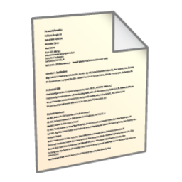
$ ls -F
bin/ data/ mail/ music/
notes.txt papers/ pizza.cfg solar/
solar.pdf swc/
vlad
bin
data
mail
music
notes.txt
papers
pizza.cfg
solar
solar.pdf
swc

Slide 78
$ ls -F
bin/ data/ mail/ music/
notes.txt papers/ pizza.cfg solar/
solar.pdf swc/
By convention, use filename extension to indicate file type

Slide 79
$ ls -F
bin/ data/ mail/ music/
notes.txt papers/ pizza.cfg solar/
solar.pdf swc/
By convention, use filename extension to indicate file type
.txt for text, .pdf for PDF, .cfg for configuration file, etc.

Slide 80
$ ls -F
bin/ data/ mail/ music/
notes.txt papers/ pizza.cfg solar/
solar.pdf swc/
By convention, use filename extension to indicate file type
.txt for text, .pdf for PDF, .cfg for configuration file, etc.
But this is only a convention, not a guarantee

Slide 81
$ ls –F data

Slide 82
$ ls –F data
amino_acids.txt elements/ morse.txt
pdb/ planets.txt sunspot.txt
$

Slide 83
$ ls –F data
amino_acids.txt elements/ morse.txt
pdb/ planets.txt sunspot.txt
$
a relative path
vlad
data

Slide 84
$ ls –F data
amino_acids.txt elements/ morse.txt
pdb/ planets.txt sunspot.txt
$
a relative path
relative to
current working directory
vlad
data

Slide 85
$ ls –F /data
access.log backup/ hardware.cfg
network.cfg
$

Slide 86
$ ls –F /data
access.log backup/ hardware.cfg
network.cfg
$
an absolute path

Slide 87
$ ls –F /data
access.log backup/ hardware.cfg
network.cfg
$
an absolute path
leading '/' means "from root"

Slide 88
$ ls –F /data
access.log backup/ hardware.cfg
network.cfg
$
/
an absolute path
leading '/' means "from root"
so it always refers to
this directory
bin
data
users
tmp
imhotep
larry
vlad

Slide 89
$ pwd
/users/vlad
$

Slide 90
$ pwd
/users/vlad
$ ls
bin/ data/ mail/ music/
notes.txt papers/ pizza.cfg solar/
solar.pdf swc/
$

Slide 91
$ pwd
/users/vlad
$ ls
bin/ data/ mail/ music/
notes.txt papers/ pizza.cfg solar/
solar.pdf swc/
$ cd data

Slide 92
$ pwd
/users/vlad
$ ls
bin/ data/ mail/ music/
notes.txt papers/ pizza.cfg solar/
solar.pdf swc/
$ cd data
change directory

Slide 93
$ pwd
/users/vlad
$ ls
bin/ data/ mail/ music/
notes.txt papers/ pizza.cfg solar/
solar.pdf swc/
$ cd data
change directory
actually doesn't change the directory

Slide 94
$ pwd
/users/vlad
$ ls
bin/ data/ mail/ music/
notes.txt papers/ pizza.cfg solar/
solar.pdf swc/
$ cd data
change directory
actually doesn't change the directory
changes the shell's idea of
which directory we are in

Slide 95
$ pwd
/users/vlad
$ ls
bin/ data/ mail/ music/
notes.txt papers/ pizza.cfg solar/
solar.pdf swc/
$ cd data
$ pwd
/users/vlad/data
$

Slide 96
$ pwd
/users/vlad
$ ls
bin/ data/ mail/ music/
notes.txt papers/ pizza.cfg solar/
solar.pdf swc/
$ cd data
$ pwd
/users/vlad/data
$ ls
amino_acids.txt elements/ morse.txt
pdb/ planets.txt sunspot.txt
$

Slide 97
$ pwd
/users/vlad
$ ls
bin/ data/ mail/ music/
notes.txt papers/ pizza.cfg solar/
solar.pdf swc/
$ cd data
$ pwd
/users/vlad/data
$ ls
amino_acids.txt elements/ morse.txt
pdb/ planets.txt sunspot.txt
$
because we're now "in"
this directory

Slide 98
$ pwd
/users/vlad/data
$

Slide 99
$ pwd
/users/vlad/data
$ cd ..

Slide 100
$ pwd
/users/vlad/data
$ cd ..
the directory above the current one

Slide 101
$ pwd
/users/vlad/data
$ cd ..
the directory above the current one
its parent directory

Slide 102
$ pwd
/users/vlad/data
$ cd ..
$ pwd
/users/vlad
$

Slide 103
$ pwd
/users/vlad/data
$ cd ..
$ pwd
/users/vlad
$ ls
bin/ data/ mail/ music/
notes.txt papers/ pizza.cfg solar/
solar.pdf swc/
$

Slide 104
$ pwd
/users/vlad/data
$ cd ..
$ pwd
/users/vlad
$ ls
bin/ data/ mail/ music/
notes.txt papers/ pizza.cfg solar/
solar.pdf swc/
$ ls -F -a
./ ../ bin/ data/
mail/ music/ notes.txt papers/
pizza.cfg solar/ solar.pdf swc/

Slide 105
$ pwd
/users/vlad/data
$ cd ..
$ pwd
/users/vlad
$ ls
bin/ data/ mail/ music/
notes.txt papers/ pizza.cfg solar/
solar.pdf swc/
$ ls -F -a
./ ../ bin/ data/
mail/ music/ notes.txt papers/
pizza.cfg solar/ solar.pdf swc/
"show all"

Slide 106
$ pwd
/users/vlad/data
$ cd ..
$ pwd
/users/vlad
$ ls
bin/ data/ mail/ music/
notes.txt papers/ pizza.cfg solar/
solar.pdf swc/
$ ls -F -a
./ ../ bin/ data/
mail/ music/ notes.txt papers/
pizza.cfg solar/ solar.pdf swc/
parent directory

Slide 107
$ pwd
/users/vlad/data
$ cd ..
$ pwd
/users/vlad
$ ls
bin/ data/ mail/ music/
notes.txt papers/ pizza.cfg solar/
solar.pdf swc/
$ ls -F -a
./ ../ bin/ data/
mail/ music/ notes.txt papers/
pizza.cfg solar/ solar.pdf swc/
parent directory
/users

Slide 108
$ pwd
/users/vlad/data
$ cd ..
$ pwd
/users/vlad
$ ls
bin/ data/ mail/ music/
notes.txt papers/ pizza.cfg solar/
solar.pdf swc/
$ ls -F -a
./ ../ bin/ data/
mail/ music/ notes.txt papers/
pizza.cfg solar/ solar.pdf swc/
this directory
itself

Slide 109
Things are different on Windows

Slide 110
Things are different on Windows
C:\Users\vlad

Slide 111
Things are different on Windows
C:\Users\vlad
Drive letter

Slide 112
Things are different on Windows
C:\Users\vlad
Drive letter
Each drive is a separate file system

Slide 113
Things are different on Windows
C:\Users\vlad
Backslash \ as separator

Slide 114
Things are different on Windows
C:\Users\vlad
Backslash \ as separator
Unix uses \ to escape special characters
in names like my\ files.txt

Slide 115
Things are different on Windows
C:\Users\vlad
Case insensitive

Slide 116
Things are different on Windows
C:\Users\vlad
Case insensitive
c:\users\vlad C:\USERS\VLAD C:\uSeRs\VlAd

Slide 117
Things are different on Windows
C:\Users\vlad
Cygwin: /cygdrive/c/Users/vlad
Map drive letters to "directories"

Slide 118
Things are different on Windows
C:\Users\vlad
Cygwin: /cygdrive/c/Users/vlad
Map drive letters to "directories"
And use / instead of \

Slide 119
Things are different on Windows
C:\Users\vlad
Cygwin: /cygdrive/c/Users/vlad
Map drive letters to "directories"
And use / instead of \
But still case insensitive

Slide 120
Things are different on Windows
C:\Users\vlad
Cygwin: /cygdrive/c/Users/vlad
Map drive letters to "directories"
And use / instead of \
But still case insensitive
Can't put backup.txt and Backup.txt in a directory

Slide 121
pwd | print working directory
cd | change working directory
ls | listing
. | current directory
.. | parent directory

Slide 122
created by
Greg Wilson
August 2010
Copyright © Software Carpentry 2010
This work is licensed under the Creative Commons Attribution License
See http://software-carpentry.org/license.html for more information.

Slide 123
The Unix Shell
Creating and Deleting

Slide 124
Notes:
124

Slide 125
shell
Notes:
125

Slide 126
shell
pwd | print working directory
cd | change working directory
ls | listing
. | current directory
.. | parent directory
Notes:
126

Slide 127
shell
pwd | print working directory
cd | change working directory
ls | listing
. | current directory
.. | parent directory
But how do we create things
in the first place?
Notes:
127

Slide 128
$ pwd
/users/vlad
$

Slide 129
$ pwd
/users/vlad
$ ls -F
bin/ data/ mail/ music/
notes.txt papers/ pizza.cfg solar/
solar.pdf swc/
$

Slide 130
$ pwd
/users/vlad
$ ls -F
bin/ data/ mail/ music/
notes.txt papers/ pizza.cfg solar/
solar.pdf swc/
$ mkdir tmp

Slide 131
$ pwd
/users/vlad
$ ls -F
bin/ data/ mail/ music/
notes.txt papers/ pizza.cfg solar/
solar.pdf swc/
$ mkdir tmp
make directory

Slide 132
$ pwd
/users/vlad
$ ls -F
bin/ data/ mail/ music/
notes.txt papers/ pizza.cfg solar/
solar.pdf swc/
$ mkdir tmp
make directory
a relative path, so the new directory
is made below the current one

Slide 133
$ pwd
/users/vlad
$ ls -F
bin/ data/ mail/ music/
notes.txt papers/ pizza.cfg solar/
solar.pdf swc/
$ mkdir tmp
$ ls –F
bin/ data/ mail/ music/
notes.txt papers/ pizza.cfg solar/
solar.pdf swc/ tmp/
$

Slide 134
$ pwd
/users/vlad
$ ls -F
bin/ data/ mail/ music/
notes.txt papers/ pizza.cfg solar/
solar.pdf swc/
$ mkdir tmp
$ ls –F
bin/ data/ mail/ music/
notes.txt papers/ pizza.cfg solar/
solar.pdf swc/ tmp/
$

Slide 135
vlad
bin
data
mail
music
notes.txt
papers
pizza.cfg
solar
solar.pdf
swc

Slide 136
vlad
bin
data
mail
music
notes.txt
papers
pizza.cfg
solar
solar.pdf
swc
tmp

Slide 137
vlad
bin
data
mail
music
notes.txt
papers
pizza.cfg
solar
solar.pdf
swc
tmp
nothing below it yet

Slide 138
$ pwd
/users/vlad
$

Slide 139
$ pwd
/users/vlad
$ ls tmp
$

Slide 140
$ pwd
/users/vlad
$ ls tmp
$
no output

Slide 141
$ pwd
/users/vlad
$ ls tmp
$ ls -a tmp
. ..
$

Slide 142
$ pwd
/users/vlad
$ ls tmp
$ ls -a tmp
. ..
/users/vlad/tmp

Slide 143
$ pwd
/users/vlad
$ ls tmp
$ ls -a tmp
. ..
/users/vlad

Slide 144
$ cd tmp
$ nano junk

Slide 145
$ cd tmp
$ nano junk
a text editor only a programmer could love

Slide 146
$ cd tmp
$ nano junk
a text editor only a programmer could love
really do mean "text"…

Slide 147
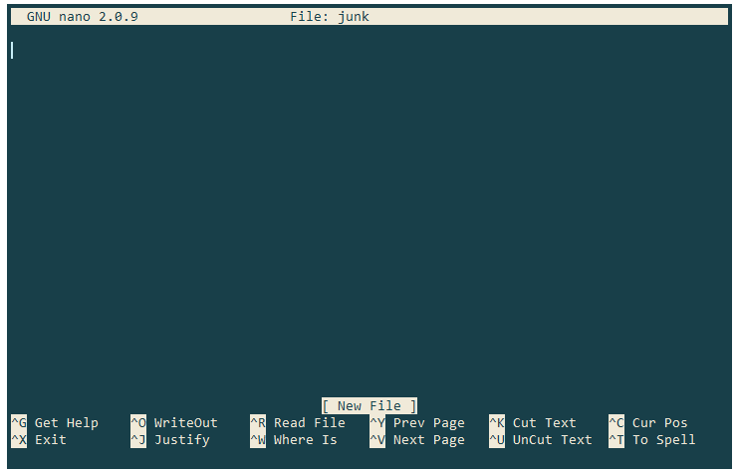
$ cd tmp
$ nano junk

Slide 148
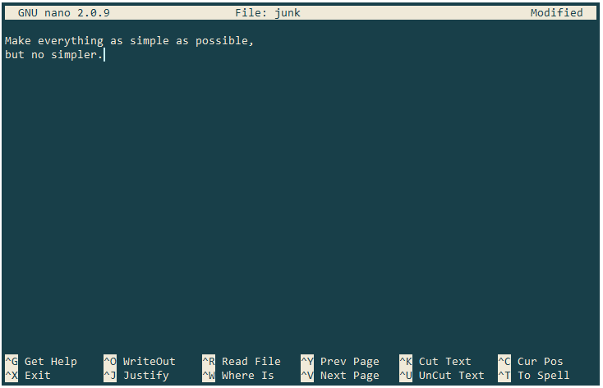
$ cd tmp
$ nano junk
That's your cursor

Slide 149
$ cd tmp
$ nano junk

Slide 150
$ cd tmp
$ nano junk
^O means "Control + O" (to save changes)

Slide 151
$ cd tmp
$ nano junk
^X to exit back to the shell

Slide 152
$ cd tmp
$ nano junk
$
nano doesn't leave any output
on the screen after it exits

Slide 153
$ cd tmp
$ nano junk
$ ls
junk
$
but it has created the file

Slide 154
$ cd tmp
$ nano junk
$ ls
junk
$ ls -s
1 junk
$
use -s to show sizes

Slide 155
$ cd tmp
$ nano junk
$ ls
junk
$ ls -s
1 junk
$
use -s to show sizes
reported in disk blocks

Slide 156
$ cd tmp
$ nano junk
$ ls
junk
$ ls -s
1 junk
$
use -s to show sizes
reported in disk blocks
a less helpful default
may have been possible…

Slide 157
$ cd tmp
$ nano junk
$ ls
junk
$ ls -s
1 junk
$ ls -s -h
512 junk
$
use -h for human-friendly output

Slide 158
$ cd tmp
$ nano junk
$ ls
junk
$ ls -s
1 junk
$ ls -s -h
512 junk
$
use -h for human-friendly output
number of bytes

Slide 159
$ cd tmp
$ nano junk
$ ls
junk
$ ls -s
1 junk
$ ls -s -h
512 junk
$
use -h for human-friendly output
number of bytes
rounded up because computer stores
things on disk using blocks of 512 bytes

Slide 160
$ cd tmp
$ nano junk
$ ls
junk
$ ls -s
1 junk
$ ls -s -h
512 junk
$ rm junk
$
remove (delete) file

Slide 161
$ cd tmp
$ nano junk
$ ls
junk
$ ls -s
1 junk
$ ls -s -h
512 junk
$ rm junk
$
remove (delete) file
there is no (easy) un-delete!

Slide 162
$ cd tmp
$ nano junk
$ ls
junk
$ ls -s
1 junk
$ ls -s -h
512 junk
$ rm junk
$ ls
$
check that it's gone

Slide 163
$ pwd
/users/vlad/tmp
$ nano junk
$ ls
junk
$

Slide 164
$ pwd
/users/vlad/tmp
$ nano junk
$ ls
junk
$ cd ..
$
change working directory to /users/vlad

Slide 165
$ pwd
/users/vlad/tmp
$ nano junk
$ ls
junk
$ cd ..
$ rm tmp
rm: cannot remove `tmp': Is a directory
$
rm only works on files

Slide 166
$ pwd
/users/vlad/tmp
$ nano junk
$ ls
junk
$ cd ..
$ rm tmp
rm: cannot remove `tmp': Is a directory
$ rmdir tmp
use rmdir to remove directories

Slide 167
$ pwd
/users/vlad/tmp
$ nano junk
$ ls
junk
$ cd ..
$ rm tmp
rm: cannot remove `tmp': Is a directory
$ rmdir tmp
rmdir: failed to remove `tmp': Directory not empty
$
but it only works when the directory is empty

Slide 168
$ pwd
/users/vlad/tmp
$ nano junk
$ ls
junk
$ cd ..
$ rm tmp
rm: cannot remove `tmp': Is a directory
$ rmdir tmp
rmdir: failed to remove `tmp': Directory not empty
$
but it only works when the directory is empty
(safety feature)

Slide 169
$ pwd
/users/vlad/tmp
$ nano junk
$ ls
junk
$ cd ..
$ rm tmp
rm: cannot remove `tmp': Is a directory
$ rmdir tmp
rmdir: failed to remove `tmp': Directory not empty
$ rm tmp/junk
$
so get rid of the directory's contents…

Slide 170
$ pwd
/users/vlad/tmp
$ nano junk
$ ls
junk
$ cd ..
$ rm tmp
rm: cannot remove `tmp': Is a directory
$ rmdir tmp
rmdir: failed to remove `tmp': Directory not empty
$ rm tmp/junk
$ rmdir tmp
$
…then get rid of the directory

Slide 171
$ pwd
/users/vlad/tmp
$ mkdir tmp
$ nano tmp/junk
$ ls tmp
junk
$

Slide 172
$ pwd
/users/vlad/tmp
$ mkdir tmp
$ nano tmp/junk
$ ls tmp
junk
$ mv tmp/junk tmp/quotes.txt
$

Slide 173
$ pwd
/users/vlad/tmp
$ mkdir tmp
$ nano tmp/junk
$ ls tmp
junk
$ mv tmp/junk tmp/quotes.txt
$
move a file

Slide 174
$ pwd
/users/vlad/tmp
$ mkdir tmp
$ nano tmp/junk
$ ls tmp
junk
$ mv tmp/junk tmp/quotes.txt
$
move a file (or directory)

Slide 175
$ pwd
/users/vlad/tmp
$ mkdir tmp
$ nano tmp/junk
$ ls tmp
junk
$ mv tmp/junk tmp/quotes.txt
$
move a file (or directory)
from here…

Slide 176
$ pwd
/users/vlad/tmp
$ mkdir tmp
$ nano tmp/junk
$ ls tmp
junk
$ mv tmp/junk tmp/quotes.txt
$
move a file (or directory)
from here…
…to here

Slide 177
$ pwd
/users/vlad/tmp
$ mkdir tmp
$ nano tmp/junk
$ ls tmp
junk
$ mv tmp/junk tmp/quotes.txt
$
move a file (or directory)
from here…
…to here
renames the file!

Slide 178
$ pwd
/users/vlad/tmp
$ mkdir tmp
$ nano tmp/junk
$ ls tmp
junk
$ mv tmp/junk tmp/quotes.txt
$ ls tmp
quotes.txt
$

Slide 179
$ pwd
/users/vlad/tmp
$ mkdir tmp
$ nano tmp/junk
$ ls tmp
junk
$ mv tmp/junk tmp/quotes.txt
$ ls tmp
quotes.txt
$ mv tmp/quotes.txt .
$

Slide 180
$ pwd
/users/vlad/tmp
$ mkdir tmp
$ nano tmp/junk
$ ls tmp
junk
$ mv tmp/junk tmp/quotes.txt
$ ls tmp
quotes.txt
$ mv tmp/quotes.txt .
$
current working directory

Slide 181
$ pwd
/users/vlad/tmp
$ mkdir tmp
$ nano tmp/junk
$ ls tmp
junk
$ mv tmp/junk tmp/quotes.txt
$ ls tmp
quotes.txt
$ mv tmp/quotes.txt .
$
move /users/vlad/tmp/quotes.txt
to /users/vlad/quotes.txt

Slide 182
$ pwd
/users/vlad/tmp
$ mkdir tmp
$ nano tmp/junk
$ ls tmp
junk
$ mv tmp/junk tmp/quotes.txt
$ ls tmp
quotes.txt
$ mv tmp/quotes.txt .
$ ls tmp
$
nothing left in tmp

Slide 183
$ pwd
/users/vlad/tmp
$ mkdir tmp
$ nano tmp/junk
$ ls tmp
junk
$ mv tmp/junk tmp/quotes.txt
$ ls tmp
quotes.txt
$ mv tmp/quotes.txt .
$ ls tmp
$ ls quotes.txt
quotes.txt
quotes.txt now in this directory

Slide 184
$ pwd
/users/vlad/tmp
$ mkdir tmp
$ nano tmp/junk
$ ls tmp
junk
$ mv tmp/junk tmp/quotes.txt
$ ls tmp
quotes.txt
$ mv tmp/quotes.txt .
$ ls tmp
$ ls quotes.txt
quotes.txt
ls with a file or directory argument
lists that file or directory

Slide 185
$ cp quotes.txt tmp/quotations.txt
$
copy a file

Slide 186
$ cp quotes.txt tmp/quotations.txt
$ ls quotes.txt tmp/quotations.txt
quotes.txt tmp/quotations.txt
$

Slide 187
$ cp quotes.txt tmp/quotations.txt
$ ls quotes.txt tmp/quotations.txt
quotes.txt tmp/quotations.txt
$ rm quotes.txt
$

Slide 188
$ cp quotes.txt tmp/quotations.txt
$ ls quotes.txt tmp/quotations.txt
quotes.txt tmp/quotations.txt
$ rm quotes.txt
$ ls quotes.txt tmp/quotations.txt
ls: cannot access quotes.txt: No such file or
directory
tmp/quotations.txt
$

Slide 189
$ cp quotes.txt tmp/quotations.txt
$ ls quotes.txt tmp/quotations.txt
quotes.txt tmp/quotations.txt
$ rm quotes.txt
$ ls quotes.txt tmp/quotations.txt
ls: cannot access quotes.txt: No such file or
directory
tmp/quotations.txt
$ cp tmp/quotations.txt .
$ ls quotations.txt
quotations.txt
$

Slide 190
$ cp quotes.txt tmp/quotations.txt
$ ls quotes.txt tmp/quotations.txt
quotes.txt tmp/quotations.txt
$ rm quotes.txt
$ ls quotes.txt tmp/quotations.txt
ls: cannot access quotes.txt: No such file or
directory
tmp/quotations.txt
$ cp tmp/quotations.txt .
$ ls quotations.txt
quotations.txt
$
this is a directory, so the copy
has the same name as the
original file

Slide 191
pwd | print working directory
cd | change working directory
ls | listing
. | current directory
.. | parent directory
mkdir | make a directory
nano | text editor
rm | remove (delete) a file
rmdir | remove (delete) a directory
mv | move (rename) a file or directory
cp | copy a file

Slide 192
created by
Greg Wilson
August 2010
Copyright © Software Carpentry 2010
This work is licensed under the Creative Commons Attribution License
See http://software-carpentry.org/license.html for more information.

